Slide 1


KICK-OFF
Popeye T-DOP-501

Slide 2
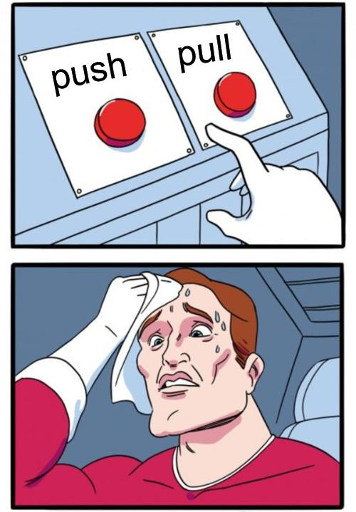
Tricky situations_
Working on a project using old versions of React and PHP
Developing on MacOS, but deploying on a Linux server
Needing different Python versions on the same server
Deploying your app faster than ever on a server

Slide 3
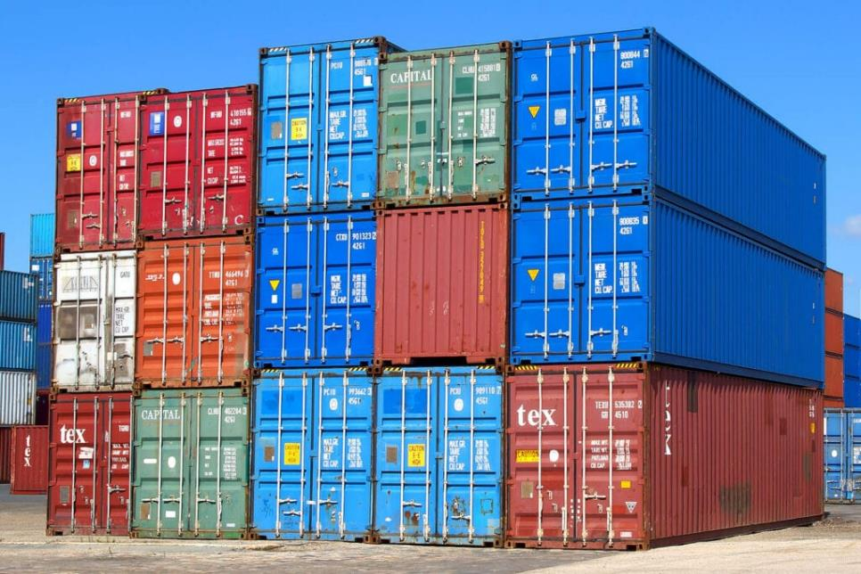
Containers for logistics_
Standardized boxes, designed and built for intermodal freight transport.
Can be used across different modes of transport, from ship to rail to truck, without [un|re]loading them.
Management is standardized for all, regardless of its content!

Slide 4
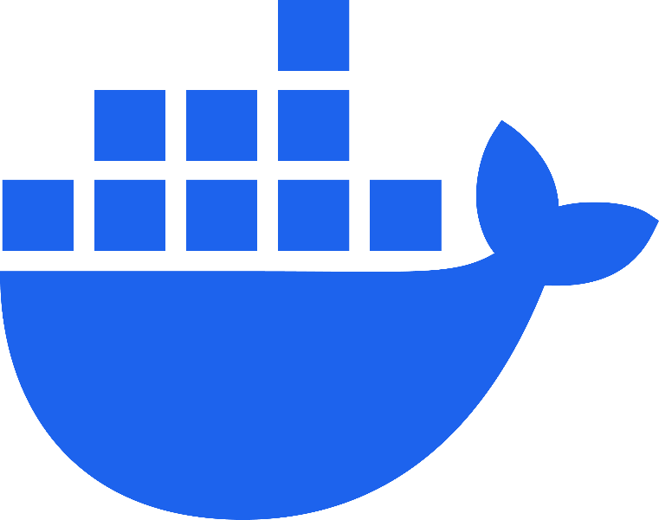
Containers for DevOps_
Standardized boxes, designed and built for application portability.
Can be used across different OS, from Linux to Windows to Mac, without modifying them.
Management is standardized for all, regardless of its content!

Slide 5
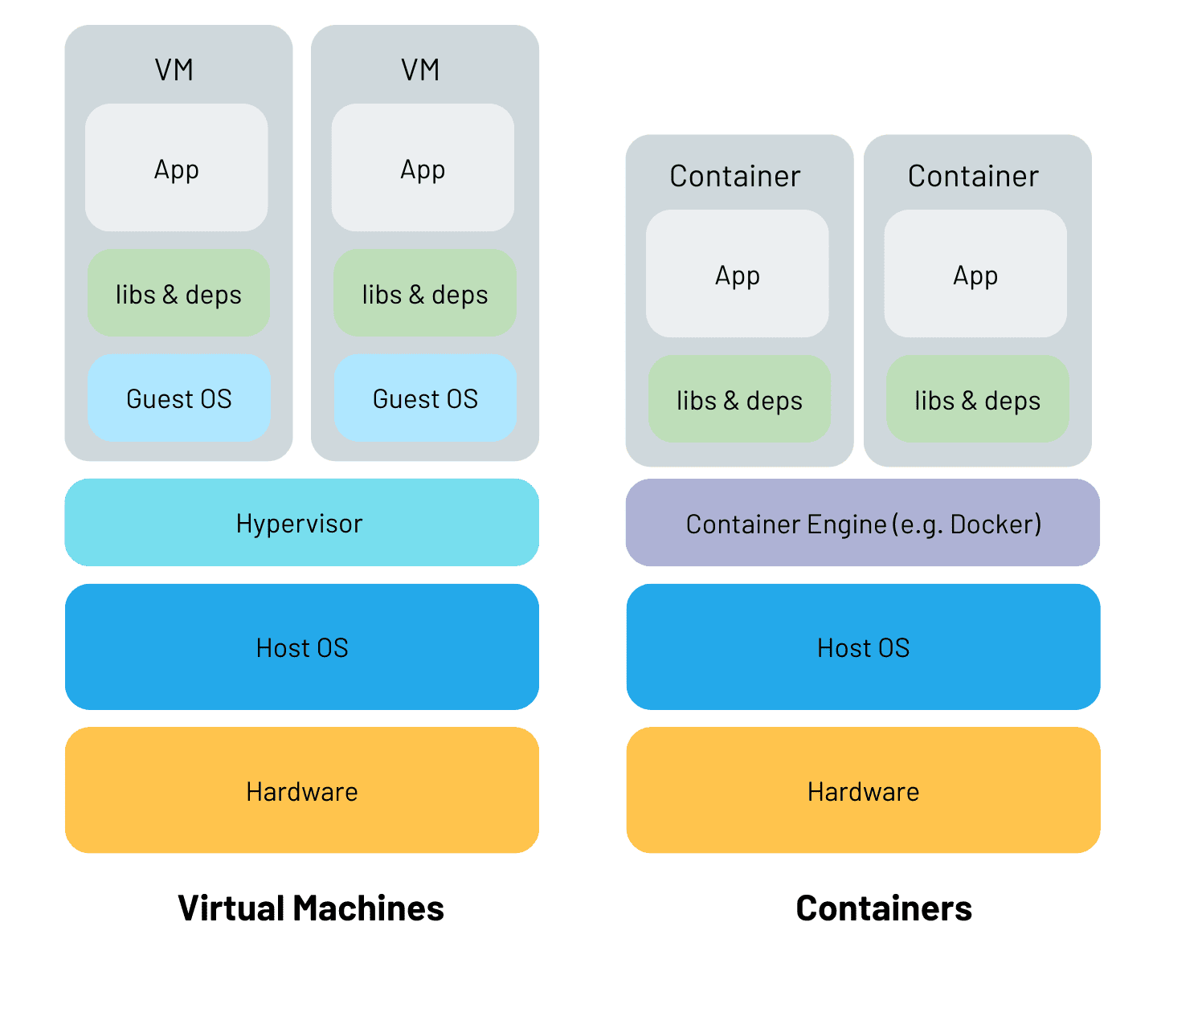
Containers for DevOps_
Containers are isolated but share OS (and sometimes bins & libs).

Slide 6

The project_
You must deploy a project
5 services => you’ll need to identify them first
The version of each service is not the latest
You need to find out which one is the correct one
You’ll use Docker in other projects => So work hard!

Slide 7

Best practices_
Follow the KISS principle
Use official images as base
One app per container
NEVER commit sensitive data
(such as .env/passwords)

Slide 8
QUESTIONS?

