Slide 1


KICK-OFF
DevOps

Slide 2
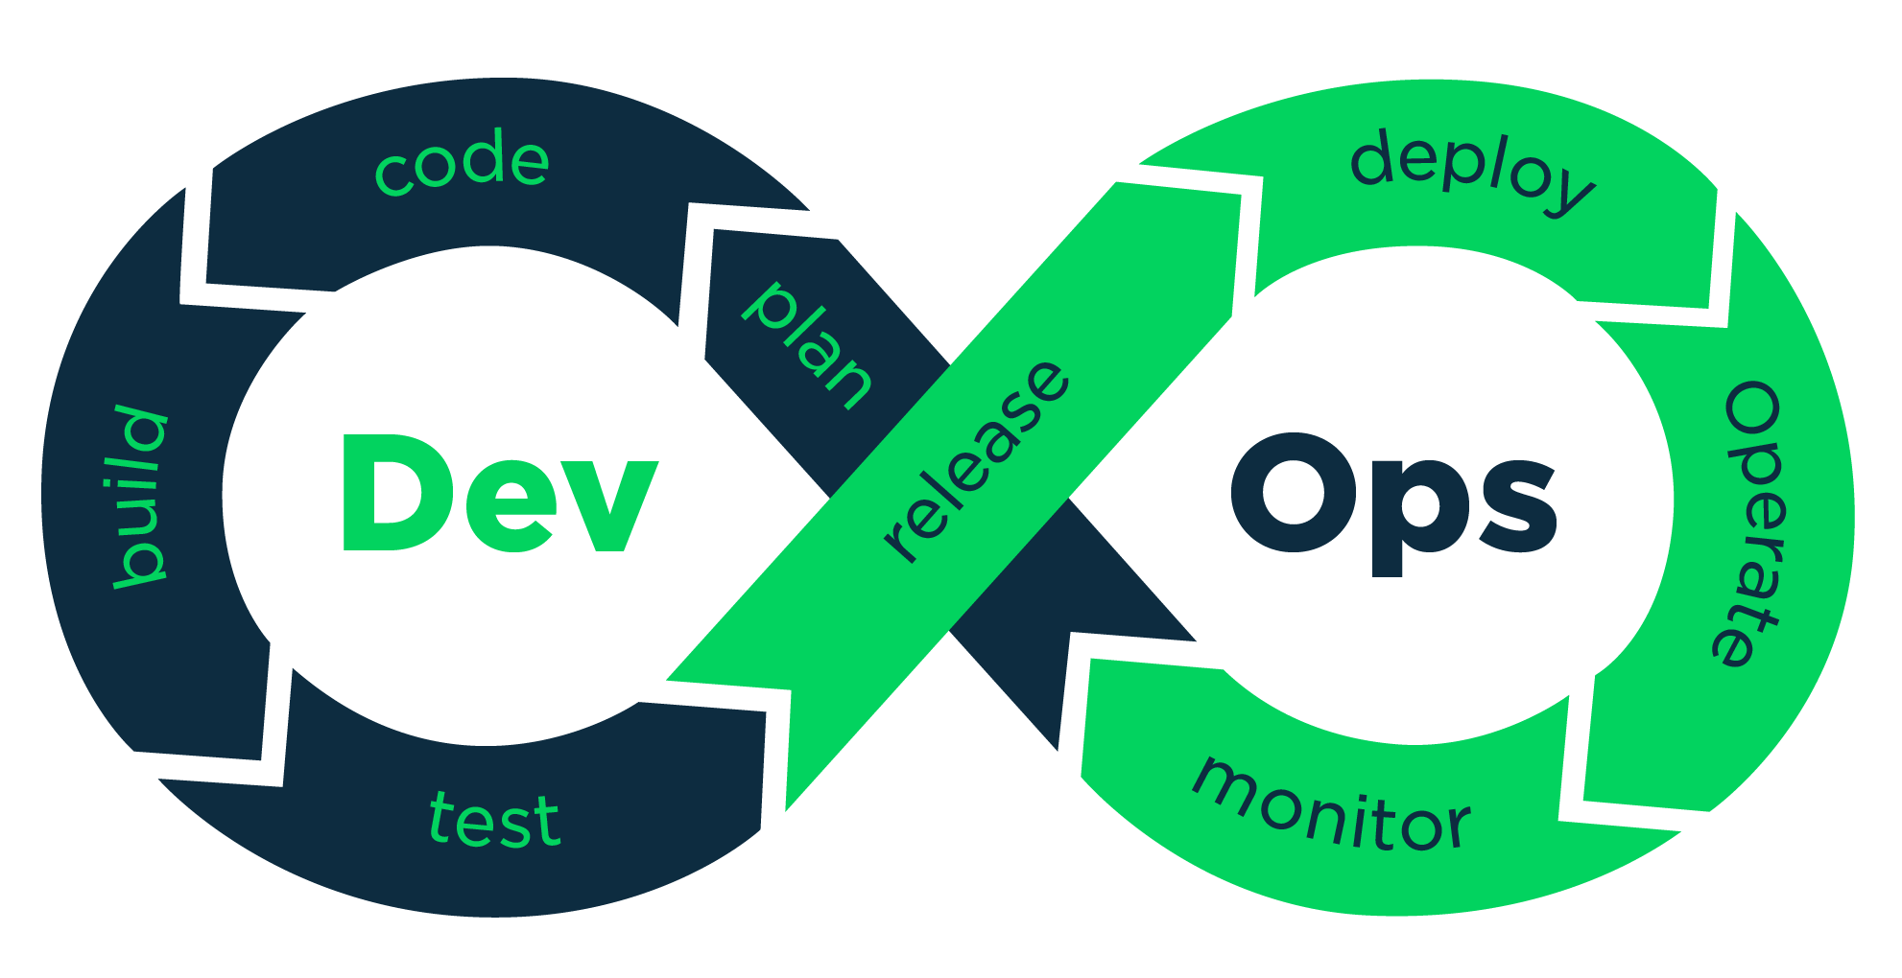
About DevOps_
Developers write code
Operators make sure the infrastructure is working
DevOps is about making everything united and keeping everyone happy

Slide 3
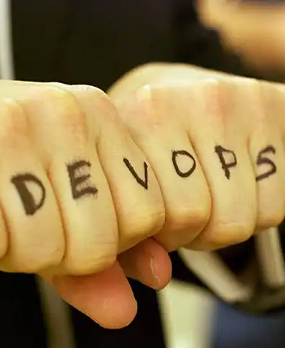
The philosophy_
Set of best-practices and tools between devs and sys admin to improve and shorten the development life cycle.

Slide 4

DevOps main benefits_
Improved quality and automation
Faster, better, stronger product delivery
Easier maintainability and issue resolution
Geater flexibility, scalability and availability
Reduced complexity, cycle time, human labor and costs
Maire time + freedom for creative and innovative tasks

Slide 5
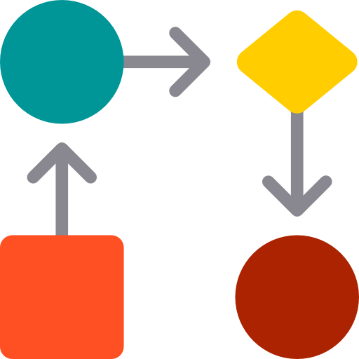
USE-CASE 1: Reproductible test environment_
You embed source code, runtime and dependencies in containers
A system administrator runs the containers in production
Same behavior for everyone
No more excuse such as: “But it works on my machine! :(”

Slide 6
USE-CASE 2: Continuous Integration_
You specify how to compile and build your program
A system administrator provide an automation platform
Whenever your push to your repository, it checks everything for you

Slide 7
USE-CASE 3: Resilient applications_
A system administrator build a multi-node infrastructure
It has some specific orchestration features
You deploy and never get worried if something breaks

Slide 8

DevOps main challenges_
Challenges are the best way to improve
Organization
Collaboration
Compliance
Performance
Stability
Availability
Performance

Slide 9
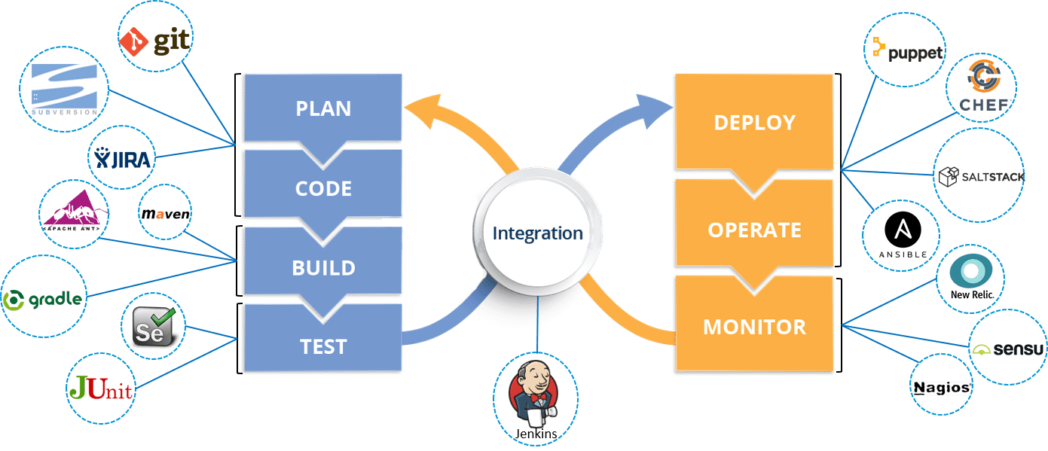
DevOps common tools_

Slide 10

DevOps projects_
2 awesome projects
(3 if you choose T-DOP-603 in June)
It will help you in your other projects
And it will facilitate your future work
Make sure you understand every notion

Slide 11

Stuff to dig and watch_
The twelve-factor app
DevOps in 5 minutes
The ING Bank improved its time to market from 13 weeks to less than 1
The Secrets to Agility at Tesla, Elon's Master Plan to Infinity
AAA Automated testing…for AAA games, by a Games developer advocate at Google
How software lifecycle integration and DevOps are transforming car development
Game development with Dori Exterman, CTO at IncrediBuild

Slide 12
QUESTIONS?

