Slide 1

Candidate Romeo Silvestri
AgriData Analysis, Modeling, and Simulation Specialist
FBK – Fondazione Bruno Kessler, Trento, Italy
E-mail: silveromeo98@gmail.com

Slide 2

Who am I
🚀 Passionate Data Scientist
🎓 Master’s Degree Graduate in Statistics
Favorite Fields: big data, databases, predictive modeling
Hobbies: playing chess, drawing, writing poetry, listening to music
Birth
Scientific High School
Master
Padua
2017-2020
2023
2012-2017
2020-2023
Rome
1998
Verona
Bachelor
Internship

Slide 3


University
University of Padua
Sep 2017 – Nov 2020
Sapienza University of Rome
Nov 2020 – Mar 2023
Faculty: Statistics for Technology and Science
Main Courses:
Analysis
Linear Algebra
Probability
Programming
Sampling Theory
Statistical Models
Time Series
Faculty: Statistical Sciences
Curriculum: Data Analysis
Main Courses:
Big Data Analytics
Causal Inference
Data Management for Data Science
Data Mining and Classification
Statistical Learning
Other Activity: University Tutor
Basics

Slide 4

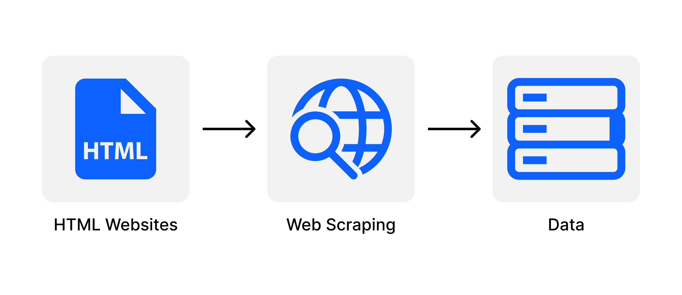


Master’s Thesis
Analyzing Forecasting Models for Real Estate Markets
Dataset: 50 features of 6000+ houses in Madrid
Objective: compare spatial statistical models to predict real estate sales prices
Web Scraping
Geolocalization
(GIS Software)
Predictive Modeling + Comparison
(R language)
Results: XGBoost is the best model and predicts sales prices acurately

Slide 5

Internship
Statistician
Mar 2023 – Aug 2023
Main Activities:
Reporter: processed and analyzed national demographic microdata using Excel and SQL to uncover critical socio-economic trends. The outcomes of this analysis were subsequently harnessed in the production of periodic reports, serving as valuable insights for informing political and strategic decisions.
Researcher: authored a scientific article evaluating the suitability of the Austrian quality-framework of 2016 for the Italian Census, achieving statistically significant results and providing key recommendations.
Statistical Developer: developed an indicator system for statistical quality control of 6 statistical registers and implemented it with R Studio.

Slide 6



















Technical Skills
Programming Languages
Databases
Analytics Tools
Presentation Tools

Slide 7
Thank you

