Slide 1


IRRITRE
Predictive Models for Sensors
FBK – Fondazione Bruno Kessler, Trento, Italy
Romeo Silvestri
E-mail: silveromeo98@gmail.com

Slide 2
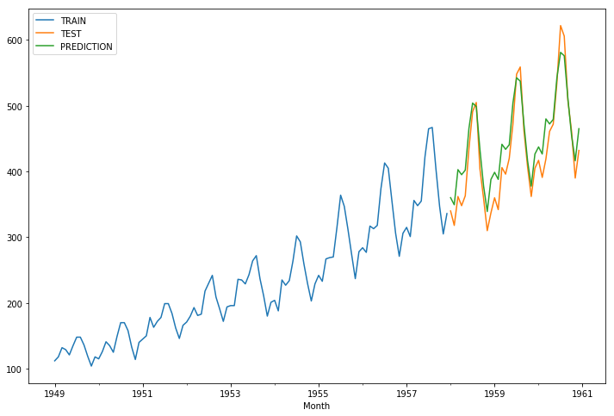
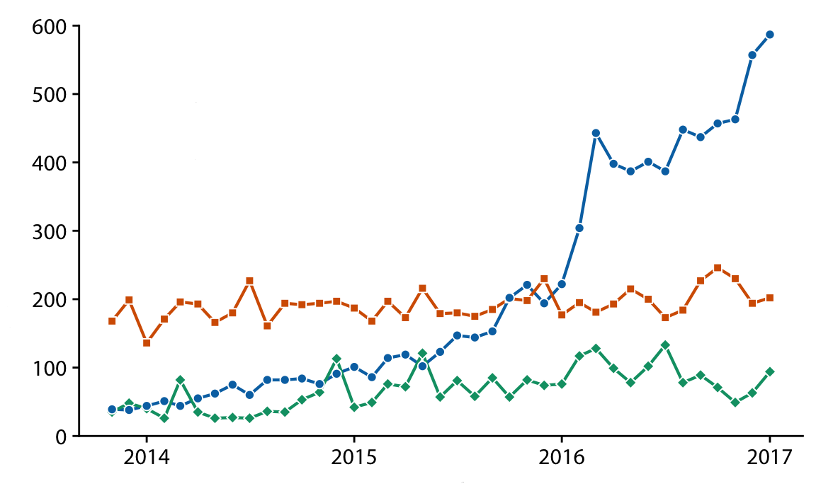
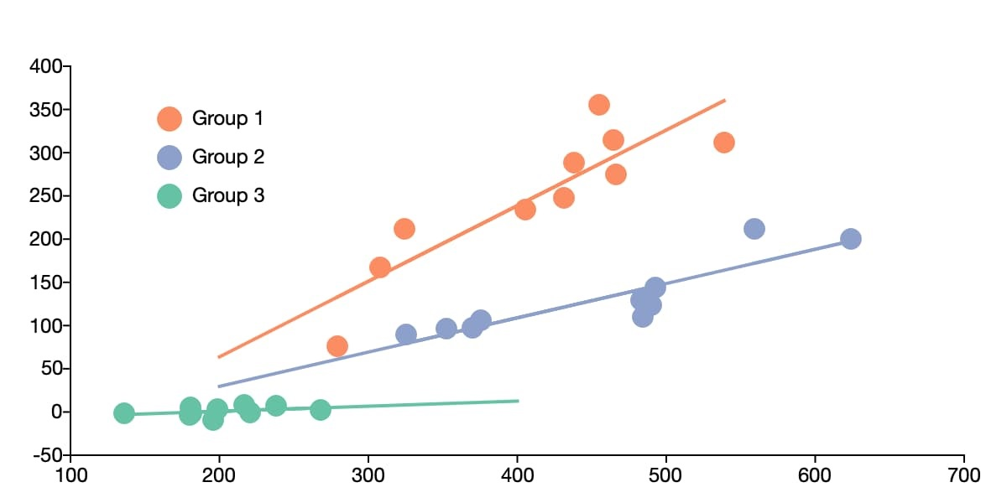
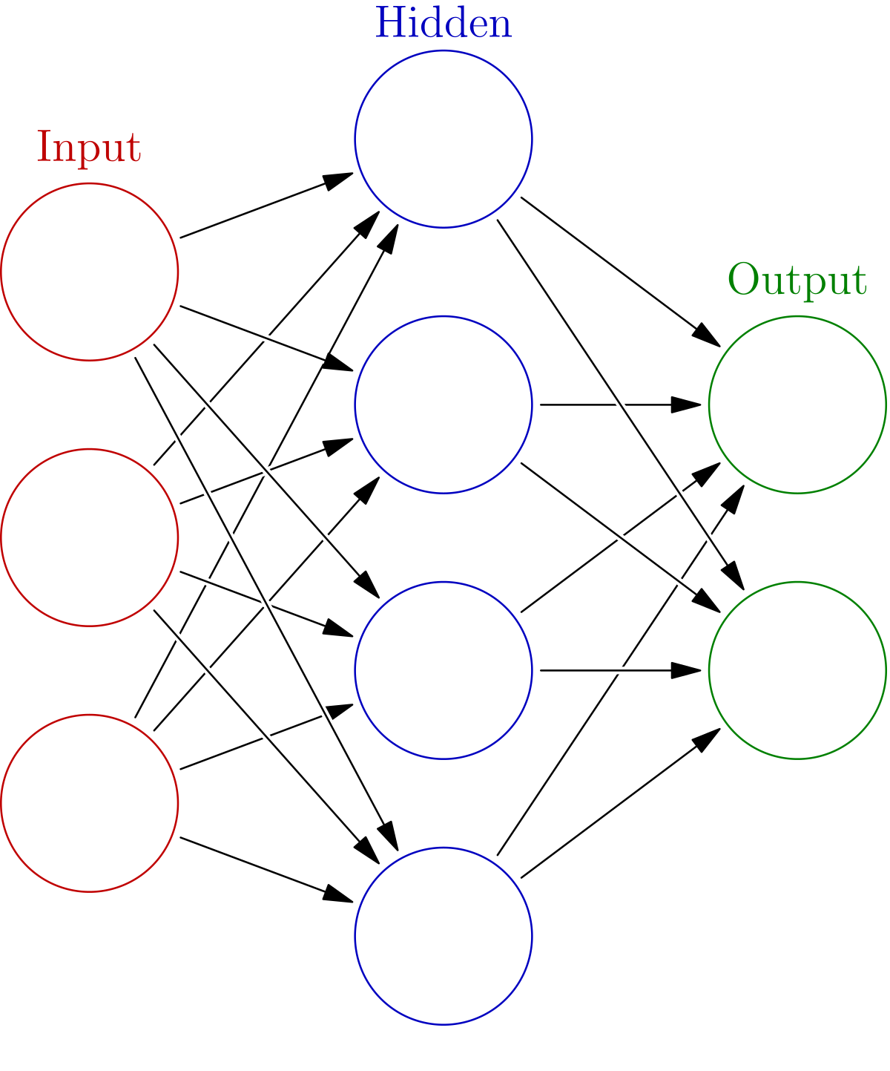
Strategies
1 . Single Model per sensor
Time Series Models with splitting by Time
2 . Single Model per sensor
Time Series Models with splitting by Sensor
3 . General Model for ALL sensors
Panel Data Models (FE, RE, ME)
4 . Single or General Model
Deep Learning Models (CNN, RNN)
Status
Completed
Improvable
In Progress
Next Step

Slide 3
Pre-Processing
Starting Point
Scenario: 1 model per sensor (tensiometer)
Features:
min, max, median, average, sum per day
- Tensiometers (depth 30) + Tensiometers (depth 60) in pairs according to location
- Amount of Rain
- Air Humidity
- Solar Radiation
- Temperature
- Irrigation
Total: 35 features observed for 3 days each (total of 105)
to be tested

Slide 4
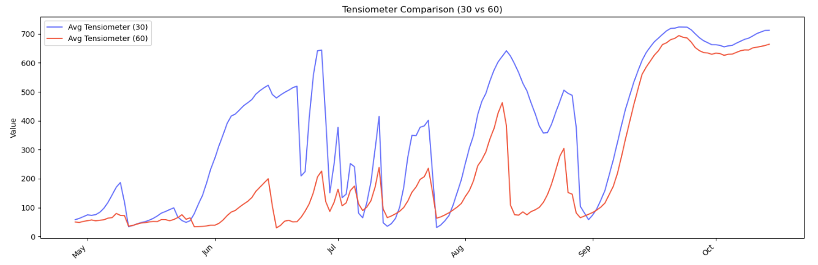
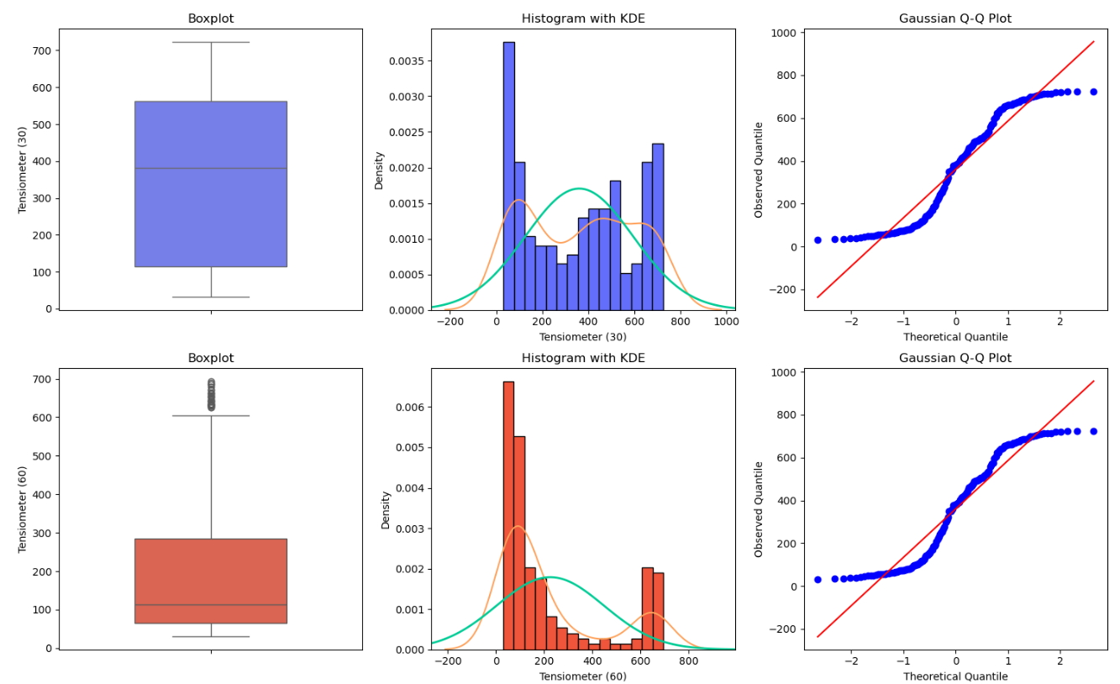
Example
Group 1: sensor 72 (depth 30) + sensor 71 (depth 60)
Train-Test Split
70% train
30% test

Slide 5
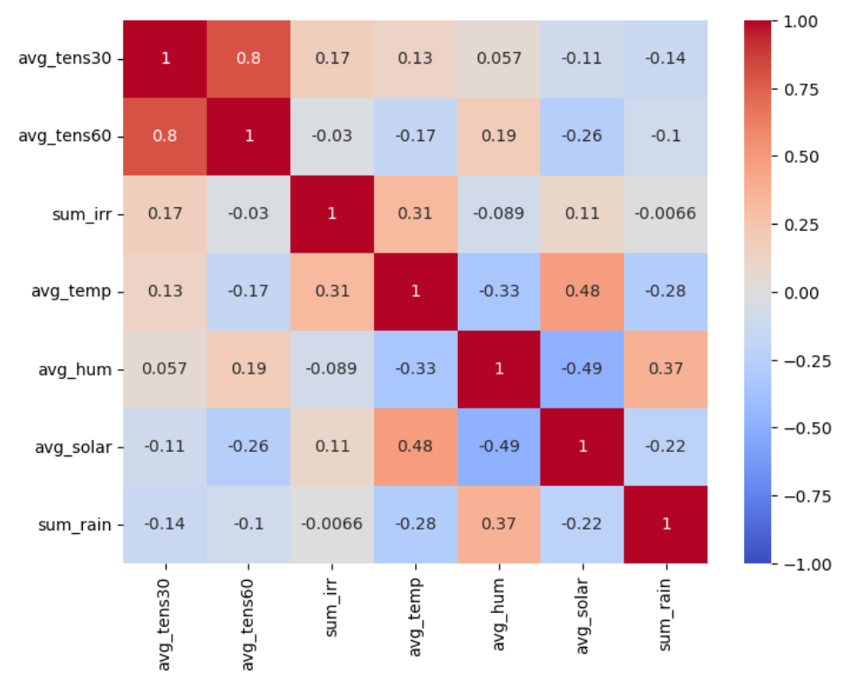

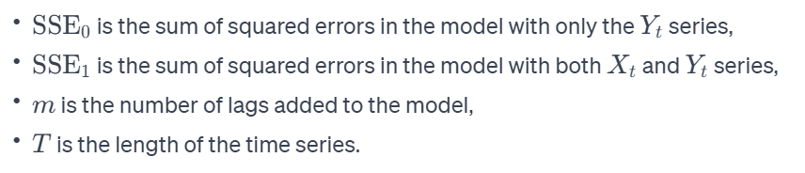
Exploratory Data Analysis (EDA)
Correlation vs Causality
Granger Causality Test: compares the time series of Y with the time series X with a given lag k

Slide 6
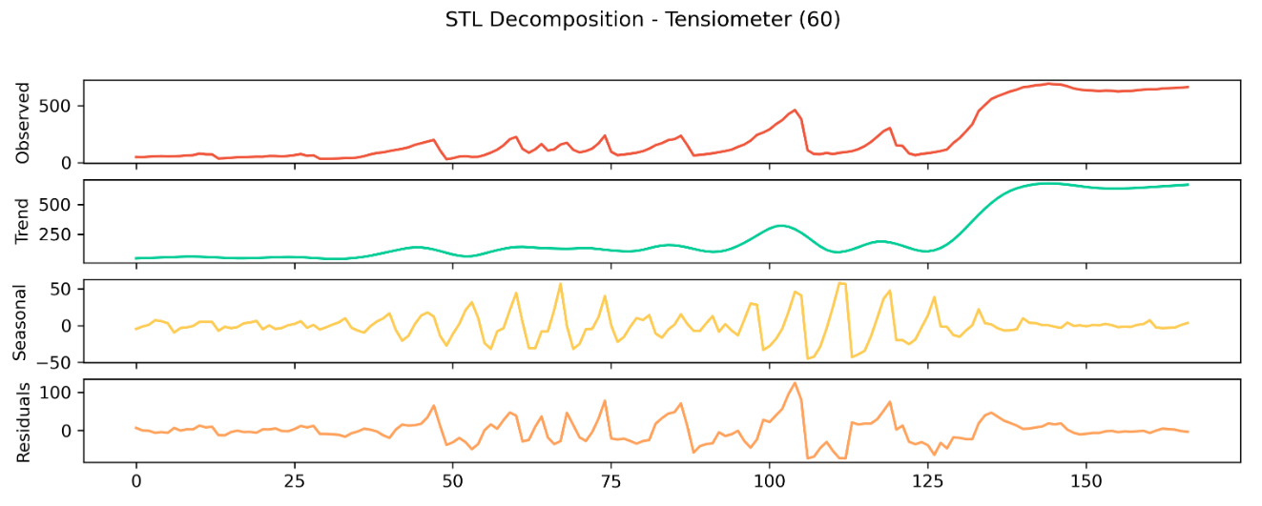
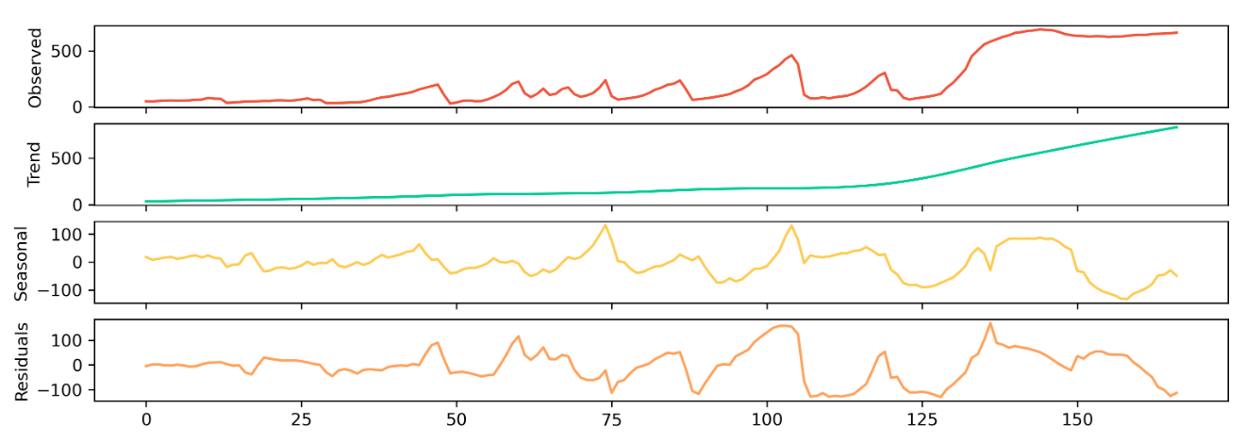
Seasonal and Trend Decomposition using Loess (STL)
Weekly (7 days)
Monthly (30 days)

Slide 7

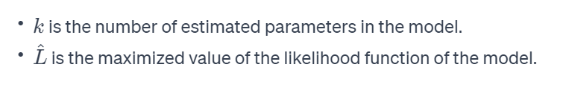
Time Series Forecasting
Features Selection
Akaike Information Criterion
LM training with all the Features
Stepwise Selection based on AIC
ARIMAX with Selected Features

Slide 8

ARIMAX Model
AR = AutoRegressive
I = Integrated
MA = Moving Average
X = eXogenous variables

Slide 9
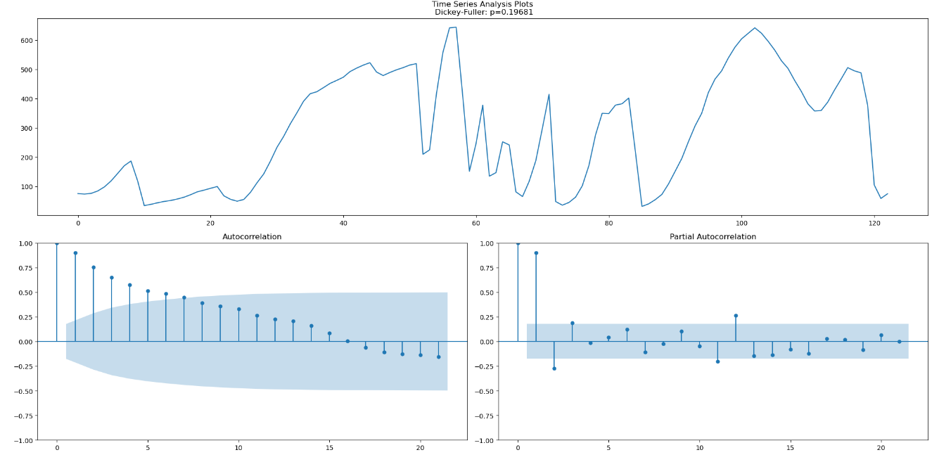
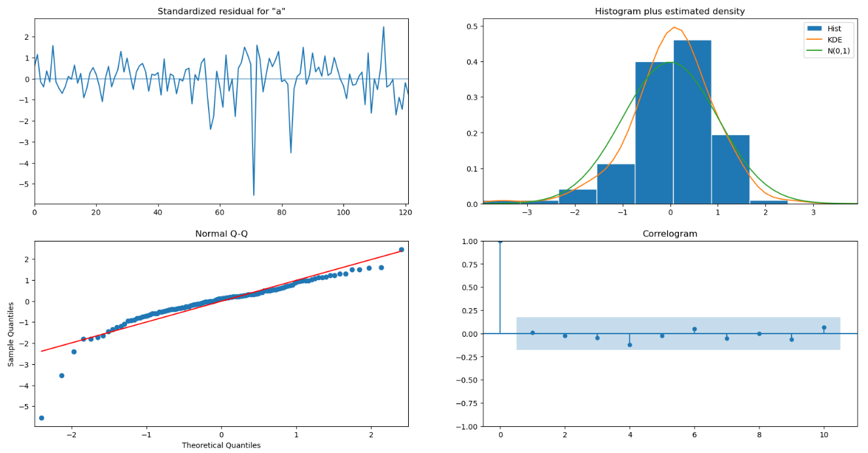
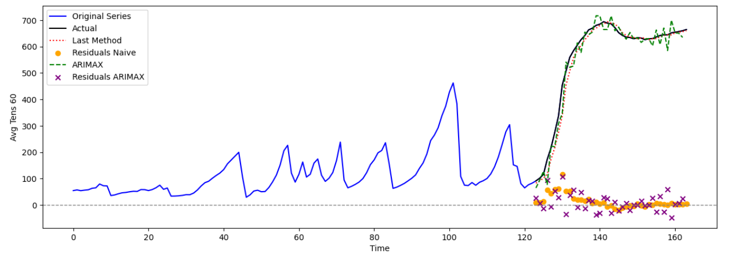
Hyperparameter Tuning, Diagnostics, Forecasting …

Slide 10
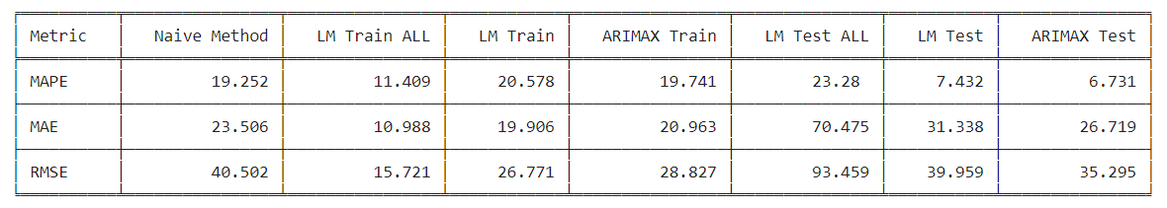
Results (sensor 71)
Key Points to interpret the Results:
The Baseline is the Naïve Method (tomorrow will be like today)
It is important to balance between adaptation and adaptability (avoid overfitting)
Often the ARIMAX model is adapted worse to the train set than the LM for better results on the test set
The ARIMAX model is consistently better (for almost all sensors) than the LM and the ARIMA model

Slide 11
Pros vs Cons
Pros
model training with AIC criterion ensures balance between comparison metrics (no preferred metrics)
the results are quite consistent across sensors
arimax is a linear model so the interpretation of results is easy
Cons
non-linear relationship are not managed (to do this you need to perform transformations or introduce interactions)
you need to develop a model for each sensor
Next Steps
Introduce a seasonal component with SARIMAX models
Find the correct number of days to consider for building the features
Predict more days at each step
Develop a general model for all sensors (Panel Data Models)
Develop a deep neural network model (CNN or RNN)

Slide 12
Thank you

