Slide 1
How to Load & Run Models
Objective
Forecasting Problem where you want to predict the average tensiometer value (soil moisture) for a given day
Independent Features
Feature | Unit of Measure | Summary Values
Temperature | Celsius (°C) | min, max, avg, med
Air Humidity | Relative Humidity (% RH) | min, max, avg, med
Solar Radiation | Surface Power Density (W/m²) | min, max, avg, med
Rain | Millimetres per Hour (mm/h) | max, med, sum
Irrigation | Liters per Minute (l/min) | sum
Tensiometer | Millibar (mBar) | min, max, avg, med, sum
Tens. Residuals of LM | Millibar (mBar) | avg
AR component
MA component
All these features are measured for the 3 days preceding the one you want to predict, for a total of 66 features
Target Feature: Average Tensiometer Value for the given day

Slide 2
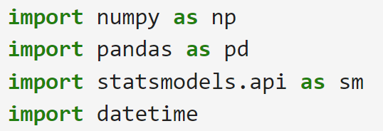
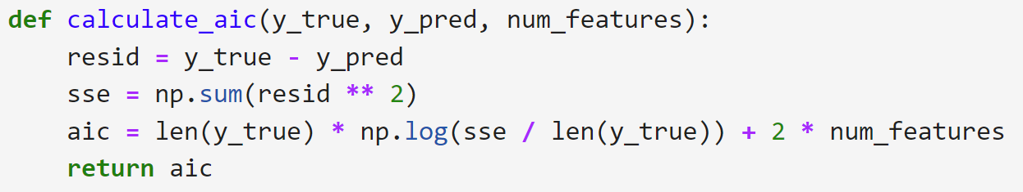
Load Libraries and Functions
Simply load the libraries and the manually defined functions by running the Python code
Libraries
Functions

Slide 3
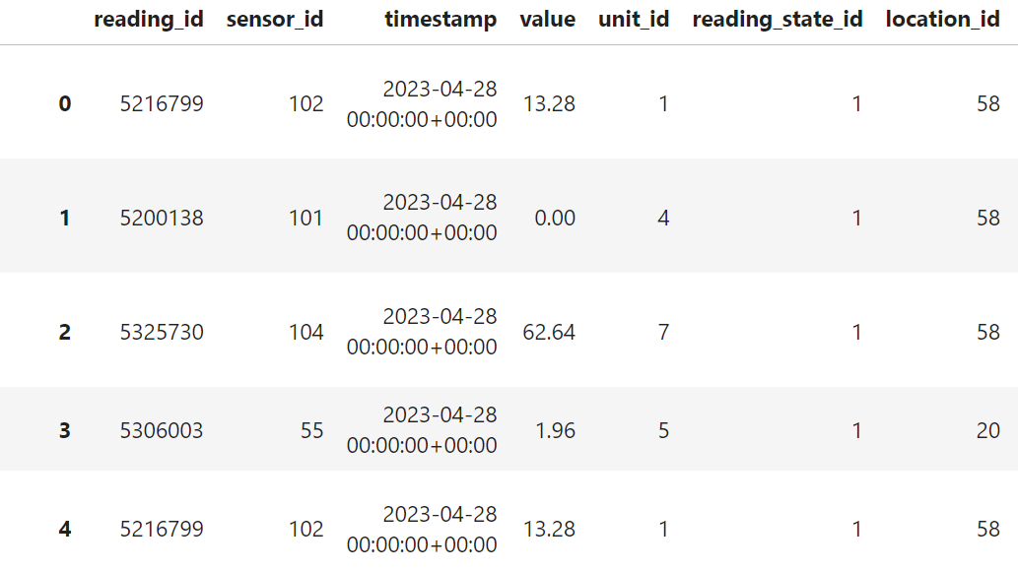
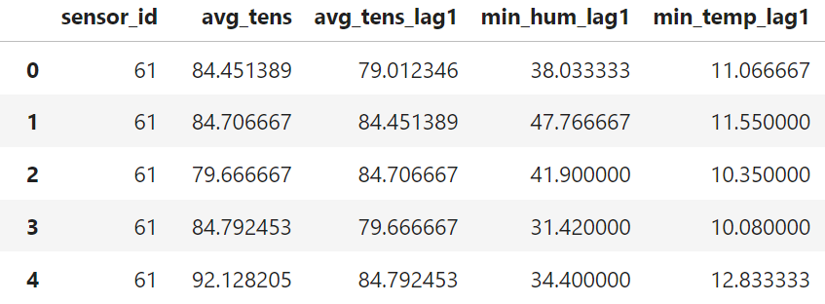
Pre-process the Train Data
Run the manually defined function to pre-process the training data: data are cleaned, aggregated on a daily basis and shifted properly
Raw Data
Clean Data

Slide 4
Steps in details:
Load the raw data with the following features required (the database table is indicated):
reading_id: identification code associated with the reading
timestamp: date and time at which the sensor reading took place
sensor_id: identification code associated with the sensor
value: reading value for a given sensor_id at a specific timestamp
description: type of sensor, defined in the sensor table
group: cluster to which the sensor belongs, defined as in the names.csv file
Round down each timestamp to the nearest date, thus cutting off the hour component of each day
Duplicate the dataset so that tensiometers in the same group with different depths are correctly processed separately from each other (this step could be changed to make the code more usable)
reading table

Slide 5
Aggregate the dataset values by date, sensor_id and group by calculating the following summary measures for each sensor and day: minimum, maximum, mean, median and sum.
Perform a pivotal transformation based on date and group, creating a new dataset where the unique values of description become the columns and the summary measures populate the cells.
Delete summary measurements that are not of interest for the analysis, such as wind measurements. Therefore, leave only the measures in according to the features table.
Remap the sensors according to the artificially created groups in step c)

Slide 6
Linearly impute any missing values, making sure that these correspond to an average between the previous day and the day after the one not present.
Recreate a dataset of values shifted up to 3 days from the one of interest
Delete data on superfluous dates, i.e. the first 3 days (28, 29, 30 April) and the last one (15 October)
For each sensor, train a linear regression model in order to calculate the residuals that will then be used as components in the ARIMAX models. For each model, feature selection was by bidirectional stepwise selection based on Akaike's information criterion (AIC).

Slide 7
Pre-process the Target Data
Run the manually defined function to pre-process the target data: data are cleaned, aggregated on a daily basis and shifted properly
Raw data must refer to observations from 3 days before the date on which the tensiometer value is predicted. In addition, the raw data must refer only to the target tensiometer values and their associated sensors, i.e. those of the nearest irrigator and weather station.
To understand precisely which irrigator and weather station are associated with the tensiometer, please refer to the names.csv file, but insert just one tensiometer per group.

Slide 8
Steps in details:
Enter the raw data for a specific group, considering only the target tensiometer, with the values of 3 days before the date on which the tensiometer value is predicted; the following features are required:
timestamp: date and time at which the sensor reading took place
sensor_id: identification code associated with the target tensiometer
value: reading value for a given sensor_id at a specific timestamp
description: type of sensor, defined in the sensor table
Excluding the steps involving the group variable (steps c, g, h, j), the steps are the same as in the pre-processing for train data.

Slide 9
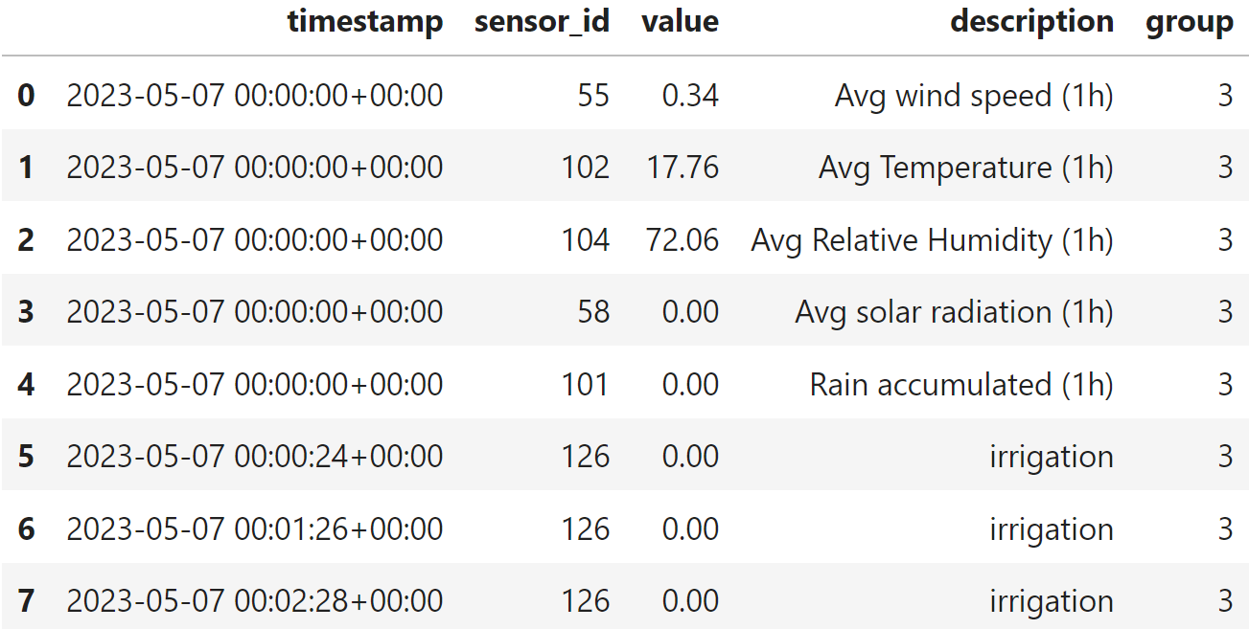
Example
If we want to predict the value of tensiometer number 75 (depth 60) for 10 May 2023, we will have to take into account its values over the previous 3 days (7, 8, 9 May) and those of the associated sensors:
- Tensiometer: sensor 75
- Temperature: sensor 102
- Air Humidity: sensor 104
- Rain: sensor 101
- Irrigation: sensor 126
- Wind Speed: sensor 55 (not essential)
Data for sensor 73 (depth 30) are then not entered.

Slide 10
Output of the data required for prediction after pre-processing:
It actually corresponds to a single one-dimensional array associated with the forecast date, i.e. 10 May

Slide 11

Forecasting
Run the model_predict function indicating the reference sensor, the pre-processed data and the variable selection strategy.
you will obtain the tensiometer value for the target date

Slide 12
Steps in details:
Enter the following parameters in the appropriate function:
sensor_id: identification code associated with the target tensiometer
X_target: features associated to the target tensiometer, corresponds to the output of the function pre_processing_target
data_train: preprocessed dataset on which the model will be trained, corresponds to the output of the function pre_processing
fs_strategy: strategy for feature selection, it can take the value 'aic' for a selection based on Akaike's criterion or the value 'pls' for a strategy based on Partial Least Squares type dimensionality reduction
Define a dictionary for the tensiometer clusters associated with each target tensiometer, based on the results of the report

Slide 13
Search for the best subset that shows the best performance in terms of RMSE on the train dataset. For the PLS strategy, new features are also calculated again based on RMSE minimization.
Perform the feature selection
Run the model
Compute the prediction for the day of interest (forecasting)

