Slide 1
SOLUTION OF LINEAR DIOPHANTIne EQUATIONS WITH TWO VARIABLES
Babin timofei 10”Т”

Slide 2

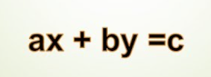
Definition
A linear Diophantine equation with two unknowns is an equation of the form Ax+By = C, where A,B,C are given non-zero integers, x and y are unknown integers.

Slide 3

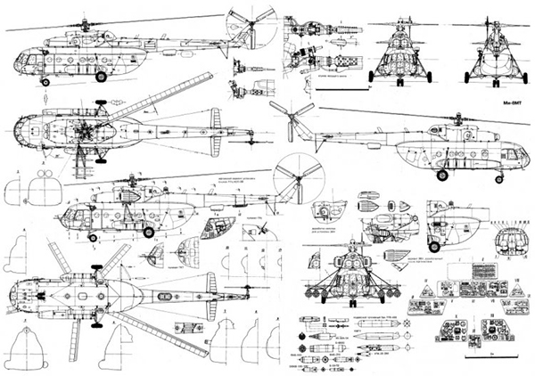
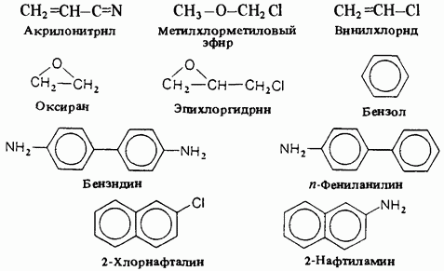

Relevance and areas of application
Simplify work with Diophantine equations and optimize workflow in various fields. For example:
Molecular physics
Organic chemistry
Various computer algorithms (RSA decryption)
Development of complex technical systems

Slide 4

Target of the work
Implementation of algorithms for solving linear Diophantine equations in two variables using initial coefficients, as well as further derivation of answers of a general form.

Slide 5
Implementation stages
Research on the topic of Diophantine equations
Thinking through an implementation plan, finding the main points of support ​
Implementation of machine code by researching methods for solving a mathematical problem
Preparation of documentation and report preparation
“Grinding” the code and optimizing it to improve performance

Slide 6
Brief implementation
1. To check for the presence of solutions to the equation, a check is carried out to find the 1st random solution; for this, the Extended Euclid Algorithm is used
2. Since the Diophantine equation has both positive and negative roots, to derive the answers we introduce an additional condition (range of x and y)
3 As a result, we get 2 parts of the output. 1 – for range x. 2 – for y

Slide 7
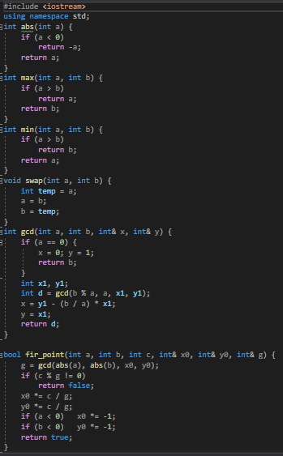
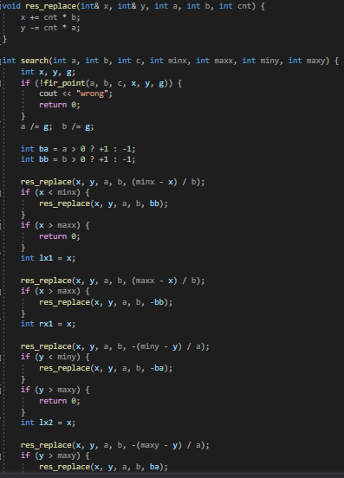

Slide 8
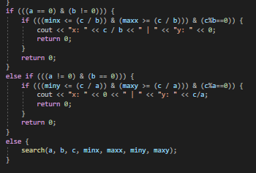

Slide 9
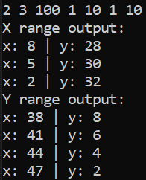

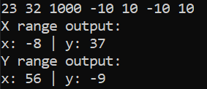
Demonstration of work

