Slide 1
Chapter 6: CPU Scheduling

Slide 2
CPU Scheduling
In a single-processor system, only one process can run at a time
Any others must wait until the CPU is free
The objective of multi-programming is to have some process running at all times, to maximize CPU utilization.
A process is executed until it must wait, typically for the completion of some I/O request.
During I/O request the CPU sits idle. All the waiting time is wasted; no useful work is completed.
With multi-programming, we try to use this time productively
When one process has to wait, the OS takes the CPU away from that process and gives the CPU to another process and this pattern continues.

Slide 3
Basic Concepts
CPU–I/O Burst Cycle – Process execution consists of a cycle of CPU execution and I/O wait
CPU burst: The time when the process is in CPU execution.
I/O burst: The time when the process is in I/O wait.
CPU burst followed by I/O burst
CPU burst distribution is of main concern

Slide 4
Preemptive and Non-Preemptive Scheduling
Short-term scheduler Whenever the CPU becomes idle, the OS must select one of the processes in the ready queue to execute. The selection process is carried out by the short-term scheduler. The scheduler selects a process from the processes in memory that are ready to execute and allocates the CPU to that process.
Dispatcher The dispatcher module gives control of the CPU to the process selected by the short-term scheduler.
Dispatch latency – time it takes for the dispatcher to stop one process and start another running
Dispatch involves:
switching context
switching to user mode
jumping to the proper location in the user program to restart that program

Slide 5
Preemptive and Non-Preemptive Scheduling
CPU scheduling decisions may take place when a process:
1. Switches from running to waiting state
2. Switches from running to ready state (interruption)
3. Switches from waiting to ready (completion of I/O)
Terminates
Scheduling under 1 and 4:
No choice in terms of scheduling.
A new process (if one in the ready queue) must be selected for execution.
Under 2 – 3: A process must be selected from the ready queue based on some selection method

Slide 6
Scheduling Criteria
CPU utilization: We want to keep the CPU as busy as possible
CPU utilization can range 0 – 100 percent
Lightly loaded system utilizes up to 40% CPU
Heavily loaded system utilizes up to 90% CPU
Throughput: Number of processes that complete their execution per time unit
Turnaround time: Amount of time to execute a particular process
Submission of execution to completion.
It includes waiting time to get into memory, waiting in the ready queue, execution on the CPU and doing I/O
Waiting time: Amount of time a process has been waiting in the ready queue
Response time: Amount of time it takes from when a request was submitted until the first response is produced, not the final result.

Slide 7
Scheduling Algorithm Optimization Criteria
Max CPU utilization
Max throughput
Min turnaround time
Min waiting time
Min response time

Slide 8

First- Come, First-Served (FCFS) Scheduling
The process that requests the CPU first is allocated the CPU first
The implementation of FCFS policy is easily managed with a FIFO queue.
When a process enters the ready queue, its PCB is linked onto the tail of the queue.
When the CPU is free, it is allocated to the process at the head of the queue.

Slide 9
First- Come, First-Served (FCFS) Scheduling
Process Burst Time
P₁ 24
P₂ 3
P₃ 3
Suppose that the processes arrive in the order: P₁ , P₂ , P₃ The Gantt Chart for the schedule is:
Waiting time for P₁ = 0; P₂ = 24; P₃ = 27
Average waiting time: (0 + 24 + 27)/3 = 17

Slide 10
FCFS Scheduling (Cont.)
Suppose that the processes arrive in the order:
P₂ , P₃ , P₁
The Gantt chart for the schedule is:
Waiting time for P₁ = 6; P₂ = 0; P₃ = 3
Average waiting time: (6 + 0 + 3)/3 = 3
Much better than previous case
It’s non preemptive: No choice but the execute the first come process.

Slide 11
Shortest-Job-First (SJF) Scheduling
Associate with each process the length of its current/remaining CPU burst
Use these lengths to schedule the process with the shortest time
If two process has same CPU burst, then FCFS is used to break the tie.
SJF is optimal – gives minimum average waiting time for a given set of processes

Slide 12
Example of SJF
ProcessArriva l Time Burst Time
P₁ 0.0 6
P₂ 2.0 8
P₃ 4.0 7
P₄ 5.0 3
SJF scheduling chart
Average waiting time = (3 + 16 + 9 + 0) / 4 = 7
For FCFS, it would be 10.25

Slide 13
Example of Shortest-remaining-time-first
Now we add the concepts of varying arrival times and preemption to the analysis
ProcessA arri Arrival TimeT Burst Time
P₁ 0 8
P₂ 1 4
P₃ 2 9
P₄ 3 5
Preemptive SJF Gantt Chart
Average waiting time = [(10-1)+(1-1)+(17-2)+5-3)]/4 = 26/4 = 6.5 ms

Slide 14
Priority Scheduling
A priority number (integer) is associated with each process
The CPU is allocated to the process with the highest priority (smallest integer ≡ highest priority)
Preemptive
Nonpreemptive
SJF is priority scheduling where priority is the inverse of predicted next CPU burst time
Problem ≡ Starvation – low priority processes may never execute
Solution ≡ Aging – as time progresses increase the priority of the process

Slide 15
Example of Priority Scheduling
ProcessA arri Burst TimeT Priority
P₁ 11 3
P₂ 5 1
P₃ 2 4
P₄ 1 5
Priority scheduling Gantt Chart
Average waiting time = 8.2 msec

Slide 16
Round Robin (RR)
Fairness and Responsiveness: Unlike other scheduling, Round Robin ensures that every process gets an equal share of the CPU.
Avoids the scenario where long processes or low-priority tasks are left waiting for a long time
Ensures improved responsiveness—an essential feature in time-sharing systems.
Avoiding Starvation: In Priority Scheduling, low-priority processes may suffer from starvation.

Slide 17
Round Robin (RR)
Each process gets a small unit of CPU time (time quantum q), usually 10-100 milliseconds. After this time has elapsed, the process is preempted and added to the end of the ready queue.
If there are n processes in the ready queue and the time quantum is q, then each process gets 1/n of the CPU time in chunks of at most q time units at once. No process waits more than (n-1)q time units.
Timer interrupts every quantum to schedule next process
Performance
q large ⇒ FIFO (Example)
q small ⇒ q must be large with respect to context switch, otherwise overhead is too high

Slide 18
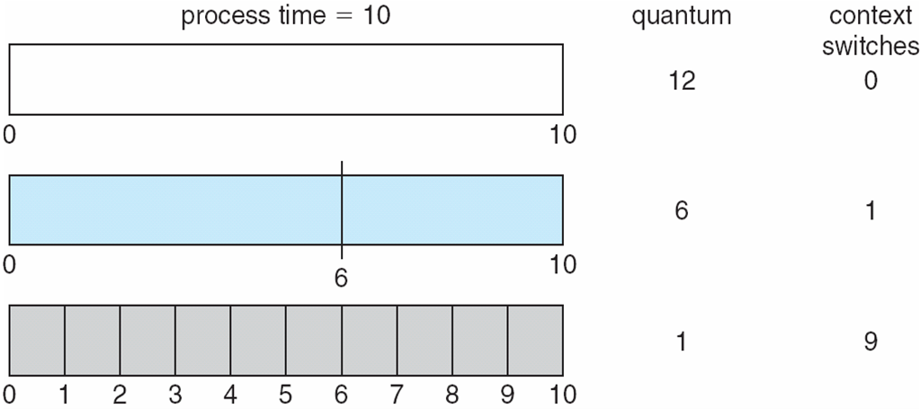
Time Quantum and Context Switch Time

Slide 19
Example of RR with Time Quantum = 4
Process Burst Time
P₁ 24
P₂ 3
P₃ 3
The Gantt chart is:
Typically, higher average turnaround than SJF, but better response
q should be large compared to context switch time
q usually 10ms to 100ms, context switch < 10 usec

Slide 20
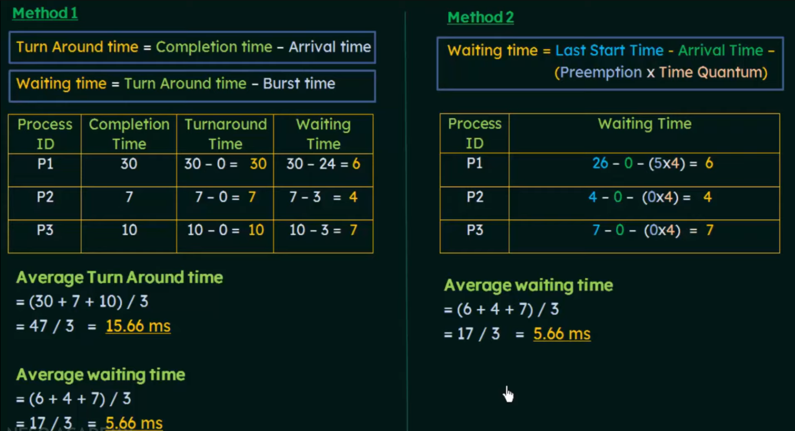
Example of RR with Time Quantum = 4

Slide 21
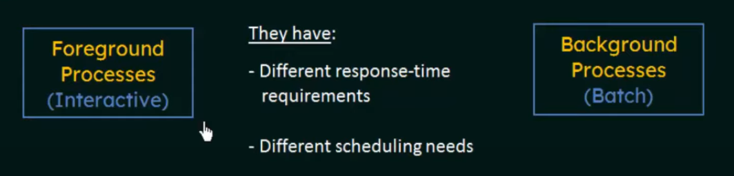
Multilevel Queue
Ready queue is partitioned into separate queues, eg:
foreground (interactive)
background (batch)
Each queue has its own scheduling algorithm:
foreground – RR
background – FCFS
The scheduling will take place within and among the queues

Slide 22
Multilevel Queue
Scheduling must be done between/among the queues:
Fixed priority scheduling; (i.e., serve all from foreground then from background). Possibility of starvation.
Time slice – each queue gets a certain amount of CPU time which it can schedule amongst its processes; i.e., 80% to foreground in RR
20% to background in FCFS

Slide 23
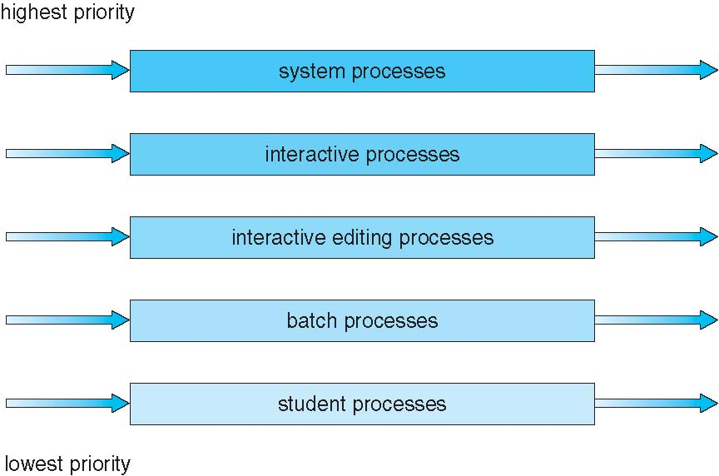
Multilevel Queue Scheduling

Slide 24
Multilevel Feedback Queue
A process can move between the various queues; aging can be implemented this way
Multilevel-feedback-queue scheduler defined by the following parameters:
number of queues
scheduling algorithms for each queue
method used to determine when to upgrade a process
method used to determine when to demote a process
method used to determine which queue a process will enter when that process needs service

Slide 25
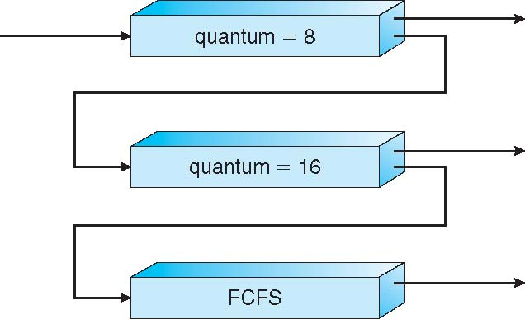
Example of Multilevel Feedback Queue
Three queues:
Q₀ – RR with time quantum 8 milliseconds
Q₁ – RR time quantum 16 milliseconds
Q₂ – FCFS
Scheduling
A new job enters queue Q₀ which is served RR
When it gains CPU, job receives 8 milliseconds
If it does not finish in 8 milliseconds, job is moved to queue Q₁
At Q₁ job is again served FCFS and receives 16 additional milliseconds
If it still does not complete, it is preempted and moved to queue Q₂

Slide 26
End of Chapter 6

