Slide 1

KNOWLEDGE CHECK V2
This is completely redesigned and rewritten application "Knowledge Check".
Team4:
Deniss Sutugins
Denys Haponov
Dmitrijs Klujevs
Dmitry Fedorov
Pavels Vetlugins
Mentor:
Valdis Vītoliņš
Accenture Java Bootcamp
July-2018

Slide 2

BUSINESS ANALYSIS AND ANALYSIS OF GIVEN INPUT
Needs
improving practical examination for student knowledge check to provide ease of use
and improvement in performance both on the user and admin side.
Avoiding possible complications ensuring correct user input procedure.
Commitments
Plain text file Import / Export for data migration- IMPLEMENTED
Test coverage >= 80% - 87.7%
Project is well documented and supported by JavaDocs and Admin documentation- IMPLEMENTED
System fully functional (student web-form with the selected topic questions)- IMPLEMENTED
Admin (teacher) can Start, Stop, Import/Export questions and Get Exam Results- IMPLEMENTED

Slide 3
GOAL
Develop Java-based application for testing student knowledge which is more convenient and flexible
that current solution
(as of 16.07.2018).
Demonstrate good understanding and use the following technologies:
Java
SQL
Spring Boot
Implement flexible architecture adaptive to change

Slide 4
STAKEHOLDERS ASSESSMENT AND REQUIREMENTS
Student
Login by 4-char code and start the test
GUI page with questions is displayed
For single choice – radio buttons
For multi choice – checkbox buttons
Teacher/Admin
Create, edit, delete questions
Start/Stop test session
View results

Slide 5

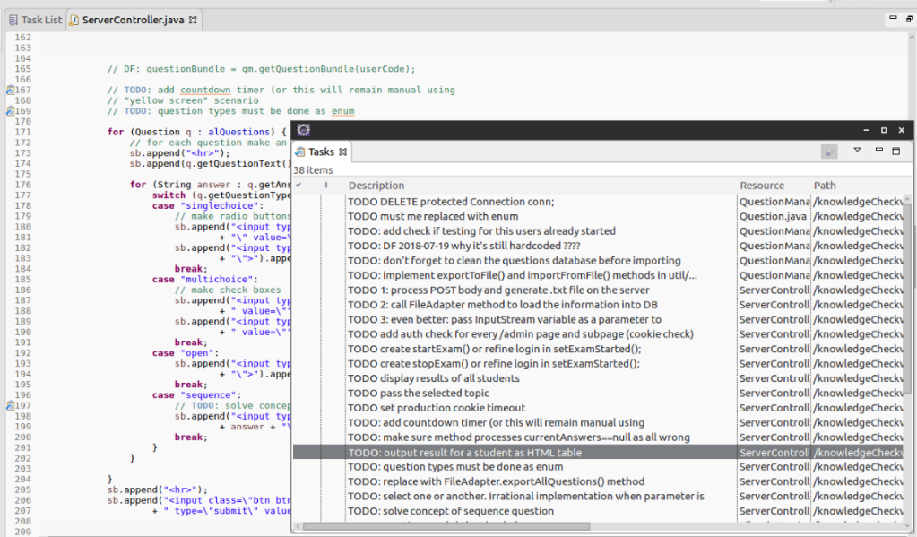
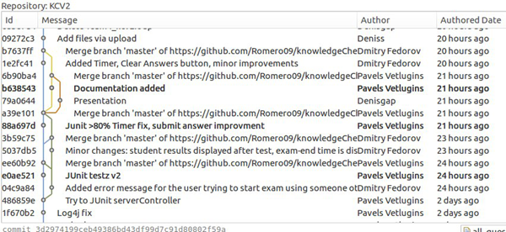
PROJECT PLANNING
Distribute the Difficult Tasks First
decide which tasks need to be completed and when. to ensure we stay productive and motivated
we assigned the most time consuming and difficult tasks at the beginning of the project.
Avoided assigning these types of tasks late in the day
Parallel implementation
To assure steady work flow working in parallel is an important part of any project and ours shows such approach.

Slide 6
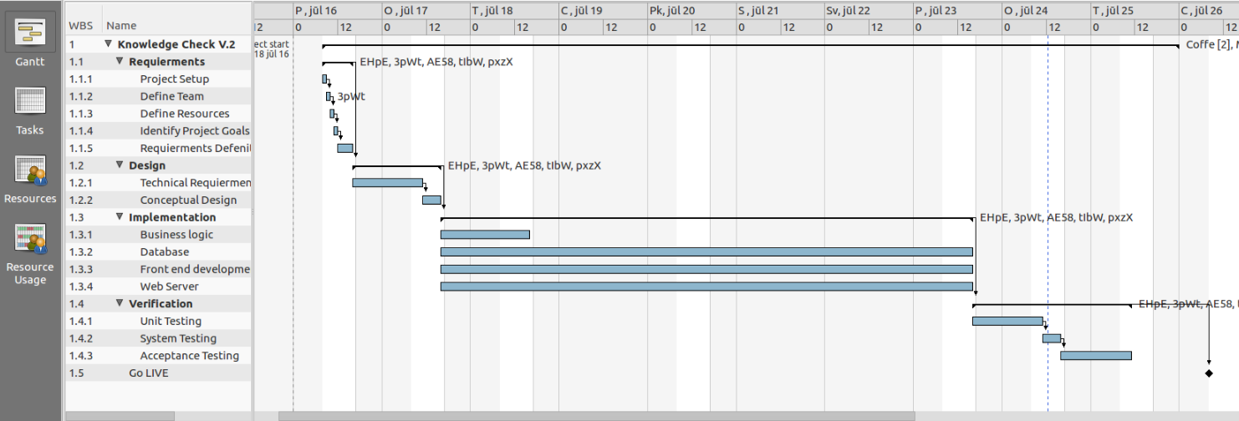
Be Reasonable
Don’t set your expectations so high that you set yourself and your team up for failure.
Implement must have functions first and leave the optional tasks for later in the project.
Account for Absences
To manage our team’s workload better we knew when and who are going to be around.
We talked about upcoming off days and included those in our planning,
so we don’t assign work while we are away.

Slide 7
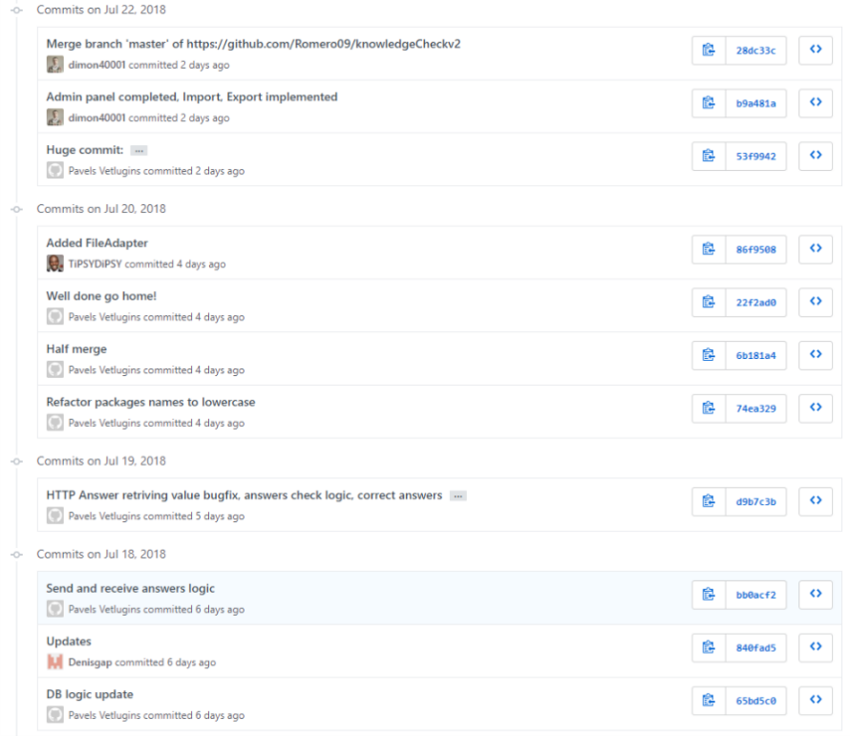

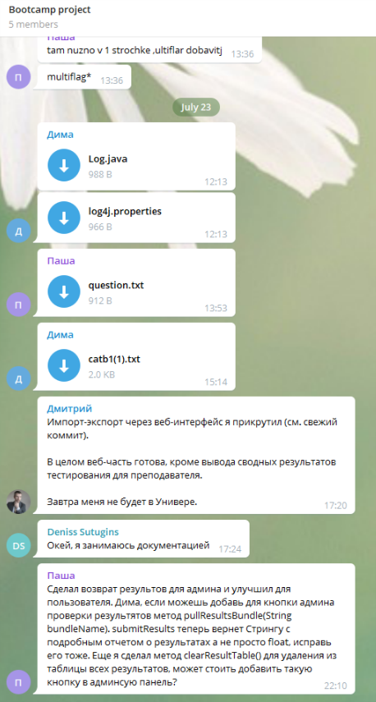

Communication is Key
To ensure good communication, we created an environment in which discussions and Chat
are key elements for our progress, to distribute work load and help each other in the process of development.

Slide 8
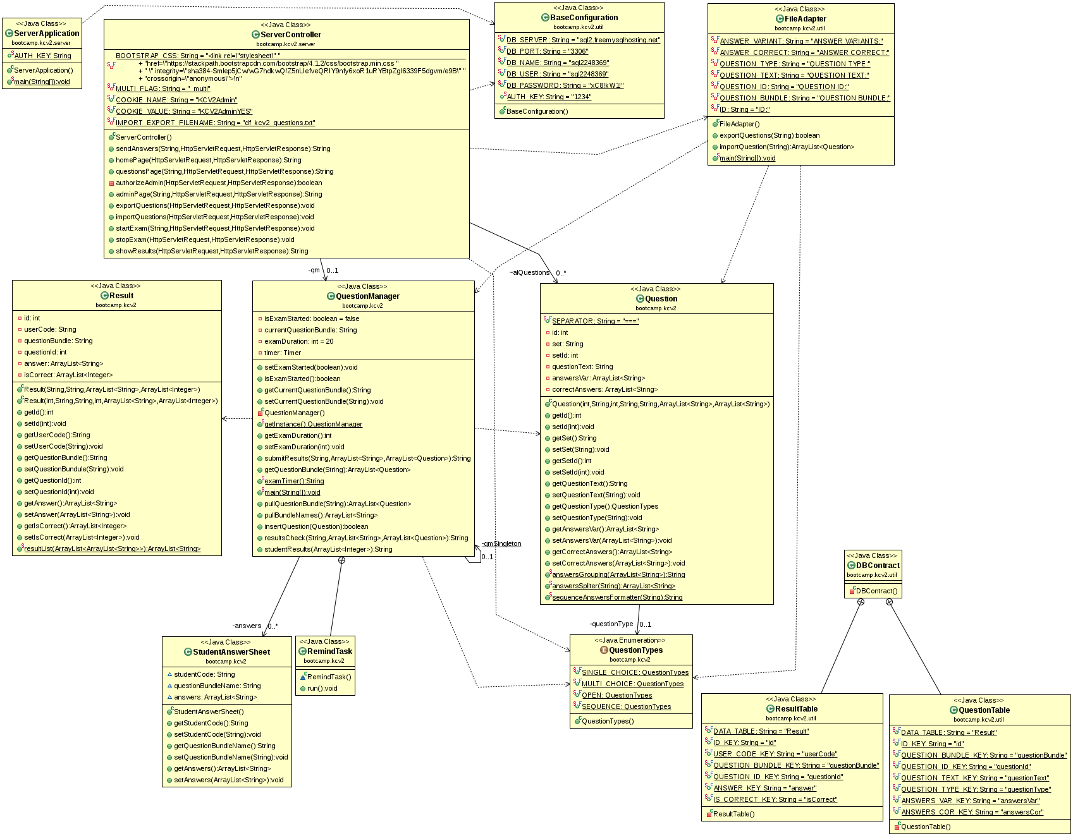
SYSTEM OVERALL DESIGN

Slide 9

CHOSEN FRAMEWORK
  Radically faster getting started experience
  for our project we used the framework to which we were introduced during the boot camp.
  Taking into account that the time frame for the project is very limited we decided to go with a fast option
  in order to concentrate time on more important issues.
  Easier dependency management /Different build / deployment options.
  In order to have an option to quickly add and remove dependencies we used the Apache Maven
  based on the concept of a project object model (POM), Maven can manage a project's build
  simply by adding dependencies to the pom.xml file.

Slide 10
org.springframework.http
Contains a basic abstraction over client/server-side HTTP.
HttpRequestRepresents an HTTP request message, consisting of method and uri.
MediaType: Represents an Internet Media Type, as defined in the HTTP specification.
org.springframework.context.annotation
Configuration: Indicates that a class declares one or more @Bean methods and may be processed
by the Spring container to generate bean definitions and service requests for those beans at runtime
ComponentScan: Configures component scanning directives for use with @Configuration classes.
org.springframework.stereotype
Controller:Indicates that an annotated class is a "Controller" (e.g. a web controller).

Slide 11
org.springframework.web.bind.annotation
Annotations for binding requests to controllers and handler
methods as well as for binding request parameters to method arguments.
RequestBody: Annotation indicating a method parameter should be bound to the body of the web
request.
RequestMapping: Annotation for mapping web requests onto specific handler classes and/or handler
methods.
ResponseBody: Annotation which indicates that a method return value should be bound to the web
response body.
RequestParam: Annotation which indicates that a method parameter should be bound to a web
request parameter.
org.springframework.web.multipart.support
StandardMultipartHttpServletRequest:
All Implemented Interfaces: HttpServletRequest, ServletRequest, MultipartHttpServletRequest,
MultipartRequestSpring MultipartHttpServletRequest adapter, wrapping a Servlet 3.0 HttpServletRequest
and its Part objects. Parameters get exposed through the native request's getParameter methods –
without any custom processing on our side.

Slide 12

org.springframework.boot
The main library providing features that support the other parts of Spring Boot, these include:
SpringApplication: providing static convenience methods that make it easy to write a stand-alone
Spring Application. Its sole job is to create and refresh an appropriate Spring ApplicationContext
Autoconfigure: Spring Boot can configure large parts of common applications based on the content
of their classpath. A single @EnableAutoConfiguration annotation triggers auto-configuration of the
Spring context.

Slide 13
javax.servlet.http
HttpServletRequest
Extends the ServletRequest interface to provide request information for HTTP servlets.
HttpServletResponse
Extends the ServletResponse interface to provide HTTP-specific functionality in sending a response.
Cookie
Creates a cookie, a small amount of information sent by a servlet to a Web browser, saved by the browser
Part
This class represents a part or form item that was received within a multipart/form-data POST request.
Java.sql
Provides the API for accessing and processing data stored in a data source using the JavaTM
programming language. This API includes a framework whereby different drivers can be installed
dynamically to access different data sources.

Slide 14

SYSTEM DATA MODEL
MySQL
For our project we chose MySQL mostly because It’s ubiquitous many Linux or Windows based
web hosts use it. A lot of open source projects are connected to it.
If you’re in a shared hosting environment you can’t just go an install something else,
but you can stick with MySQL and download just about any open source software and use it.
phpMyAdmin
is a free and open source administration tool for MySQL.
As a portable web application written primarily in PHP, it has become one of the most popular MySQL
administration tools, especially for web hosting services.

Slide 15
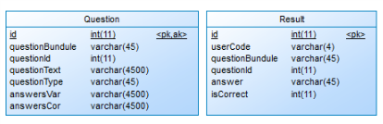
DATABASE TABLES
QuestionBundle: corresponds to the subject/theme
QuestionID: Question id for each question
Question Text: the actual question text
Question Type: the type of the question
AnswersVar: all variants of answers for the question
AnswerCor : correct variants for the question
UserCode: code of the user
QuestionBundle: corresponds to the subject/theme
QuestionId:Question id for each question
Answer: the chosen answer
Iscorrect: 1 for correct 0 for incorrect

Slide 16

AUTOMATED UNIT TESTS
JUnit is an open source Java testing framework used to write
and run repeatable tests
JUnit is integrated with Eclipse
Need only to add:
import org.junit.Test;

Slide 17
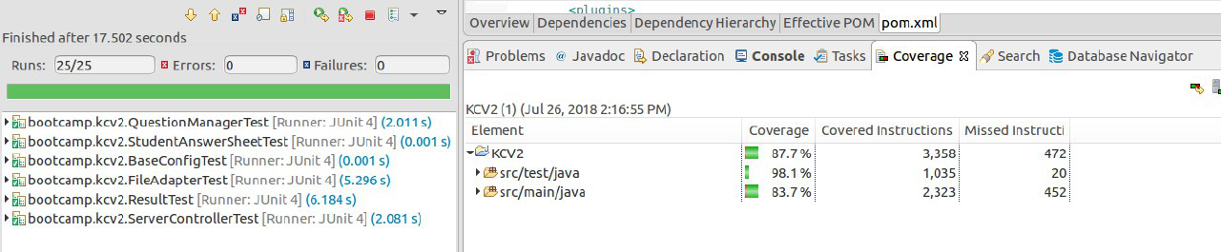
JUNIT TESTS IN PROJECT
In this project we used JUnit tests in order to check and control work of our code.
To check that each method inside the program is working properly we implemented JUnit tests which provide us with feedback regarding the objects and values passed through methods.
As we committed to deliver at least 80% testing coverage, you can observe below:

Slide 18

SYSTEM BUILDING AND DEPLOYMENT
A central feature in Maven is dependency management.
Maven's dependency-handling mechanism is organized around a coordinate system identifying
individual artifacts such as software libraries or modules.
Our project that needs, org.springframework library in that case we simply have to declare
org.springframework coordinates in POM.xml
Maven will automatically download the dependency and the dependencies that org.springframework
itself needs (called transitive dependencies) and store them in the user's local repository.

Slide 19
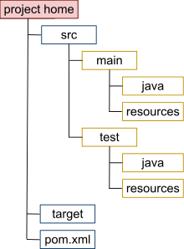
STRUCTURE
project home Contains the pom.xml and all subdirectories.
src/main/java Contains the deliverable Java sourcecode for the project.
src/main/resources Contains the deliverable resources for the project, such as property files.
src/test/java Contains the testing Java sourcecode for the project.
src/test/resources Contains resources necessary for testing.

Slide 20
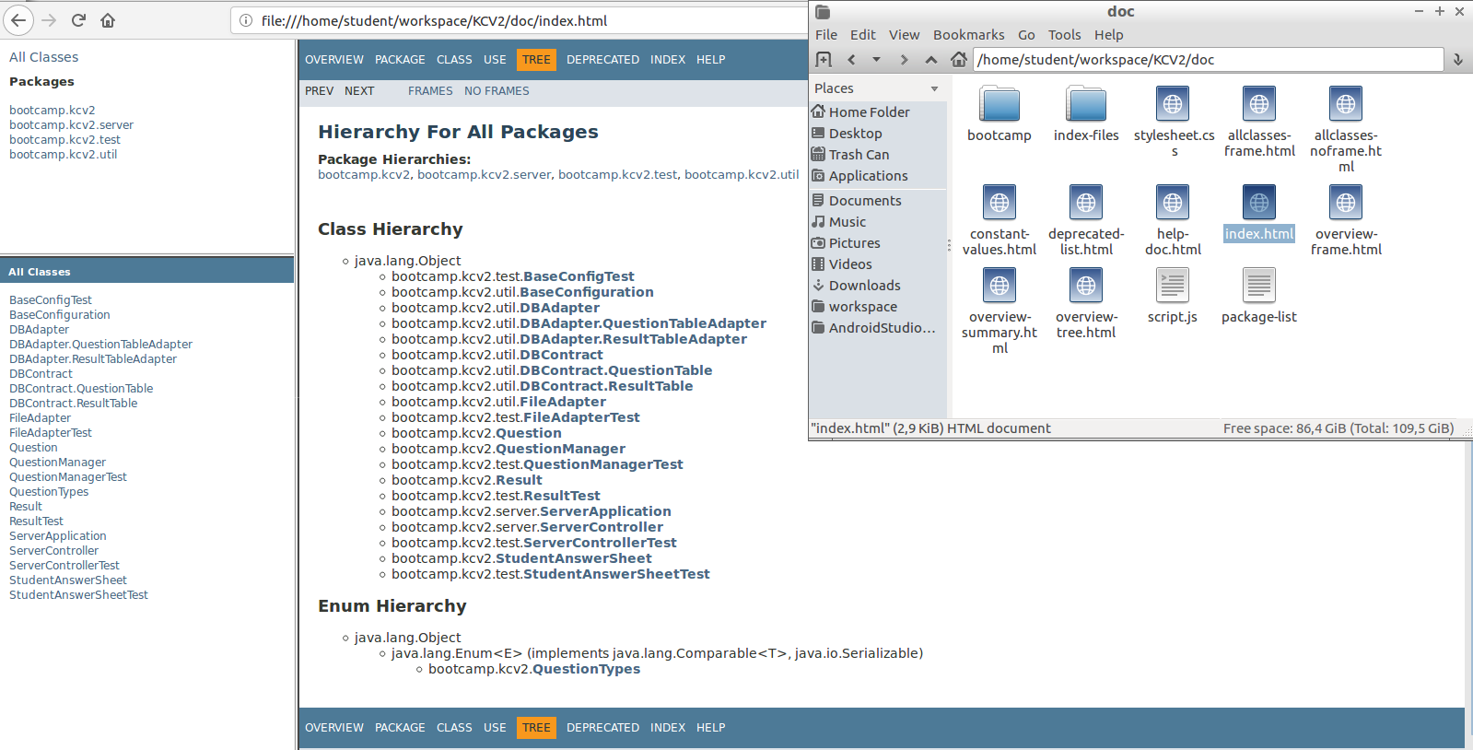
JAVA DOCS DOCUMENTATION

Slide 21
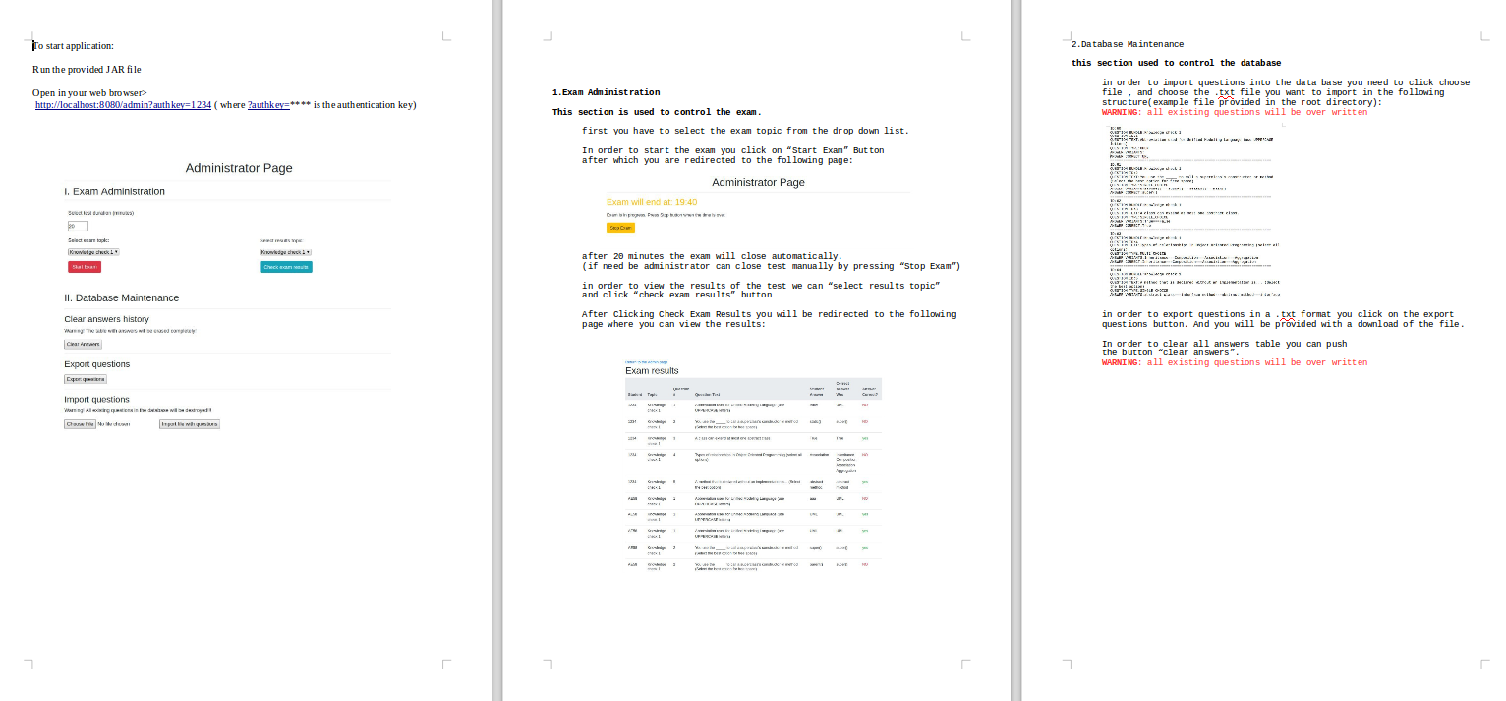
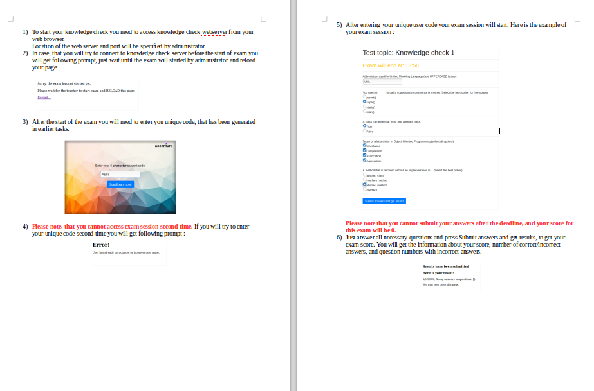
ADMIN/USER DOCUMENTATION
The project provided with Administrator and user Guides in the root directory:

Slide 22
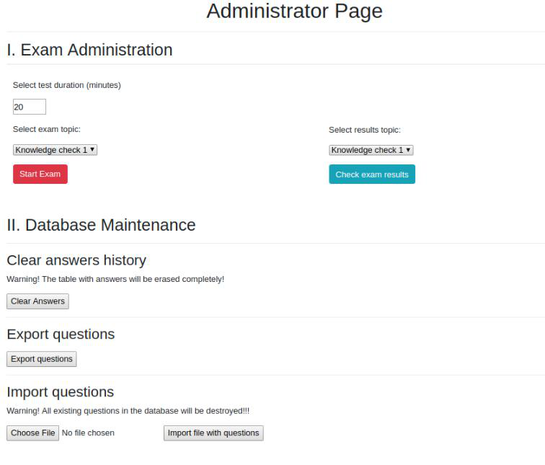
ADMINISTRATOR PAGE
1. Drop down list: choose Subject for testing
2. Button “Start Exam”: Starts exam for students
3. Button “Check Exam results”
Show results
4.Button “Clear Answers”: clears the answers table form database
5.Button “Export questions”: exports questions into txt file
6. import questions: import questions from txt file

Slide 23
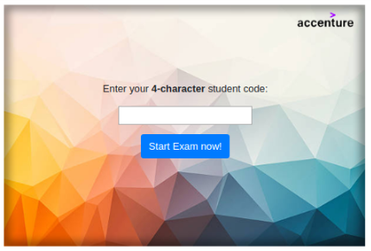
USER PAGE

Slide 24
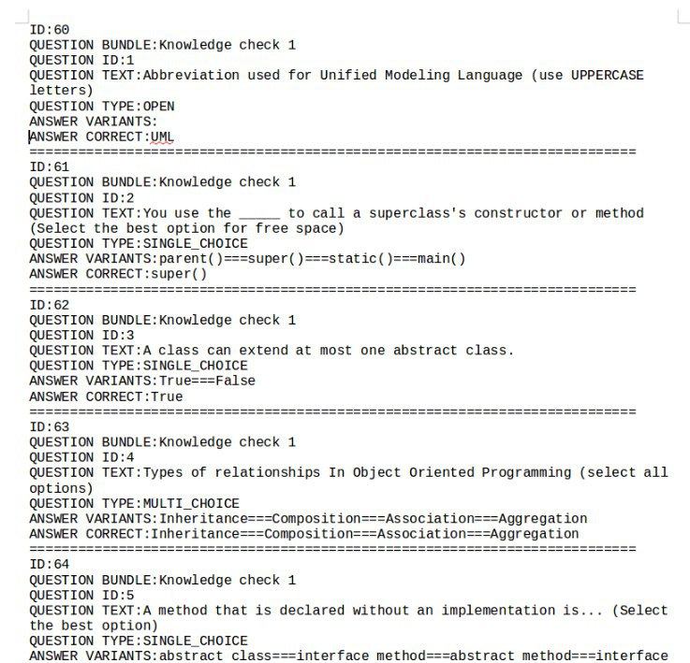

QUESTIONS IMPORT/EXPORT
Our project supports importing and exporting answers from and to the database using a structured .txt file (to the right) to ease administrators CRUDE operation.
By clicking “Export Questions” you can download the .txt file directly and edit it afterwards to import it using the choose file button.

Slide 25
DEMONSTRATION
In browser>
http://localhost:8080

Slide 26

DEMONSTRATION
In browser>
http://localhost:8080

Slide 27
FINAL OVERVIEW
project URL: https://github.com/Romero09/knowledgeCheckv2
Main features of the project :
List of team members and their main contribution to the project
Biggest challenges in the project and lessons learned.
Future work

Slide 28
That’s it

