Slide 1

KNOWLEDGE CHECK V2
This is completely redesigned and rewritten application "Knowledge Check".
Team4:
Den
Den
Dima
Dmitri
Pavel
Sensei:
Valdis Vītoliņš
Accenture Java Bootcamp
July-2018

Slide 2
BUSINESS ANALYSIS AND ANALYSIS OF GIVEN INPUT
Needs
improving practical examination for student knowledge check to provide ease of use and improvement in performance both on the user and admin side.Avoiding possible complications ensuring correct user input procedure.
Commitments
Plain text file Import / Export for data migaration
Test coverage >= 80%
Project is well documented and supported by JavaDocs and Admin documentation
System fully functional
Admin (teacher) can Start, Stop, Import, Export and Get Exam Results

Slide 3
GOAL
Develop Java-based application for testing student knowledge which is more convenient and flexible that current solution
(as of 16.07.2018).
Demonstrate good understanding and use the following technologies:
Java
SQL
Spring Boot
Implement flexible architecture adaptive to change

Slide 4
STAKEHOLDERS ASSESSMENT AND REQUIREMENTS
Student
Login by 4-char code and start the test
GUI page with questions is displayed
For single choice – radio buttons
For multi choice – checkbox buttons
Teacher/Admin
Create, edit, delete questions
Start/Stop test session
View results

Slide 5

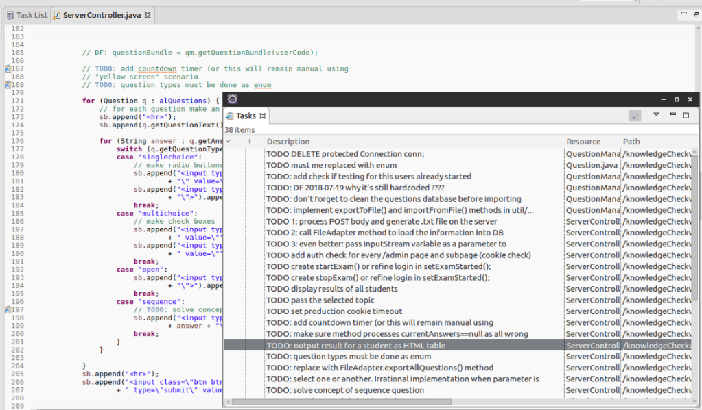
PROJECT PLANNING
Distribute the Difficult Tasks First
decide which tasks need to be completed and when. to ensure we stay productive and motivated we assigned the most time consuming and difficult tasks at the beginning of the project. Avoided assigning these types of tasks late in the day

Slide 6
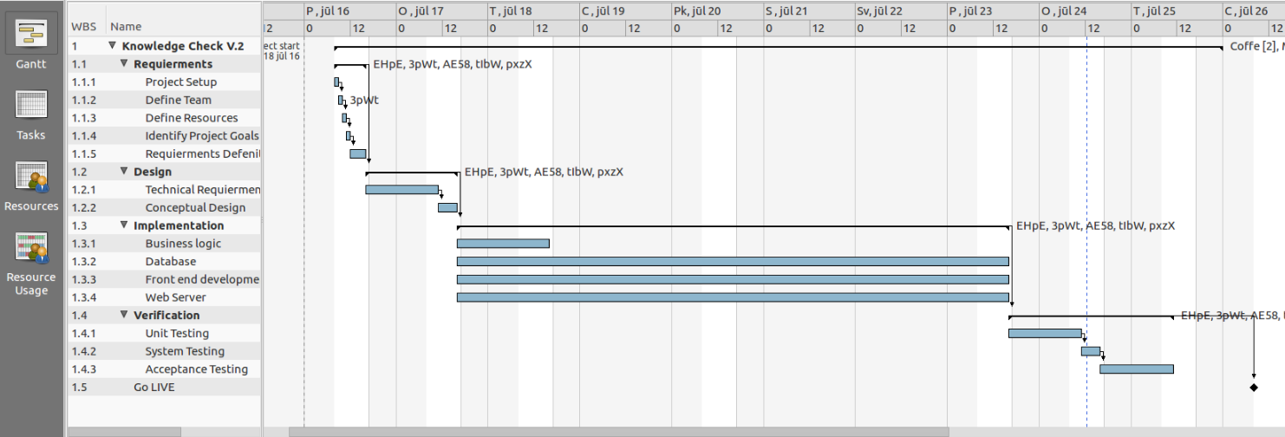
Be Reasonable
Don’t set your expectations so high that you set yourself and your team up for failure. Implement must have functions first and leave the optional tasks for later in the project.
Account for Absences
To manage our team’s workload better we knew when and who are going to be around. We talked about upcoming off days and included those in our planning, so we don’t assign work while we are away.

Slide 7
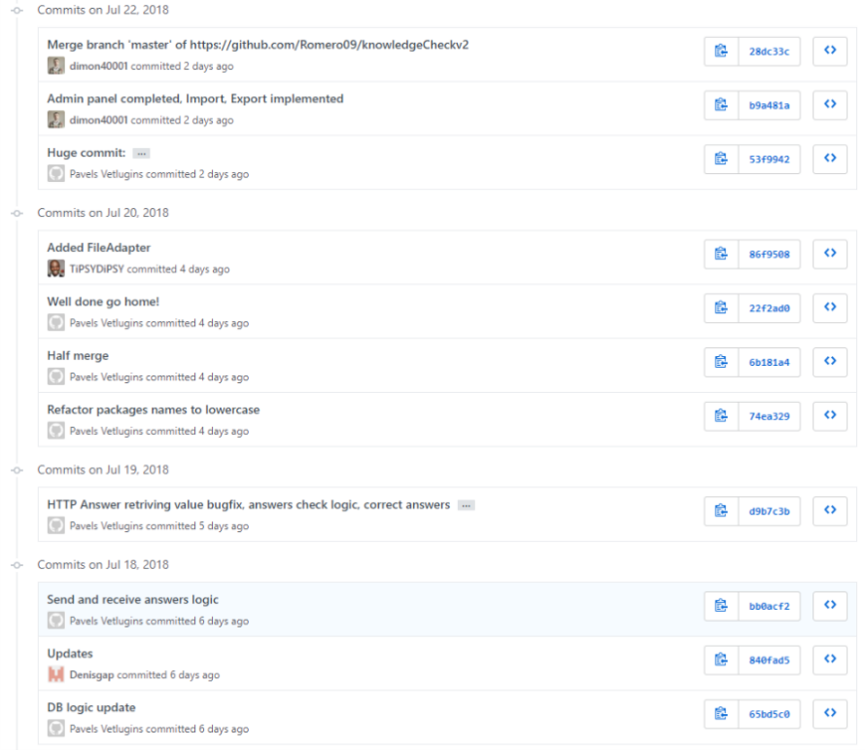

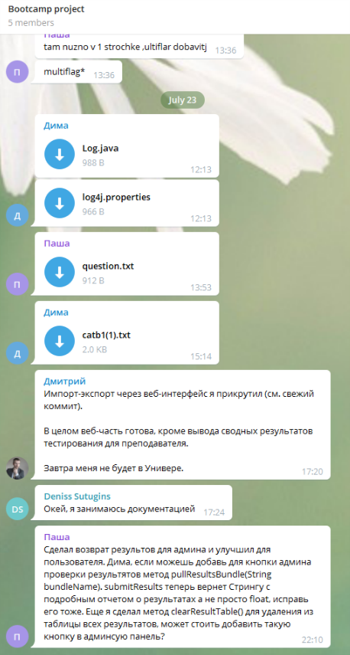

Communication is Key
To ensure good communication, we created an environment in which discussions and Chat
are key elements for our progress, to distribute work load and help each other in the process of development.

Slide 8
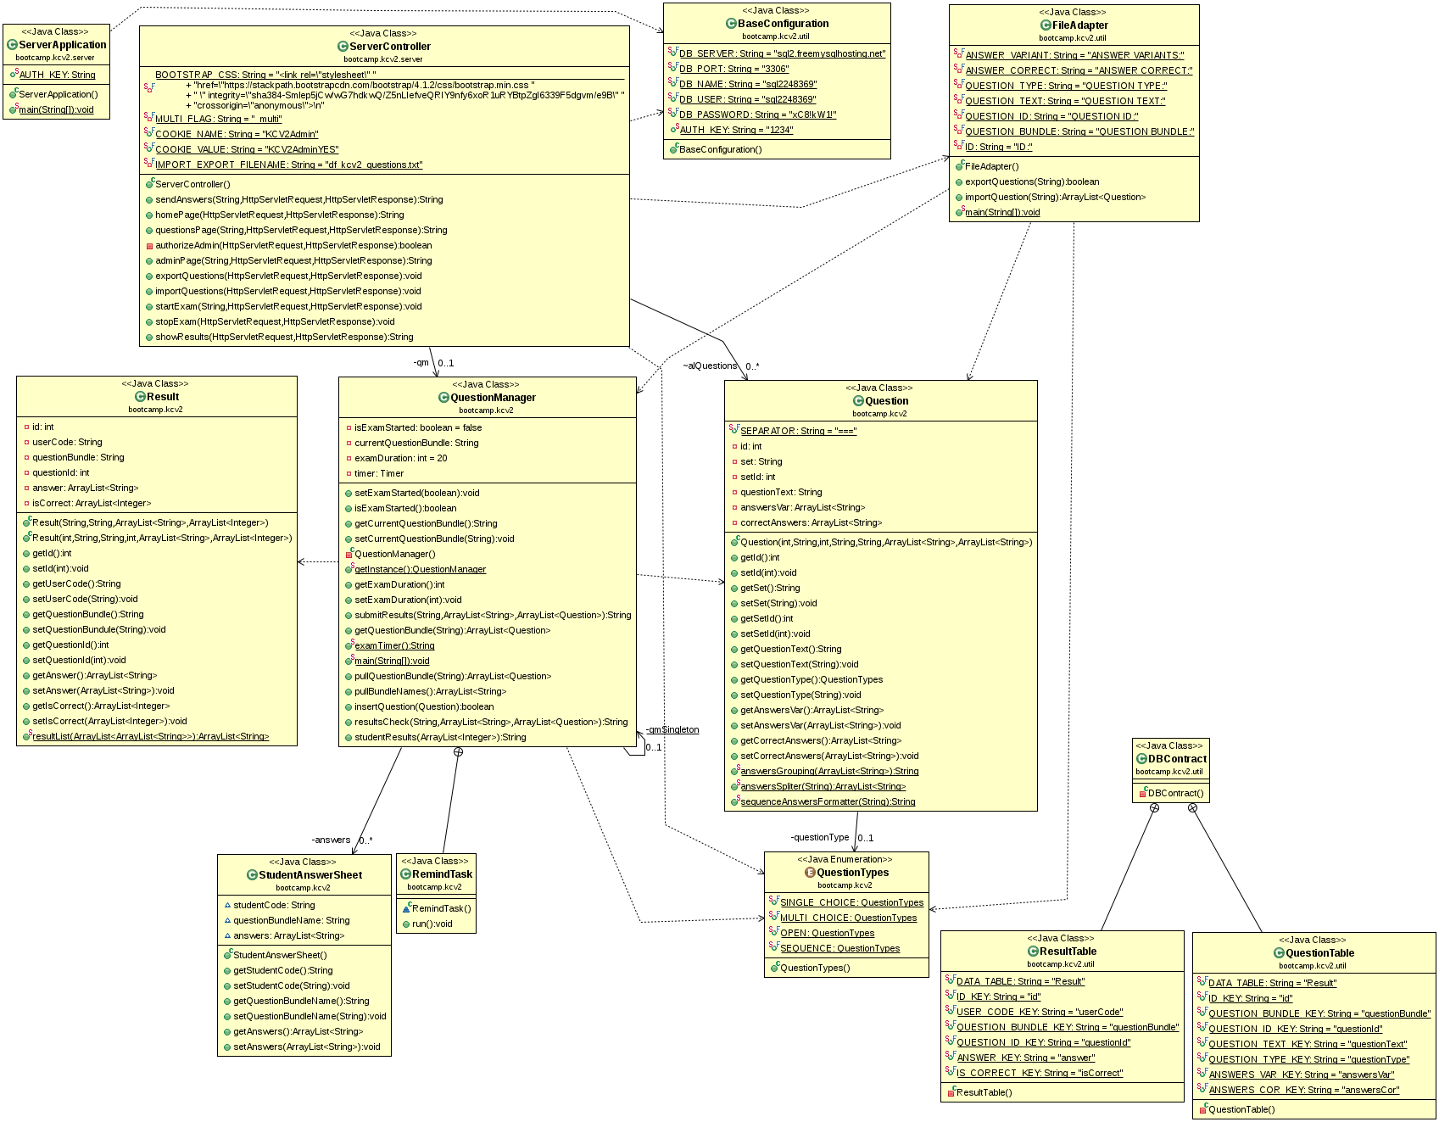
SYSTEM OVERALL DESIGN

Slide 9

CHOSEN FRAMEWORK
  Radically faster getting started experience
  for our project we used the framework to which we were introduced during the bootcamp. Taking into account that the time frame for the project is very limited we decided to go with a fast option in order to concentrate time on more importatnt issues.
  Easier dependency management /Different build / deployment options.
  In order to have an option to quickly add and remove dependencies we used the Apache Maven based on the concept of a project object model (POM), Maven can manage a project's build simply by adding dependencies to the pom.xml file.

Slide 10
org.springframework.http
Contains a basic abstraction over client/server-side HTTP.
HttpRequest: Represents an HTTP request message, consisting of method and uri.
MediaType: Represents an Internet Media Type, as defined in the HTTP specification.
org.springframework.context.annotation
Configuration: Indicates that a class declares one or more @Bean methods and may be processed by the Spring container to generate bean definitions and service requests for those beans at runtime
ComponentScan: Configures component scanning directives for use with @Configuration classes.
org.springframework.stereotype
Controller: Indicates that an annotated class is a "Controller" (e.g. a web controller).

Slide 11
org.springframework.web.bind.annotation
Annotations for binding requests to controllers and handler
methods as well as for binding request parameters to method arguments.
RequestBody: Annotation indicating a method parameter should be bound to the body of the web request.
RequestMapping: Annotation for mapping web requests onto specific handler classes and/or handler methods.
ResponseBody: Annotation which indicates that a method return value should be bound to the web response body.
RequestParam: Annotation which indicates that a method parameter should be bound to a web request parameter.
org.springframework.web.multipart.support
StandardMultipartHttpServletRequest:
All Implemented Interfaces: HttpServletRequest, ServletRequest, MultipartHttpServletRequest, MultipartRequest
Spring MultipartHttpServletRequest adapter, wrapping a Servlet 3.0 HttpServletRequest and its Part objects. Parameters get exposed through the native request's getParameter methods - without any custom processing on our side.

Slide 12

org.springframework.boot
The main library providing features that support the other parts of Spring Boot, these include:
SpringApplication: providing static convenience methods that make it easy to write a stand-alone Spring Application. Its sole job is to create and refresh an appropriate Spring ApplicationContext
Autoconfigure: Spring Boot can configure large parts of common applications based on the content of their classpath. A single @EnableAutoConfiguration annotation triggers auto-configuration of the Spring context.

Slide 13
javax.servlet.http
HttpServletRequest Extends the ServletRequest interface to provide request information for HTTP servlets.
HttpServletResponse Extends the ServletResponse interface to provide HTTP-specific functionality in sending a response.
Cookie Creates a cookie, a small amount of information sent by a servlet to a Web browser, saved by the browser, and later sent back to the server.
Part This class represents a part or form item that was received within a multipart/form-data POST request.
Java.sql
Provides the API for accessing and processing data stored in a data source using the JavaTM programming language. This API includes a framework whereby different drivers can be installed dynamically to access different data sources.

Slide 14

SYSTEM DATA MODEL
MySQL
For our project we chose MySQL mostly because It’s ubiquitousGo to any Linux or Windows based web host, and there it is. Download an open source project and most of time that’s what it’s connected to. If you’re in a shared hosting environment you can’t just go an install something else, but you can stick with MySQL and download just about any open source software and use it.
phpMyAdmin
is a free and open source administration tool for MySQL. As a portable web application written primarily in PHP, it has become one of the most popular MySQL administration tools, especially for web hosting services.

Slide 15
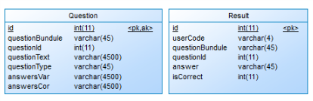
DATABASE TABLES
QuestionBundle: corresponds to the subject/theme of the test
QuestionID: Question id for each question
Question Text: the actual question text
Question Type: the type of the question
( SINGLE_CHOICE, MULTI_CHOICE, OPEN, SEQUENCE)
AnswersVar: all variants of answers for the question
AnswerCor : correct variants for the question
UserCode: code of the user
QuestionBundle: corresponds to the subject/theme of the test
QuestionId:Question id for each question
Answer: the chosen answer
Iscorrect: 1 for correct 0 for incorrect

Slide 16

AUTOMATED UNIT TESTS
JUnit is an open source Java testing framework used to write
and run repeatable tests
JUnit is integrated with Eclipse
Need only to add:
import org.junit.Test;

Slide 17
EXAMPLES OF JUNIT TESTS IN PROJECT HERE PLEASE
SHOW THAT WE HAVE PROMISED 80% COVERAGE IF POSSIBLE

Slide 18

SYSTEM BUILDING AND DEPLOYMENT
A central feature in Maven is dependency management.
Maven's dependency-handling mechanism is organized around a coordinate system identifying individual artifacts such as software libraries or modules.
Our project that needs, org.springframework library in that case we simply have to declare org.springframework coordinates in POM.xml
Maven will automatically download the dependency and the dependencies that org.springframework itself needs (called transitive dependencies) and store them in the user's local repository.

Slide 19
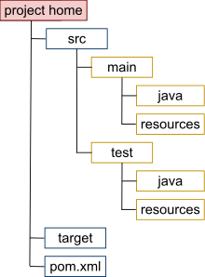
STRUCTURE
project home Contains the pom.xml and all subdirectories.
src/main/java Contains the deliverable Java sourcecode for the project.
src/main/resources Contains the deliverable resources for the project, such as property files.
src/test/java Contains the testing Java sourcecode (JUnit or TestNG test cases, for example) for the project.
src/test/resources Contains resources necessary for testing.

Slide 20
USER, ADMINISTRATOR GUIDES AND OTHER DOCUMENTATION

Slide 21
DEMONSTRATION
In browser>
http://localhost:8080

Slide 22

DEMONSTRATION
In browser>
http://localhost:8080

Slide 23
FINAL OVERVIEW
project URL: https://github.com/Romero09/knowledgeCheckv2
Main features of the project :
List of team members and their main contribution to the project
Biggest challenges in the project and lessons learned.
Future work

Slide 24
That’s it

