Slide 1







IBM Data Analyst Capstone Project: Emerging Technology Trend Analysis
Legesse A. Kibrom
June 2024

Slide 2



OUTLINE
Executive Summary
Introduction
Methodology
Results
Visualization – Charts
Dashboard
Discussion
Findings & Implications
Conclusion
Appendix

Slide 3

EXECUTIVE SUMMARY
Current Technology Usage
Programming Language
Database
Platform
Web Framework
Future Technology Trend
Programming Language
Database
Platform
Web Framework
Demographics Survey
Gender and Age Gaps

Slide 4

INTRODUCTION
Analyzing Technology Trend of Developers around the World in 2019.
Identifying Future Skill Requirements.
What are the top programming in demand?
What are the Top Database Skills in demand?
What are the most popular IDEs?
Audience:
IT professionals
IT Industry

Slide 5

METHODOLOGY
Data Collection Sources:
Stack Overflow Developer 2019 Survey
Programming Languages Annual Salary
GitHub Job Posting
Data Exploration and Cleaning
Python
Data Visualization
IBM Cognos Analysis
Presentations

Slide 6
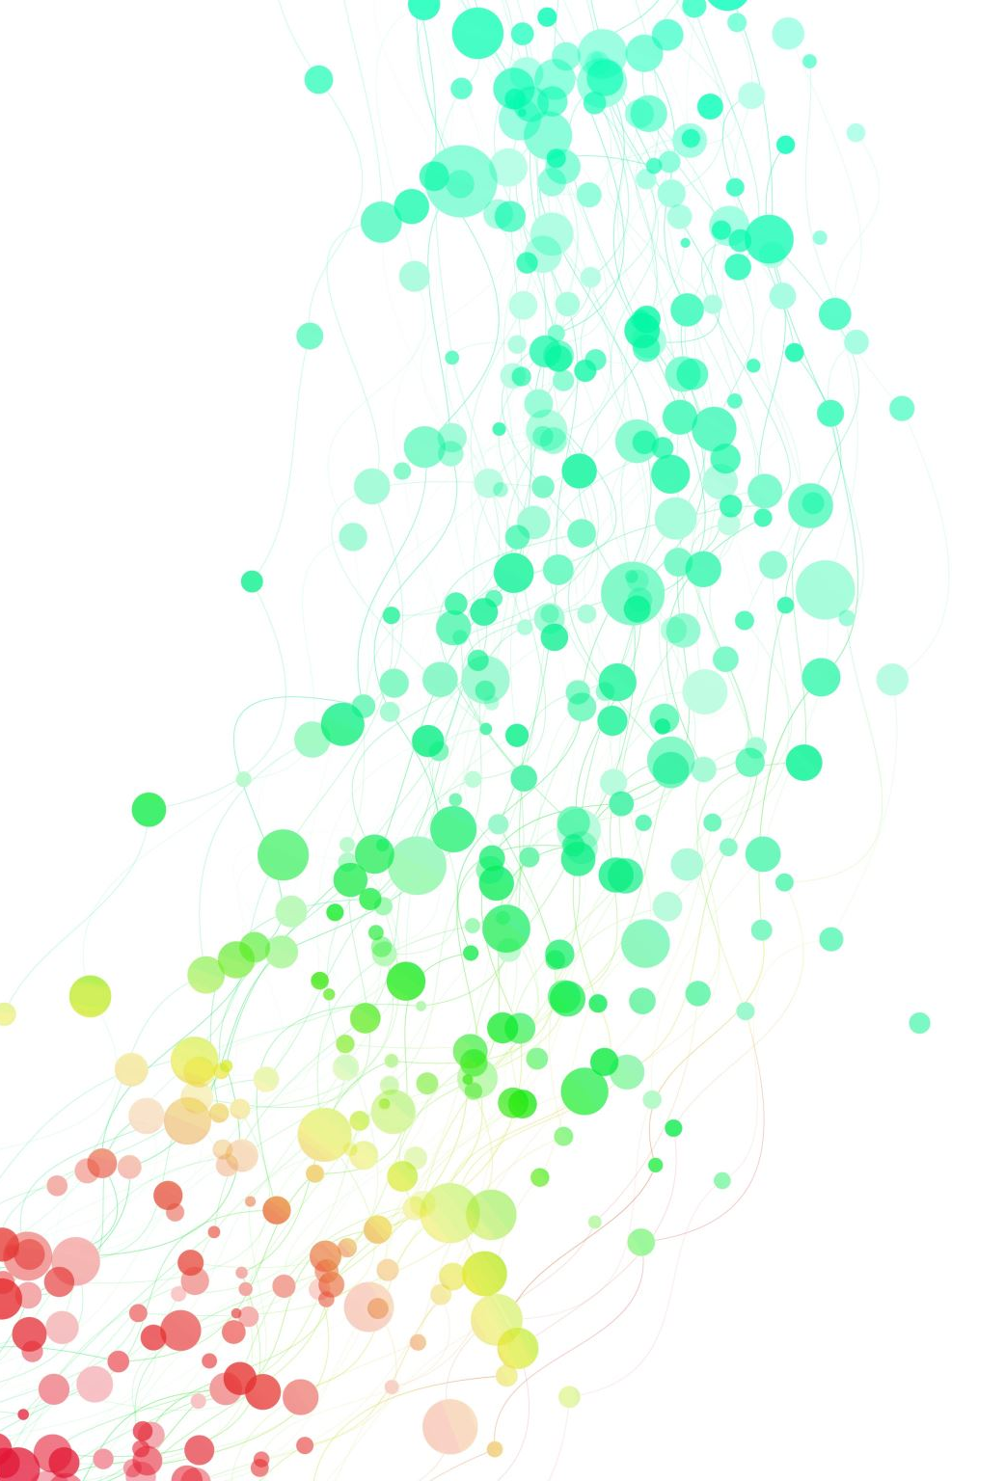
Results

Slide 7
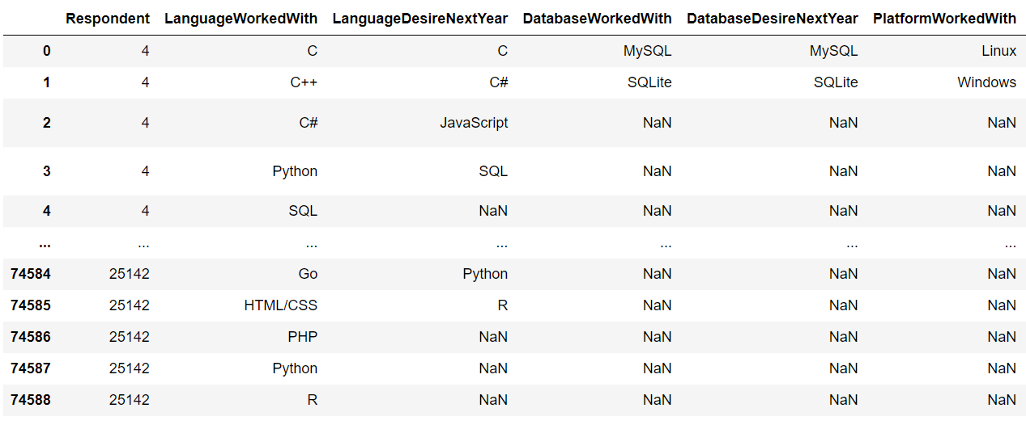
Data Technology Survey table

Slide 8
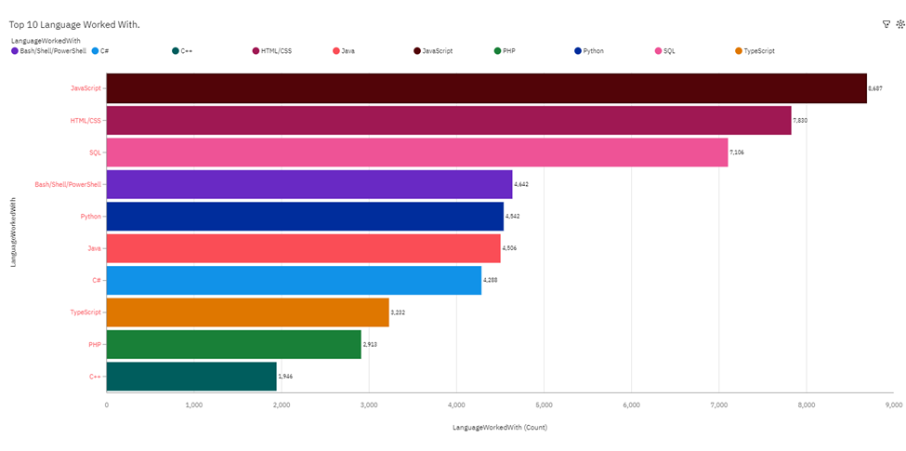
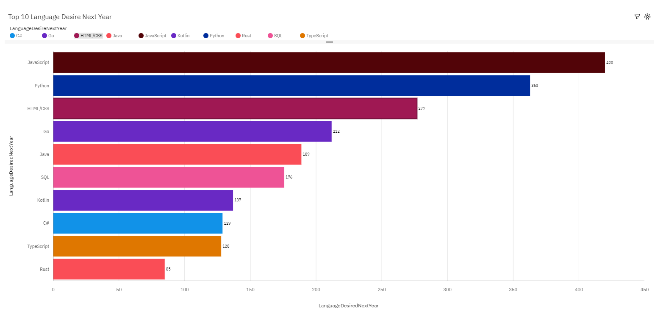
PROGRAMMING LANGUAGE TRENDS
Current Year
Next Year

Slide 9
PROGRAMMING LANGUAGE TRENDS - FINDINGS & IMPLICATIONS
Findings
JavaScript, HTML/CSS, and SQL are the top trending in the world
JavaScript, Python, and HTML/CSS are becoming more and more popular
Implications
Web developments are still in high demand
JavaScript and Python are crucial to learn for developers

Slide 10
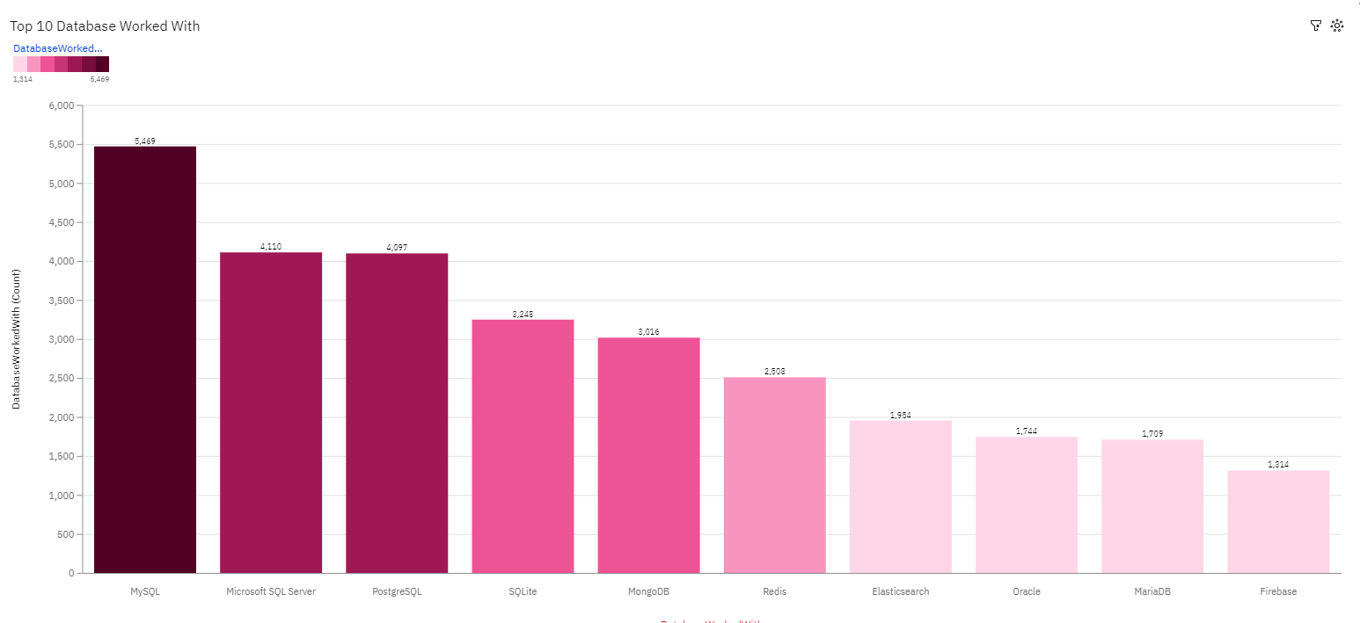
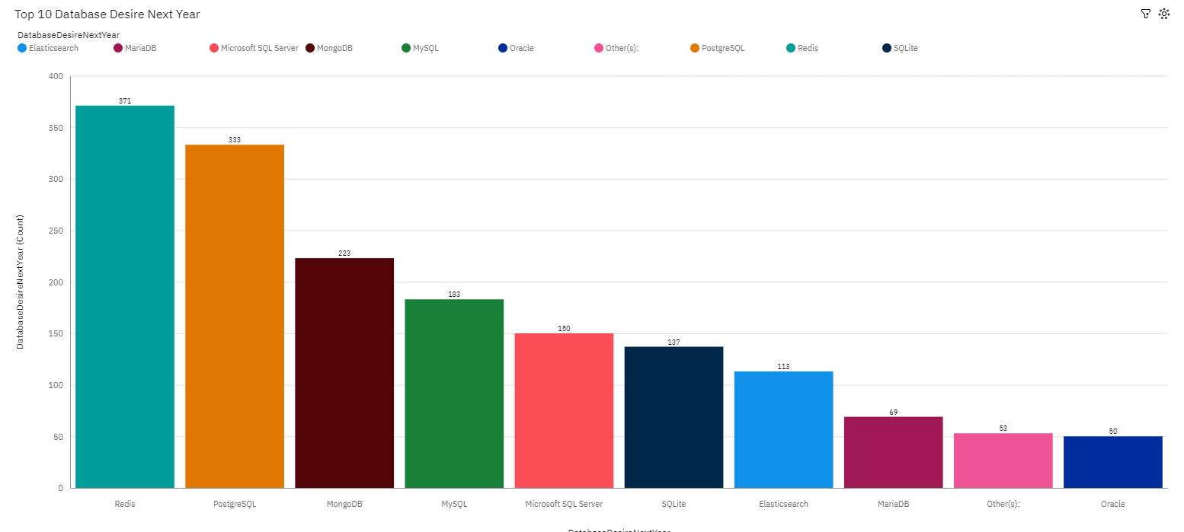
DATABASE TRENDS
Current Year
Next Year

Slide 11
DATABASE TRENDS - FINDINGS & IMPLICATIONS
Findings
MySQL is the most popular Database behind Microsoft SQL server
Redis and PostgreSQL are the upcoming favorites.
Skills in Redis and Elasticsearch are most desirable than Microsoft SQL server
Implications
Open-source databases like MySQL are still preferable
PostgreSQL and MongoDB are the most consistent in demand

Slide 12

DASHBOARD
https://github.com/Romhaikb/Capstone-project/blob/main/Part%20A%20-%20Building%20A%20Dashboard%20With%20IBM%20Cognos%20Analytics.pdf

Slide 13
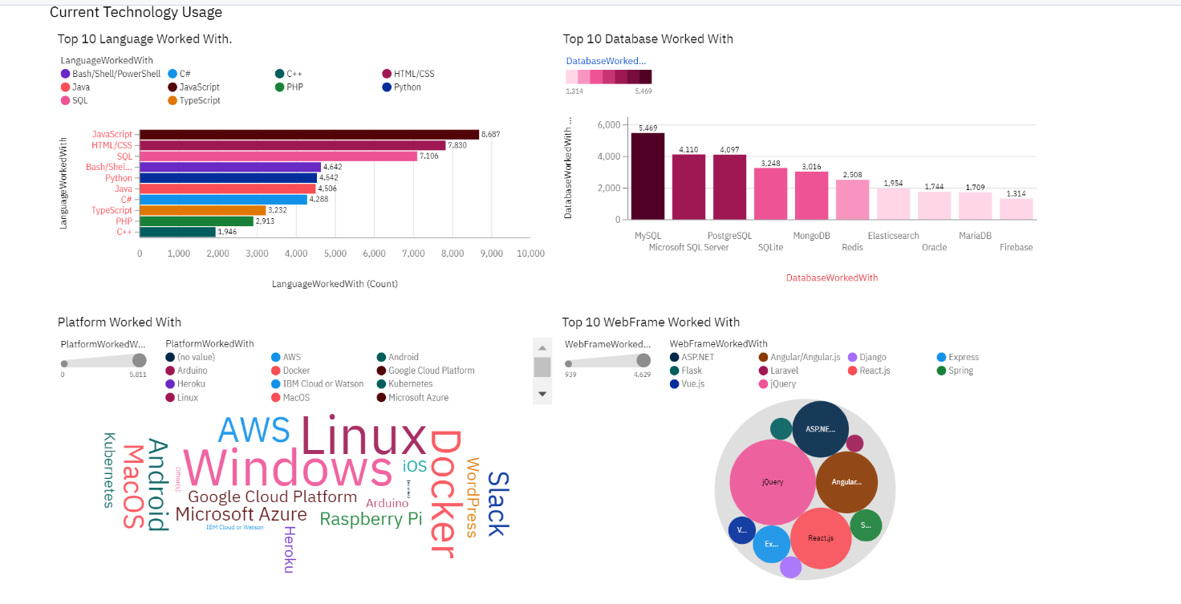
Current Technology Usage
Screenshot of dashboard tab 1 goes here

Slide 14
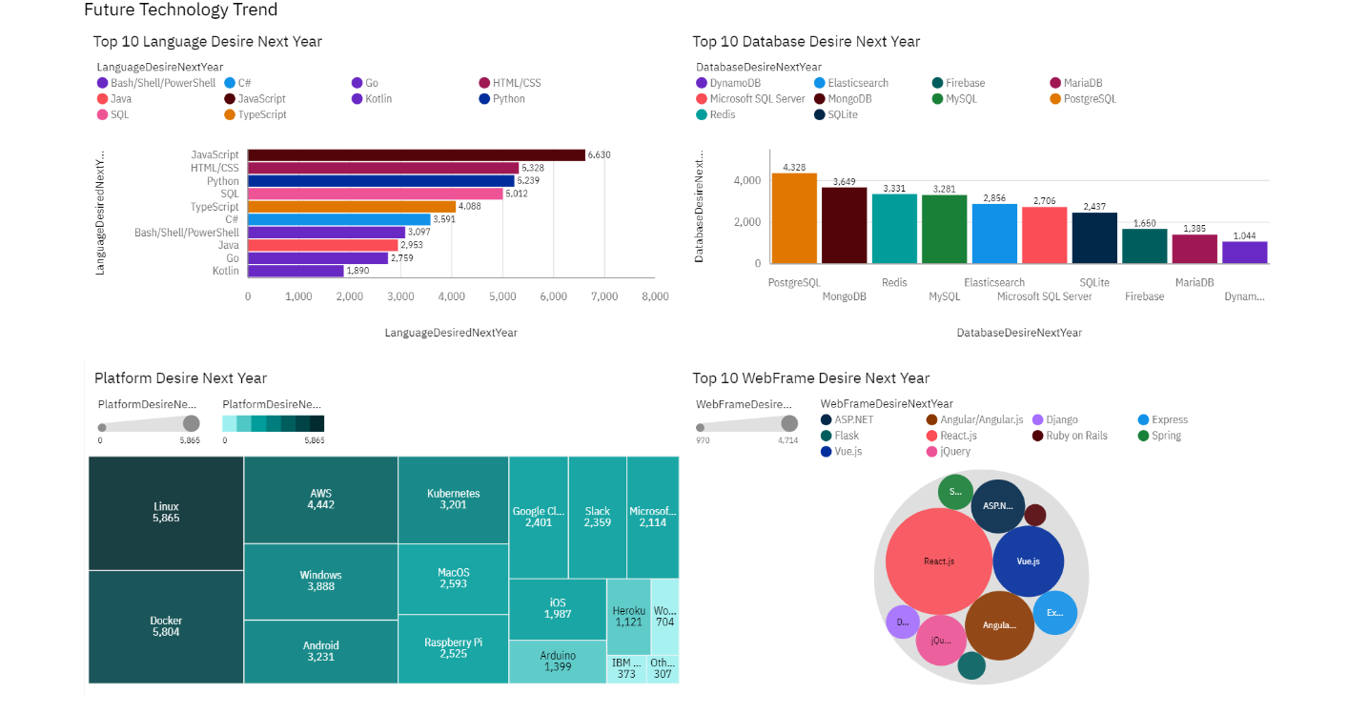
Future Technology Trend
Screenshot of dashboard tab 2 goes here

Slide 15
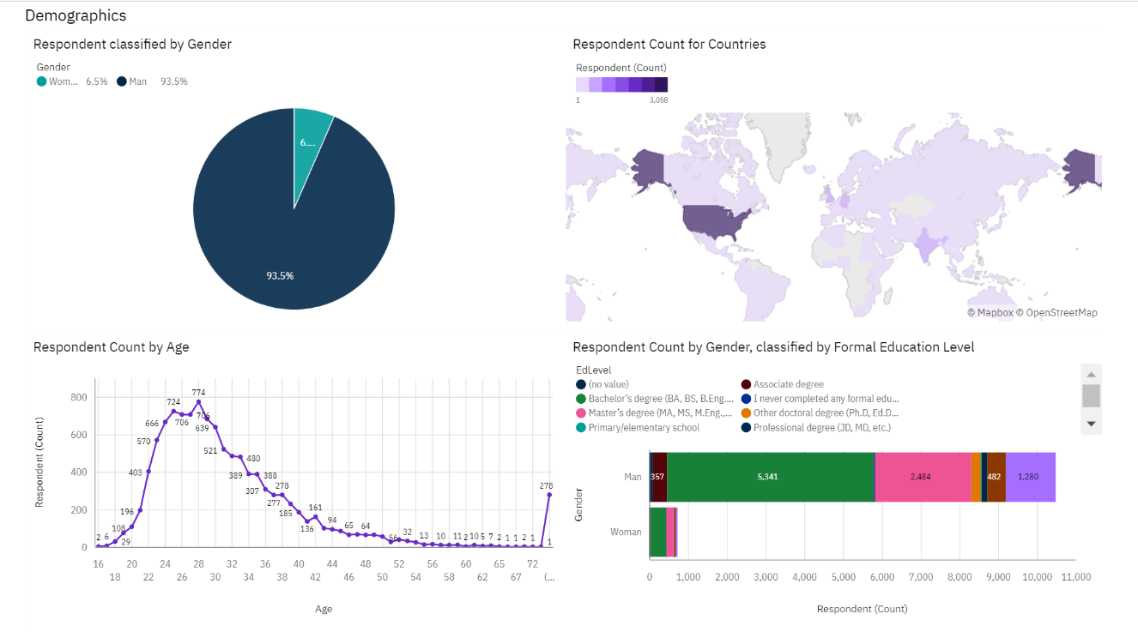
Demographics

Slide 16
DISCUSSION
Technology Usage trend Now and Future
New Technology constantly emerges leading to changes in demand
Gender, Age, and Education discrimination in IT industry

Slide 17
OVERALL FINDINGS & IMPLICATIONS
Findings
There are gender and age discrimination
Technology trends changes every year
Docker is the most popular platform
Implications
IT Industry and Programmers companies should always follow the latest technology trends
Countries should have the equal chance to be exposed to new technology
Gender and Age should not be one of the concerns or benefits of Employment

Slide 18

CONCLUSION
Technology Trend for current and Next year
Programming Languages, Database, Platform and Web frame Trends.
Demographic Overview
Gender and Education

Slide 19

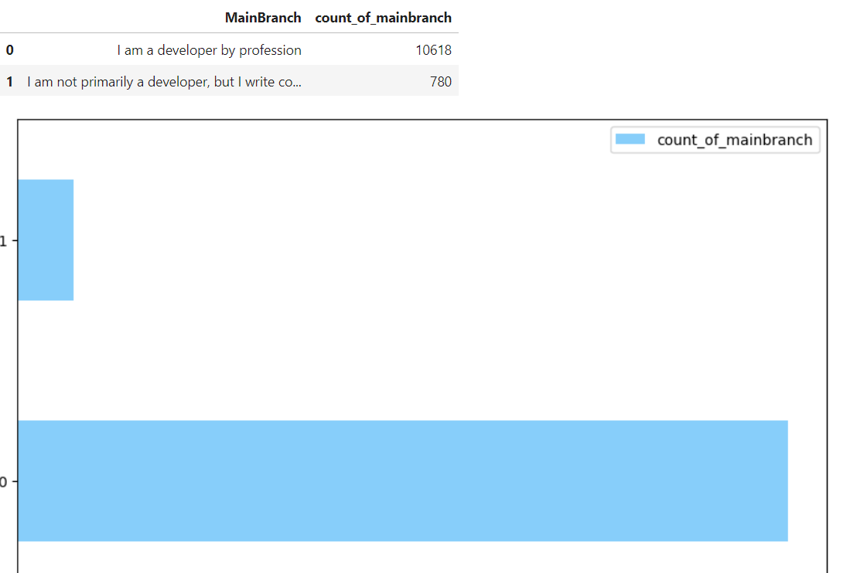
APPENDIX

Slide 20
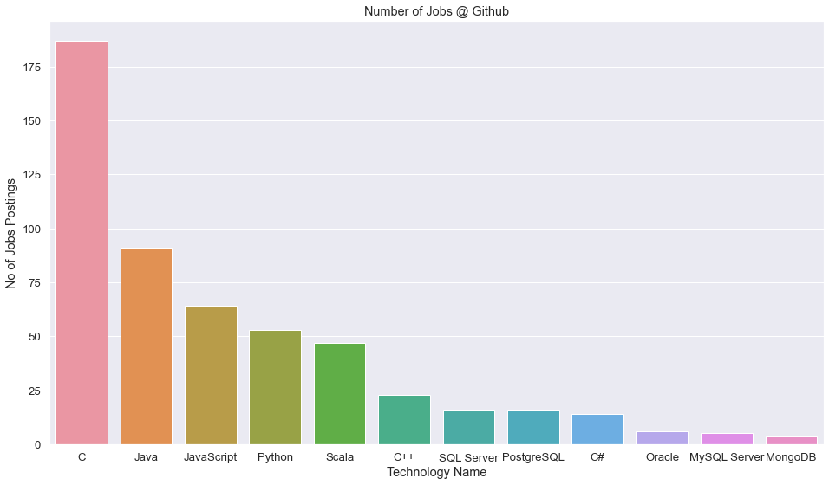
JOB POSTINGS

Slide 21
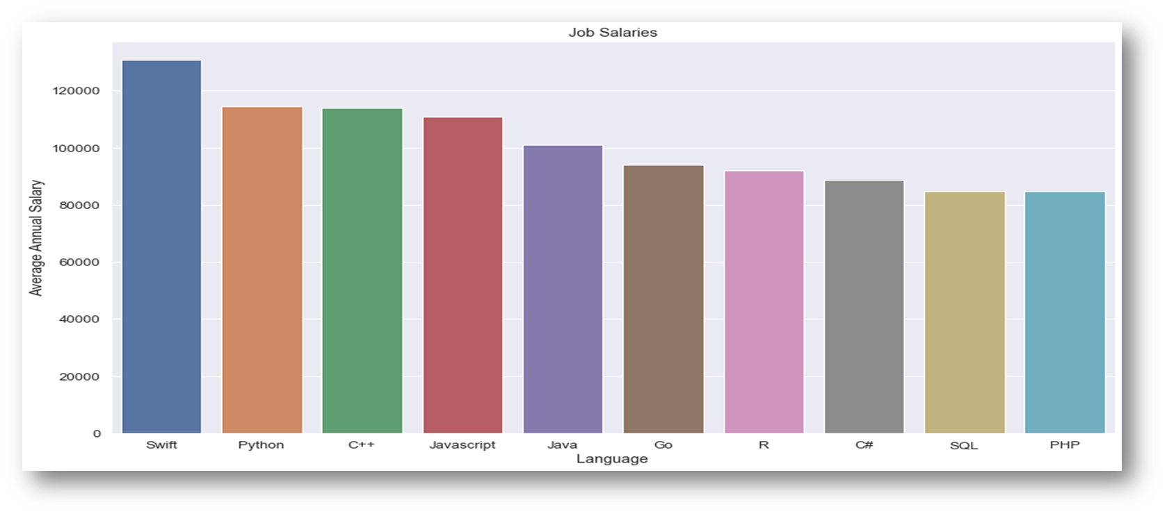
POPULAR LANGUAGES

