Slide 1
Chapter 2 -- PROBLEMFORMULATION
STATE
SPACE REPRESENTATION AND PRODUCTION SYSTEMS
DR. GOUTAM SARKER, CSE, NITDGP, SM IEEE
15
1/28/2021 3:54:44 PM
Dr. Goutam Sarker

Slide 2
STATE SPACE REPRESENTATION OF A PROBLEM
To represent a problem through State Space Representation, four basic problem components are listed as below:
Construction of a state space.
Identification of a set of initial states.
Identification of a set of goal states.
Identification of a set of rules.

Slide 3
A sample state space representation of a problem
A
Initial state
B
C
Intermediate states
D
E
F
G
H
I
The terminal nodes are all possible goal states

Slide 4
PRODUCTION
SYSTEMS
One alternative and most powerful methodology for problem representation is Production System.
Four basic components of any Production System
are:
At least one Knowledge Base.
A set of Rules of implication.
A Control Strategy to mobilize the search to goal(s)
A Mechanism to physically apply those rules of implication.

Slide 5
Production systems contd..
One simplest example of problem is:
Production System for a given
A → B | E B → C | F C → D | G E → H | I

Slide 6
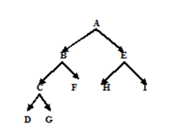
Equivalent State space representation

Slide 7
Production system components contd..
The production rules tell us what are the valid moves from one state to another to land to the goal state(s) from the initial states via intermediate states.
The knowledge base(s) contains the set of facts and
rules to be used to go about the solution.
The Control Strategy has to create motion.
The physical application of the control strategy is performed with the help of Rule Applier.

Slide 8
There are two basic features of any control strategy:
Control Strategy has to create Local Motion.
Control Strategy has to create Global Motion.
Local Motion implies the motion created by the control strategy over the course of a single step.
Global Motion created by control strategy creates motion over several steps

Slide 9
It may also happen that a few local motions are so bad to create backward motion so that the same control strategy cannot be called globally efficient.
Thus we are able to conclude that in any search technique, a good control strategy has to create both Local and Global Motion.

Slide 10
Here presently we are starting with two very basic and fundamental control strategies used in any search process. They are:
Depth First Search (DFS)
Breadth First Search (BFS)

Slide 11
Depth First Search (DFS): The specificity about this kind of search strategy is that during searching, depth has to get more preference than breadth.
Breadth First Search (BFS): The specialty about this kind of search process is that in a particular state we apply sequentially (or in parallel if the system supports parallelism) all the applicable rules and the process is continued until the goal state(s) are reached.

Slide 12
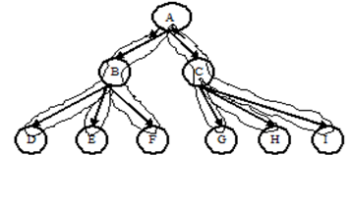
The path of a Depth First Search

Slide 13
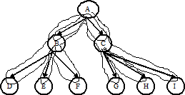
The path of a Breadth First Search

Slide 14
Unguided vs. Guided searches
These types of searches are called uninformed or unguided searches or routine searches because of the obvious reason that during the search process there is no guidance provided to the search engine or control strategy.
There is another kind of search for which some information or guidance is provided regarding in which portion of the state space the solution is situated, so that the search may directly concentrate on that portion and gets converged onto it without wandering off in the irrelevant directions.

Slide 15
The tree of different Search Strategies:

Slide 16
A few more routine searches beyond DFS and BFS
Depth First Iterative Deepening Search
Bidirectional Search.
Limited Horizon Search.

Slide 17
Depth First Iterative Deepening Search
This is a special kind of DFS where, in all iterations, depth is increased in a step of unity from the previous depth starting from a depth of unity and with that depth in the iteration the DFS technique is applied.
So over here, the disadvantages of ordinary DFS it totally removed.

Slide 18

Moves for Depth First Iterative Deepening Search
A
B
C
D
E
F
G
H
I

Slide 19
Advantages of DFIDS
Since it expands all nodes at a given depth before expanding nodes at a greater depth, it is guaranteed to find a shortest path solution.
Over and above it will never fall into a blind ally like ordinary DFS.

Slide 20
Disadvantage of DFIDS
It performs useless or wasted computations before reaching the desired depth where the goal is situated. This is due to the fact that the same nodes are explored more than one time where the desired goal is not obtained in a particular depth.

Slide 21
BFS vs. DFIDS
Suppose the depth of the state space representation is denoted by „d‟. In the worst case the number of nodes explored by BFS is having maximum, and that maximum value is:
N = 1 + b + b ² + b ³ + b ⁴ + … … … … … + b ^{d}
= (b - 1 ) / ( b – 1 )
d+1

Slide 22












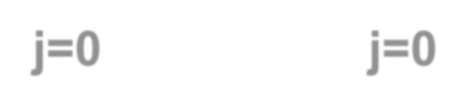








So the total number of nodes expanded by Depth First Iterative Deepening Search for the problem of depth „d‟ for a complete tree is :
 | d |  |  | d
= | Σ | N | = | Σ | ( b
^{N} id
j+1
- 1 ) / ( b – 1 )
j=0
j=0
= [ ( b
d+2
- 2b - bd + d +1 ) / ( b – 1 )
2

Slide 23
This number is exponentially large for a substantially large value of depth „d‟ and breadth „b‟ of the state space representation of the problem.

Slide 24
Bidirectional Search
Here the search process proceeds in both forward and backward direction simultaneously or in parallel.
If the problem is such that the equivalent state space representation is too huge and bushy then Bi directional Search is more efficient than the Unidirectional Searches.

Slide 25
A worst case Bi directional search

Slide 26
Drawback of Bi directional Search
It might so happen that two searches cross each other without meeting at a point. So although there is a solution, it could not be detected.

Slide 27
Limited Horizon Search:
The entire search is terminated finding the exact goal (s), if the
without search
engine is unable to find the goal or solution within a finite time interval. Then the inexact goals are only considered.

Slide 28
Why Limited Horizon Search?
If the search mechanism is integrated to a real time system, which has to produce output within a fixed or minimum time interval this Limited Horizon Search is applied.
In some problems it is computationally too much expensive and/or time consuming and thereby infeasible to apply any unguided or routine search to find the path for the goal.

Slide 29
Applications of Limited Horizon Search
„Limited Horizon Search‟ may be efficiently applied by a DFS process for a depth „d‟.
Similarly it can be applied to other routine searches like, BFS, Depth First Iterative Deepening Search also.

Slide 30
End of Chapter - 2

