Slide 1
citibike_analysis
File created on: 1/15/20 9:29:21 PM PST

Slide 2
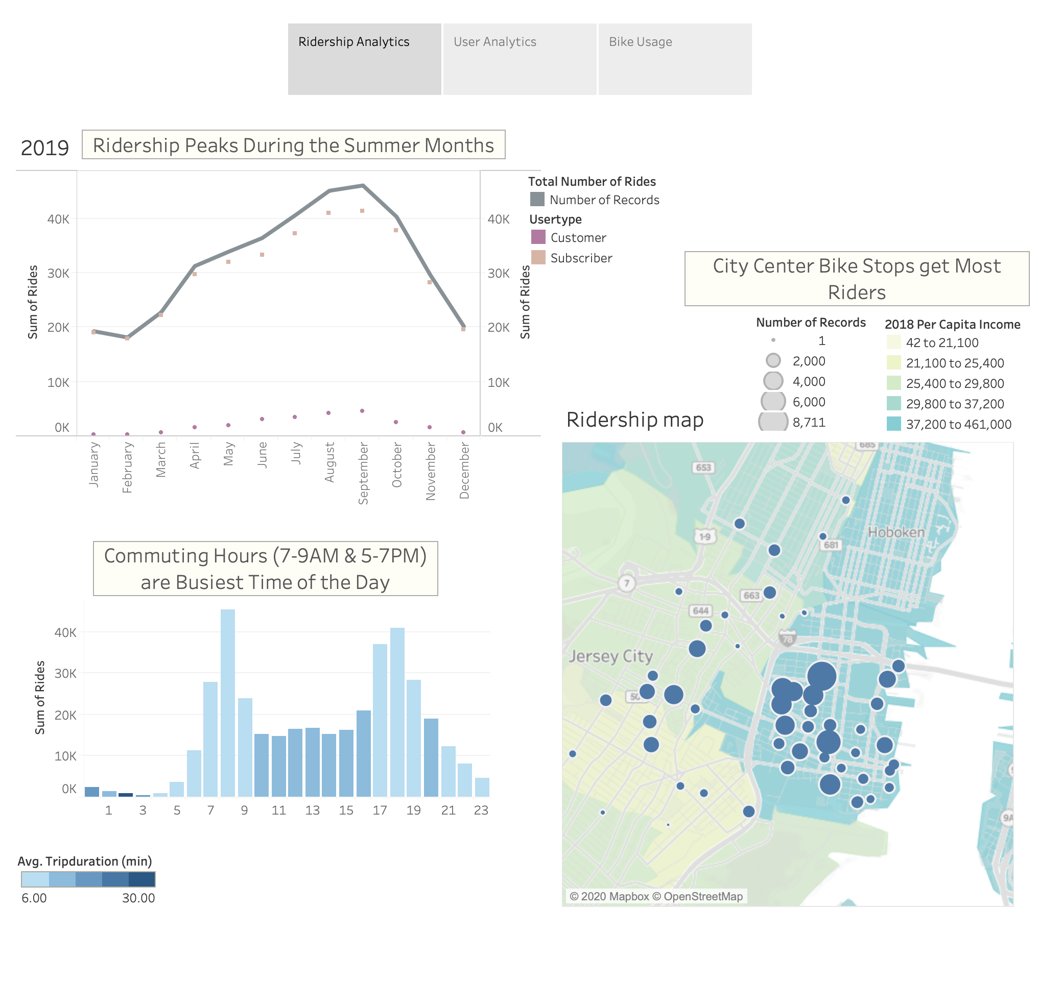

Slide 3
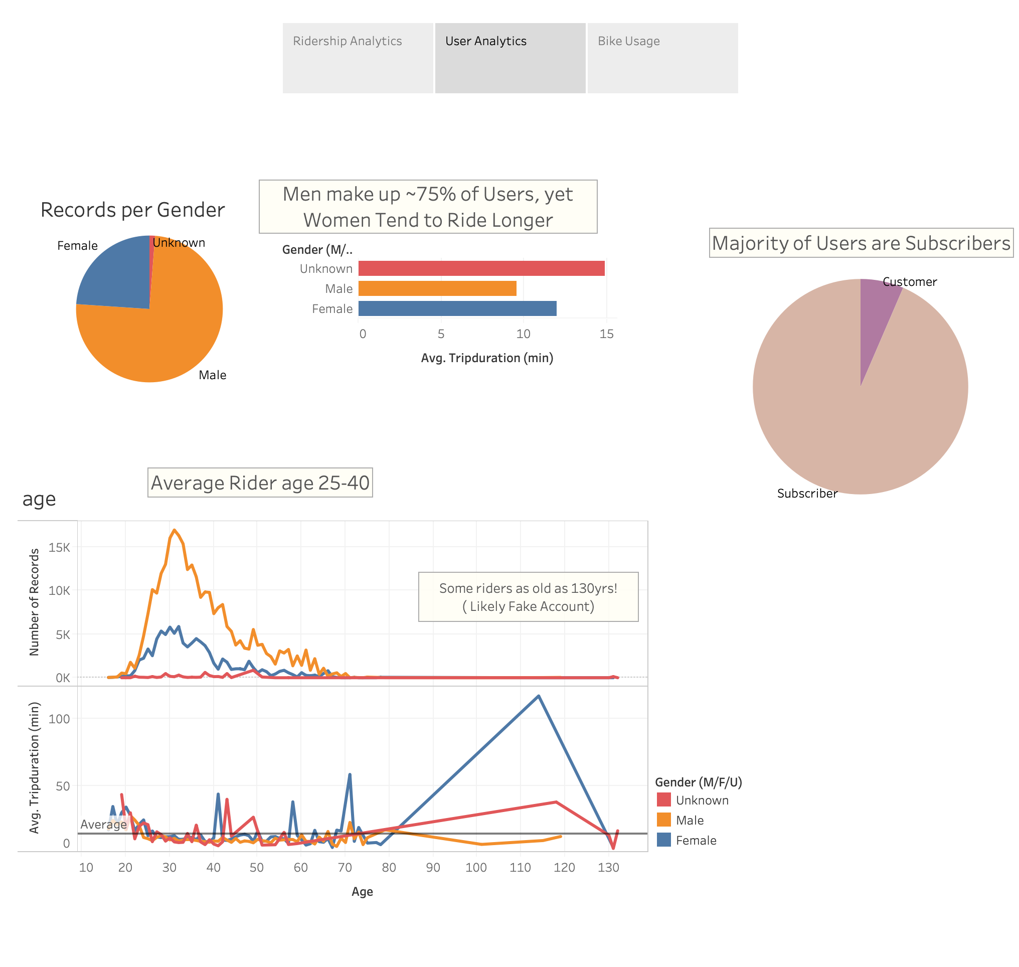

Slide 4
