Slide 1

DriverPass System Analysis
Romi’on Price

Slide 2

System Requirements
Functional Requirements
Users should be able to login securely, select from the three packages if it’s a new user, have access to course material, and make appointments or modify them.
IT will be able to adapt system to DMV compliance via DMV updates, remove permissions, and reset passwords
Non-Functional Requirements
DriverPass will be available on Mac, Windows, Linux, and mobile
If accessed on mobile should be able to resize and fit to screen accordingly
Notes:
Users can login securely to view course material, make appointments, modify or cancel appointments. Ensures that there is no unwanted access to DriverPass and keeps users' information secure. IT makes sure course material is DMV compliant, especially if a new DMW update notification is sent out. This makes sure that coursework and exams are compliant with DMV standards.
DriverPass will be available to Mac, Window, Linux, and mobile. This allows for users on different OS to be able to access DriverPass system. If DriverPass is accessed on mobile, interface should be able to fit screen accordingly. This will make sure system is clearly displayed and is easily accessed by trusted users.

Slide 3
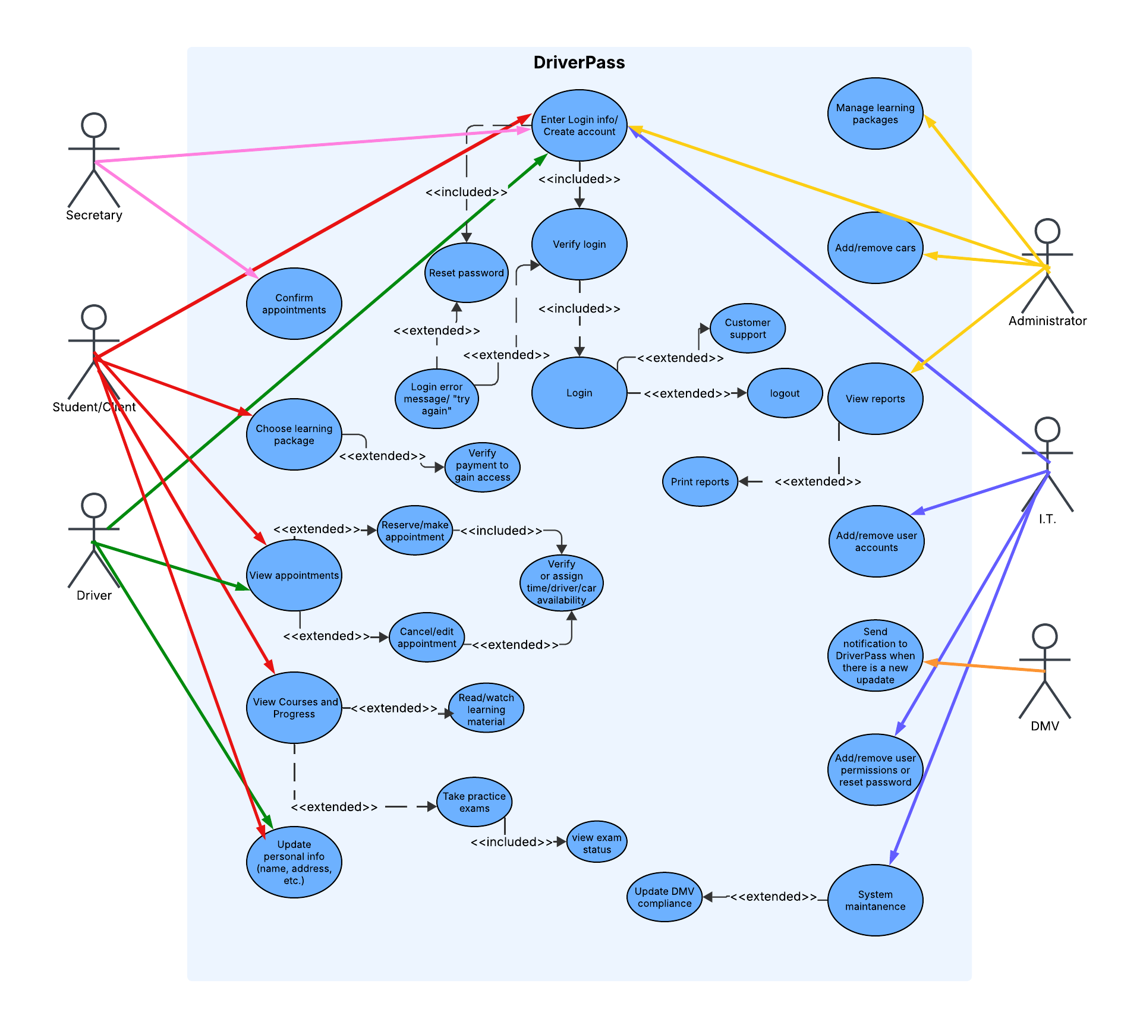
Use Case Diagram
Notes:
The different people in this system are the Secretary, Student/client, Driver, Administrators, I.T. and the DMV. The scenarios being confirming appointments, choosing learning package, viewing appointments, viewing progress, updating personal info, Managing packages, add/remove cars, view reports, add/remove accounts, compliance notification from DMV, add/remove user permissions, and system maintenance. Each one tied to the it’s respective actor. Making sure each employee or clients logins are secured through login verification, making sure payments are also verified as well so student can access bought learning package and schedule appointments. Employee’s have different levels of permissions depending on role within DriverPass.

Slide 4
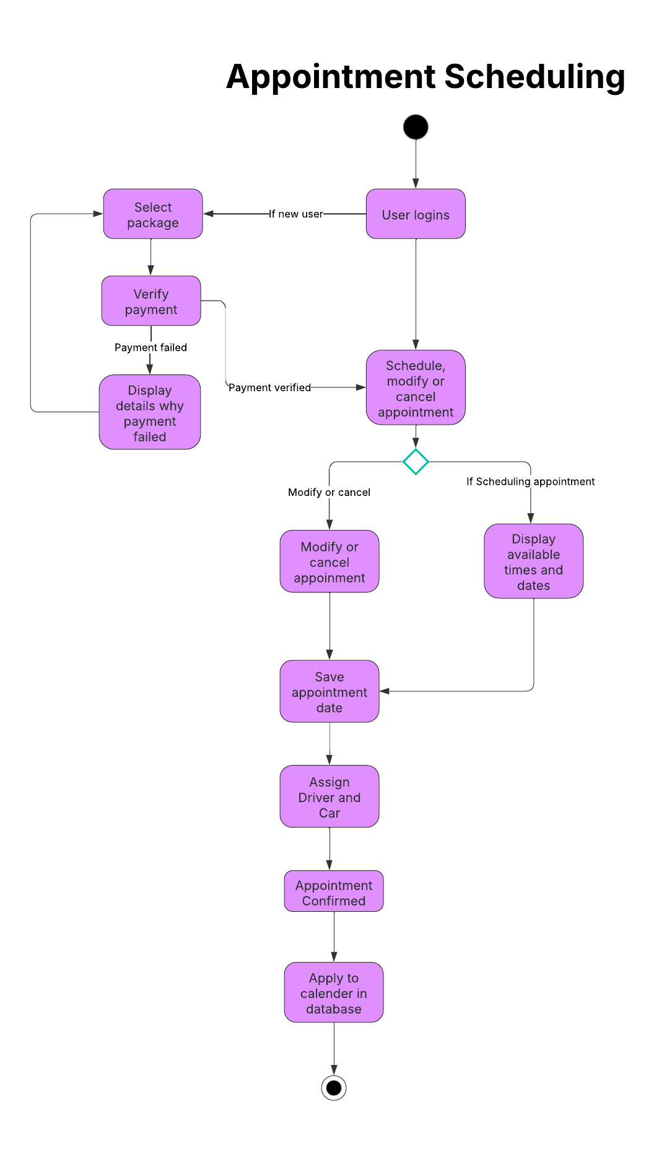
Activity Diagram
Notes:
In this diagram, I’m breaking down the scenario of appointment scheduling. To start, the user logins to Driverpass and if the user prompted to select the package they want I, if they are a new user. The payment is verified and is looped back to selecting package if payment details failed. Once the user’s payment is verified or they signed in to driver pass, they can schedule, modify, or cancel appointment. They can then save their appointment date and get a Driver and car assigned to them. The appointment gets confirmed is added to calendar in database. Payment verification makes sure the client has purchased their package to access DriverPass and its coursework. This ensures only authorized people can access Driverpass contents or schedule an appointment.

Slide 5
Security
Secure login for users and case sensitive credential input.
Account locks if attempts is greater than allotted tries
Secure payment verification and client payment information
If password is forgotten, request should be verified with IT
HTTP secure system to ensure data exchange is secure.
Admin should be alterted with any brute force hacking attempts
Permissions removed if no longer employee or if user permissions are made unavailable.
Notes:
I ensured security is implemented into my design by first starting with Secure logins into DriverPass and case sensitive credential input. If the attempts to login to DriverPass is greater than allotted tires, accounts temporarily locks. Secure payment verification is essential, as well as client payment information. Ensuring data isn’t altered and is kept secure, using a secure system would make sure data communication is secure as well. Any hacking and brute force attempts will be alerted to Administrators in real time. Only authorized users can access DriverPass and permissions can be revoked if the user is no longer authorized.

Slide 6
System Limitations
Cloud based system that requires internet access.
Study material and exams should be DMV compliant
Owner has 10 cars currently
Unknown budget and constrained technical staffing limit
Offline data cannot be updated in offline mode.
Notes:
Internet access is for accessing DriverPass. The material and exams are DMV compliant and will be updated when DMV updates DriverPass. The DriverPass system currently has 10 cars only, limiting how much clients are helped and the availability of the cars. Currrent budget is unknown and the amount of staffing is limited due to budget. Although documents can be downloaded for offline viewing, offline data cannot be updated in offline mode.

