Slide 1
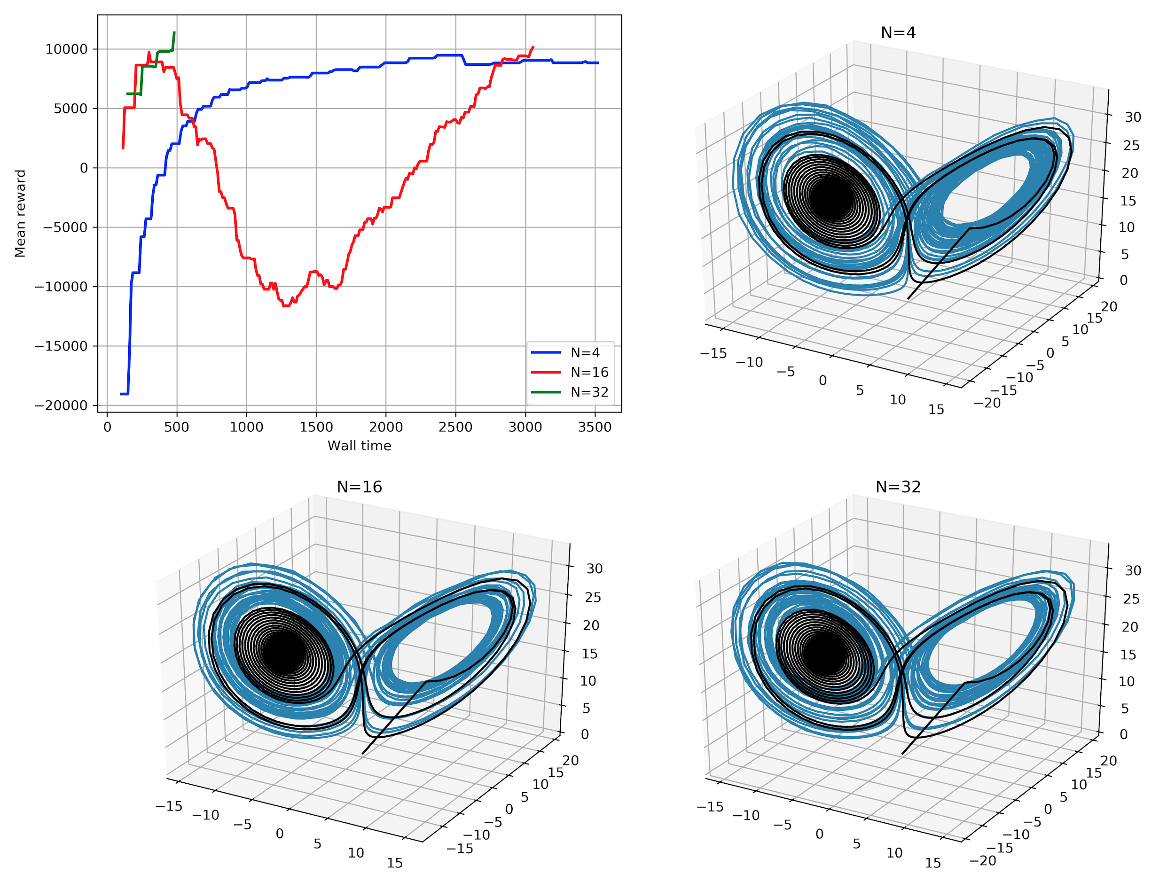


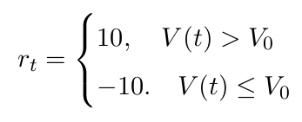
Lorenz system
Control policy :
Reward :
# ranks | # of time steps | # of episodes | Mean reward
4 | 370000 | 91 | 8820
16 | 1290000 | 321 | 10124
32 | 512000 | 117 | 11354

