Slide 1

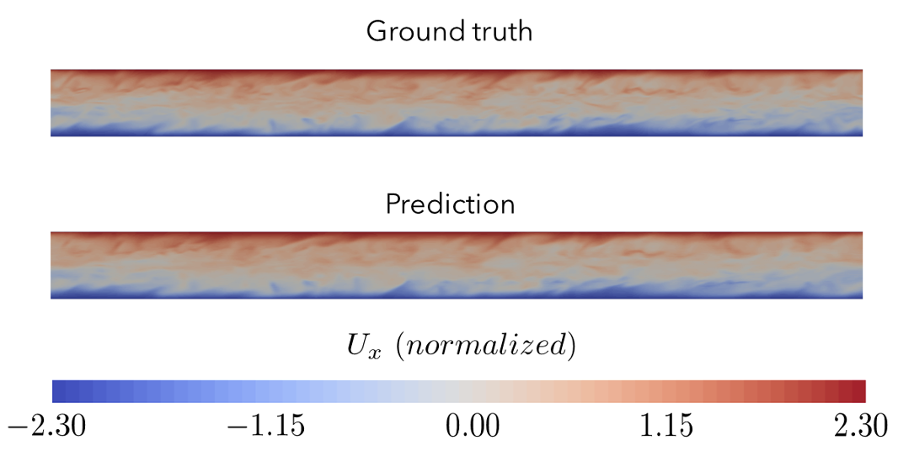
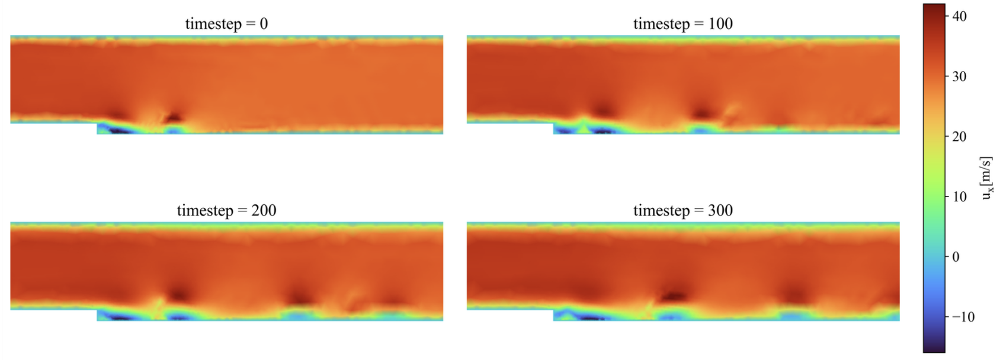
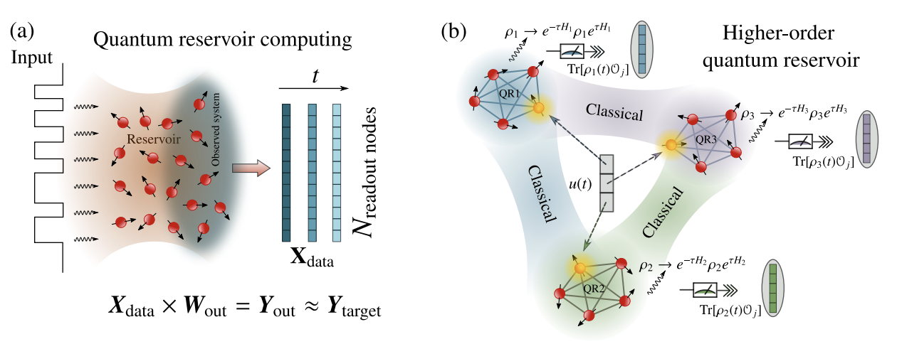
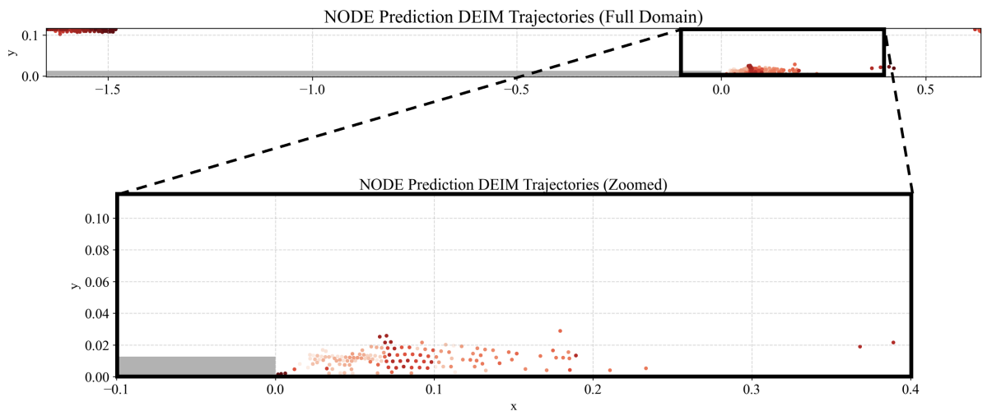
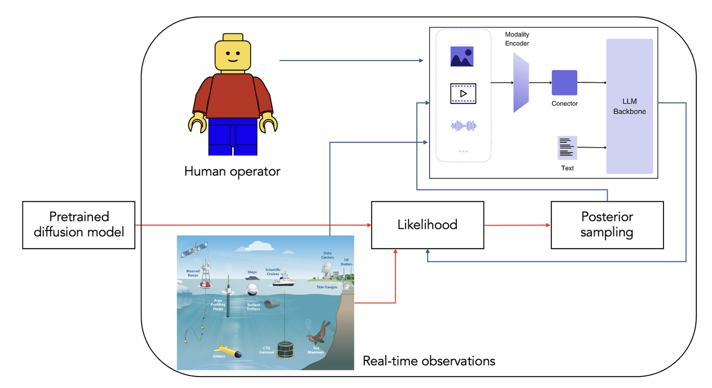
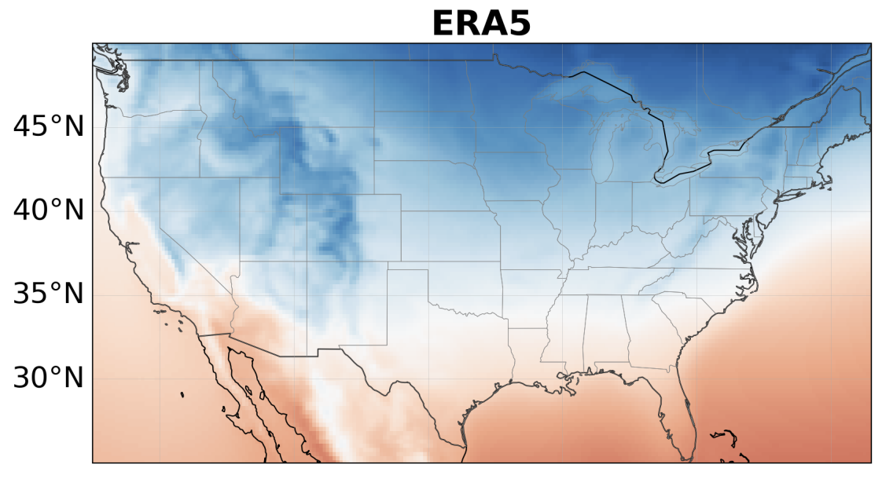
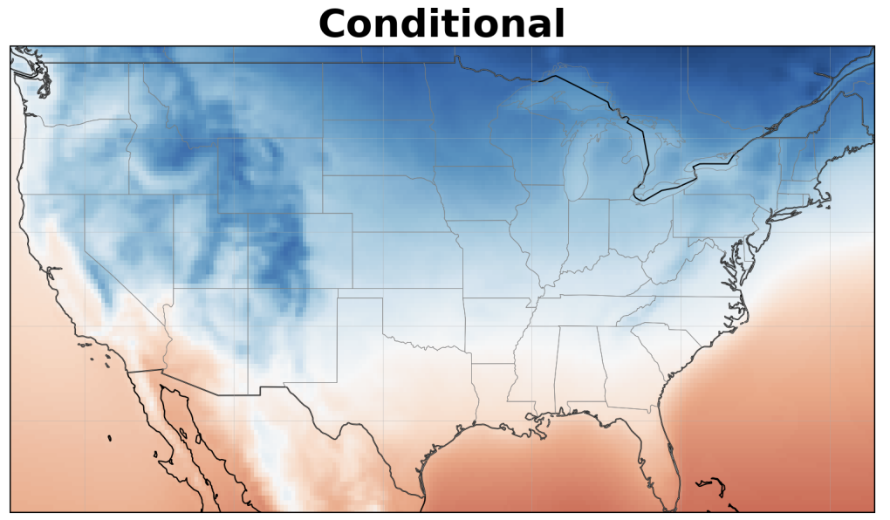









The Interdisciplinary Scientific Computing Laboratory PI – Romit Maulik
Vision: To unite data science, artificial intelligence, quantum, and classical scientific computing techniques for accelerated scientific discovery.
Mission: Developing physics-informed, multimodal data-driven machine learning algorithms that improve the predictability of complex systems. Leveraging quantum-inspired computing paradigms to accelerate classical simulation workflows.
Physics-informed artificial intelligence
for rapid predictions
Solving challenging optimization problems accurately and efficiently
Developing novel paradigms in scientific computing
We develop algorithms that dramatically accelerate the simulation of complex physical systems encountered in engineering, Earth sciences, nuclear fusion and fission. For example, we build surrogate models for rapid forecasting of near-wall turbulent flows encountered in hypersonic flight, and rapidly predict the Earth’s atmosphere using deep learning models
Many optimization problems are not amenable to gradient-based techniques. We develop algorithms for such applications using dynamical systems theory, computational statistics, and deep generative machine learning. For example, we can compute sensitivities of long-time averages of chaotic dynamical systems – addressing a historical challenge in controlling energetic fluid systems.
While grand-challenge applications drive significant algorithm development in ISCL, we also perform fundamental research in novel paradigms for computing. Examples include quantum-inspired methods for optimization and for simulating partial differential equations, and open-source low-cost agentic AI geared towards resource-limited environments
Predicting the boundary layer of a turbulent hypersonic flow at Mach 5 given far off-wall velocities (top),
and predicting a finely resolved near-surface temperature over CONUS given information from a coarse weather model (bottom). Both approaches were trained using conditional diffusion models with deep learning backbones.
Optimal sensor placement for state-reconstruction of a turbulent unsteady flow over a backwards facing step. Sensors are dynamically adapted based on vortical structures, while guided by information content obtained from surrogate model sensitivities.
Quantum reservoir computers can be used for efficient approximations of dynamical systems (top, figure from Tran and Nakajima, 2020). Agentic workflows built on open-source, quantized, vision language models can be used for automation and decision making without access to the internet or substantial hardware (bottom).
Kim, Hojin, et al. "Multiscale Hypersonic Boundary Layer Reconstruction via Spectral Binning and Subdomain-wise Conditional Diffusion." arXiv preprint arXiv:2606.15023 (2026).
Guan, Haiwen, et al. "High‐resolution downscaling of a lightweight climate emulator using diffusion‐based super‐resolution." Journal of Geophysical Research: Machine Learning and Computation 3.5 (2026): e2026JH001290.
Kim, Hojin, and Romit Maulik. "Interpretable Diagnostics and Adaptive Data Assimilation for Neural ODEs via Discrete Empirical Interpolation." arXiv preprint arXiv:2510.21852 (2025).
Barwey, Shivam, Hojin Kim, and Romit Maulik. "Interpretable A-posteriori error indication for graph neural network surrogate models." Computer Methods in Applied Mechanics and Engineering 433 (2025): 117509.
Jain, Vinamr, and Romit Maulik. "Higher order quantum reservoir computing for non-intrusive reduced-order models." AIAA SCITECH 2026 Forum. 2026.
Team, Gemma, et al. "Gemma: Open models based on gemini research and technology." arXiv preprint arXiv:2403.08295 (2024).
Notes:
Research focus: generative models, inverse problems, and scientific data/model fusion.
Sources used in the poster:
https://arxiv.org/abs/2603.12635 (turbulent-flow diffusion posterior sampling; source figure: single_vs_multi.png)
https://arxiv.org/abs/2608.05103 (latent video flow-matching atmospheric assimilation; source figures: schematic_new.pdf, sr_fields.png, igra_fields.png)
https://arxiv.org/abs/2602.13416 (diffusion-based climate downscaling and LUCIE; reviewed as supporting context)
https://arxiv.org/abs/2609.29027 (heterogeneous atmospheric observation interfaces; source figure: figure2_observation_geometry_annual_polished.pdf)

