Slide 1
containers on theta and theta-gpu
An introduction
ALCF Computational performance workshop
May 4-6, 2021
Romit Maulik, Taylor Childers, Corey Adams
Datascience team
Argonne Leadership Computing Facility

Slide 2
Outline
Using singularity containers on Theta and Theta-GPU
Using Docker-hub to build containers and build them using Singularity on Theta (for running MPI apps).
Using pre-existing singularity images on Theta-GPU for deep learning workloads.
When in doubt – message us on the CPW portal.

Slide 3
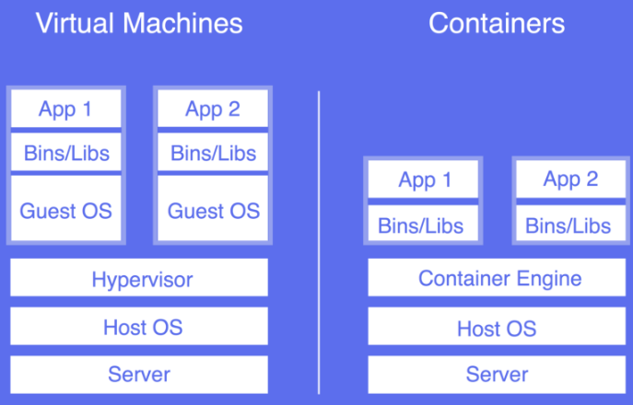
Containers
Lightweight alternatives to virtual machines and increasingly popular for cloud applications. Examples: Docker, Singularity, Rocket etc.
Singularity is our container of choice for security reasons.
However, Docker is the most widely used container platform.

Slide 4
Dockerfiles and Docker-hub
Option 1: Build a docker image on their local machine and upload to docker-hub (needs local installation of docker).
Option 2: Link Github and docker-hub and auto-build using Dockerfile. (does not need local installation but useful for testing anyway).
We’ll show you how docker and docker-hub can be used to port your docker containers to Theta and build Singularity images.
Due to time constraints – we cannot show you how to install docker on your local machine (but this is not very difficult):
Visit: https://docs.docker.com/engine/install/ and choose your OS.
Our results/demos today from docker version 20.10.6

Slide 5

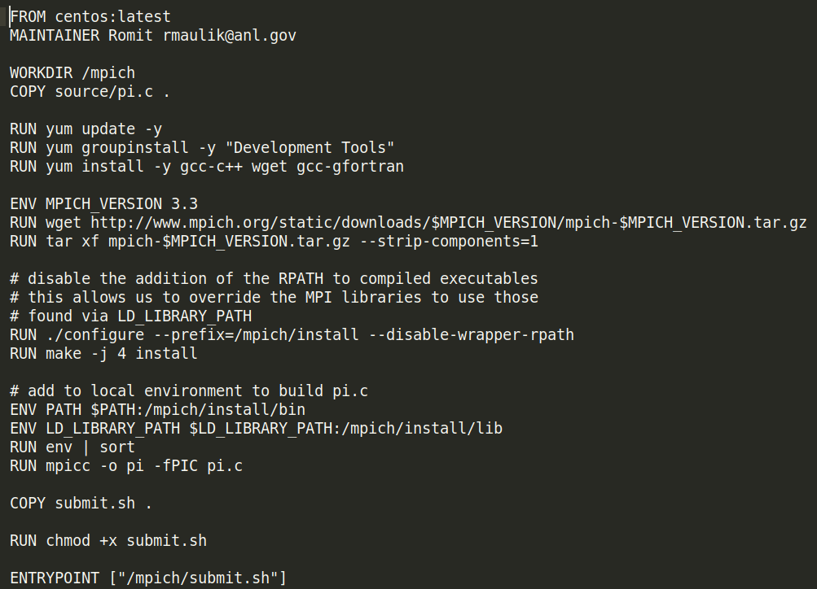
An example Dockerfile
Container OS
pulled from docker-hub repository
Working directory in container – copy source
Install appropriate packages for building app
Build your app
Specify script to run and copy from local

Slide 6
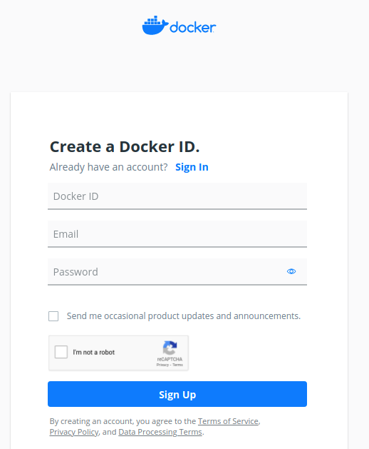
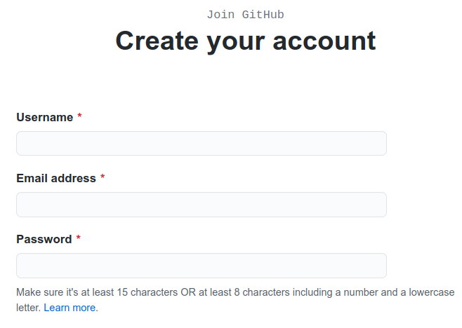
Linking Github and Docker-hub
Make sure you have both Github and Docker-hub accounts (sign up with email).

Slide 7
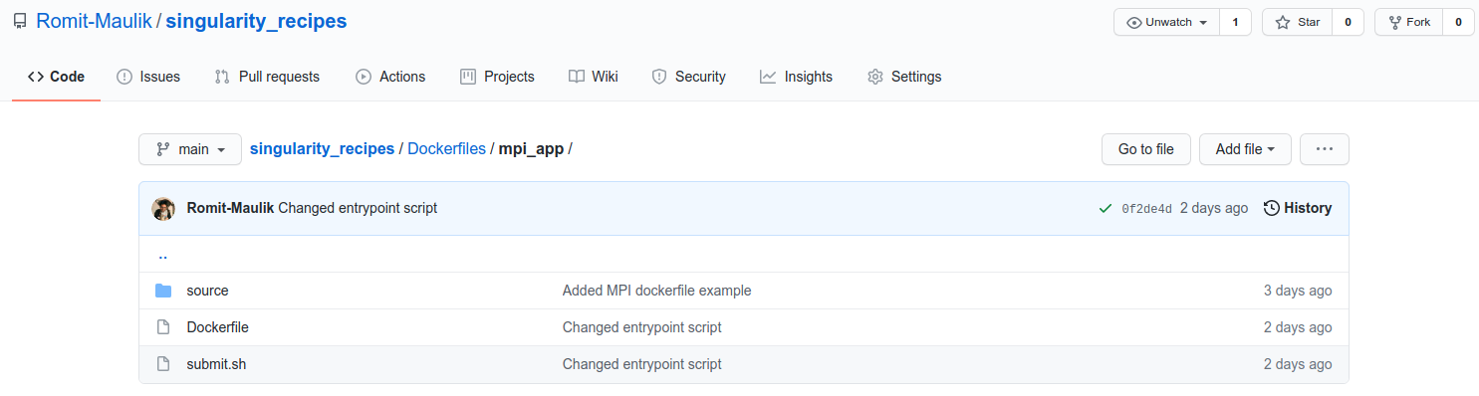
Linking Github and Docker-hub
Make sure you have both Github and Docker-hub accounts (sign up with email).
Push your Dockerfile to a github repository

Slide 8
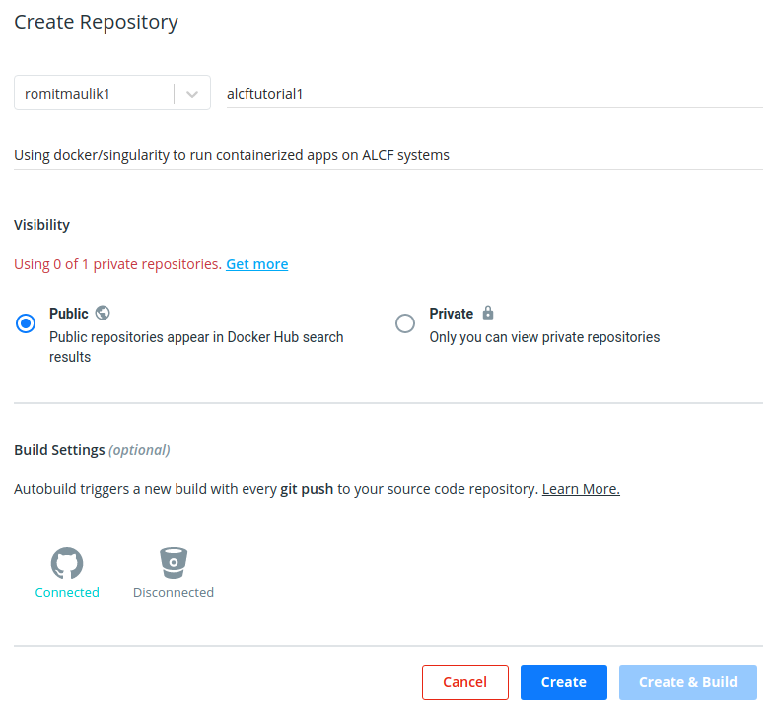
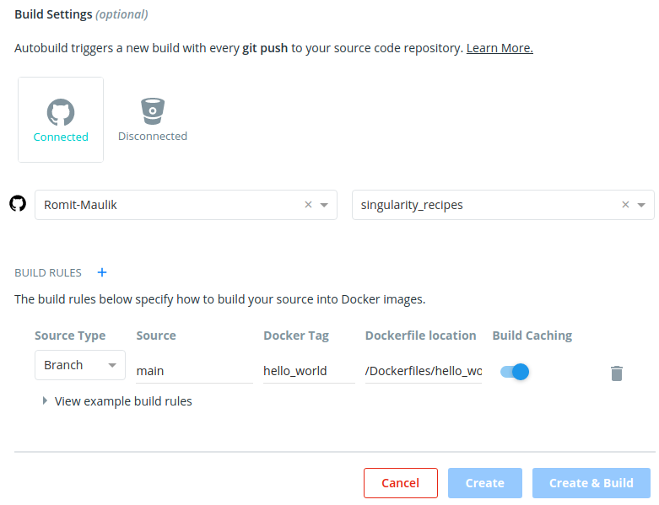
Linking Github and Docker-hub
Link that repository with a Docker-hub repository
This will be disconnected the first time
Specify branch, image name (tag), path to docker file in repo

Slide 9
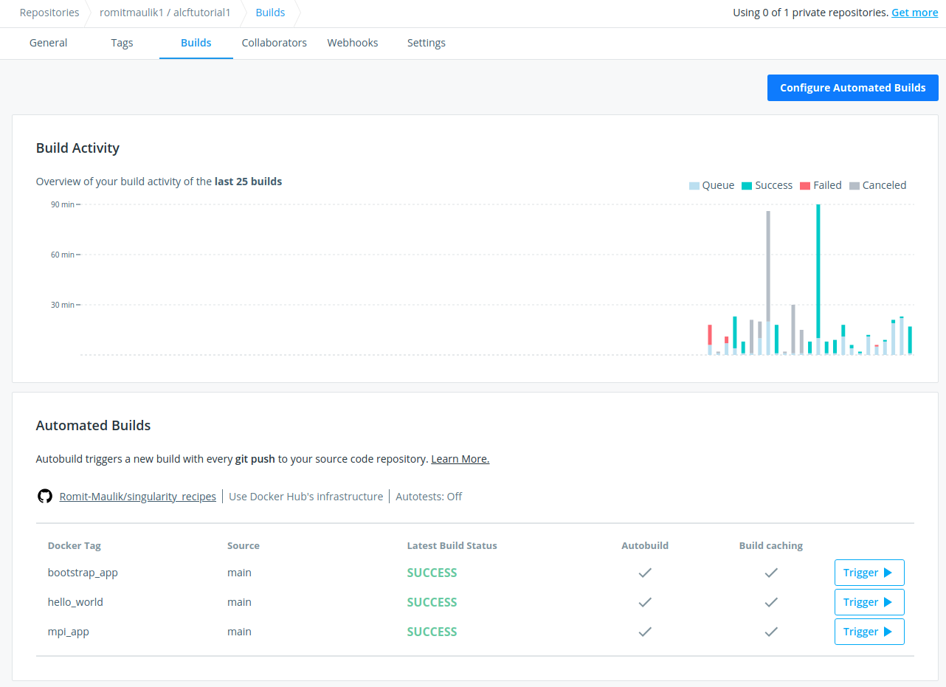
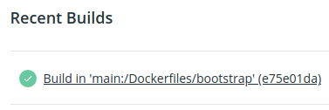
Linking Github and Docker-hub
Building on docker-hub is slow (when compared to your local machine) but once complete you should see something like this
Using “Configure Automated Builds” to edit build names (tags), paths etc.
Clicking on a recent build with give you logs (useful for debugging fails) and the docker file itself.

Slide 10
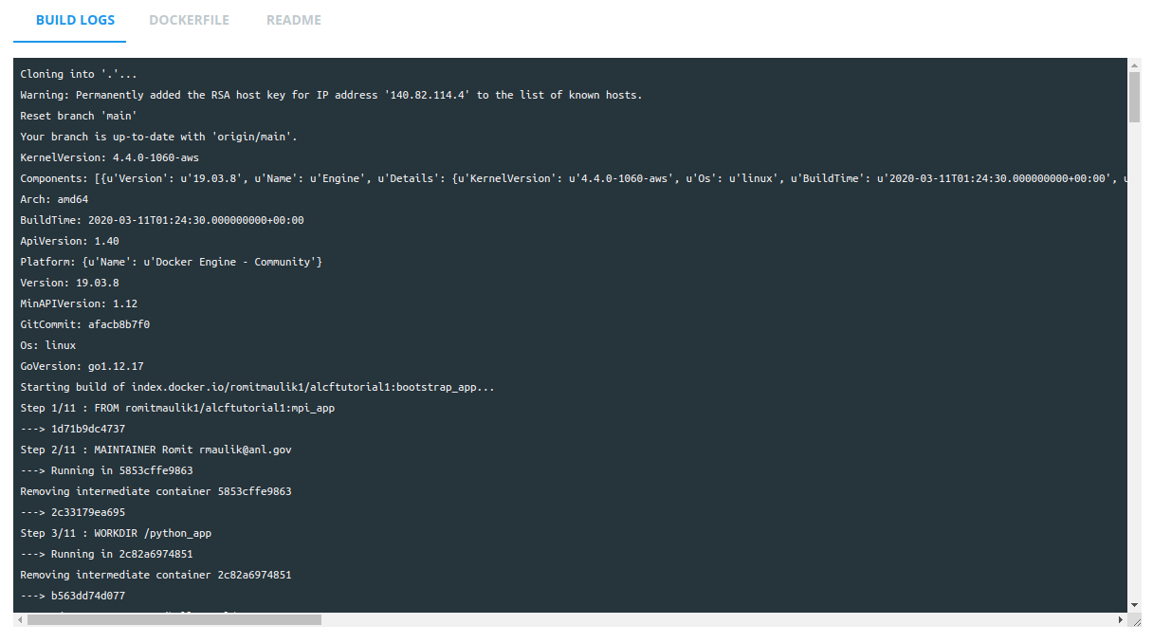
Linking Github and Docker-hub
Building on docker-hub is slow (when compared to your local machine) but once complete you should see something like this
Using “Configure Automated Builds” to edit build names (tags), paths etc.
Clicking on a recent build with give you logs (useful for debugging fails) and the docker file itself.

Slide 11
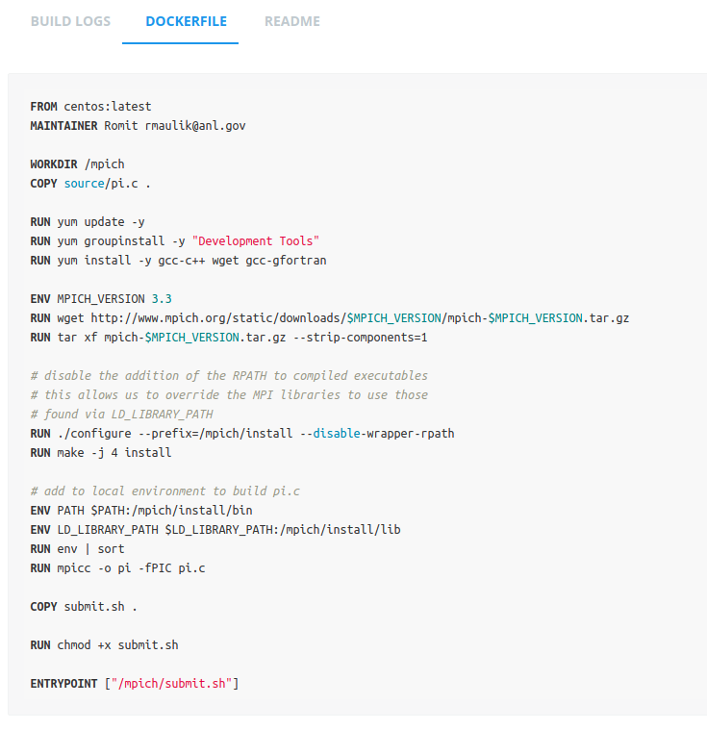
Linking Github and Docker-hub
Building on docker-hub is slow (when compared to your local machine) but once complete you should see something like this
Using “Configure Automated Builds” to edit build names (tags), paths etc.
Clicking on a recent build with give you logs (useful for debugging fails) and the docker file itself.

Slide 12
Pulling image to Theta
Once build is successful on Docker-hub – pull to Theta using singularity (version 3.6.4-1)
Command:
singularity build mpi_app.img docker://romitmaulik1/alcftutorial1:mpi_app
Explore the contents of your image with:
singularity shell mpi_app.img
You can find your source code, downloaded libraries, submit scripts in
ls /mpich/
Lets talk about running this MPI app on Theta next

