Slide 1
INDIVIDUAL PROJECT | BUAN 6342 Special Topics in Business Analytics
🛳️
RouteGuard AI
Agentic Supply Chain Disruption Analyzer
An AI-powered system that analyzes global shipping route risks using a 3-step LLM reasoning pipeline — delivering scored disruption reports and alternative routing strategies in under 60 seconds.
React 18
FastAPI
Meta Llama 3
Ollama
Python
Romit Jain | The University of Texas at Dallas

Slide 2
BUSINESS PROBLEM
Supply chain risk assessment is broken
⏱️
📊
🔁
⚠️
Slow
Inconsistent
Reactive
Error-Prone
2-4 hours per route assessment, done manually by analysts scanning news and port alerts
Different analysts reach different risk conclusions for the same route and shipment
Disruptions discovered after delays already occur, costing millions in penalties
Invalid cargo-transport combinations booked without awareness of IATA/IMDG regulations
Global supply chain disruptions cost businesses over $1.5 trillion annually | Source: McKinsey Global Institute

Slide 3
SOLUTION
RouteGuard AI — What It Delivers
🔍
Active Disruptions
📈
Risk Score
🗺️
Alternative Routes
Top 3 disruptions specific to the route geography
CRITICAL/HIGH/MEDIUM/LOW rating with 0-100 score
2 alternative strategies with cost and time tradeoffs
📋
Executive Summary
⚖️
Transport Validation
💬
Chat Follow-up
C-suite briefing with 3 immediate actions
30+ IATA/IMDG/IAEA rules block invalid cargo-mode combos
Ask follow-up questions with full analysis context

Slide 4
BUSINESS WORKFLOW
3-Step Agentic LLM Pipeline
📦
01
02
03
▶
User Input
Step 1
Step 2
Step 3
Origin, Destination
Mode, Cargo, Value
Disruption
Identification
Risk Scoring +
Alternatives
Executive
Summary
▶
▶
▶
LLM identifies top 3 active disruptions specific to the route geography in 2024-2025
LLM scores risk dimensions, computes on-time probability, and proposes 2 alternative routes
LLM synthesizes Steps 1 and 2 into a C-suite briefing with immediate actions
Why Agentic?
Each step is a separate LLM call with its own expert persona — a risk analyst, a scoring expert, and a VP-level briefer. The output of each step is passed as context to the next, creating a reasoning chain that no single prompt could achieve.

Slide 5
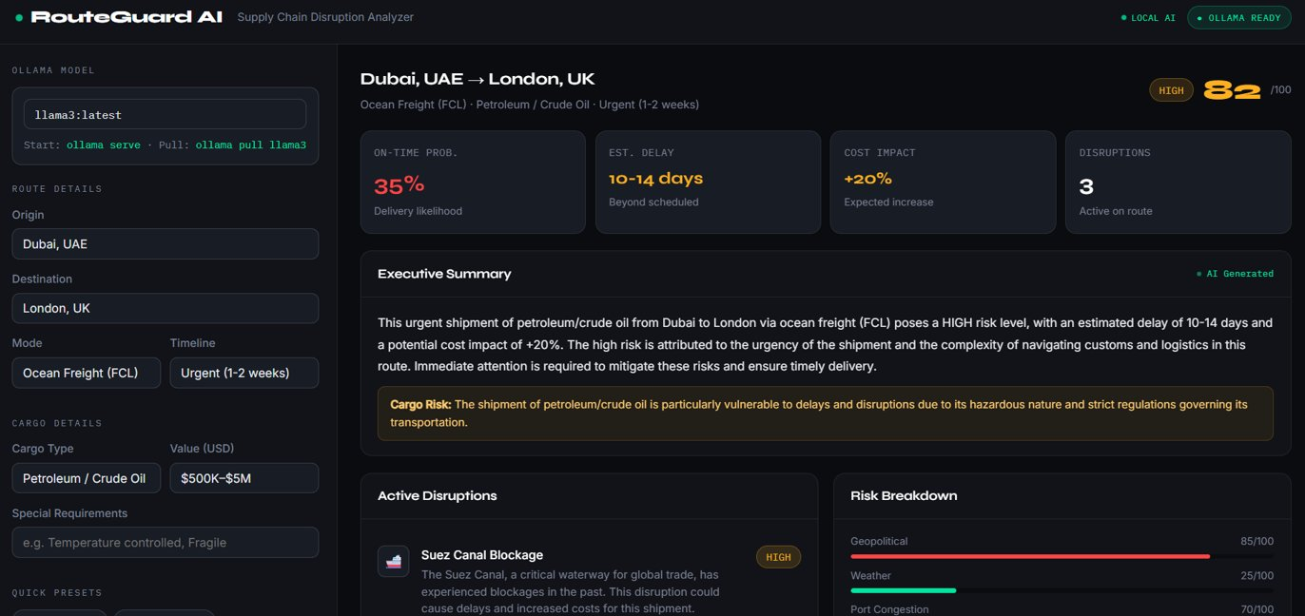
APPLICATION DEMO
Live Application — RouteGuard AI
🟢
Ollama Ready
Llama 3 running locally
⚡
3-Step Pipeline
Sequential LLM reasoning
🚨
Risk Score
0-100 with severity level
🗺️
Alt Routes
Cost and time tradeoffs
💬
Chat Q&A
Context-aware follow-ups

Slide 6
TECH STACK & IMPACT
Built for Real-World Supply Chain Teams
Layer | Technology
Frontend | React 18 + Vite
Backend | FastAPI (Python)
LLM Runtime | Ollama (Local)
LLM Model | Meta Llama 3
HTTP Client | Axios / httpx
60%
3
Reduction in manual
route assessment time
Sequential LLM calls
per analysis (agentic)
30+
23
Transport restriction
rules (IATA/IMDG/IAEA)
Cargo types across
7 industry categories
RouteGuard AI demonstrates how agentic LLM pipelines can solve real logistics intelligence problems, delivering in seconds what takes analysts hours, with built-in regulatory compliance and natural language follow-up.

