Slide 1
SEQUENTIAL HEALTH INTELLIGENCE
PatientWatch
Smart Healthcare Patient Deterioration
Monitoring & Early Warning System
A reproducible three-state Gaussian HMM prototype
180 artificial admissions · 8,640 observations · seed 42
SYNTHETIC DATA ONLY / EDUCATIONAL RESEARCH / NOT FOR CLINICAL USE
01

Slide 2
PATIENTWATCH · UNIT 4 / PROJECT 03
The problem & our objective
• Single vital signs do not describe a patient’s entire trajectory.
• Estimate evolving latent health states from repeated measurements.
• Expose uncertainty using filtering and retrospective smoothing.
• Evaluate research alerts honestly before discussing real-world use.
SYNTHETIC DATA ONLY / EDUCATIONAL RESEARCH / NOT FOR CLINICAL USE
02

Slide 3
PATIENTWATCH · UNIT 4 / PROJECT 03
A disclosed synthetic longitudinal cohort
• 180 independent admissions × 48 hourly readings; no real patient records.
• Five features: HR, SpO2, respiratory rate, systolic BP and temperature.
• Three-regime Markov simulator with Gaussian noise and patient offsets.
• 7.5% missing cells and occasional sensor corruption; generator included.
SYNTHETIC DATA ONLY / EDUCATIONAL RESEARCH / NOT FOR CLINICAL USE
03

Slide 4
PATIENTWATCH · UNIT 4 / PROJECT 03
The complete research workflow
• Dataset → range checks → per-patient forward fill → training median fallback.
• Chronological admission split: 108 train / 36 validation / 36 test.
• Training-fitted scaling → HMM EM → custom sequential inference.
• Frozen validation threshold → held-out metrics → interactive dashboard.
SYNTHETIC DATA ONLY / EDUCATIONAL RESEARCH / NOT FOR CLINICAL USE
04

Slide 5
PATIENTWATCH · UNIT 4 / PROJECT 03
Model: three-state Gaussian HMM
• Hidden states: Stable / Watch / Critical (interpretive labels, not diagnoses).
• Transition matrix captures persistence and change between hourly regimes.
• Diagonal Gaussian emissions connect hidden state to five observed vital signs.
• Baum–Welch maximum likelihood; best of three restarts by train likelihood.
SYNTHETIC DATA ONLY / EDUCATIONAL RESEARCH / NOT FOR CLINICAL USE
05

Slide 6
PATIENTWATCH · UNIT 4 / PROJECT 03
Core algorithms implemented ourselves
• Scaled Forward–Backward = chain sum-product with explicit scaling factors.
• Filter alpha uses only present/past observations; smoother gamma uses future.
• Log-domain Viterbi with backpointers gives a retrospective decoded path.
• Only causal filtered probabilities enter the early-warning score.
SYNTHETIC DATA ONLY / EDUCATIONAL RESEARCH / NOT FOR CLINICAL USE
06

Slide 7
PATIENTWATCH · UNIT 4 / PROJECT 03
How we validate implementation
• Exact enumeration on a tiny HMM verifies posteriors and likelihood.
• A 10,000-step test checks numerical stability.
• Future-perturbation tests verify causal prefix invariance.
• Reference posterior max error: 5.55e-16; Viterbi matches hmmlearn.
SYNTHETIC DATA ONLY / EDUCATIONAL RESEARCH / NOT FOR CLINICAL USE
07

Slide 8
PATIENTWATCH · UNIT 4 / PROJECT 03
Define the alert before evaluating it
• Synthetic onset = first pair of consecutive critical-regime hours.
• Score = six-hour learned-critical reachability from filtered state probabilities.
• Censor unknown negative outcomes; exclude all post-onset windows.
• Choose threshold on validation only; event lead time requires an alert within 6h.
SYNTHETIC DATA ONLY / EDUCATIONAL RESEARCH / NOT FOR CLINICAL USE
08

Slide 9
PATIENTWATCH · UNIT 4 / PROJECT 03
Held-out results: useful, but not clinical evidence
0.792
72.2%
84.3%
5.5h
AUROC
Window sensitivity
Window specificity
Median event lead time
95% patient-bootstrap AUROC CI: 0.708–0.875
Detected 12/12 events, but alerted 14/24 non-event patients.
Current-vitals logistic baseline AUROC: 0.786; no significant advantage claimed.
SYNTHETIC DATA ONLY / EDUCATIONAL RESEARCH / NOT FOR CLINICAL USE
09

Slide 10
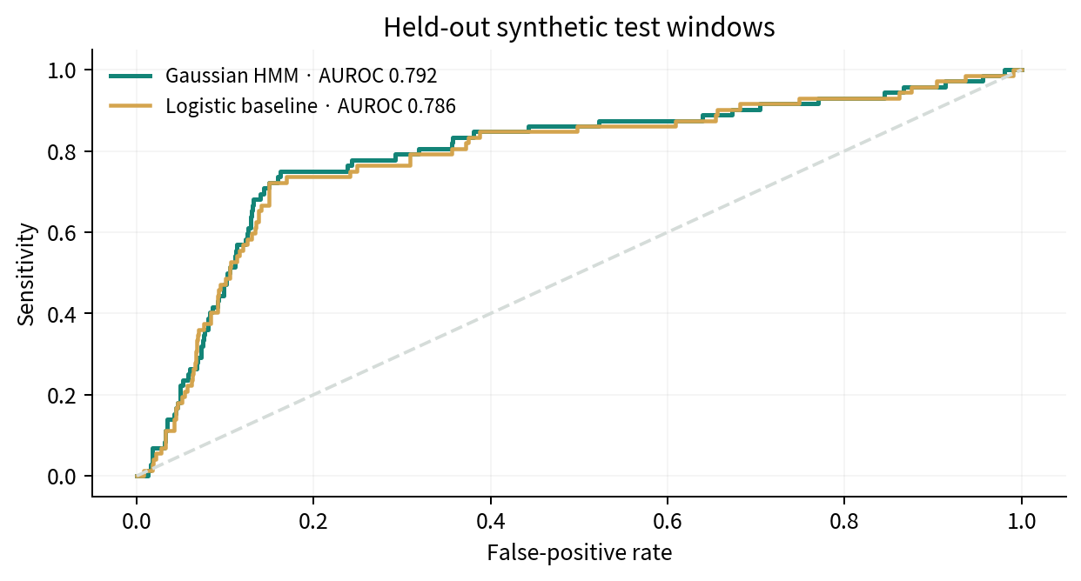
PATIENTWATCH · UNIT 4 / PROJECT 03
Compare against a non-sequential baseline
Same cohort, preprocessing and endpoint.
Separate validation thresholds.
400 whole-patient bootstrap replicates.
Small test cohort; synthetic benchmark only.
SYNTHETIC DATA ONLY / EDUCATIONAL RESEARCH / NOT FOR CLINICAL USE
10

Slide 11
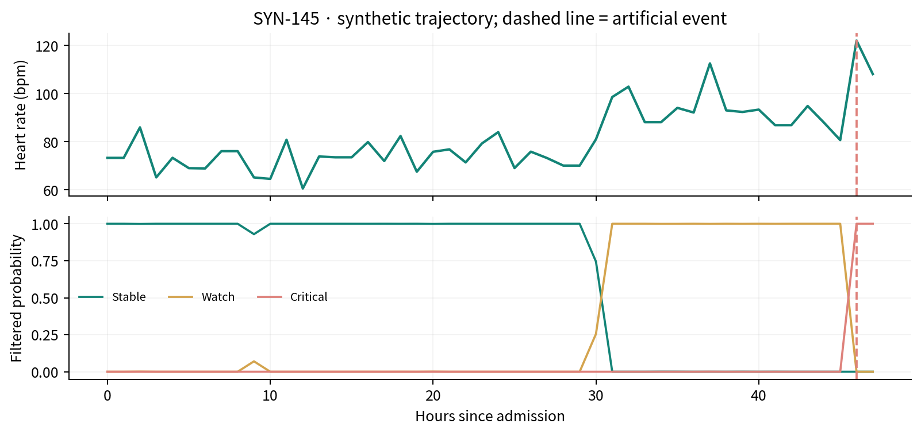
PATIENTWATCH · UNIT 4 / PROJECT 03
Explore the patient trajectory
SYNTHETIC DATA ONLY / EDUCATIONAL RESEARCH / NOT FOR CLINICAL USE
11

Slide 12
PATIENTWATCH · UNIT 4 / PROJECT 03
Demonstration walkthrough
• Open the dashboard; select a held-out artificial patient.
• Switch vital signs; drag the observation-hour slider or replay the sequence.
• Compare causal filtering with retrospective smoothing and Viterbi.
• Inspect performance, false-alert burden, methodology and submission downloads.
SYNTHETIC DATA ONLY / EDUCATIONAL RESEARCH / NOT FOR CLINICAL USE
12

Slide 13
PATIENTWATCH · UNIT 4 / PROJECT 03
Limits, responsibility & next steps
• The simulator resembles HMM assumptions; results cannot transfer to patients.
• No treatments, demographics, irregular samples or adjudicated clinical endpoints.
• High event recall coexists with many non-event patients receiving alerts.
• Real extension: credentialed MIMIC-IV, approved handling, external validation and clinical review.
SYNTHETIC DATA ONLY / EDUCATIONAL RESEARCH / NOT FOR CLINICAL USE
13

Slide 14
PATIENTWATCH · UNIT 4 / PROJECT 03
Submission & reproducibility
• Executed Jupyter notebook, technical report PDF and this presentation.
• Dataset CSV, saved parameters, computed results and source code on GitHub.
• README: setup, regeneration, testing, data schema and demo script.
• github.com/RomitDeokar/ML_Unit4 · Rabiner (1989) · hmmlearn docs
SYNTHETIC DATA ONLY / EDUCATIONAL RESEARCH / NOT FOR CLINICAL USE
14

