Slide 1

SAMSUNG PRISM
Generative AI
Hackathon
3rd Edition 2026 – 27
Theme ID - Theme 05: Interruptible Real-Time Agents
Team Name - Wizards
College Name – SRM Institute of Science and Technology
Member Name & Email 1 – Rian k Sinu - rs7067@srmist.edu.in
Member Name & Email 2 – Romit Deokar - rd3432@srmist.edu.in
Member Name & Email 3 – Pragalbh Rai - pr2231@srmist.edu.in
Member Name & Email 4 – Manmohan Singh - ms5592@srmist.edu.in
Submission Github link -TriageLine

Slide 2
Theme
Theme 05: Interruptible Real-Time Agents – build a voice-native agent that keeps working while the user interrupts, hesitates and corrects themselves.
Problem: standard assistants are half-duplex (listen → think → speak). Real callers interrupt and change their mind mid-sentence, and today's assistants fall apart when they do.
Three capabilities required at once:
  Stay responsive – spoken feedback within a few hundred ms; no dead air and no false "done!" claims.
  Work asynchronously – tool calls, perception and reasoning run in the background and never block the conversation.
  Recover cleanly – discard stale intent on a correction, update tool arguments, never perform the same state-changing action twice.
Benchmark: Full-Duplex-Bench v3 (FDB-v3) via LiveKit – 100 real human recordings, 5 disfluency types (filler, pause, hesitation, false start, self-correction), 12 mock tools in 4 domains, chains of 1–3 calls.
Our extension use case: Triage Line – roadside / incident triage on the same LiveKit agent shell.

Slide 3
Existing Solutions & Gaps
Existing solutions
Half-duplex assistants – listen, then think, then speak; a barge-in is ignored or restarts the turn.
Native realtime speech models (GPT-Realtime, Gemini Live) – the published FDB-v3 baselines.
Cascaded Whisper → LLM → TTS pipelines – the third published baseline; every stage waits for the previous one.
LLM-planner-only agents – flexible, but slow and non-deterministic on multi-step tool chains.
Gaps we address
Self-corrections ("Tuesday… no, Wednesday") are where every published system loses points.
Multi-step tool chains break when an early value changes mid-utterance.
Stale work keeps running after the user changes their mind; results arrive late and are spoken as fact.
State-changing calls get duplicated or their late outcome is silently lost.
Consequential actions (dispatch, escalation) run on a misheard or superseded request, with no safe confirmation step.
Dead air or false "done!" while slow tools (up to ~14 s) are still running.

Slide 4
Our Solutions & Architecture Diagram
Caller /
FDB-v3 input.wav
Silero VAD
+ turn detector
STT
Deepgram nova-3 | Gemini
TriageAdapter
commit gate · barge-in ·
async tool tasks
ParticipantAgent
FAST · SLOW · COORD
(epoch + ledger)
TTS
Deepgram aura-2 | Gemini
→ agent audio to caller
Extension · Triage Line (triage_livekit_agent.py)
triage_brain → Deliberation → Commit state machine (PROPOSED → PENDING_CONFIRMATION → FINALIZED / ABORTED) → SIMULATED dispatch log
Official FDB-v3 mock_apis.py (12 tools, fresh registry per room)
tool_call / cancel_tool ⇄ tool_result tagged with call_id + epoch
Telemetry: per-turn latency + tool-call logs
Fast path (<5 ms): self-repair-aware parsing (last correction wins); classifies a barge-in as revise / retract / intent-switch; speaks an acknowledgement and cuts agent speech on VAD onset.
Slow path: every tool call is its own asyncio task, so STT, TTS and tools never block the conversation.
Coordination: an epoch counter is bumped on every correction; stale results are dropped or re-validated against the slots they depended on.
State-change safety: an operation ledger per idempotency key – no duplicate commit, no auto-retry of an unknown outcome, late results reconciled truthfully.
Deterministic core: rules-first understanding; the optional LLM planner is schema-validated and OFF in the scored run.

Slide 5
Demo & Product Walkthrough
1. Reproduce FDB-v3 in one command: PYTHON=python3.12 ./run_fdb_v3.sh configures, judge off(exact match) as sanctioned . runs the official runner and evaluators, and fails loudly on any stale or partial result.
2. Real interruption on the benchmark: a recording with a self-correction; result_triageline.json shows the corrected tool call.
3. PWA interruption (recorded, docs/video/pwa_interrupt.mp4): request → barge-in correction → stale flight search cancelled → corrected booking → same-breath "actually, don't do that" performs nothing.
4. Triage Line, live at /rtc.html?flow=triage:
  Caller: "My car broke down near Highway 9." Agent: "I'll dispatch a tow truck to Highway 9. Should I go ahead?"
  Caller interrupts: "Actually, I'm on Highway 12." → agent stops speaking, aborts the Highway 9 action, re-deliberates and proposes Highway 12.
  Caller: "Yes, go ahead." → only Highway 12 is dispatched (SIMULATED). On disconnect, any pending action is force-aborted.
5. Safety: nothing finalizes without an explicit "yes"; a correction always aborts the stale proposal.
Demo video (max 5 min): https://drive.google.com/file/d/1GDqNa02lEbf5xl4cgFHxh8mEMuRj_Doh/view?usp=sharing

Slide 6
Tools and tech stack used
Voice runtime & speech
LiveKit Agents 1.8.3 (WebRTC) – custom cascaded agent; Python 3.10–3.12
Silero VAD + LiveKit semantic turn-detector for end-of-turn
Deepgram nova-3 (streaming STT) and aura-2 (TTS); Gemini flash-lite as fallback
Understanding
Custom rules-based ParticipantAgent (schema-driven, deterministic)
Optional LLM planner: Gemini → Cerebras → OpenRouter → Mistral (T=0, seed 7, schema-validated)
Benchmark & backend
Full-Duplex-Bench v3 pinned at commit 3e799c45; official evaluators; NeMo ASR (parakeet)
FastAPI + Uvicorn gateway; token API for native LiveKit SDKs
Mobile PWA (text, voice clips, camera frames) and /rtc.html WebRTC voice client
DevOps & quality
Docker + docker-compose; one-command reproduction script (run_fdb_v3.sh)
pytest (224 tests) + 10 JS tests; CI template; integrity-audit script

Slide 7
Impact & Use case
Use case: Triage Line – roadside / incident triage
A caller reports a breakdown or incident; the agent asks only what it needs (location, hazards, injuries).
Deliberates before any consequential action: tow dispatch for a breakdown, emergency escalation when a hazard is reported.
Every action runs through a two-phase commit: PROPOSED → PENDING_CONFIRMATION → FINALIZED / ABORTED.
A mid-prompt correction ("no, I'm past exit 12") aborts the stale proposal and re-deliberates.
Runs end to end in the same LiveKit shell as the benchmark worker. All actions are simulated.
Impact
No wrong-location dispatch – corrections abort stale actions and re-plan.
No unconfirmed or duplicate actions in noisy, stressful calls.
Hands-free, voice-first – suited to drivers and people in distress.
Nothing left dangling – force_resolve_pending() ends every call with all actions in a terminal state.
Reusable pattern – the same interruptible, confirm-before-acting core fits in-car assistants, customer-support bots and booking agents.

Slide 8
Innovation highlights, results and limitations
Innovation
Epoch-guarded cancellation of stale work
Operation ledger – idempotent state changes, truthful late-result reconciliation
Commit gate merges endpointer-split speech; a VAD onset re-arms the timer
Two-phase confirmation with abort on correction
Schema-driven rules handle unseen tools zero-shot
Spoken-id repair: self-corrected ids ("order 4471, no wait, 90210") and spelled letter ids ("B O B" → BOB) resolve to the id the caller settled on
Results (mode stated)
Offline text replay (diagnostic, judge off): 91/100 strict; tool-selection 98.6%; argument acc. 93.7%
Held-out paraphrase set (rules only): 29/30
Live LiveKit run, 4 Oct 2026 (Deepgram, judge off): turn-take 99/100; tool-selection 86.4%; argument acc. 55.2%; strict pass 45/100; avg latency 5.01 s
Engineering: 242 Python + 10 JS tests pass; integrity audit PASS
Limitations
Remaining live gap is argument extraction under real STT surface forms(wrong tools 43, wrong arguments 29 of 72 failures). One recording(housing_14_61517db6) never triggered VAD → no agent response; reported as a miss.
Judged live run not done (no OpenAI key available)
All actions simulated – not an emergency service
Location extraction is regex/keyword based (no geocoding); sessions are process-local

Slide 9
What’s next
Close the live-benchmark gap: run the judged live FDB-v3 with team keys; stream STT partials into the commit gate; tune the settle timer; speak a truthful filler earlier while slow tools run.
STT-error-tolerant matching for spelled IDs, fillers and self-corrections.
Real integrations for Triage Line: CAD, tow and emergency-services APIs, plus geocoding for locations.
Production readiness: user identity, persistent multi-replica sessions, and a native mobile app on the LiveKit SDK.
Live-room validation: barge-in, mid-sentence correction and disconnect/rejoin tests with real callers; confirm zero duplicate state changes in the tool log.
Broader domains: in-car destination change, device troubleshooting with a camera frame, hands-free assistants.

Slide 10
Brownie points slide( differentiation)
Safety-first by design: nothing finalizes without an explicit "yes", no duplicate state changes, no false "done". Nine confirmation-safety probes (E-01…E-09) are pinned as regression tests.
Honest evaluation: every number states its mode; the offline replay is labelled diagnostic. A strict integrity audit found no benchmark phrasing in decision code, and the held-out set was never used to tune rules.
Schema-driven and zero-shot: rules read tool schemas (types, enums, descriptions), so hidden or unseen tools work from the manifest alone – no scenario-keyed logic.
Deterministic and reproducible: pinned versions and seeds, LLM planner off in the scored run, and one command that fails loudly instead of scoring a partial run.
End to end, one shell: the benchmark worker and the Triage Line extension share a LiveKit agent, with a mobile PWA and a token API for native apps.

Slide 11
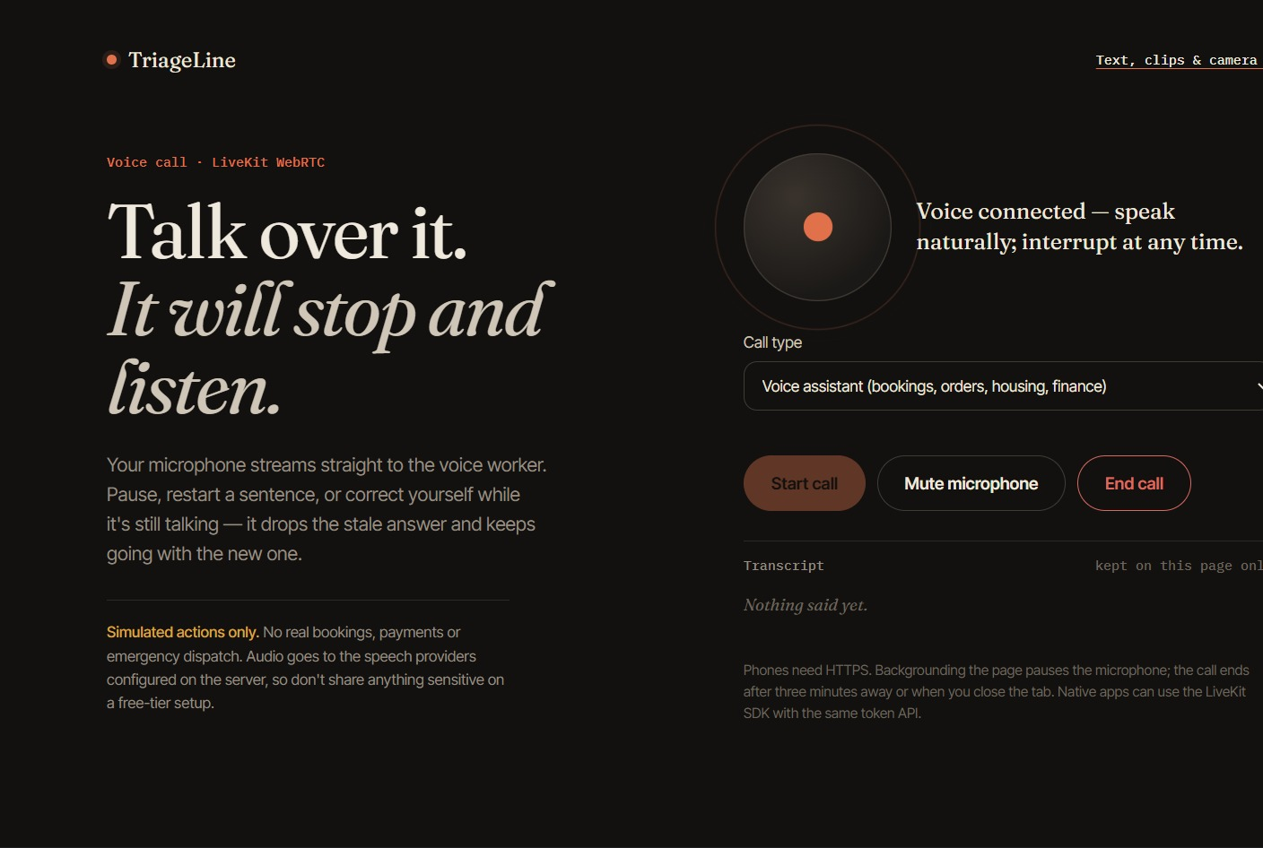
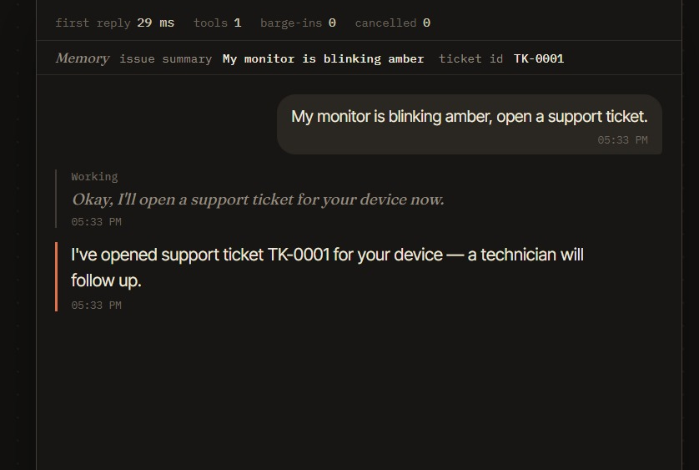
Screenshot of the working prototype

Slide 12
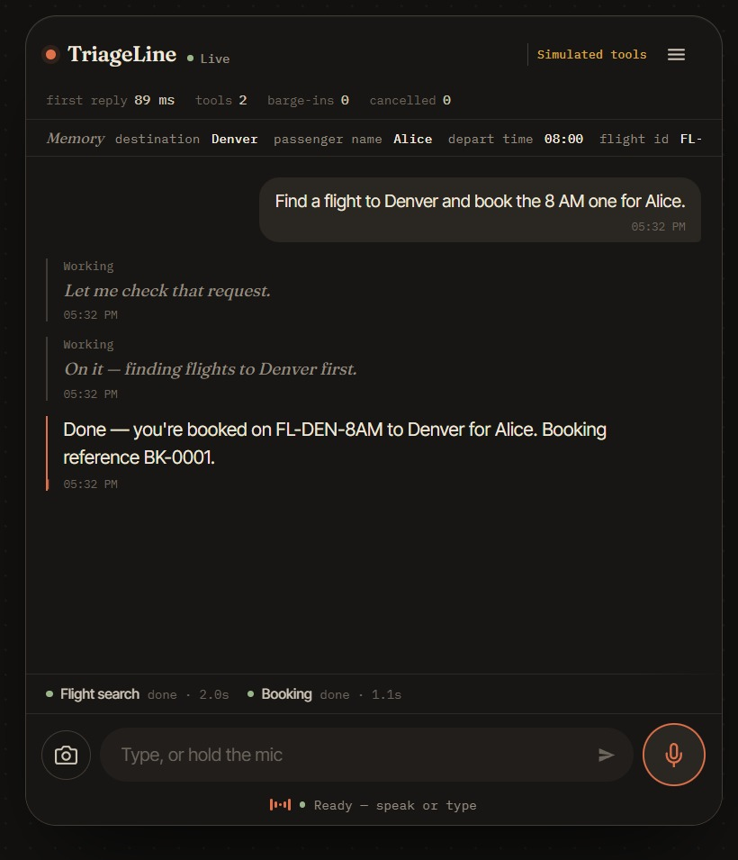
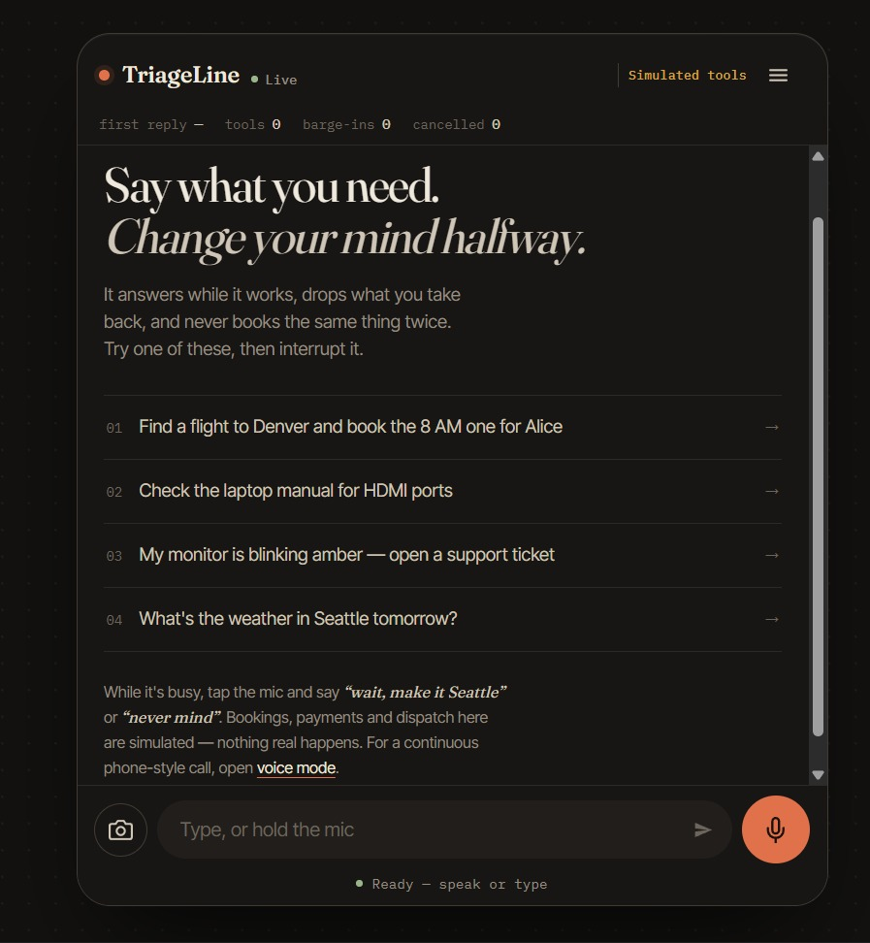
Screenshot of the working prototype

Slide 13
Checklist- Updated on Public GitHub
Working prototype code – public or shared GitHub repo (Y/N)
✓
Y
README with reproducible setup instructions (Y/N)
✓
Y
Demo video, max 5 minutes (YouTube or Drive link)
https://drive.google.com/file/d/1GDqNa02lEbf5xl4cgFHxh8mEMuRj_Doh/view?usp=sharing
✓
Presentation file (PPT or PDF) (Y/N)
✓
Y

Slide 14
Thank you
Organised by the Language AI Team and the PRISM Team, Samsung R&D Institute India
Notes:
Closing slide. Add the Google Form URL and a contact email before sharing. Edition 2 organising team for reference: Language AI - Sourabh Tiwari, Gaurav, Sanjeeth Pothireddy, Gorang Maniar; PRISM - Binny Lakra, Prakhar Chandrakar, Vishu Kumar; Kick-off and mentors - Giridhar Jakki, Deepraj Prabhakar Patkar (Language AI), Srimanu Prasad Nagaraju, Ashish Kumar (Tech Strategy).

