Slide 1
EMBER / UNIT 5 / PROJECT 03
Explore conditions. Understand uncertainty.
AI-Based Wildfire Occurrence Risk Assessment
Bayesian Model Averaging with Logistic Regression, Decision Tree and Random Forest
UCI Forest Fires / Montesinho, Portugal / 517 records
Student details: add your name, roll number and institution.
Positive recorded-area proxy, not ignition probability | 01
Notes:
Target: 1[recorded burned area > 0], conditional on a recorded fire. Area = 0 is not a confirmed non-fire observation. This dataset cannot validate daily ignition risk.
Only 517 records from one Portuguese park, with no representative non-fire controls. Month/weekday are not complete timestamps. Spatial grouping reduces location leakage but does not remove all event/weather dependence. Test includes only eight cells. This revision reuses previously published test scores; it is not fresh external validation. Do not use this educational application for emergency decisions.

Slide 2
EMBER / UNIT 5 / PROJECT 03
First, define what we can actually predict.
Target: 1[recorded burned area > 0], conditional on a recorded fire. Area = 0 is not a confirmed non-fire observation. This dataset cannot validate daily ignition risk.
Research question: do environmental measurements discriminate this proxy on unseen spatial cells?
Positive recorded-area proxy, not ignition probability | 02
Notes:
Target: 1[recorded burned area > 0], conditional on a recorded fire. Area = 0 is not a confirmed non-fire observation. This dataset cannot validate daily ignition risk.
Only 517 records from one Portuguese park, with no representative non-fire controls. Month/weekday are not complete timestamps. Spatial grouping reduces location leakage but does not remove all event/weather dependence. Test includes only eight cells. This revision reuses previously published test scores; it is not fresh external validation. Do not use this educational application for emergency decisions.

Slide 3
EMBER / UNIT 5 / PROJECT 03
Weather in. Leakage controls throughout.
Nine scenario inputs become ten predictors: temperature, RH, wind, log1p(rain), DMC, DC, FFMC, ISI and cyclical month sine/cosine. Coordinates only define groups; area only defines the target; weekday is excluded. Invalid or nonfinite inputs fail validation.
Use whole (X,Y) spatial cells: train/validation/test seeds 42 and 43, unchanged from the original repository. Training-only four-fold GroupKFold minimizes Brier score; scalers fit inside each fold. Validation selects F1 thresholds; no test-fitted calibration. All algorithms share identical validation and test rows.
Positive recorded-area proxy, not ignition probability | 03
Notes:
Target: 1[recorded burned area > 0], conditional on a recorded fire. Area = 0 is not a confirmed non-fire observation. This dataset cannot validate daily ignition risk.
Only 517 records from one Portuguese park, with no representative non-fire controls. Month/weekday are not complete timestamps. Spatial grouping reduces location leakage but does not remove all event/weather dependence. Test includes only eight cells. This revision reuses previously published test scores; it is not fresh external validation. Do not use this educational application for emergency decisions.

Slide 4
EMBER / UNIT 5 / PROJECT 03
16 possibilities. One Bayesian average.
Enumerate all 16 subsets of weather, moisture, fire-index and season blocks. Each includes an intercept. Coefficients have normalized Gaussian priors; independent Bernoulli block priors control model complexity. Laplace marginal likelihood times model prior yields posterior weights. Twenty-point Gauss-Hermite quadrature integrates coefficient uncertainty in predictions.
Empirical prior tuning is not full integration over hyperparameters.
Positive recorded-area proxy, not ignition probability | 04
Notes:
Target: 1[recorded burned area > 0], conditional on a recorded fire. Area = 0 is not a confirmed non-fire observation. This dataset cannot validate daily ignition risk.
Only 517 records from one Portuguese park, with no representative non-fire controls. Month/weekday are not complete timestamps. Spatial grouping reduces location leakage but does not remove all event/weather dependence. Test includes only eight cells. This revision reuses previously published test scores; it is not fresh external validation. Do not use this educational application for emergency decisions.

Slide 5
EMBER / UNIT 5 / PROJECT 03
Tune inside training. Freeze before evaluation.
Four-fold grouped CV: minimize Brier score.
BMA: five prior scales and three block-prior settings.
Expanded LR/tree/forest grids; identical folds and test records.
Validation selects F1 thresholds; test scores never select a configuration.
Positive recorded-area proxy, not ignition probability | 05
Notes:
Target: 1[recorded burned area > 0], conditional on a recorded fire. Area = 0 is not a confirmed non-fire observation. This dataset cannot validate daily ignition risk.
Only 517 records from one Portuguese park, with no representative non-fire controls. Month/weekday are not complete timestamps. Spatial grouping reduces location leakage but does not remove all event/weather dependence. Test includes only eight cells. This revision reuses previously published test scores; it is not fresh external validation. Do not use this educational application for emergency decisions.

Slide 6
EMBER / UNIT 5 / PROJECT 03
Measured results on the shared test set.
Algorithm | Val. Brier | Test AUC | Test F1 | Test Brier
BMA | 0.254 | 0.527 | 0.739 | 0.257
Logistic Regression | 0.252 | 0.501 | 0.656 | 0.258
Decision Tree | 0.226 | 0.497 | 0.500 | 0.263
Random Forest | 0.237 | 0.505 | 0.659 | 0.262
Prevalence Baseline | 0.254 | 0.500 | 0.739 | 0.257
BMA F1 matches the prevalence baseline. Balanced accuracy: 0.500.
There is no established meaningful predictive gain from expanded tuning.
Positive recorded-area proxy, not ignition probability | 06
Notes:
Target: 1[recorded burned area > 0], conditional on a recorded fire. Area = 0 is not a confirmed non-fire observation. This dataset cannot validate daily ignition risk.
Only 517 records from one Portuguese park, with no representative non-fire controls. Month/weekday are not complete timestamps. Spatial grouping reduces location leakage but does not remove all event/weather dependence. Test includes only eight cells. This revision reuses previously published test scores; it is not fresh external validation. Do not use this educational application for emergency decisions.

Slide 7
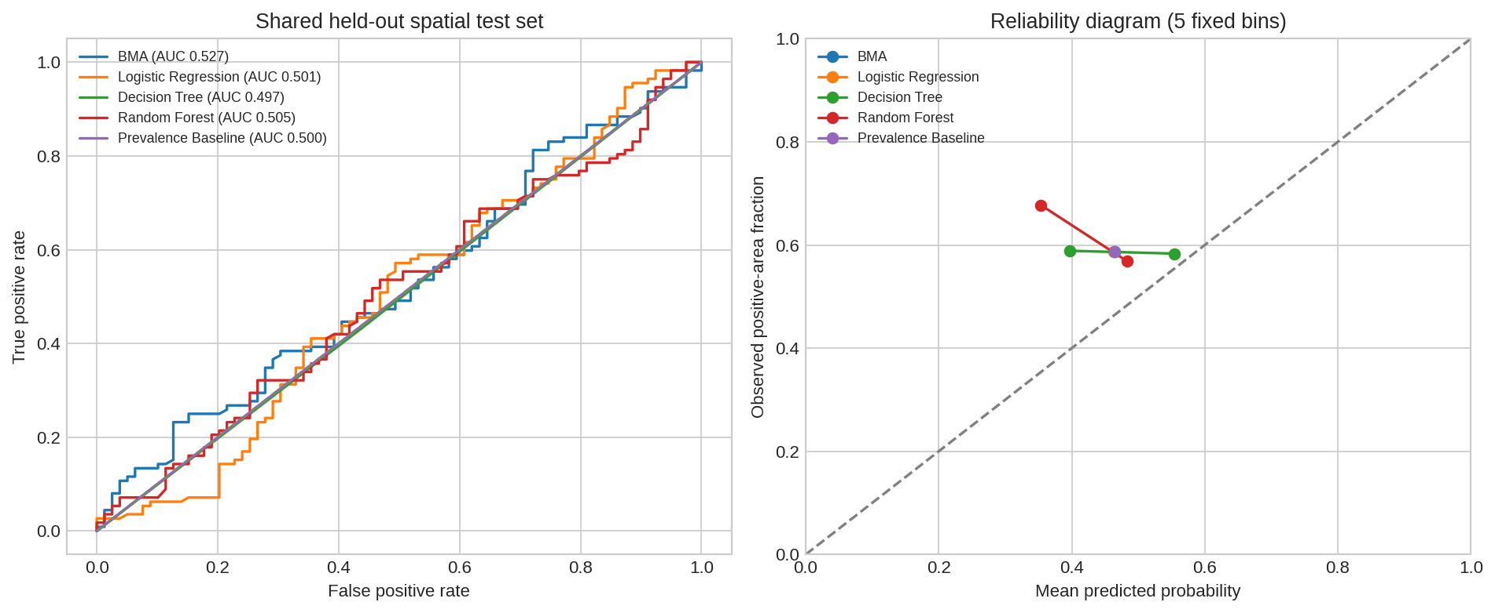
EMBER / UNIT 5 / PROJECT 03
Check calibration, not just classification.
Positive recorded-area proxy, not ignition probability | 07
Notes:
Target: 1[recorded burned area > 0], conditional on a recorded fire. Area = 0 is not a confirmed non-fire observation. This dataset cannot validate daily ignition risk.
Only 517 records from one Portuguese park, with no representative non-fire controls. Month/weekday are not complete timestamps. Spatial grouping reduces location leakage but does not remove all event/weather dependence. Test includes only eight cells. This revision reuses previously published test scores; it is not fresh external validation. Do not use this educational application for emergency decisions.

Slide 8
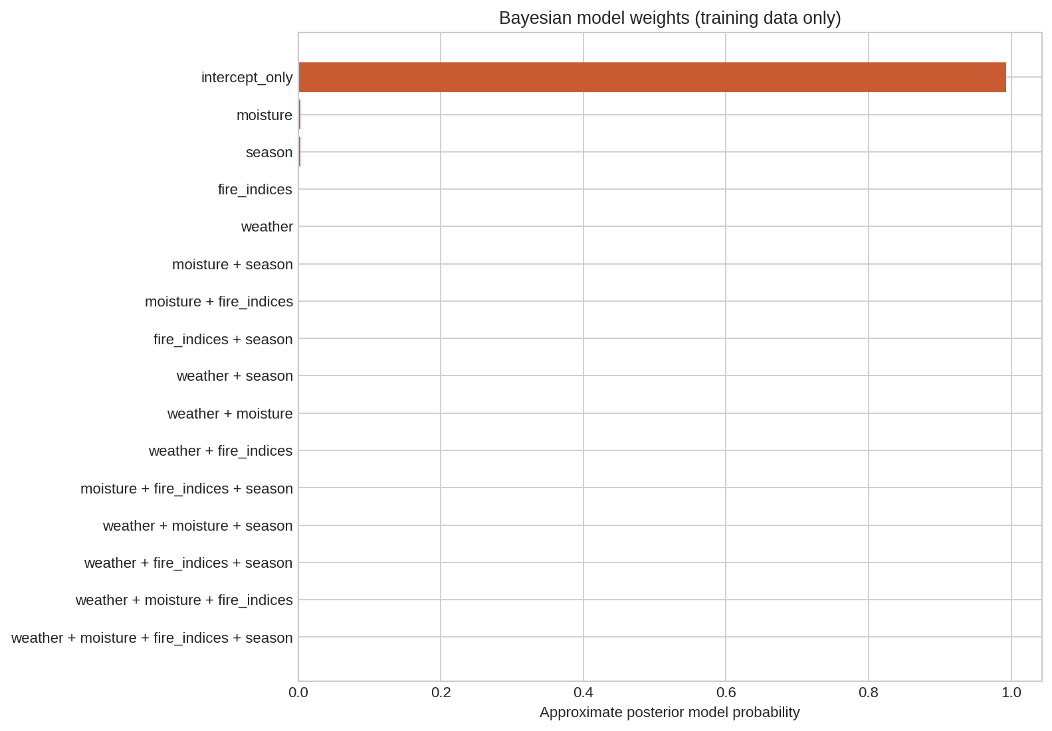
EMBER / UNIT 5 / PROJECT 03
Posterior weights tell a transparent story.
Positive recorded-area proxy, not ignition probability | 08
Notes:
Target: 1[recorded burned area > 0], conditional on a recorded fire. Area = 0 is not a confirmed non-fire observation. This dataset cannot validate daily ignition risk.
Only 517 records from one Portuguese park, with no representative non-fire controls. Month/weekday are not complete timestamps. Spatial grouping reduces location leakage but does not remove all event/weather dependence. Test includes only eight cells. This revision reuses previously published test scores; it is not fresh external validation. Do not use this educational application for emergency decisions.

Slide 9
EMBER / UNIT 5 / PROJECT 03
Uncertainty is part of the result.
Pointwise 90% BMA latent-probability credible intervals sample the model index and Laplace coefficient posterior (2,000 draws, seed 42). Conditional on the candidate family; they do not account for dataset bias. Test metric 95% percentile intervals resample spatial cells 500 times (seed 2026), skip one-class resamples, and do not refit models. They describe conditional sampling variability, not external validity.
Positive recorded-area proxy, not ignition probability | 09
Notes:
Target: 1[recorded burned area > 0], conditional on a recorded fire. Area = 0 is not a confirmed non-fire observation. This dataset cannot validate daily ignition risk.
Only 517 records from one Portuguese park, with no representative non-fire controls. Month/weekday are not complete timestamps. Spatial grouping reduces location leakage but does not remove all event/weather dependence. Test includes only eight cells. This revision reuses previously published test scores; it is not fresh external validation. Do not use this educational application for emergency decisions.

Slide 10
EMBER / UNIT 5 / PROJECT 03
A working, auditable research demonstration.
Scenario studio with all model probabilities and credible intervals.
Batch CSV scoring, JSON export and input-range checks.
Model performance, Bayesian evidence and dataset explorer.
Executed notebook, short report, editable presentation and audit CSVs.
Positive recorded-area proxy, not ignition probability | 10
Notes:
Target: 1[recorded burned area > 0], conditional on a recorded fire. Area = 0 is not a confirmed non-fire observation. This dataset cannot validate daily ignition risk.
Only 517 records from one Portuguese park, with no representative non-fire controls. Month/weekday are not complete timestamps. Spatial grouping reduces location leakage but does not remove all event/weather dependence. Test includes only eight cells. This revision reuses previously published test scores; it is not fresh external validation. Do not use this educational application for emergency decisions.

Slide 11
EMBER / UNIT 5 / PROJECT 03
Better data is the next real improvement.
Only 517 records from one Portuguese park, with no representative non-fire controls. Month/weekday are not complete timestamps. Spatial grouping reduces location leakage but does not remove all event/weather dependence. Test includes only eight cells. This revision reuses previously published test scores; it is not fresh external validation. Do not use this educational application for emergency decisions.
Next: representative controls, exact observation windows, independent regions and chronological validation.
Positive recorded-area proxy, not ignition probability | 11
Notes:
Target: 1[recorded burned area > 0], conditional on a recorded fire. Area = 0 is not a confirmed non-fire observation. This dataset cannot validate daily ignition risk.
Only 517 records from one Portuguese park, with no representative non-fire controls. Month/weekday are not complete timestamps. Spatial grouping reduces location leakage but does not remove all event/weather dependence. Test includes only eight cells. This revision reuses previously published test scores; it is not fresh external validation. Do not use this educational application for emergency decisions.

Slide 12
EMBER / UNIT 5 / PROJECT 03
Reproduce the evidence.
python -m wildfire.train
python -m wildfire.deliverables
python -m pytest -q
python -m streamlit run app.py
UCI: doi.org/10.24432/C5D88D / Cortez & Morais (2007), CC BY 4.0
Positive recorded-area proxy, not ignition probability | 12
Notes:
Target: 1[recorded burned area > 0], conditional on a recorded fire. Area = 0 is not a confirmed non-fire observation. This dataset cannot validate daily ignition risk.
Only 517 records from one Portuguese park, with no representative non-fire controls. Month/weekday are not complete timestamps. Spatial grouping reduces location leakage but does not remove all event/weather dependence. Test includes only eight cells. This revision reuses previously published test scores; it is not fresh external validation. Do not use this educational application for emergency decisions.

