Slide 1
The Data
The data provided has information about doctors and their treatments for patients, doctors and their drug prescribing for patients, and providers for home health care and providers of durable medical equipment (DME), prosthetics, orthotics and supplies.

Slide 2
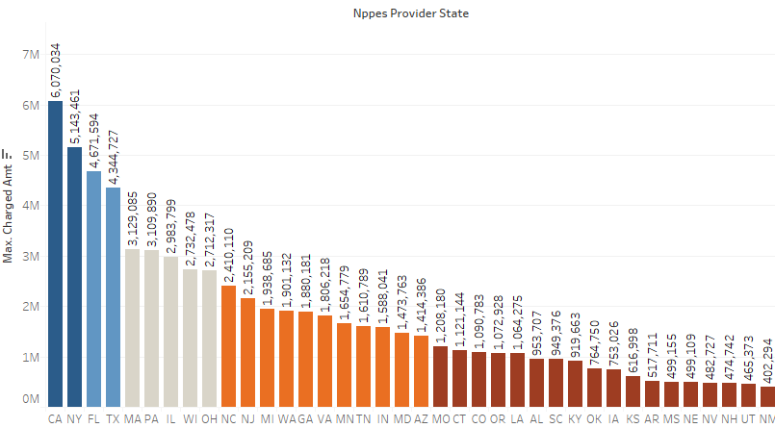
Expensive Procedures by Region
Using Submitted charge amount as the judgement factor and grouping by states (region) for United States. We choose US because other countries have very few rows in the dataset.

Slide 3
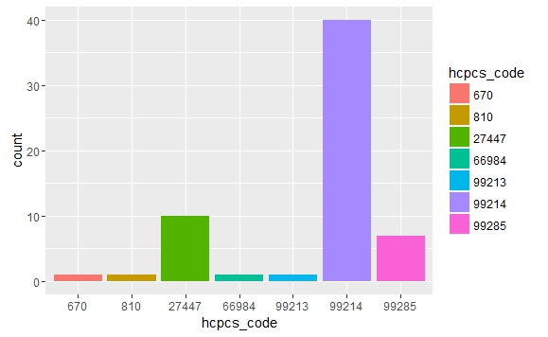
Expensive Procedures by Region
Following are top 7 procedures that are expensive across all regions (categorized using HCPCS Code)

Slide 4
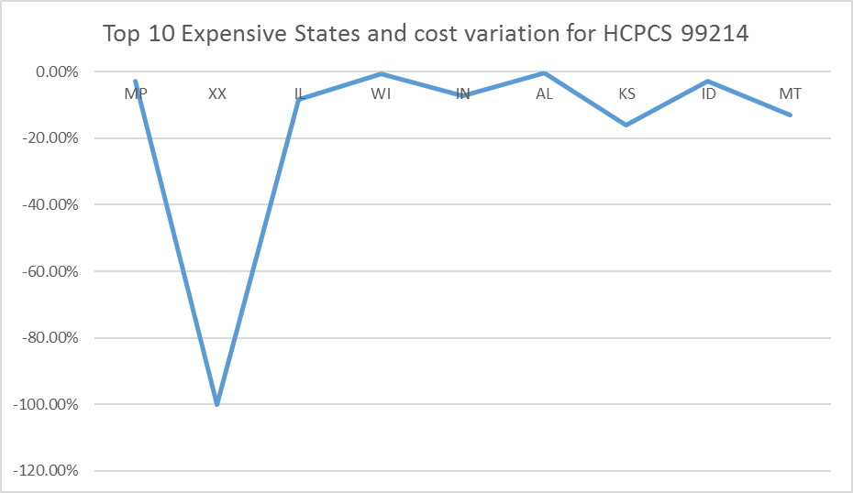
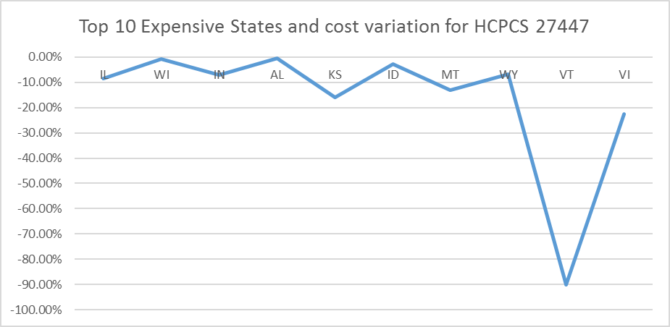
Expensive Procedures by Region
Variance By Region (Grouped by HCPCS Code)

Slide 5
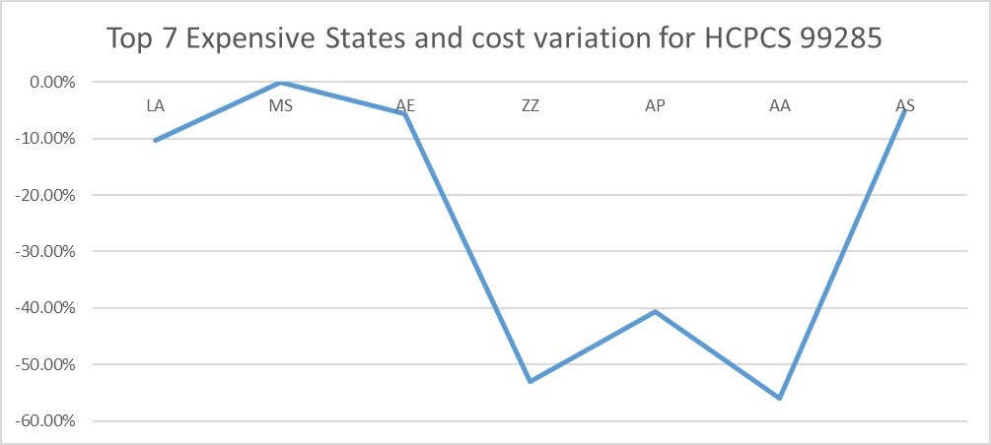
Potential Physician Fraud or Abuse
Complete List here

Slide 6
Physician Fraud and Abuse
The highest submitted amounts are for the following
Practices
Ambulatory Surgical Center
Cardiac Surgery
Using Medicare_ps_puf dataset We calculate submitted charge amount per service for each provider as total submitted charge amount / total number of services provided
After this we group by for each practice and calculate the average submitted charge amount per practice. Following graph shows the results across different practices

Slide 7
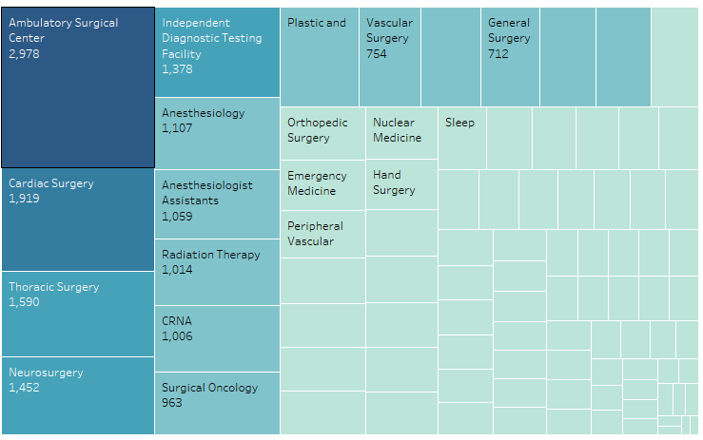
Physician Fraud and Abuse
Graph showing the average submitted medicare charge amount per provider for each of the practices

Slide 8
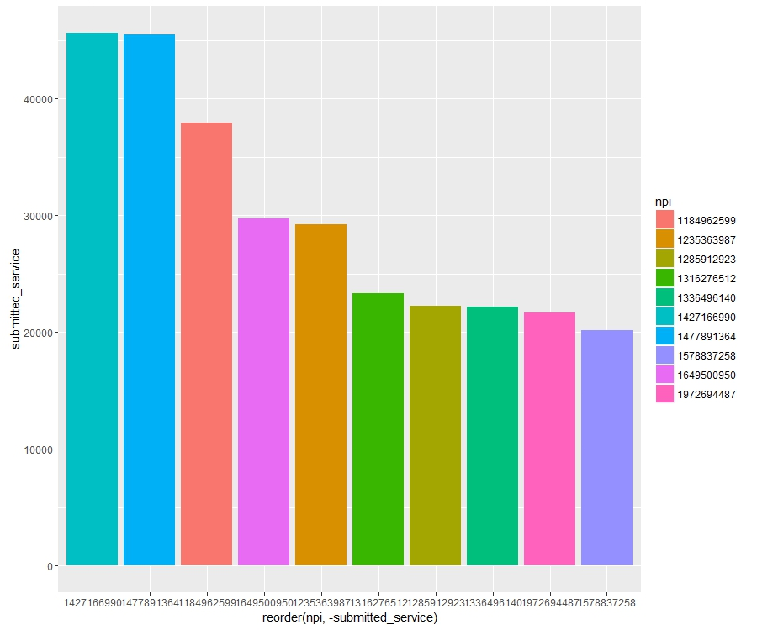
Physician Fraud and Abuse
The graph is for “Ambulatory Surgical Center” provider type. We see that the following providers, all organization types, are charging way high compared to the others.

Slide 9
Physician Fraud and Abuse
We see that the following providers, all organizations, are charging higher amount compared to the others.
Provider | Provider_Org_Last_Name | Submitted charged amount
1427166990 | LOS ALTOS SURGERY CENTER | 45653.67
1477891364 | ALASKA HEART INSTITUTE LLC | 45446.67

Slide 10
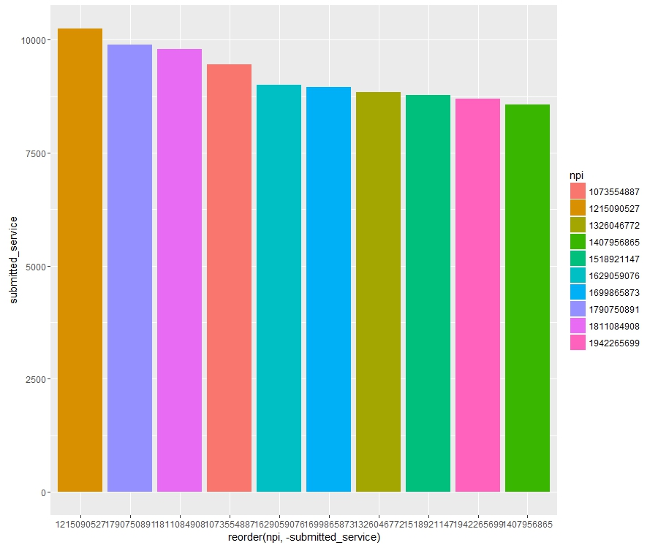
Physician Fraud and Abuse
The corresponding chart is for Cardiac surgery.
There doesn’t seem to much variation in the charged amount for this practice.

Slide 11
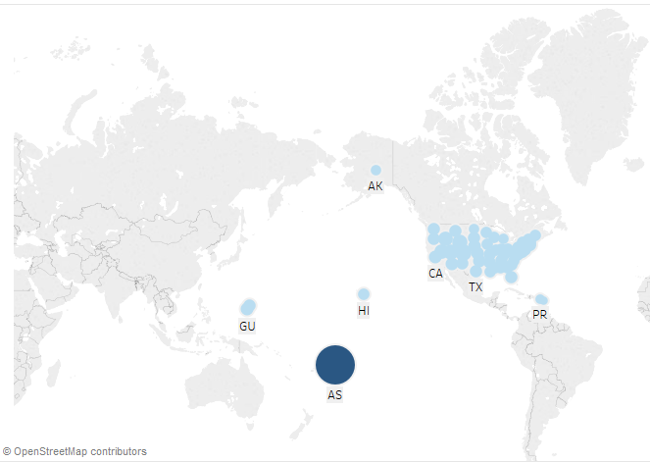
Variation in DME Spending per Beneficiary
We have used US as the country for doing the analysis.
From the above graph, we can say that for the state “AS” the average per beneficiary spending is 61.03, which is exceptionally high compared to other providers. Also this state has only one provider, IOTAMO SALEAPAGA, with NPI 1578756656. This provider is an outlier.
This outlier might be due to a very low population in this area and hence just one provider with high charge.

Slide 12
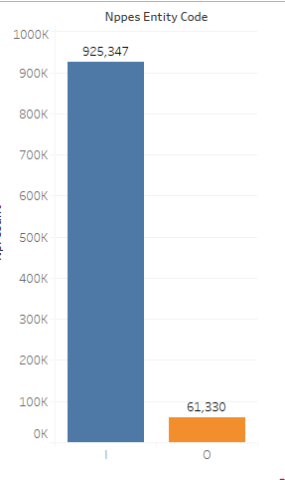
Physicians – Category/ Payments/ Specialties
Practice Type | Physicians Count
Single | 925347
Group | 61330

Slide 13
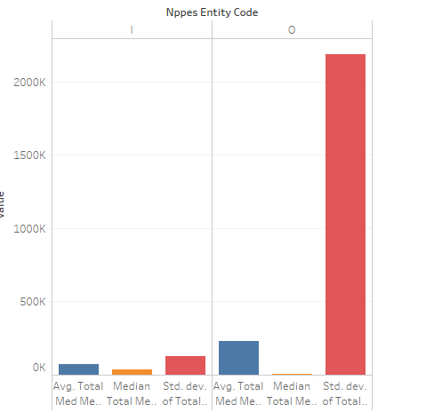
Physicians – Category/ Payments/ Specialties
Payment Variation across type of provider
We can see that for organizations, prices vary a lot among the providers
But for individual practices, prices do not vary a lot across the providers

Slide 14
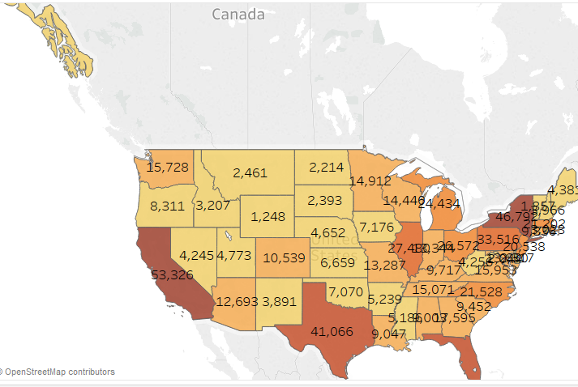
Physicians – Category/ Payments/ Specialties
The following graph shows providers count across different states in the United States. In the graph, the color of the region darkens as the count increases.
CA has the highest number of providers count as 53,326

Slide 15
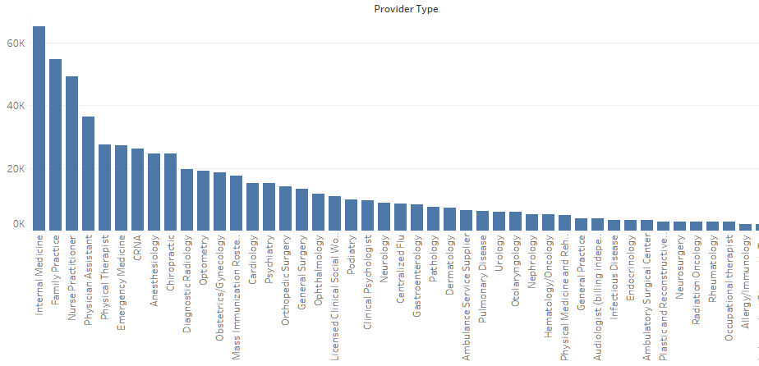
Physicians – Category/ Payments/ Specialties
Providers count also varies by specialties.

Slide 16
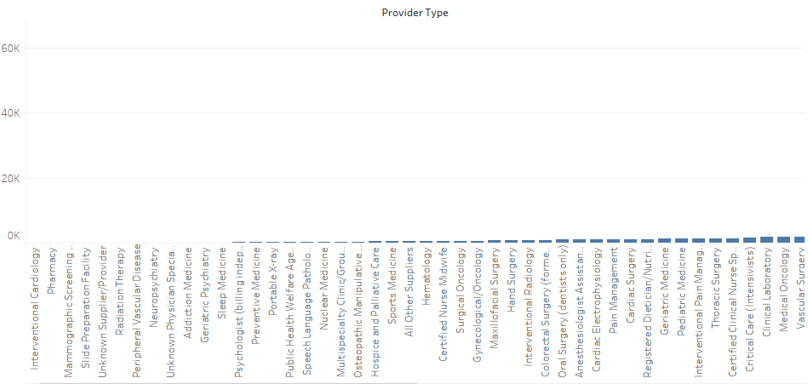
Physicians – Category/ Payments/ Specialties
Specialties in the corresponding graph have very few providers.

Slide 17
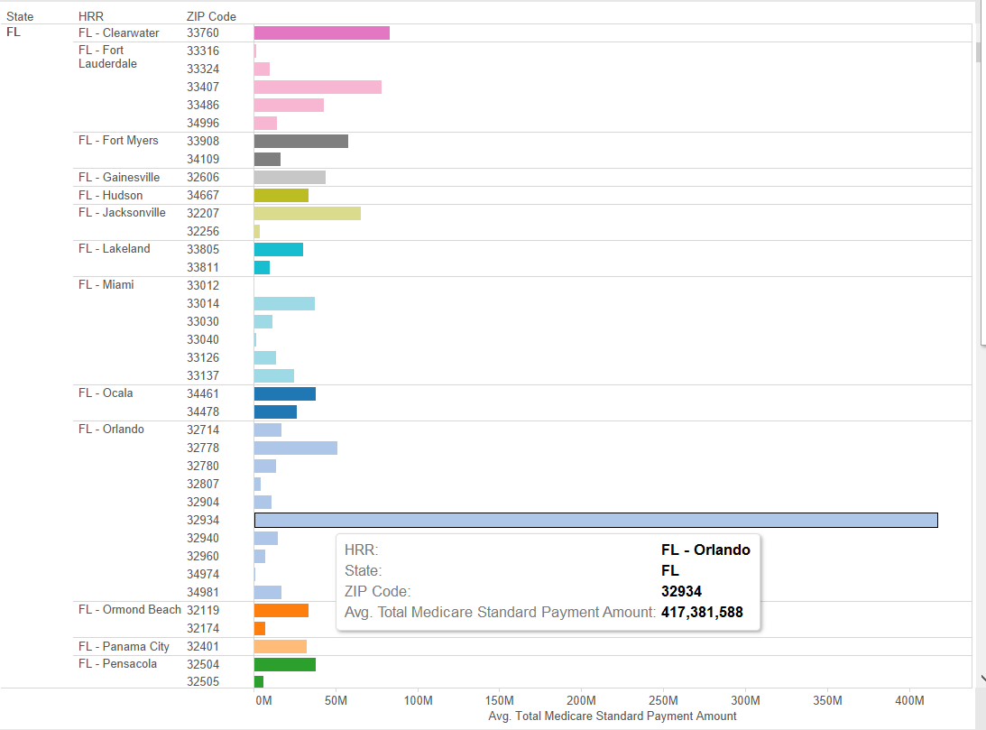
Disparities in Payment Patterns
There is a significant disparity in payment patterns by HRR in “FL- Orlando” specially for zip code 32934, where average total Medicare standard payment amount is exceptionally high. After further analyzing data for Zip 32934, average age for beneficiaries is almost 84 and data shows highest occurrences of cancer, circulatory heart diseases and stroke.

Slide 18
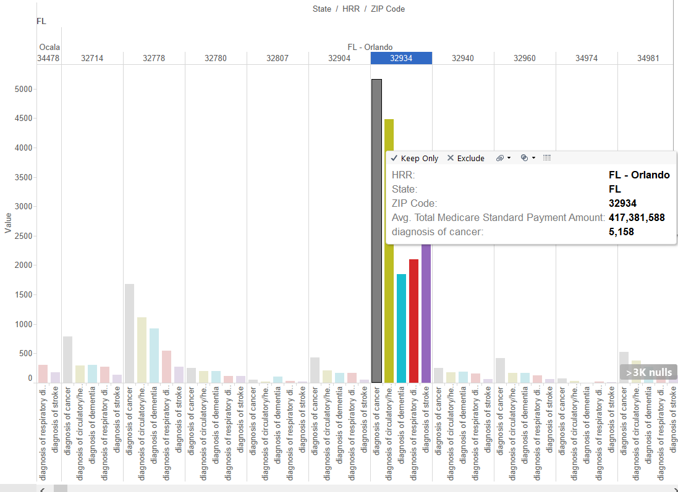
Disparities in Payment Patterns

Slide 19
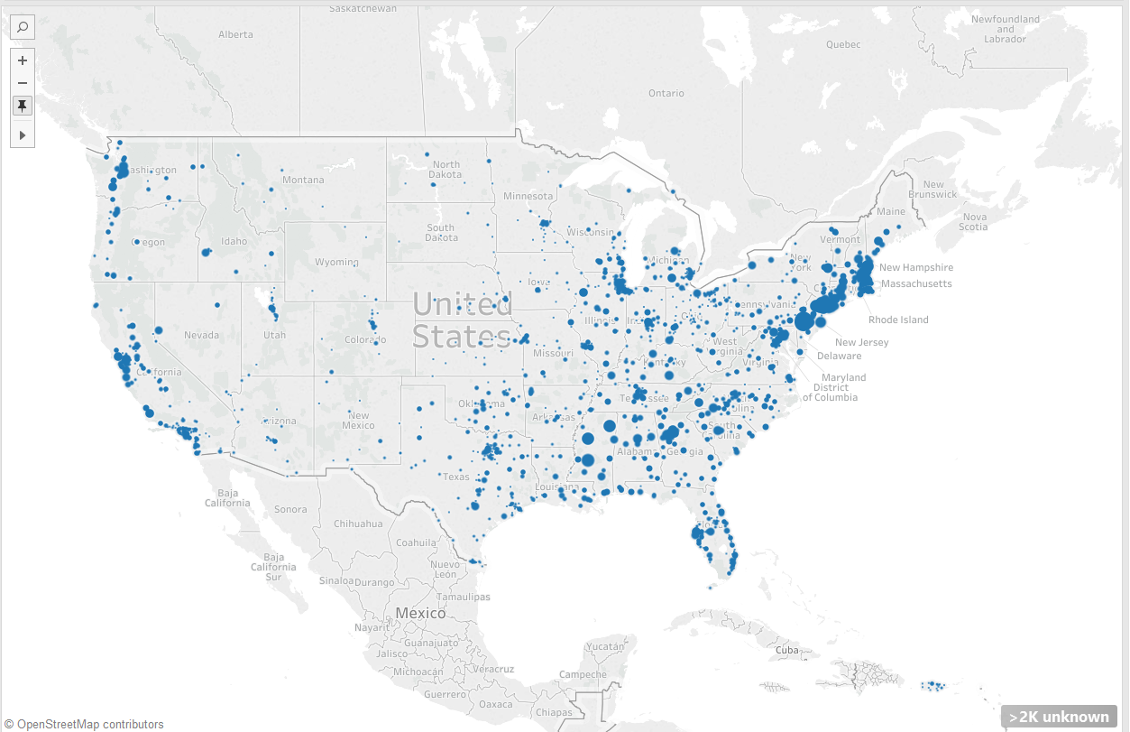
Rural/ Urban/ Ethnic/ Age Differences
Looking at the data from datasets 2 and 4, there are more health care services and average amount spent on health care services (i.e. home health care and hospice services) is more on east coast states and then on west coast (States: Washington, California). This area mostly covers urban areas in USA.

Slide 20
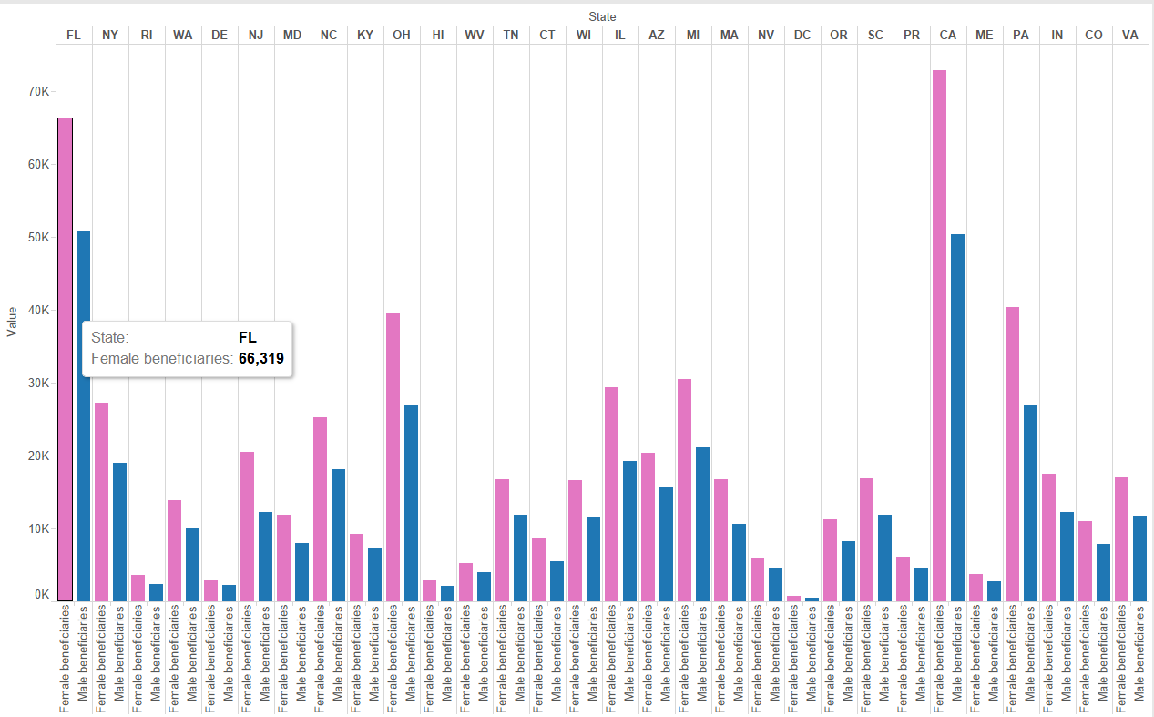
Home Health Care Analysis
Variation in amount spent by gender: Looking at data set 2 and 4, it seems more female beneficiaries as compared to male beneficiaries have opted for home health care and hospice services.

Slide 21
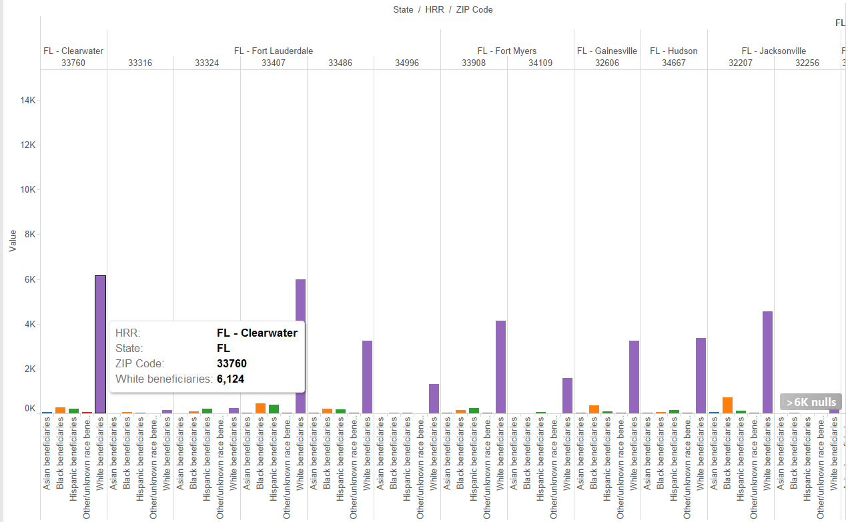
Home Health Care Analysis
Variation in amount spent by race:
It seems more white beneficiaries have enrolled for Medicare services as compared to black beneficiaries. However, this comparison doesn’t look good for Asian pacific beneficiaries. Mostly because there’s les % Asian beneficiaries above 65% and thus total % of Asian beneficiaries enrolling and using Medicare is less.

