Slide 1


Mining of Finnish-Russian trade barriers
DAVID GUSSONI
VINCENZO ROMITO
NLP & Text Mining – Project 30
A.Y. 2020 – 2021

Slide 2
Abstract
The project consists on analysing the discussions between (mainly) Russian users on a forum website about their business activities in Finland, regarding the fish industry and market. The goal is to investigate what are the main trade barriers encountered to develop their business exploiting NLP tools. Then, the focus is on the sentiment the users are experiencing while they’re approaching their difficulties. Moreover, we will compare them with official statistical data coming from the WEO (World Economic Organization), linking the macro-categories detected in the forum with the one classified by official trade organizations.

Slide 3
NLP topics investigated
Semantic analysis (synonyms and/or inflection words detection for some key words, named-entity tagger)
Sentiment analysis (tracking sentiments throughout a thread using polarity scores)
Text categorization (LDA analysis, WordCloud visualization)

Slide 4
Work distribution
Empath client: https://github.com/Ejhfast/empath-client
exploited for category generation
Prior work:
Fuzzy-string-matching: https://www.datacamp.com/community/tutorials/fuzzy-string-python will be used to link sentiments and categories
David
Sentiment analysis, WordCloud, documentation
Group tasks:
Vincenzo
Database connection, pre-processing, semantic analysis
Together
Text categorization (LDA) – to be completed

Slide 5



Data sources and Technologies
Database provided by Karelia CBC: forum discussions, including usernames, URLs and dates (under privacy agreement)
NLTK
VADER
WordNet
WordCloud / PIL
SpaCy
Gensim
Python 3.0

Slide 6
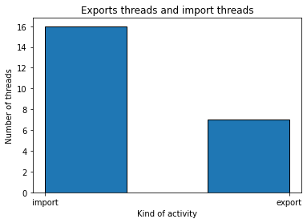

Current results: import/export threads
Discussions
Pre-processing
Levenshtein ratio $≥$ 0.85
WordNet
YES!
Relevant thread storage
Histogram

Slide 7
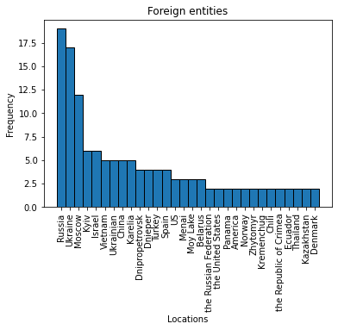
Current results: GPE detection
Filtered document
Spacy, label=GPE
Noisy terms
30 GPE tagged
Histogram
Foreign named entities outside Russia:
Ukraine
Asia

Slide 8
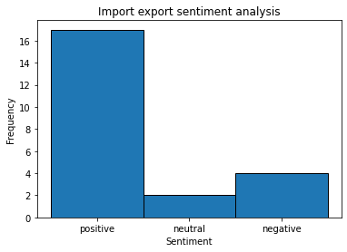
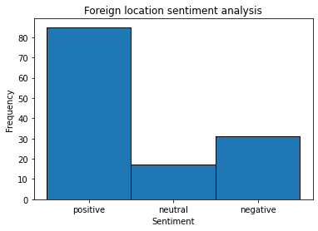
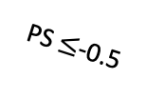
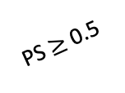

Current results: preliminary sentiment analysis
Positive thread
PS $≥$0.5
Relevant threads
VADER
-1$≤$ Polarity score $≤$+1
Otherwise…
Neutral thread
PS $≤$-0.5
Negative thread

Slide 9
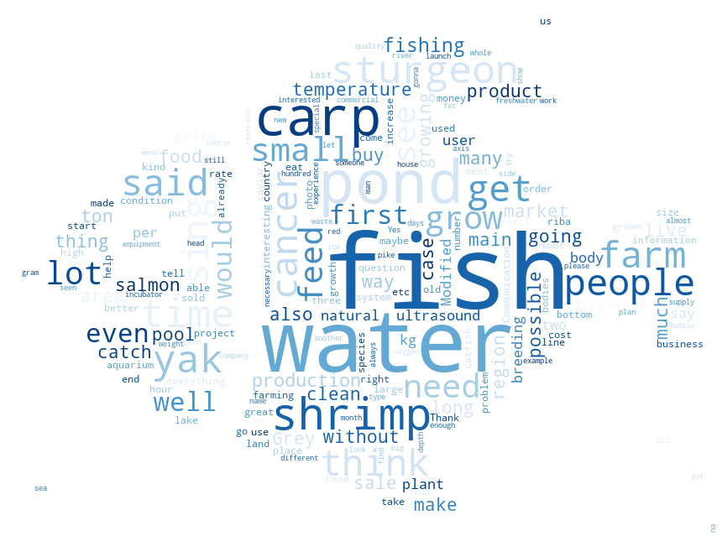
Current results: text categorization
Filtered document
Noisy terms
WordCloud tool
WordCloud tool
stop words
WordCloud data visualization
Empath category generation
('cleaning', 0.0076)
('business', 0.00701)
('economics', 0.00667)
('shape_and_size', 0.00598)
('liquid', 0.00580)
('shopping', 0.00494)
﻿('swimming', 0.01699)
('ocean', 0.01653)
('sailing', 0.01633)
('animal', 0.01019)
('exotic', 0.00876)
('beach', 0.0080)
Based on cosine similarity!

Slide 10
Future schedule
5 out of 11 tasks are completed
OCTOBER
NOVEMBER
LDA
WEO categories
sentiment analysis
Fuzzy
string matching
GUI
Report

Slide 11
Thank you for the attention!

