Slide 1
Football matches analysis and prediction
Romito Vincenzo - 2002967
Giacomo Zarba Meli - 1807439

Slide 2
Football is a sport that is very present in people life’s, people use to watch, play, and also BET.

Slide 3

The holy grail...
Predict the outcome of a game!
BUT is it actually possible to do better that the bookmakers?
They adjust the pay out based on their prediction
They base their prediction on complex machine learning models
They get it right slightly more than 50% of the time

Slide 4

Exploratory Data Analysis
Top football matches
Top football teams
Top football players
Goal analysis in each league
Home factor advantage
Leagues predictability

Slide 5
The Dataset
European Soccer Database by Hugo Mathien
Some of the data we will use:
+25,000 matches
+10,000 players
11 European leagues
Seasons 2008 to 2016
Players and Teams' attributes from FIFA
Betting odds from up to 10 providers (B365,BetWin etc.)

Slide 6
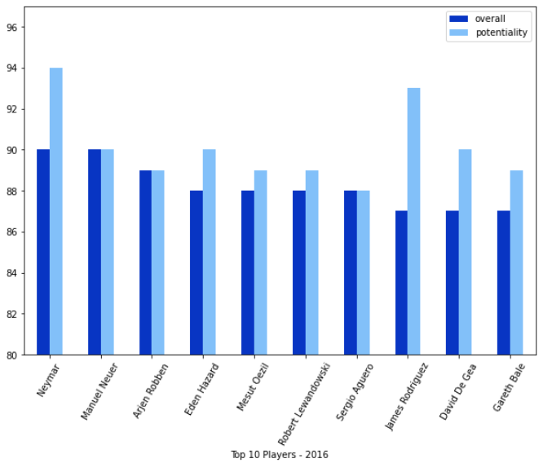
EDA - Top players analysis
Top 10 players with:
Highest overall
Highest potential

Slide 7
EDA - Top players analysis
Some of our findings:
Messi and Ronaldo always in the top 2 with 2016 as an outlier
Almost the totality of the players are from La Liga and the Premier League
The majority of these players are offensive players. These anomalies also represents critics towards the Ballon d’Or

Slide 8
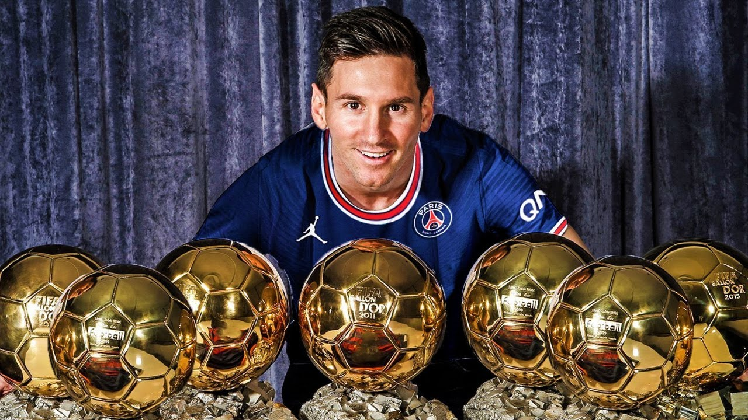
EDA - Top players analysis
Some of our findings:
FIFA players potential actually works, just look at Messi!

Slide 9
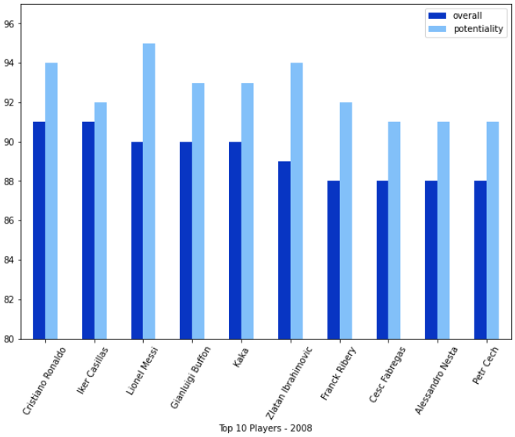
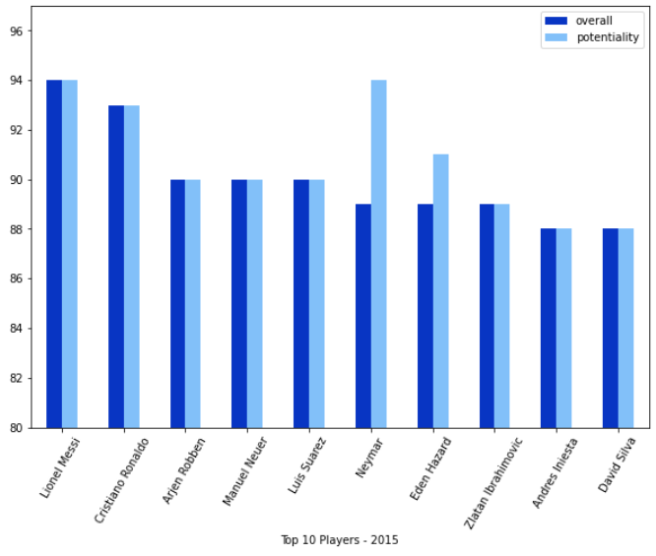
EDA - Top players analysis
Overall: 90
Potential: 95
Overall: 94
Potential: 94

Slide 10
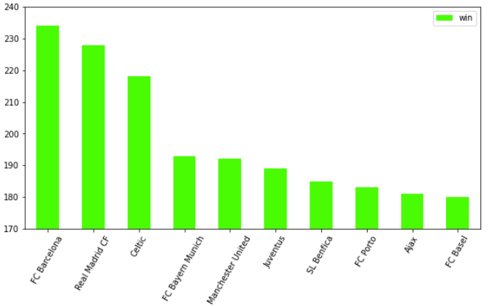
EDA - Top teams analysis
Top 10 most winning teams ever

Slide 11
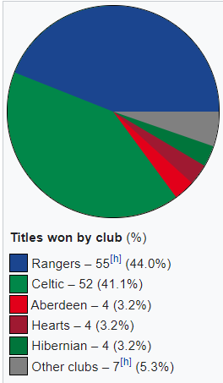
EDA - Top teams analysis
Some of our findings:
They are not equivalent in their strenght.
Different competitiveness of each championship
Celtic FC it’s in the top 3 because of the nature of the Scottish Premier League

Slide 12
EDA - Top matches analysis
Top 10 matches ever based on the total number of goals
This will both take into consideration:
Extremely close matches
Extremely dominated matches

Slide 13
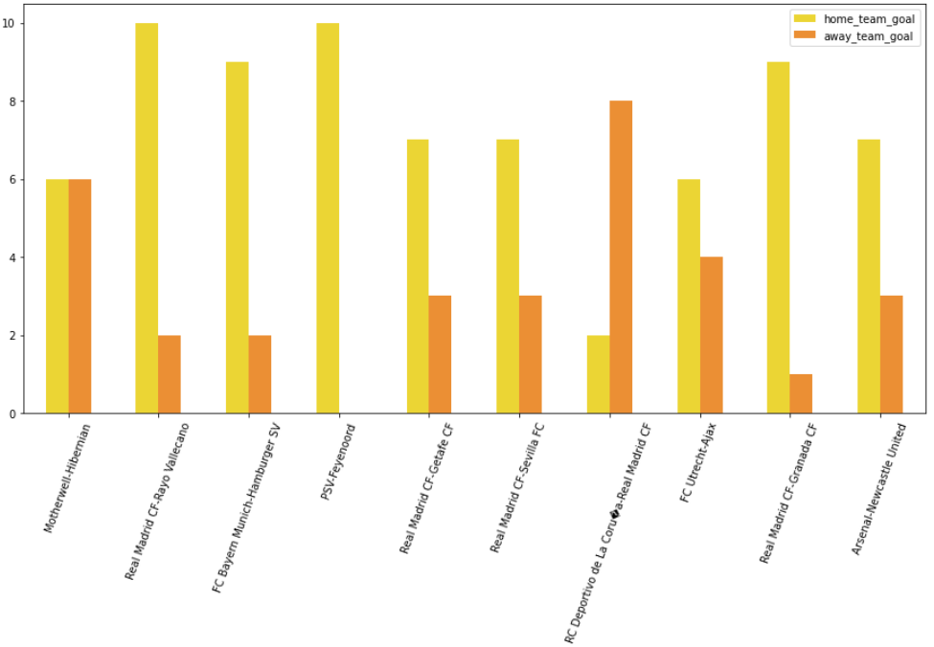
EDA - Top matches analysis

Slide 14
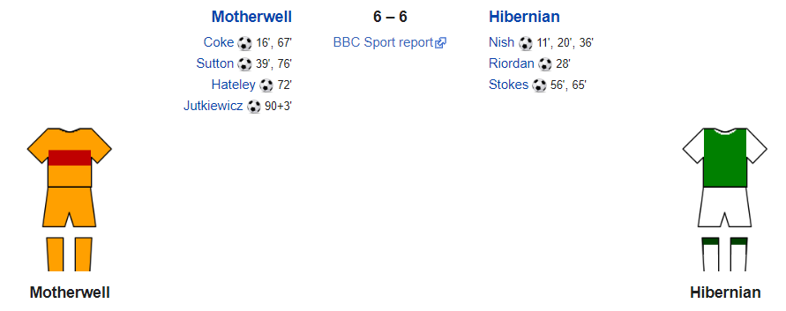
EDA - Top matches analysis
Some of our findings:
Highest scoring match in the Scottish Premier
Both of the teams chasing the qualification for the UEFA Europa League

Slide 15
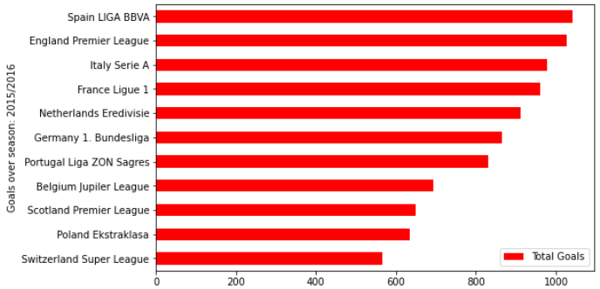
EDA – Goal Analysis in each league
To analyze trends of goals scoring in the different nations

Slide 16
EDA – Goal Analysis in each league
Some of our findings:
Liga, Premier and Seria A most common top 3
More money means more goals
Switzerland always at the bottom of the chart, probably because of the fashion of the league

Slide 17
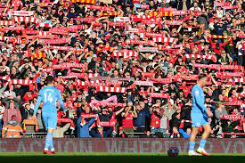
Home Factor Advantage
Home team wins 45% of the time.
This is a well known statistics by soccer fans
But
Which league has the biggest home advantage?
And what team is the best performer while playing at its own stadium?

Slide 18
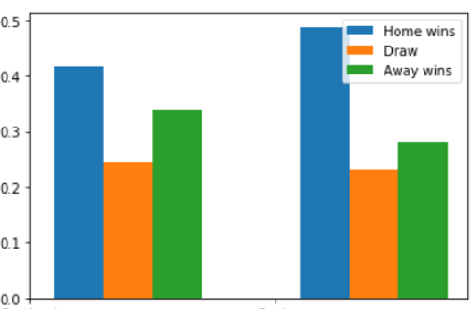


Home advantage by country
Turns out it is SPAIN
48.8 % win rate
At the opposite of the spectrum we find SCOTLAND
41.6% win rate

Slide 19


Home advantage by team
Best home-wins percentage
Best percentage of wins while playing at home
0.86 %
0.90 %
Wins: 131
Draws: 12
Losses: 9
Home wins: 9
Away wins: 1

Slide 20
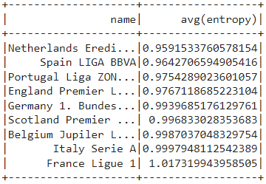
Most predictable league
Exploiting the entropy of betting odds
If the outcomes (H-D-A) are equally probable, the uncertainty is maximal and so is the entropy
MORE PREDICTABLE
LESS PREDICTABLE

Slide 21
Classification
Goals
Check performances of selected models with our selected features
Deduce our best models in terms of accuracy score
Make a comparison with results obtained by a bookmakers odds-based model
It is possible to perform better than bookmakers ML models used to create odds?

Slide 22
Development workflow
Features extraction through custom functions
Apply functions and create the final Dataframe to use
Data preparing for Classification model’s inputs
Create the Correlation Matrix and select the features
Bookmakers predictions - Configuration and Evaluation
Selected models – Training , Testing and Evaluation
Logistic Regression
Naive Bayes
Random Forest
SVM w. OVR
Models scores summary
Hints about our approach to Cross Validation
Extras
User-friendly web application

Slide 23
Features extraction
Goal difference until the current match
Total points in last 3 games played before the match
Total points in the season until the current match
BK predictions of home win, away win or draw
Average overall rating of team’s line-up
(Obviously, every features must be computed for home team and away team)

Slide 24
Apply and persist data
Goals
Avoiding data computing errors
Time saving
Steps
What’s about time of computation and in-parallel jobs execution?
Progress apply in order to generate the new dataframes for every features for every season
Convert the computed dataframes to csv files and persist them on Google Drive

Slide 25
Import and Union
Steps
Import of files from Drive as PySpark DF
Join them and create the complete DF for the specific season
Union of season dataframes in the final one

Slide 26
Data preparing
Types
Features: All numerical with a not precise distribution
Label: MultiClass of type String (H, A, D)
Stages needed (transformation):
StringIndexer
VectorAssembler
Scaler
After the first one we are able to create the Correlation Matrix
Last two stages are assembled in a Pipeline Object
Random Splitting

Slide 27
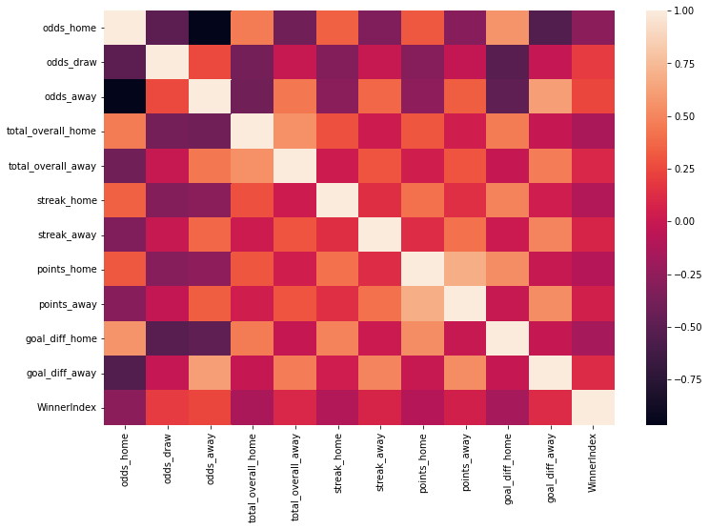
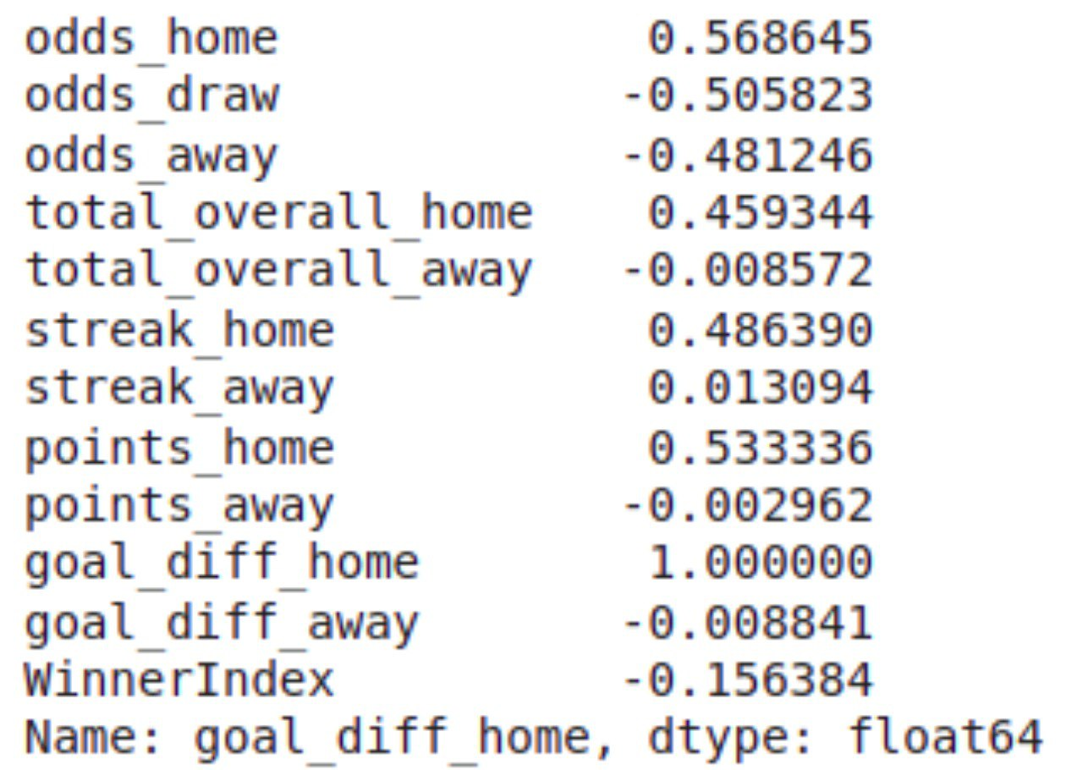
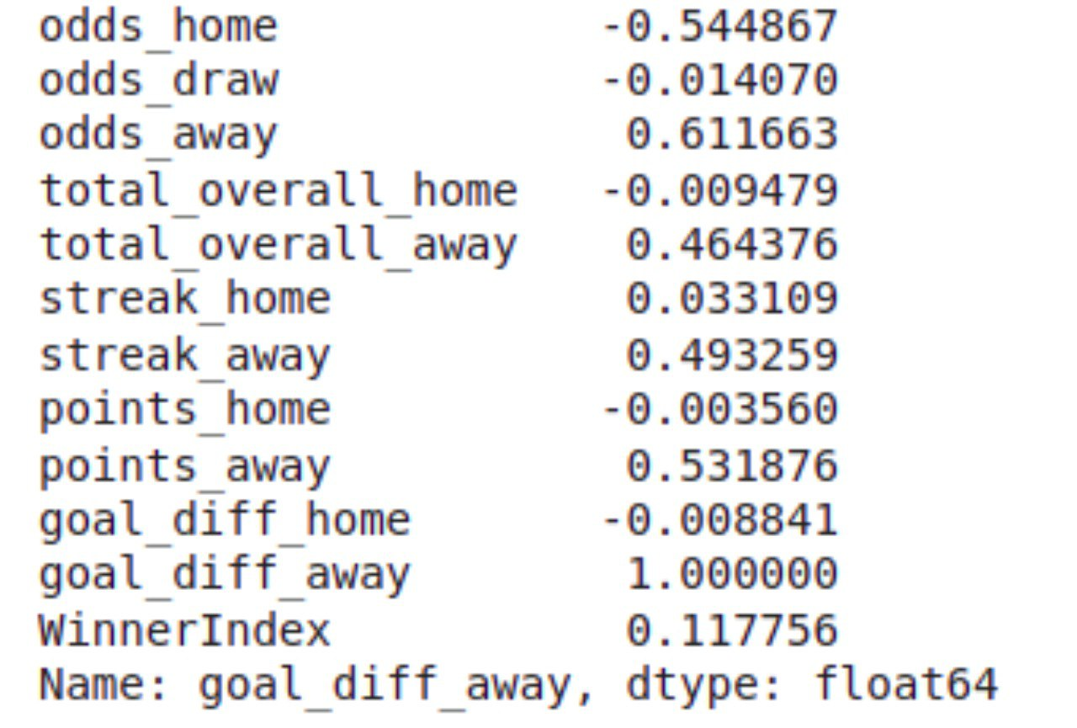
Correlation Matrix
Main aspects
Results:

Slide 28
MODELS

Slide 29
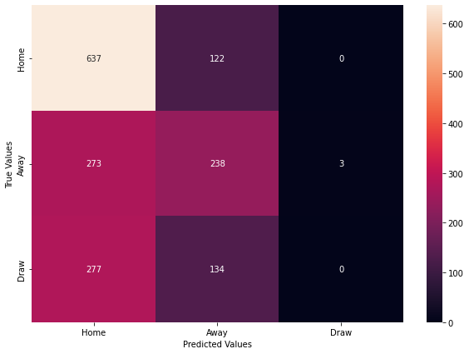
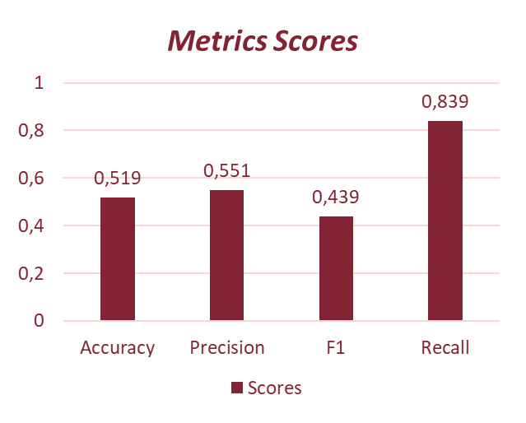
Bookkeepers Prediction
Main aspects of BK predictions and DF
Results:
Confusion Matrix

Slide 30
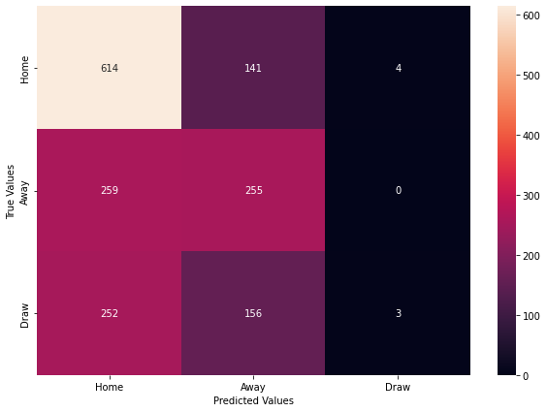
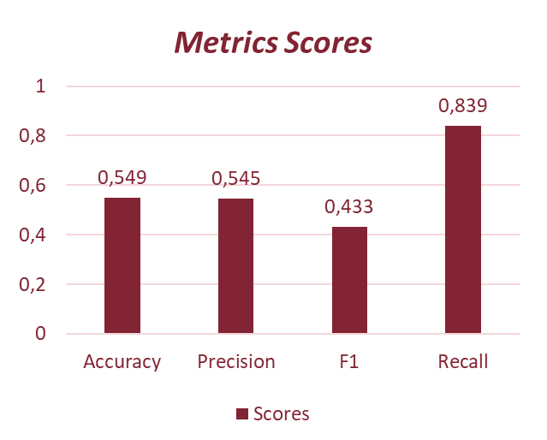
Logistic Regression
Main aspects
Results:
Confusion Matrix

Slide 31
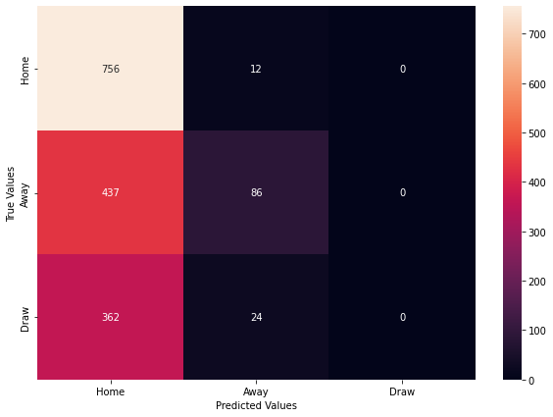
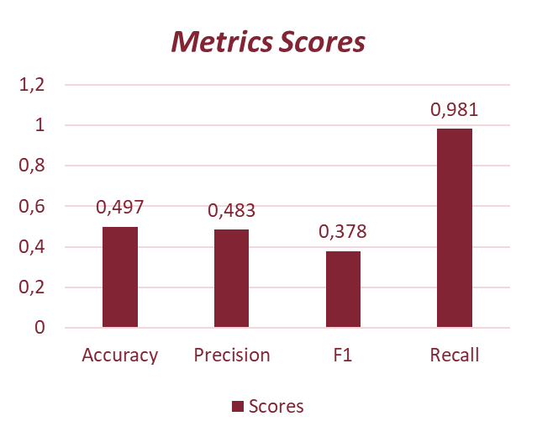
Naïve Bayes
Main aspects
Results:
Confusion Matrix

Slide 32

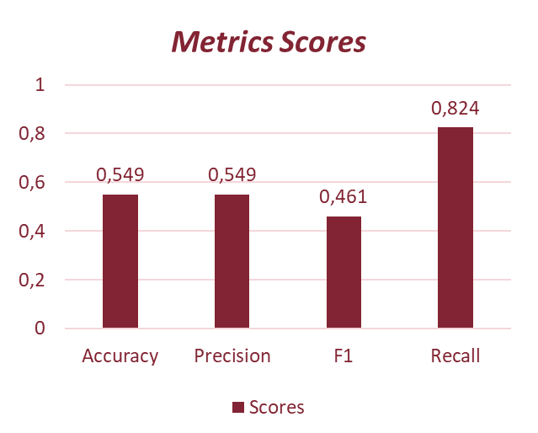
Random Forest Classifier
Main aspects
Results:
Confusion Matrix

Slide 33
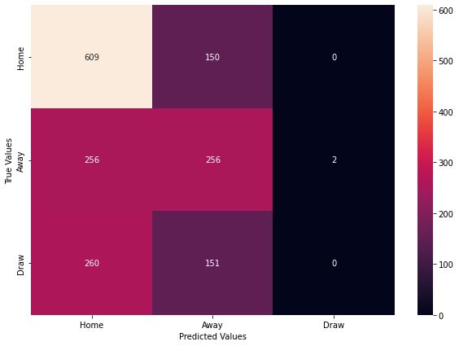

Support Vector Classifier w. One VS Rest
Main aspects and OVR Technique
Results:
Confusion Matrix

Slide 34
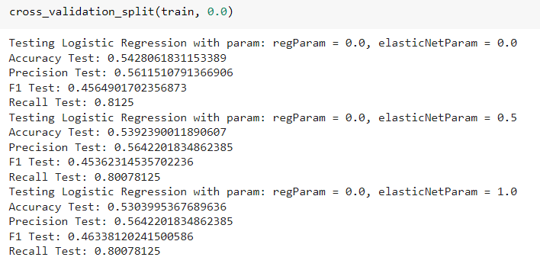
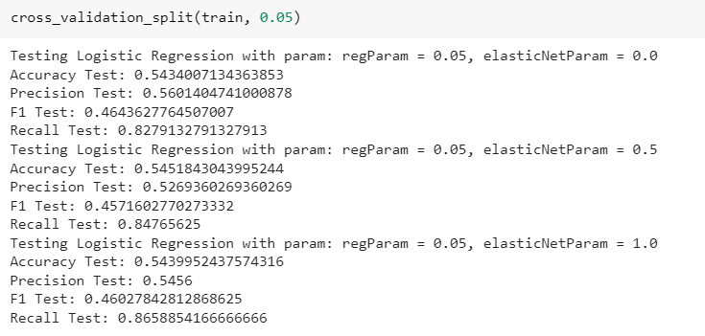
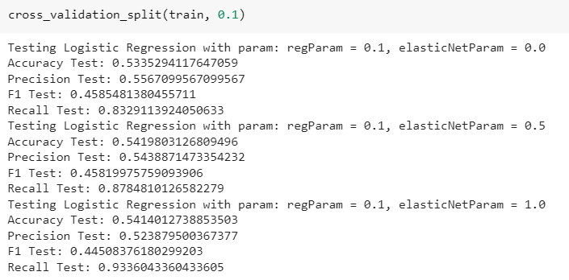
Some hints about our approach to Cross Validation
on Logistic Regression Model…
Initial approach
Cross Validator
Error!
RAM Overload
Solution!
Build our custom Cross Validation function and splitting parameters testing
Result
Deductions and Configuration

Slide 35
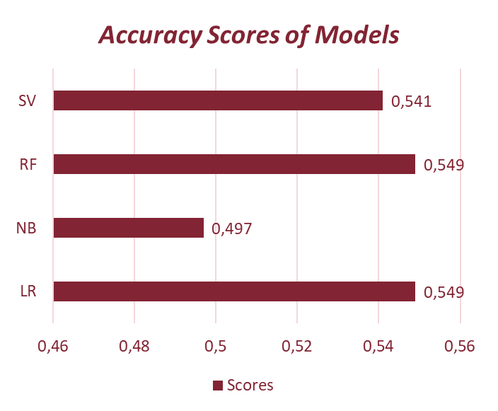
Summarizing…
Better models: Logistic Regression and Random Forest!
Because of better and more uniform performances over different train/test splits, we choiced use Logistic Regression Model as the selecteed model

Slide 36
Final results!
Final result: we manage to create a better performing module thank the BK leveraging their stats!
As shown in the confusion matrix, our models outperform the bookies especially regarding draw predictions

Slide 37




Extras… The Web Application
Pages
Homepage
Prediction Page
Naive Betting Page
Functionalities
Selecting the League and access the predicted probabilities for H, A, D
Set the budget to invest in order to simulate a naive betting process
Tools:
Ngrok: in order to obtain a public temporary url for the web-app
Flask Framework: to define web-app routes and policies
PySpark
HTML

Slide 38
Conclusions and possible improvements
Betting strategies
Even tho we outperformed the bookies in the match predictions, this doesn’t mean we can actually make money out of that since the pay outs vary depending on their prediction of the match
Our web app actually shows that allowing the user to delegate our model with a naive betting strategies implies a loss of money
Improvements
Implement cross validation for Random Forest
Improve the Web App
Implement a more sofisticated betting strategy (accumulator betting and leagues predictability exploiting)
Refine the feature extraction phase

Slide 39


Thank you for the attention!

