Slide 1

CAP455 OBJECT ORIENTED PROGRAMMING USING C++

Slide 2

Pointer to Pointer
A pointer to a pointer is a form of multiple indirection or a chain of pointers. Normally, a pointer contains the address of a variable. When we define a pointer to a pointer, the first pointer contains the address of the second pointer, which points to the location that contains the actual value as shown below.

Slide 3
Pointer to Pointer
#include <iostream>
using namespace std;
int main () {
int var;
int *ptr;
int **pptr;
var = 3000;
ptr = &var;
pptr = &ptr;
cout << "Value of var :" << var << endl;
cout << "Value available at *ptr :" << *ptr << endl;
cout << "Value available at **pptr :" << **pptr << endl;
return 0;
}

Slide 4
Dangling Pointers
A pointer pointing to a memory location that has been deleted (or freed) is called dangling pointer.
There are three different ways where Pointer acts as dangling pointer

Slide 5
1. De-allocation of memory
#include <cstdlib>
#include <iostream>
int main()
{
int* ptr = (int *)malloc(sizeof(int));
// After below free call, ptr becomes a
// dangling pointer
free(ptr);
// No more dangling pointer
ptr = NULL;
}

Slide 6
2. Function Call
#include <iostream>
int* fun()
{
int x = 5;
return &x;
}
int main()
{
int *p = fun();
fflush(stdin);
std::cout << *p;
return 0;
}

Slide 7
3. Variable goes out of scope
void main()
{
int *ptr;
.....
.....
{
int ch;
ptr = &ch;
}
.....
// Here ptr is dangling pointer
}

Slide 8
NULL Pointer
NULL Pointer is a pointer which is pointing to nothing. In case, if we don’t have address to be assigned to a pointer, then we can simply use NULL.
#include <iostream>
using namespace std;
int main()
{
// Null Pointer
int *ptr = NULL;
cout << "The value of ptr is " << ptr;
return 0;
}

Slide 9
Wild pointer
A pointer that has not been initialized to anything (not even NULL) is known as wild pointer. The pointer may be initialized to a non-NULL garbage value that may not be a valid address.
int main()
{
int *p; /* wild pointer */
int x = 10;
// p is not a wild pointer now
p = &x;
return 0;
}

Slide 10
Pointer as Class Member
Every class that has a pointer data member should include the following member functions:
a destructor,
a copy constructor,
operator= (assignment)
class IntList {
private:
static const int SIZE = 10; // initial size of the array
int *Items; // Items will point to the dynamically allocated array
int numItems; // number of items currently in the list
int arraySize; // the current size of the array
public:
IntList();
~IntList();
IntList(const IntList &L);
IntList & operator=(const IntList &L);
void AddToEnd(int k); // add k to the end of the list
void Print(ostream &output) const; // print the list to output
};

Slide 11
Pointer to Object
class Box {
public:
// Constructor definition
Box(double l = 2.0, double b = 2.0, double h = 2.0) {
cout <<"Constructor called." << endl;
length = l;
breadth = b;
height = h;
}
double Volume() {
return length * breadth * height;
}
private:
double length; // Length of a box
double breadth; // Breadth of a box
double height; // Height of a box
};

Slide 12
int main(void) {
Box Box1(3.3, 1.2, 1.5); // Declare box1
Box Box2(8.5, 6.0, 2.0); // Declare box2
Box *ptrBox; // Declare pointer to a class.
// Save the address of first object
ptrBox = &Box1;
// Now try to access a member using member access operator
cout << "Volume of Box1: " << ptrBox->Volume() << endl;
// Save the address of second object
ptrBox = &Box2;
// Now try to access a member using member access operator
cout << "Volume of Box2: " << ptrBox->Volume() << endl;
return 0;
}

Slide 13
‘this’ Pointer
To understand ‘this’ pointer, it is important to know how objects look at functions and data members of a class.
Each object gets its own copy of the data member.
All-access the same function definition as present in the code segment.
Meaning each object gets its own copy of data members and all objects share a single copy of member functions.
The compiler supplies an implicit pointer along with the names of the functions as ‘this’.
The ‘this’ pointer is passed as a hidden argument to all nonstatic member function calls and is available as a local variable within the body of all nonstatic functions. ‘this’ pointer is not available in static member functions as static member functions can be called without any object (with class name).

Slide 14
1) When local variable’s name is same as member’s name
class Test
{
private:
int x;
public:
void setX (int x)
{
// The 'this' pointer is used to retrieve the object's x
// hidden by the local variable 'x'
this->x = x;
}
void print() { cout << "x = " << x << endl; }
};
int main()
{
Test obj;
int x = 20;
obj.setX(x);
obj.print();
return 0;
}

Slide 15
2) To return reference to the calling object
class Test
{
private:
int x;
int y;
public:
Test(int x = 0, int y = 0) { this->x = x; this->y = y; }
Test &setX(int a) { x = a; return *this; }
Test &setY(int b) { y = b; return *this; }
void print() { cout << "x = " << x << " y = " << y << endl; }
};
int main()
{
Test obj1(5, 5);
obj1.setX(10).setY(20);
obj1.print();
return 0;
}

Slide 16
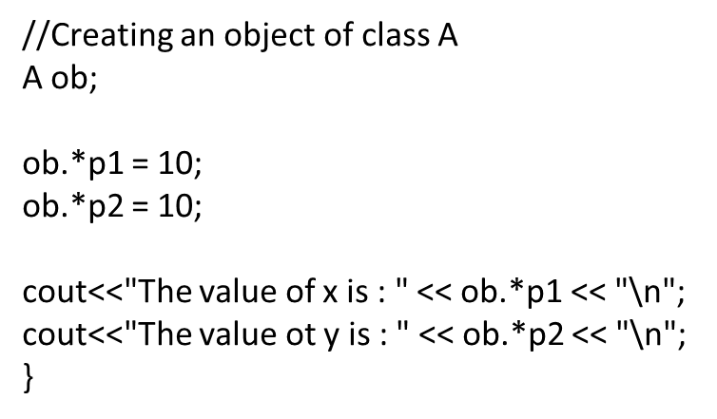
Pointer to data member
class A
{
public:
int x,y;
};
int main()
{
//Pointer to member variable x of class A
int A::* p1 = &A :: x;
//Pointer to member variable y of class A
int A::* p2 = &A :: y;

Slide 17

Any Query?

