Slide 1




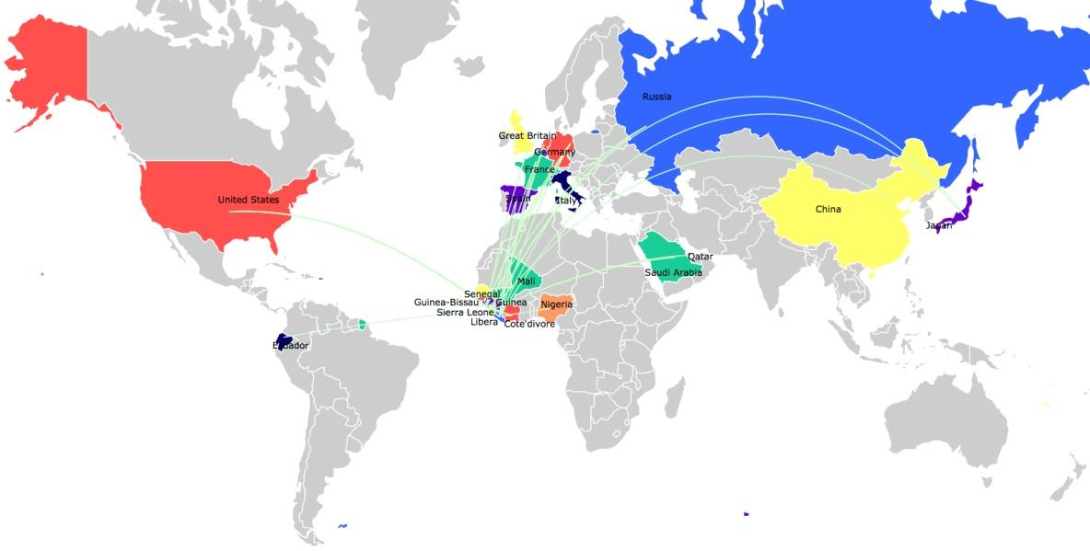
2014 Ebola Epidemic
Largest in History
CDC Estimates (Dec. 8, 2014)
  18,000 infected
  6,756 death
Major Outbreak in Guinea, Sierra Leone, Liberia
Also infected Mali, Nigeria, Senegal, United States, Spain

