Slide 1



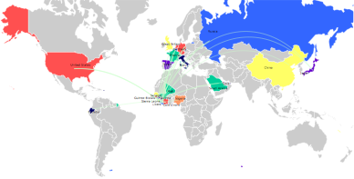
2014 Ebola Epidemic
Largest in History
CDC Estimates (Dec. 8, 2014)
18,000 infected
6,756 death
Major Outbreak in
Guinea, Sierra Leone and Liberia
Mali, Nigeria, Senegal, United States, Spain
also affected

