Slide 1
Погода в Телеграм

Slide 2
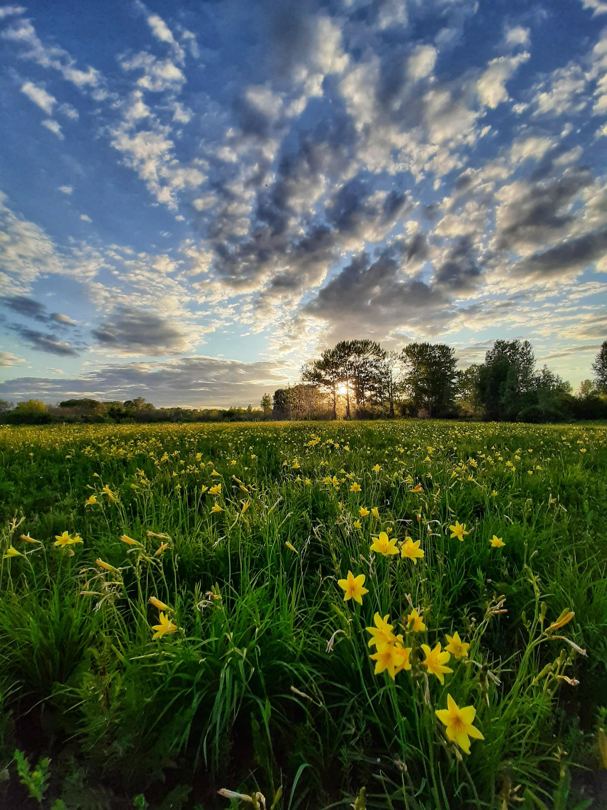
Цель проекта – создание телеграм бота, в котором можно было бы всегда получать актуальную погоду в своем городе.

Slide 3
API
В проекте использован OpenWeatherMap API для поиска и получения актуальной погоды по всему миру.

Slide 4
engaging the audience
Make eye contact with your audience to create a sense of intimacy and involvement
Weave relatable stories into your presentation using narratives that make your message memorable and impactful
Encourage questions and provide thoughtful responses to enhance audience participation
Use live polls or surveys to gather audience opinions, promoting engagement and making sure the audience feel involved

Slide 5
selecting visual aids
ENHANCING YOUR PRESENTATION

Slide 6
speaking impact
Learn to infuse energy into your delivery to leave a lasting impression
One of the goals of effective communication is to motivate your audience
METRIC | MEASUREMENT | TARGET | ACTUAL
Audience attendance | # of attendees | 150 | 120
Engagement duration | Minutes | 60 | 75
Q&A interaction | # of questions | 10 | 15
Positive feedback | Percentage (%) | 90 | 95
Rate of information retention | Percentage (%) | 80 | 85

Slide 7
Спасибо за внимание
Тимошевский Роман
9б класс гимназии №116

