Slide 2
1
2
3
4
API
(Microservice)
Handler
Unit of Work, Generic Repository, Event Bus,
Dependency Injection
…
Domain
Request
Response
ASP.NET Core
MediatR & AutoMapper
Entity Framework Core (SQL Server, MySQL, SQL Lite), Kafka, Swagger…
Pure C# Code
https://github.com/vietnam-devs/coolstore-microservices

Slide 3
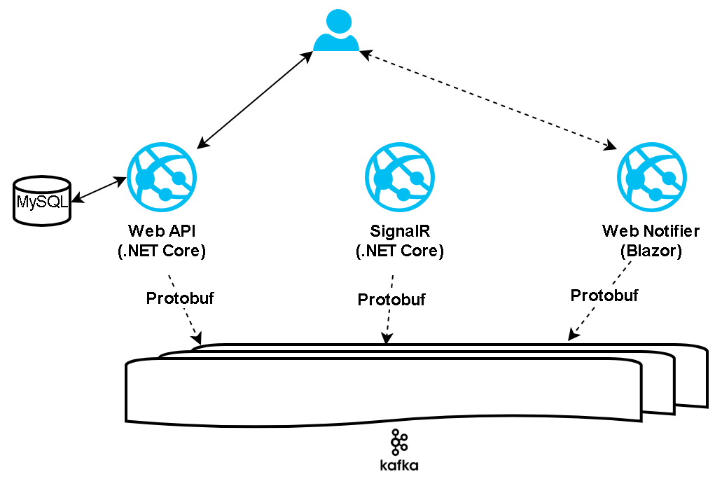

Slide 4
TaxType
(Enum)
CartItem
(Entity)
Product
(Identity)
Generic Repository
Cart
(Root Aggregate)
Unit Of Work
IShippingGateway
IPromoGateway
ICatalogGateway
ShippingGateway
PromoGateway
CatalogGateway
https://github.com/vietnam-devs/coolstore-microservices

Slide 5

Get Cart with Products
Add Product to a Cart
Update Product in the Cart
Delete Product in the Cart
Checkout

Slide 6
Clean Domain-Driven Design
4
3
2
1
API
(Presenter)
Handler
Unit of Work, Generic Repository, Event Bus,
Dependency Injection
…
Domain
Request
Response
ASP.NET Core
MediatR & AutoMapper
Entity Framework Core (SQL Server, MySQL, SQL Lite), Kafka, Swagger…
Pure C# Code
https://github.com/vietnam-devs/coolstore-microservices

Slide 7
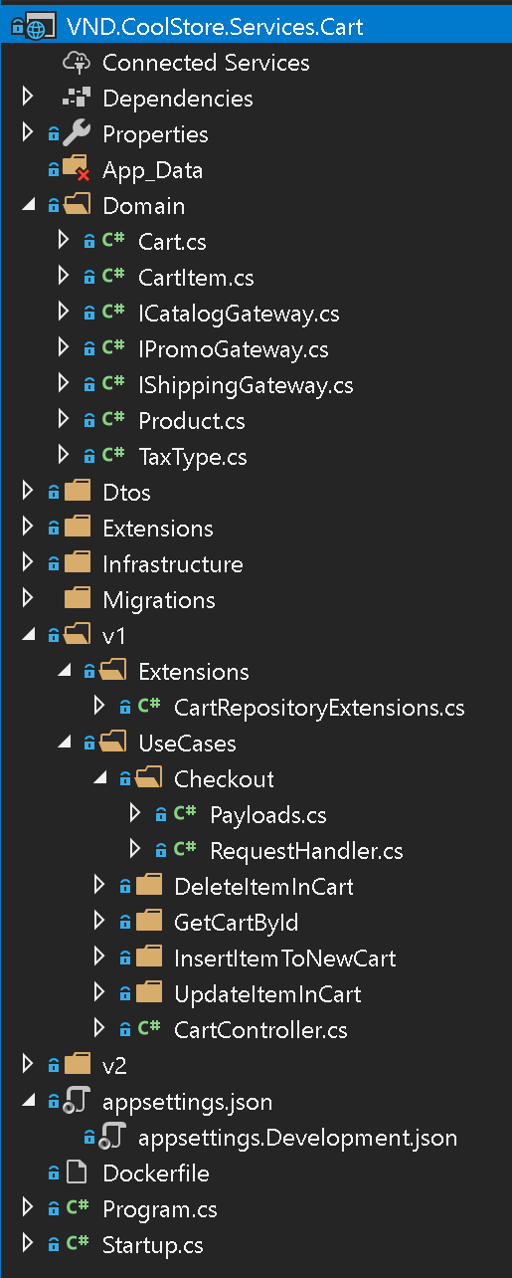
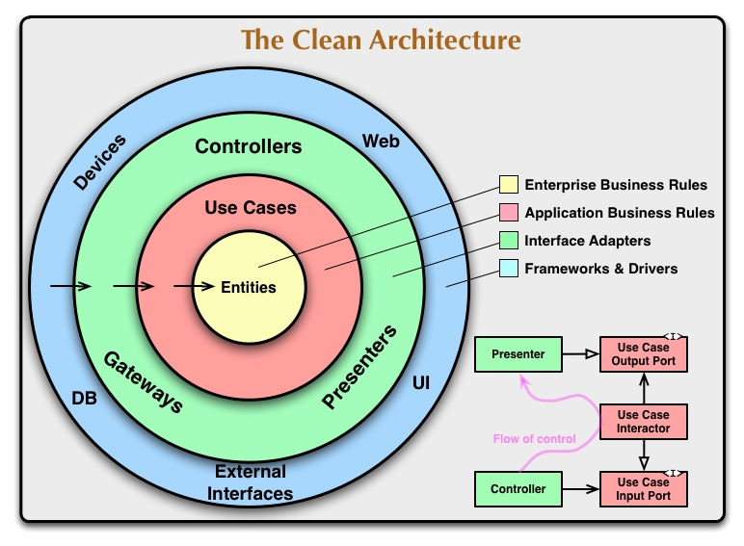
Clean Domain-Driven Design
https://github.com/vietnam-devs/coolstore-microservices

Slide 8








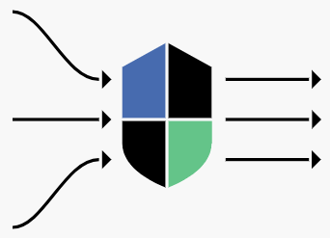




Pubic Websites
Web
Back Office
Sidecar
istio/proxy
Aggregator Microservices
REST
REST / GRAPHQL
Istio Gateway
gRPC
gRPC
gRPC
gRPC
Catalog
Rating
Cart
Inventory
Domain Microservices
https://github.com/vietnam-devs/coolstore-microservices

Slide 9
Pubic Websites
Web
Back Office
Sidecar
istio/proxy
Aggregator Microservices
REST
REST / GRAPHQL
Istio Gateway
gRPC
gRPC
gRPC
gRPC
gRPC
gRPC
Catalog
Rating
Cart
Inventory
Review
Pricing
Domain Microservices
https://github.com/vietnam-devs/coolstore-microservices

Slide 10
Web UI
Blazor
Cart
Rating
Review
Inventory
Catalog
Pricing
https://github.com/vietnam-devs/coolstore-microservices

Slide 11
Web Front-end
Cart
Rating
Review
Inventory
Catalog
Pricing
https://github.com/vietnam-devs/coolstore-microservices

Slide 12




Web Front-end
Aggregation
Service
Rating
Review
Inventory
Catalog
Cart
Pricing
https://github.com/vietnam-devs/coolstore-microservices

Slide 13




Web UI
Vuejs + Nodejs
Gateway
SQL Server
Rating
Review
Inventory
Catalog
Cart
Pricing
Mongo DB
SQL Server
SQL Server
Mongo DB

Slide 14
Bounded Context
IEventBus
(Internal)
IDispatchedBus
Outbox
(Storage)
2
Entity
Entity
Domain Events
Domain
Events
Outbox Message
(Domain Event
Envelop)
Value Object
IRepository
Domain Event Envelop
Outbox Job
1
Notification Handler<>
Command Scheduler<>
Internal Commands
(Storage)
Command Handler<>
Domain Event
Envelop
Internal Command
Internal Command
Notification Handler<>
Integration Event
1
2
Internal Command
Inbox Job
Internal Command Job
Publish (Integration Event)
Inbox
(Storage)
Integration Event Handler<>
IBusClient
Distributed Bus
(NATS, Kafka Redis)
Inbox Message
(Domain Event
Envelop)
Integration
Event
Subscribe
(Integration Event)

