Slide 2
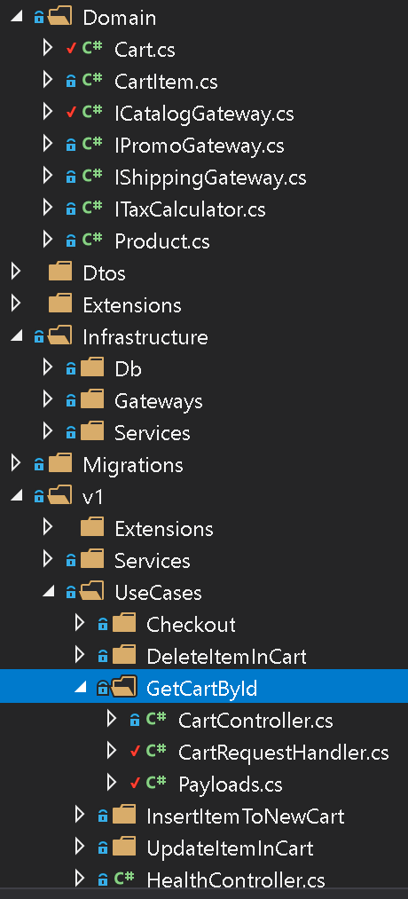
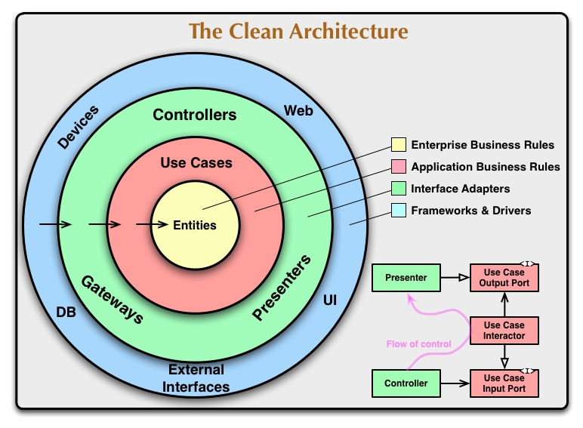

Slide 3








Web Front-end
Cart
Rating
Review
Inventory
Catalog
Pricing
https://github.com/vietnam-devs/coolstore-microservices

Slide 4




Web Front-end
Aggregation
Service
Rating
Review
Inventory
Catalog
Cart
Pricing
https://github.com/vietnam-devs/coolstore-microservices

Slide 5




Web UI
Vuejs + Nodejs
Gateway
SQL Server
Rating
Review
Inventory
Catalog
Cart
Pricing
Mongo DB
SQL Server
SQL Server
Mongo DB

