Slide 1
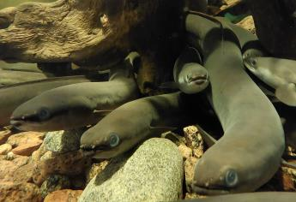
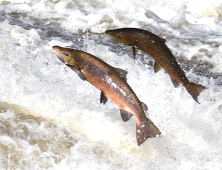
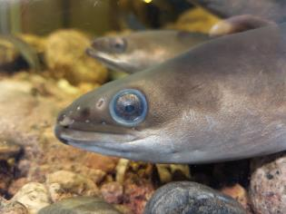
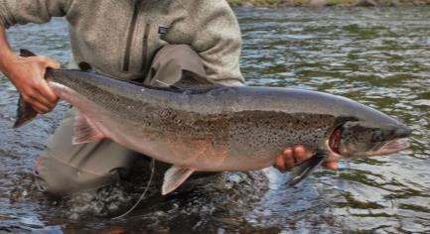














WP4 - Enhancing stock assessment models (Task 4.3. - Benchmarking tools to enhance computational performance of SAM) Optimizing MCMC Workflows in Complex Ecological Models Lessons from salmon and eels stock assessment models (Focus on efficiency, HMC challenges, and NIMBLE workflow design) Romuald HOUNYEME, UMR DECOD, Institut Agro, France Collaborations Etienne Rivot, Rémi Patin, Marie-Pierre Etienne, Hilaire Drouineau, Rob van Gemert
©Helminen
©U3E
©Helminen
©Helminen
Meeting with Perry de Valpine - October 15th, 2025
The EU is not responsible for the content of the project
Notes:
Slide 1 – Introduction
Hello everyone and thank you for joining this discussion.
I’m Romuald Hounyeme, from Institut Agro Rennes, working in the DIASPARA project (Work Package 4), focused on enhancing stock assessment models through computational benchmarking. My presentation is about how we can optimize MCMC workflows in complex ecological models using NIMBLE, and what challenges we face when using HMC and NUTS samplers for large-scale hierarchical systems.

Slide 2
Special thanks to Perry de Valpine and the NIMBLE development team for the forthcoming discussion!!!
Acknowledgments

