Slide 1
HOTMOBILE 2027
Evicting Makes It Slower:
Three Properties a KV Cache Policy Needs on a Phone
Five published eviction policies, run in their own configurations on a OnePlus 15.
None behaves as published. Two engine properties explain it, and a third decides quality.
Md Romyull Islam · Kennesaw State University
OnePlus 15, Snapdragon 8 Elite Gen 5, Adreno 840 · every number measured on the device

Slide 2
THE PROBLEM
The phone is bound by the cache, not the matrix multiply
Cache size
Phi-3 at 2K holds 768 MiB of f16 KV
DRAM traffic
every step reads the whole cache once per layer
Heat
the vendor cuts the prime cores to 883 MHz at battery 50 °C
Energy
a 4096-token GPU request costs 1.4 kJ at full clock
One chain. Cache size sets traffic, traffic sets power, power sets temperature, temperature sets the throttle, and the throttle sets throughput.
So a mobile cache policy has to be judged on quality, throughput, heat and energy at once, on real hardware.
Every policy below was built for a server GPU and judged by perplexity alone.
2

Slide 3
THE THESIS
Three properties decide the outcome. Every published policy lacks one.
Policy class | Budget frees cells | Keeps the fused kernel | Retrieval survives
SnapKV, Ada-KV, H2O, TOVA | no, 36 to 68% held | no, 0.12 to 0.20x | yes
StreamingLLM | yes, 20.6% held | yes, 1.19x | no, 2 to 3 of 14 needles
μKV | yes, 7.4% held | yes, 1.19x | yes, ties the full cache
• Sequence-level selection, or the shared cell array frees nothing.
• No attention-score read at decode, or FlashAttention is lost and eviction makes the phone slower.
• Content-aware selection, or the needles go with the middle of the prompt.
μKV is the existence proof that one policy can hold all three at once. It is not a new selection rule.
3

Slide 4
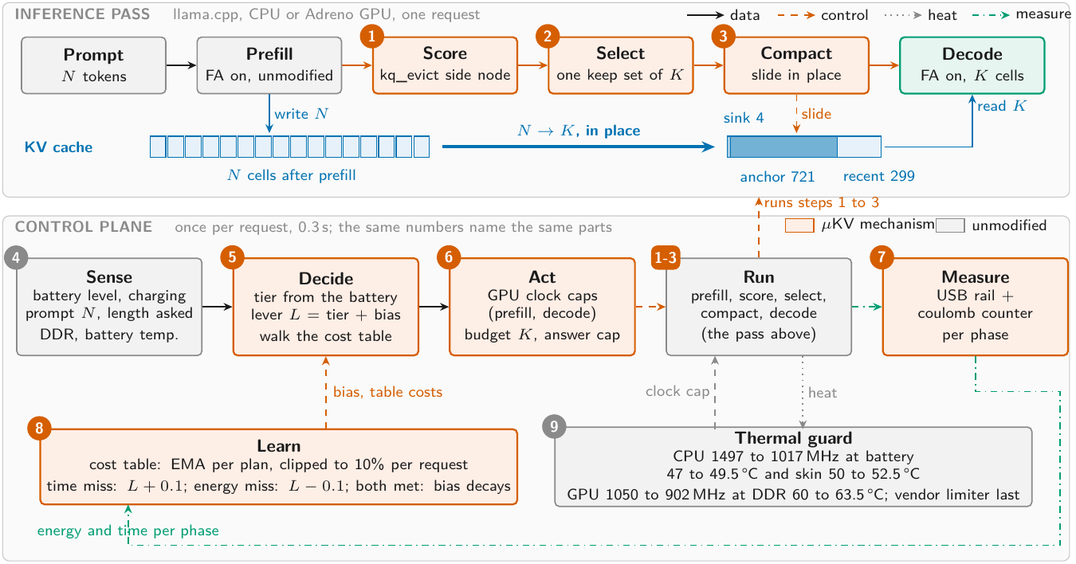
DESIGN
μKV on the phone: three changes to the pass, one controller beside it
One figure, nine parts: 1-3 the pass, 4 sense, 5 decide, 6 act, 7 measure, 8 learn, 9 thermal guard. The paper's architecture and control-plane figures are now merged into this one.
4

Slide 5
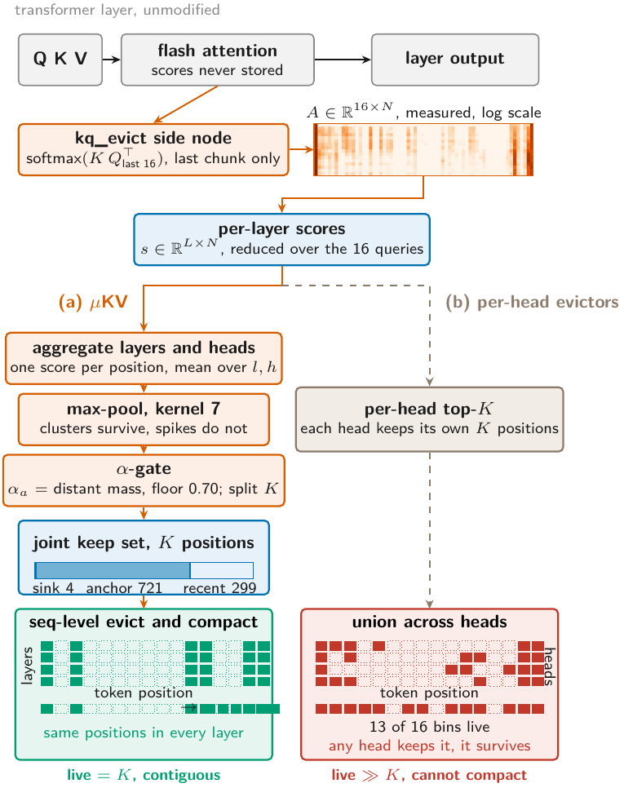
MECHANISM
Selection is sequence-level, from real attention captured in-graph
• Mean over layers and heads, then max-pool over 7 positions.
• A per-prompt split αa sets anchors against the recent window, floored at 0.70.
• On the 9737-token prompt: 4 sinks, 721 anchors, 299 recent = K of 1024.
• One keep set for every head and layer, which is what lets the array compact.
• Heat map is a real capture on Llama-3.2-1B, layer 8, 16 queries.
5

Slide 6
FROM THE SIDE NODE TO THE KEEP SET
Every part of Figure 2, in order, and what each one produces
 | Part, as labelled in the figure | What it does | What comes out
a | Q K V → flash attention → output | the unmodified layer; the fused kernel never stores attention | layer output only
b | kq_evict side node | softmax(K Qᵀ) for the last 16 queries, last chunk, as a graph output | raw attention, 16 queries
c | heat map, A ∈ ℝ^(16×N) | a real capture, Llama-3.2-1B layer 8, log scale | the 16 × N attention block
d | per-layer scores, s ∈ ℝ^(L×N) | averages the 16 query rows away | one score per layer, per position
e | aggregate layers and heads | mean over l and h; this is what makes selection sequence-level | one score per position
f | max-pool, kernel 7 | each position takes its 7-wide max: clusters survive, spikes do not | smoothed score
g | α-gate | αa is the mass outside the recent window, floor 0.70; it splits K | n_anchor and n_recent
h | joint keep set, K positions | top n_anchor by score, plus 4 sinks, plus the recent window | 4 sinks + 721 anchors + 299 recent
i | seq-level evict and compact | every layer keeps the same positions, so survivors slide together | live = K, contiguous
 | BRANCH (b): what a per-head evictor does instead
j | per-head top-K | skips part e; each head keeps its own K positions | K per head, different sets
k | union across heads | a position survives if any head keeps it | 13 of 16 bins live, cannot compact
Measured instance: on the 9737-token prompt αa came out at 0.71, so K = 1024 is 4 sinks, 721 anchors and 299 recent cells. Parts b to d are step 1 of Figure 1, e to h are step 2, i is step 3.
6

Slide 7
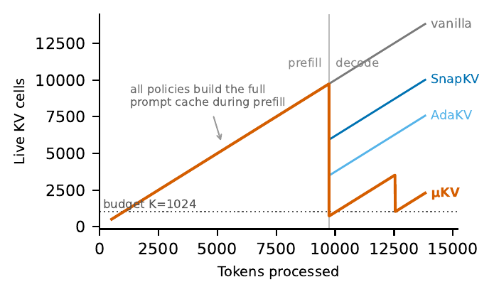
WHY BUDGETS DO NOT MATERIALIZE
Every policy builds the full prompt cache. Only some give it back.
• One cell array serves every head and every layer.
• A cell is freed only when every head and every layer drops it.
• SnapKV bottoms out at 5.9K live cells against a nominal 1024.
• μKV compacts to 721 and its re-eviction holds near 2K.
7

Slide 8
TABLE 1 · SUSTAINED DECODE ON THE PHONE CPU
9737-token prompt, 4096 generated, matched budget 1024
Policy | tok/s | Wall (s) | Live cells | DDR °C | mWh
vanilla (full cache) | 5.0 | 1055 | 9737 | 59.8 | 1033
μKV | 24.2 | 406 | 721 (1980) | 54.4 | 391
SnapKV | 6.8 | 902 | 5929 | 56.3 | 818
Ada-KV | 6.7 | 875 | 3484 | 57.1 | 1002
StreamingLLM | 6.6 | 877 | 777 | 56.7 | 1052
H2O | 5.8 | 1006 | 6110 | 54.8 | 1094
TOVA | 6.0 | 947 | 4091 | 54.4 | 1069
Llama-3.2-1B
μKV buys 4.8x the throughput at 7% of the cells and 62% less energy, with a DDR peak 5 °C below vanilla.
The four per-head evictors run at 5.8 to 6.8 tok/s and 818 to 1094 mWh against vanilla's 1033. That spread straddles the full cache rather than beating it.
Caveat: this campaign ran StreamingLLM without the fused-kernel flag, so its row understates it. See the GPU correction.
8

Slide 9
TABLE 1 continued
Three more models, each baseline at its own published budget
Bonsai-8B (1-bit weights), Phi-3-mini and gemma-2-2b. μKV at K = 1024 throughout.
Model | vanilla tok/s | μKV tok/s | gain | vanilla mWh | μKV mWh | energy cut | μKV cells
Bonsai-8B | 1.0 | 4.5 | 4.5x | 5758 | 2312 | 60% | 789 (1993)
Phi-3-mini | 1.2 | 5.5 | 4.5x | 2046 | 926 | 55% | 929
gemma-2-2b | 3.9 | 9.3 | 2.4x | 974 | 589 | 40% | 804
At their own published budgets the gap widens: SnapKV at 2048 per head keeps 94% of the cache, H2O at 20% of the prompt keeps 92%, TOVA and Ada-KV keep 77% and 71%. μKV keeps 14%.
On Bonsai-8B the full cache reaches a 72.2 °C DDR peak. μKV reaches 62.5 °C, 9.7 °C cooler, with no change to the model's parameters.
9

Slide 10
FINDING 1 · THE REALIZABILITY GAP
What each paper actually says, and what the phone gives back
Phone CPU, Llama-3.2-1B, 110 LongBench prompts, mean 8043 tokens. Every baseline at its own published budget, not ours.
Policy | What the paper actually says | Its own budget, as we ran it | Cache kept
 | CLAIMS A MEMORY REDUCTION
SnapKV | “an 8.2x enhancement in memory efficiency” at 16K inputs | 2048 per head | 94%
H2O | “reduce KV cache memory footprint by 5-10x” | 20% of the prompt | 92%
TOVA | “nearly on par …, in some cases only 1/8 of the original cache” | 2048 per layer | 77%
 | MAKES NO MEMORY-REDUCTION CLAIM
Ada-KV | “the first head-wise adaptive budget allocation strategy” | 2048 per head, reallocated | 71%
StreamingLLM | a speed claim: “up to 22.2x speedup” over recompute | 4 sinks + 2000 recent | 33%
μKV (this work) | — | 1024, sequence-level | 14%
The contradiction is only a contradiction where a memory claim was made. SnapKV and H2O claim a ratio and do not deliver it here. TOVA hedges its own claim.
Ada-KV claims quality gains at a budget you give it, and StreamingLLM claims speed. Their rows report what a per-head or windowed budget simply leaves live on this engine.
Report realized cells, not selection ratios.
10

Slide 11
TABLE 2 · MOBILE GPU, GROUPED BY HOW EACH POLICY SELECTS
Adreno 840, Llama-3.2-1B, ctx 16384, cooled per cell
Policy | n | tok/s | dec x | Cells | % cache
vanilla (no eviction) | 3 | 24.30 | 1.00 | 9741 | 100
SEQUENCE-LEVEL · budget frees cells, kernel survives
μKV, K = 1024 | 3 | 29.02 | 1.19 | 723 | 7.4
StreamingLLM, own budget | 3 | 29.03 | 1.19 | 2005 | 20.6
PER-HEAD · budget frees nothing, kernel is lost
SnapKV | 1 | 4.76 | 0.20 | 6592 | 67.7
H2O | 1 | 3.58 | 0.15 | 6110 | 62.7
TOVA | 1 | 4.34 | 0.18 | 4125 | 42.3
Ada-KV | 1 | 2.86 | 0.12 | 3519 | 36.1
CONTROLS · one property removed at a time
μKV, compaction off | 3 | 25.61 | 1.05 | 723 | 7.4
StreamingLLM, forced off the kernel | 3 | 5.81 | 0.24 | 777 | 8.0
On this phone, four of five published policies decode slower than not evicting at all.
11

Slide 12
AN ERROR WE FOUND IN OUR OWN HARNESS
StreamingLLM was run without the fused-kernel flag
Arm | tok/s | vs vanilla | Cache held | Needles
vanilla | 24.30 | 1.00 | 304.4 MB | 13 / 14
μKV, K = 1024 | 29.02 | 1.19 | 22.6 MB | 13 / 14
StreamingLLM, own budget 2004 | 29.03 | 1.19 | 62.6 MB | 3 / 14
StreamingLLM, as we first ran it | 5.81 | 0.24 | 24.3 MB | invalid output
• StreamingLLM's reference implementation concatenates survivors, so compaction is intrinsic to it. Our harness removed it.
• Corrected, it ties μKV on throughput. "μKV is the only policy faster than not evicting" was false and is gone.
• This makes the result stronger. A policy we did not author confirms that the axis of selection, not our design, is what matters.
• What separates μKV is budget and retrieval: 723 cells against 2005, and 13 needles against 3.
12

Slide 13
TABLE 3 · RETRIEVAL
A fact buried at one of seven depths in 4K or 8K of filler, 392 cells
Policy | Phi-3 | Llama-1B | Gemma-2B | Bonsai-8B | Cells attended
vanilla (full cache) | 14 | 13 | 11 | 14 | 4858
μKV | 14 | 13 | 11 | 14 | 774
SnapKV | 14 | 12 | 11 | 14 | 4237
Ada-KV | 14 | 12 | 11 | 14 | 3361
TOVA | 14 | 12 | 11 | 14 | 3670
H2O | 14 | 8 | 10 | 13 | 4212
StreamingLLM | 3 | 3 | 2 | 3 | 890
μKV matches the full cache on every model while attending to 774 cells, against 3361 to 4237 for the score-reading evictors.
StreamingLLM fails everywhere: its window evicts exactly the middle of the context. Where every policy misses a depth, the full cache misses it too.
This workload generates 64 tokens, so it is prefill-dominated and says nothing about speed or energy.
13

Slide 14
TABLE 4 · LONGBENCH, FIVE TASKS, 50 SAMPLES EACH
Llama-3.2-1B and gemma-2-2b-it
Llama-3.2-1B | HotpotQA | 2WikiMQA | MultiFieldQA | Qasper | TriviaQA | Avg | Cells kept
vanilla | 42.14 | 23.86 | 45.04 | 17.55 | 81.19 | 41.96 | 8687 (100%)
μKV | 40.72 | 25.53 | 43.23 | 17.06 | 83.88 | 42.08 (+0.1) | 826 (13.0%)
SnapKV | 41.14 | 23.51 | 45.02 | 22.81 | 81.19 | 42.73 (+0.8) | 6717 (82.4%)
Ada-KV | 41.84 | 22.17 | 46.16 | 22.10 | 81.19 | 42.70 (+0.7) | 3327 (47.3%)
TOVA | 41.61 | 22.98 | 45.62 | 21.93 | 81.86 | 42.80 (+0.8) | 3824 (53.5%)
H2O | 42.68 | 24.04 | 41.87 | 19.35 | 81.20 | 41.83 (-0.1) | 6699 (83.1%)
StreamingLLM | 35.61 | 18.14 | 36.52 | 16.51 | 81.00 | 37.56 (-4.4) | 1994 (23.0%)
gemma-2-2b-it | HotpotQA | 2WikiMQA | MultiFieldQA | Qasper | TriviaQA | Avg | Cells kept
vanilla | 46.51 | 34.51 | 45.19 | 36.42 | 87.67 | 50.06 | 6457 (100%)
μKV | 40.32 | 37.20 | 39.63 | 31.71 | 87.67 | 47.31 (-2.8) | 716 (13.0%)
SnapKV | 40.51 | 36.81 | 45.40 | 38.38 | 87.44 | 49.71 (-0.4) | 6031 (94.2%)
Ada-KV | 40.51 | 36.81 | 44.55 | 37.26 | 87.44 | 49.31 (-0.7) | 4064 (66.3%)
TOVA | 41.52 | 37.31 | 44.37 | 37.45 | 87.44 | 49.62 (-0.4) | 4087 (66.9%)
H2O | 37.38 | 37.31 | 43.61 | 35.37 | 87.44 | 48.22 (-1.8) | 5869 (92.1%)
StreamingLLM | 41.51 | 32.67 | 38.72 | 28.59 | 87.67 | 45.83 (-4.2) | 1995 (30.9%)
14

Slide 15
TABLE 4 continued
Phi-3-mini and Bonsai-8B
Phi-3-mini | HotpotQA | 2WikiMQA | MultiFieldQA | Qasper | TriviaQA | Avg | Cells kept
vanilla | 46.86 | 43.51 | 57.05 | 36.92 | 87.87 | 54.44 | 9702 (100%)
μKV | 45.97 | 43.18 | 55.85 | 40.80 | 86.37 | 54.43 (-0.0) | 853 (12.2%)
SnapKV | 46.85 | 40.01 | 55.62 | 38.35 | 87.20 | 53.61 (-0.8) | 7629 (83.4%)
Ada-KV | 46.90 | 38.48 | 56.51 | 37.33 | 87.87 | 53.42 (-1.0) | 4056 (50.6%)
TOVA | 54.81 | 38.67 | 55.33 | 50.60 | 87.87 | 57.45 (+3.0) | 4550 (54.9%)
H2O | 48.32 | 39.66 | 56.12 | 36.97 | 88.20 | 53.85 (-0.6) | 8702 (91.2%)
StreamingLLM | 40.71 | 41.88 | 40.05 | 30.68 | 87.87 | 48.24 (-6.2) | 1999 (20.6%)
Bonsai-8B | HotpotQA | 2WikiMQA | MultiFieldQA | Qasper | TriviaQA | Avg | Cells kept
vanilla | 35.11 | 33.39 | 50.03 | 38.53 | 86.15 | 48.64 | 8928 (100%)
μKV | 35.16 | 24.33 | 48.13 | 32.30 | 84.95 | 44.97 (-3.7) | 797 (12.6%)
SnapKV | 38.58 | 34.30 | 50.12 | 38.59 | 88.15 | 49.95 (+1.3) | 8716 (96.1%)
Ada-KV | 34.46 | 34.48 | 50.75 | 37.56 | 87.48 | 48.95 (+0.3) | 5293 (68.2%)
TOVA | 37.06 | 30.19 | 50.76 | 37.88 | 87.48 | 48.67 (+0.0) | 5700 (72.5%)
H2O | 36.66 | 28.54 | 49.03 | 34.97 | 88.15 | 47.47 (-1.2) | 7798 (90.9%)
StreamingLLM | 34.40 | 24.97 | 30.13 | 30.24 | 86.26 | 41.20 (-7.4) | 2246 (25.2%)
Desktop GPU, f16 KV, K = 1024; StreamingLLM at its own budget of 2004. The phone pass is on the next slide.
15

Slide 16
TABLE 5 · LONGBENCH ON THE PHONE
103 prompts on the phone CPU, Llama-3.2-1B, each policy at its own budget
Policy | Budget | 2Wiki | Hotpot | Qasper | Trivia | Mean | Cache
vanilla (full cache) | full | 22.79 | 29.29 | 19.96 | 75.35 | 36.85 | 100%
μKV | 1024 | 27.86 | 25.96 | 19.01 | 75.21 | 37.01 | 14%
SnapKV | 2048 | 20.50 | 31.43 | 20.72 | 79.19 | 37.96 | 94%
Ada-KV | 2048 | 20.75 | 31.43 | 19.66 | 79.19 | 37.76 | 71%
TOVA | 2048 | 18.75 | 31.37 | 20.33 | 79.19 | 37.41 | 77%
H2O | 20% of N | 14.61 | 31.32 | 19.58 | 79.19 | 36.17 | 92%
StreamingLLM | 2004 | 22.59 | 22.63 | 18.59 | 76.14 | 34.99 | 33%
μKV scores 37.0 against the full cache's 36.9 while holding 14% of the cache.
SnapKV, Ada-KV and TOVA gain 0.6 to 1.1 F1 while holding 71 to 94%. What separates the policies is the cache each one frees, not the budget it asks for.
16

Slide 17
IS THIS ONE ENGINE?
No. The coupling lives in the KV memory layout.
Engine | How KV memory is laid out | Can a per-head budget free memory?
llama.cpp | one contiguous cell array per layer | only where every head agrees
vLLM PagedAttention | block = [blocks, kv heads, head size, block size] | only where every head agrees
MLC-LLM | paged, the same shape | only where every head agrees
ExecuTorch, vendor SDKs | static position-indexed tensors | only where every head agrees
KV-Compress reports the same limitation independently: per-head eviction "adds fragmentation and cannot realize the theoretical compression rates in physical memory."
It fixes this on the server by paging per head inside PagedAttention. That needs a per-head block table and a custom kernel.
A phone runtime has neither, and a mobile GPU driver makes both expensive. That is the point.
17

Slide 18
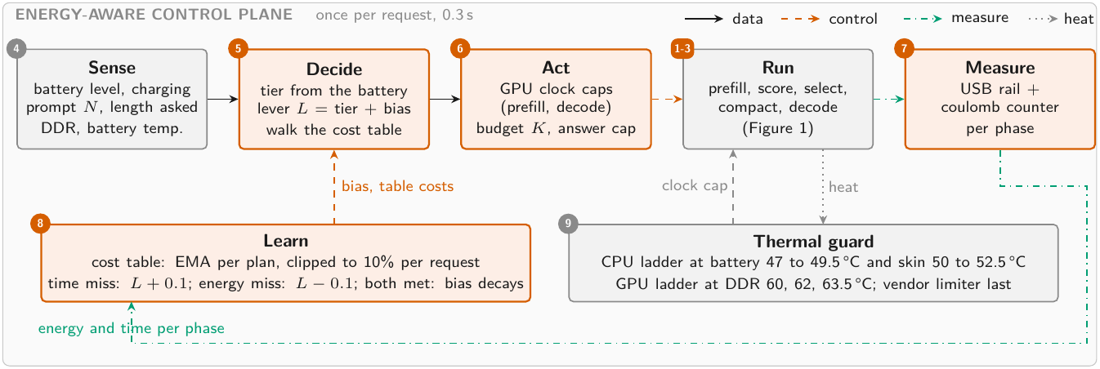
CONTROL PLANE
One lever, two loops, and a cost table measured on the device
The lower half of the figure above, enlarged. Run is steps 1 to 3. No online policy learning runs on the phone; the decision is a deterministic table walk.
18

Slide 19
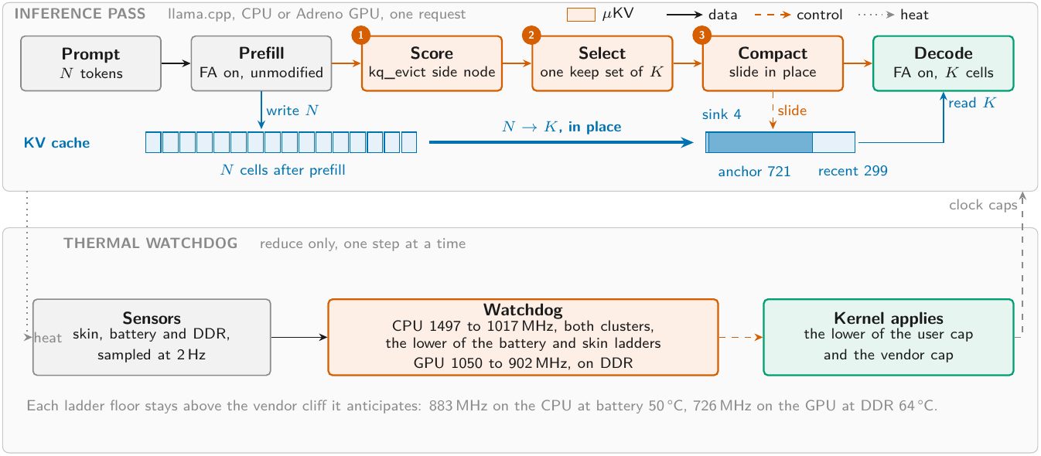
THE WATCHDOG IS A LADDER, NOT A CAP
Three caps, five ladders, three sensors, reduce only
Each CPU cluster takes the lower of the battery and skin ladders. DDR above 71 °C floors both to 1267 MHz. Battery here is temperature in °C, not charge in %; the scheduler tiers use charge.
19

Slide 20
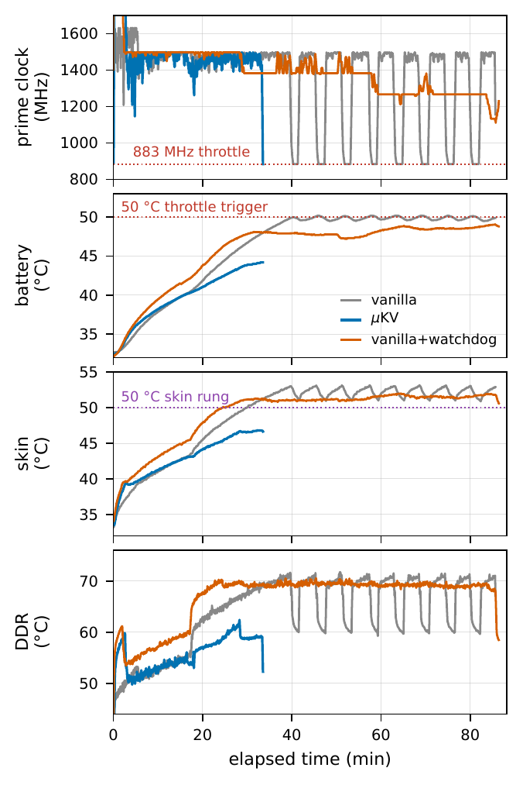
THE WORKLOAD THAT REACHES THE CLIFF
Bonsai-8B, phone CPU, full cache against μKV
• The full cache runs 85.6 minutes and drives the battery to 50.2 °C.
• At 50 °C the vendor deep-throttles both clusters to 883 MHz, in a sawtooth of 17 dips totalling 923 s.
• μKV finishes in 33.2 minutes at a 44.2 °C peak, before the trigger ever fires.
• Given the watchdog, the full cache's battery rise flattens from 0.48 to 0.05 °C per minute.
• The watchdog never fired in any Table 1 cell. That result is pure eviction.
20

Slide 21
A NEGATIVE RESULT WORTH REPORTING
Cache size is not a temperature actuator
• We tied the cache budget itself to DDR temperature, a four-tier ladder over K in {256 ... 1024}.
• Halving K under co-load left peak DDR unchanged.
• On a cool phone a smaller cache runs hotter at peak, because the saved bandwidth converts straight into speed and power.
• On the GPU the clock ladder does work: 1289 against 1390 J and a DDR peak of 75 against 90 °C, for 1% more time.
Cache size controls throughput, time and energy. The clock caps heat.
21

Slide 22
TABLE 6 · ENERGY-AWARE SCHEDULING
123 requests through a real discharge, 91% to 11%, charging off
Battery charge | GPU plan (MHz) | Answer cap (tokens) | Cable J | Battery J | Battery s
mains or above 50% | 1200, decode 902 | 4096 | 1336 | 885 | 280
21 to 50% | 1200, decode 726 | 1024 | 577 | 748 | 210
20% or below | 902 | 512 | 500 | 506 | 177
GPU unavailable | CPU, K = 1024 | by tier | 822 | — | —
The cache budget K stays at 1024 cells in every tier. The answer cap is a token count. Same number, different quantity.
• The two lower tiers cut energy per request by 15% and 43%, with time falling 25% and 37%.
• On the battery the phone is a different machine. The same healthy request costs 885 J instead of 1336.
• The OEM caps prefill at 726 MHz within a minute of every request when unplugged, so the answer cap carries the saving.
• Mean prediction error was 8.9% on battery against 3.7% on the cable. The clipped learning tracked the shift.
22

Slide 23
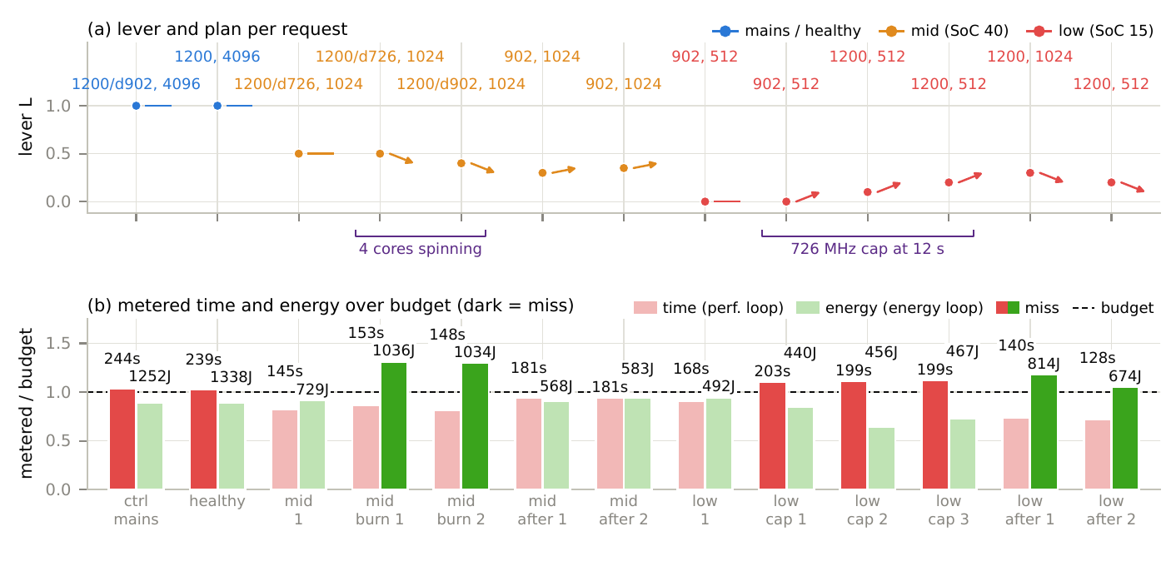
THE LOOPS, PROVOKED
Thirteen cooled requests carrying real disturbances
Four spinning cores pushed a mid-tier request 30% over budget. An external 726 MHz cap put three low-tier requests 10 to 12% over time.
23

Slide 24
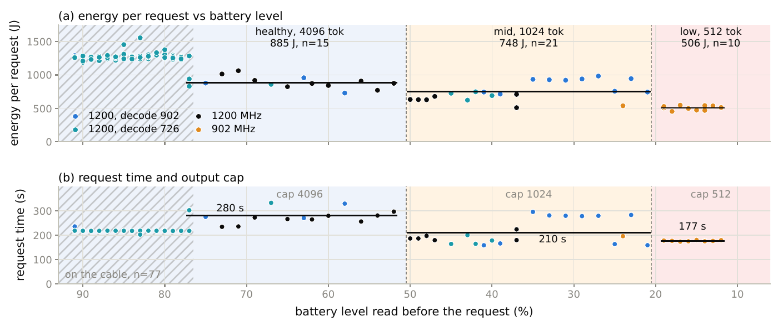
THE REAL DISCHARGE
A loop resident on the phone, 123 requests, no forced state
The scheduler switched on the first request past each threshold: 4096 tokens down to 52%, the 1024 cap from 50%, the low plan from 19%.
24

Slide 25
DOES IT NEED LEARNING?
A contextual bandit on the same objective, one pull = one real request
Context | Battery | wq | wt | we | Time slack
healthy | mains or >50% | 0.55 | 0.40 | 0.05 | 5%
mid | 21 to 50% | 0.35 | 0.20 | 0.45 | 22%
low | 20% or below | 0.20 | 0.10 | 0.70 | 40%
• Arms: GPU clock 1200, 902, 726 MHz. Flat caps only.
• Reward is the scheduler's own tier utility, so both optimize the same thing.
• Epsilon-greedy 0.25, warm start of one pull per context and arm.
• 24 pulls, each behind a cooling gate, energy metered.
• Llama-3.2-1B, 9737 prompt, 1024 output, K = 1024.
Reward r = wq − wt · T/Tref − we · E/Eref
with Eref = 782.0 J and Tref = 142.4 s, the cost table's
prediction for this request at 1200 MHz.
25

Slide 26
TABLE 7 · EVERY CONTEXT AND ARM THE BANDIT PULLED
All 24 pulls, measured energy and time
Context | Arm (MHz) | pulls | Energy (J) | Time (s) | Mean reward
healthy | 1200 | 6 | 804.6 | 139.1 | +0.1079 | bandit's choice
healthy | 902 | 1 | 599.4 | 180.6 | +0.0043
healthy | 726 | 1 | 559.0 | 218.4 | -0.0991
mid | 1200 | 1 | 799.5 | 139.1 | -0.3054
mid | 902 | 6 | 579.6 | 180.5 | -0.2370 | bandit's choice
mid | 726 | 1 | 579.5 | 218.5 | -0.2903
low | 1200 | 1 | 790.2 | 139.2 | -0.6050
low | 902 | 4 | 591.4 | 180.7 | -0.4562 | bandit's choice
low | 726 | 3 | 563.4 | 218.4 | -0.4577 | within 0.0015 of 902
The low tier's two best arms are effectively tied, which is why the scheduler's stopping rule refusing 726 costs nothing.
26

Slide 27
TABLE 8 · WHAT LEARNING BOUGHT
Rule and bandit scored on the same objective
Tier | Rule's plan | Utility | Bandit | Utility | Gain | Verdict
healthy | prefill 1200, decode 902 | +0.0989 | 1200 | +0.0999 | +0.0010 | tie
mid | prefill 1200, decode 726 | -0.2845 | 902 | -0.2440 | +0.0405 | bandit wins
low | 902 | -0.4551 | 902 | -0.4551 | 0 | identical
The one disagreement, in physical units
Mid tier, 9737 prompt + 1024 output | Energy (J) | Time (s) | Utility
Rule: prefill 1200, decode 726 | 750.0 | 144.5 | -0.2845
Bandit: flat 902 | 589.5 | 181.4 | -0.2440
Difference | -160.5 (-21%) | +36.9 (+26%) | +0.0405 (+14%)
The rule refuses that plan because 181.4 s misses the mid tier's 173.1 s time budget, not because it ranks it lower.
27

Slide 28
TABLE 9 · WHAT LEARNING COST
Regret against an oracle playing the bandit's own best arm
 | Pulls | Energy (kJ) | Regret
Warm start, one pull per context and arm | 9 | 5.9 | 0.542
Free choices | 15 | 9.8 | 0.043
Total | 24 | 15.7 | 0.585
15.7 kJ
149 min
energy to learn
phone time
• 93% of the regret falls in the mandatory warm start, which must play arms it already has reason to avoid.
• The rule pays none of this. Its table is measured once, offline, and then corrected by two loops at 0.3 s per request.
• So learning is worth it only where the rule's time guard binds, and only if you are willing to trade 26% latency for 21% energy.
28

Slide 29
RELATED WORK
Nobody has measured KV eviction on a phone GPU
System | Venue | Hardware evaluated on | Phone | Compute | KV mechanism
KV EVICTION, BUT NEVER ON A PHONE
SnapKV, Ada-KV, H2O, TOVA, PyramidKV | 2023-24 | A100-class servers | no | server GPU | eviction
KVSwap | MobiSys 2025 | Jetson Orin AGX 64 GB + NVMe | no | board GPU | offload to disk
MobiLoRA | ACL 2025 | NVIDIA AGX Orin | no | board GPU | cache reuse
KeyDiff | NeurIPS 2025 | A100; unnamed Samsung phone (kernel only) | yes | not stated | eviction
ON A REAL PHONE, BUT NEVER EVICTION, NEVER THE GPU
DynaKV | 2025 | OnePlus Ace5 Pro, 12, Ace3, Ace2 | yes | CPU only | offload to UFS
ActiveFlow | 2025 | OnePlus 12, Pixel 6, Infinix ZERO 30 | yes | CPU only | weights, not KV
PowerInfer-2 | MobiSys 2025 | OnePlus 12, OnePlus Ace 2 | yes | CPU and NPU | neurons, not KV
PerCache | 2026 | Pixel 7, Redmi K60 Pro, S22 Ultra | yes | not stated | QKV reuse (RAG)
ON A PHONE GPU, BUT NO CACHE MANAGEMENT
LLMs in Your Pockets | 2026 | 7 devices: Adreno 750/730, Mali G720/G78 | yes | CPU, GPU, NPU | none
LLM Inference at the Edge | 2026 | S24 Ultra (Adreno 750), iPhone 16 Pro | yes | GPU | none
μKV (this work) |  | OnePlus 15, Adreno 840 | yes | CPU and GPU | eviction + compaction
29

Slide 30
WHAT IS OPEN
Stated plainly, because a workshop paper should
• Eviction is destructive. μKV cannot recall a span it dropped.
• The natural next step is a third tier: park mid-scored cells in NAND using the scores μKV already computes. Reload is 23 MB for 721 cells, single-digit ms at UFS 4.0.
• The blocker is not reload cost. No mobile engine can shrink and regrow its KV pool, so parking frees nothing today.
• Nobody has measured what parking costs in flash write energy and wear. That is the number that decides whether the tier is worth having.
• The ladders are calibrated to one SoC. What generalizes is the protocol of anchoring a ladder above a measured vendor trigger, not the thresholds.
• Four of the per-head GPU cells are n = 1. The CPU StreamingLLM row still carries our fused-kernel omission.
30

Slide 31
TAKEAWAYS
Budgets are not compression
A per-head budget that looks good on a server is a full cache in disguise on the device. 36 to 68% stays live.
The kernel path sets the speed
Reading attention scores costs FlashAttention. Four of five published policies decode slower than not evicting.
The axis of selection is the thing
Sequence-level compacts and keeps the kernel. A baseline we did not author confirms it.
μKV is the existence proof that one policy can hold all three properties at once: in-graph scoring, one keep set, in-place compaction.
On the phone it decodes 4.8x the full cache on the CPU at 7% of the cells and 62% less energy, and 1.19x on the Adreno at the same cell count.
Report realized cells, not selection ratios. Say which kernel your policy leaves behind.
31

