Slide 1
HOTMOBILE 2027 · SUBMISSION DRAFT
μKV: Energy- and Thermal-Aware KV-Cache Eviction for LLM Inference on a Phone
An LLM keeps the whole conversation in a cache a phone cannot afford, so eviction throws parts of it away. We ran nine published methods on a real phone and measured speed, energy and heat. One method ran 3.3x faster on the phone's CPU and 3.7x slower on its GPU. The hardware, not the method, decides whether eviction is worth doing.
WHAT WE CONTRIBUTE
The first end-to-end account of published eviction on a phone, measured on speed, energy, temperature and cache actually freed, plus the three device-level failures that decide whether it pays.
4.80x
7.4%
-58%
faster than the full cache, phone CPU
of the cache still live, and really freed
energy for the same 4096 tokens
Md Romyull Islam · Kennesaw State University · OnePlus 15, Snapdragon 8 Elite Gen 5
1

Slide 2
THE GAP
Eviction is designed on server GPUs and justified by one number
What the literature reports
What a phone deployment needs
How much cache it drops, a nominal budget K
Quality on server GPUs (LongBench, NIAH)
Per-head keep-sets, paged KV, unlimited power
KeyDiff comes closest: scoring-kernel latency on a phone, not end-to-end
Cells actually freed, not the budget requested
Throughput by phase, because prefill and decode differ
Energy and temperature: the device throttles
Whether the engine can even execute the policy
The systems that do run on phones (KVSwap, DynaKV, MobiLoRA) move bytes rather than discard them. None evicts. None reads the battery.
RESEARCH GAP
2

Slide 3
BREAK 1 OF 3 · BUDGETS DO NOT MATERIALIZE
SnapKV asks for 1024 cells and keeps 8893.
THE PROBLEM
THE EVIDENCE
Every policy reports how much cache it drops. For the four policies that choose per head, that number is not what gets freed on this phone. For the two that choose at sequence level, it is.
91.3%
WHY IT HAPPENS
Phone engines store the KV cache in ONE array shared by all heads and layers. SnapKV, Ada-KV, H2O and TOVA each pick a different keep-set per head. The engine can only free a cell that EVERY head agreed to drop, so the keep-sets pile up and almost nothing is released.
SnapKV still holds 91.3% of the cache after asking to keep 1024 of 9741 cells. It pays the cost of eviction and collects none of the benefit.
OUR SOLUTION
μKV picks ONE keep-set for all heads and layers. There is nothing to union, so every cell it drops is actually freed and the survivors can be packed together. KeyDiff is sequence-level too, so its budget is also real; we differ in what happens next, not here.
BREAK 1
3
Notes:
RETENTION IS MEASURED, NOT INFERRED. Each policy's live-cell count comes from the run metadata; retention is that count divided by the 9741-cell prompt. SnapKV 8893/9741 = 91.3%, Ada-KV 3489/9741 = 35.8%, TOVA 4093/9741 = 42.0%, muKV 721/9741 = 7.4%.
SCOPE. The failure is the per-head class, not eviction in general. KeyDiff asks 2048 and keeps 2049, so its budget is real too. Do not overstate this as nobody-s-budget-is-real.
IF ASKED WHY IT WORSENS WITH WIDTH: a cell frees only when every head drops it, so the chance of unanimity falls as heads multiply. Llama-1B has 8 KV heads and the class spreads 36-91%; Phi-3 has 32 and the class collapses into 85-100%.

Slide 4
WHO IS AFFECTED, AND WHO IS NOT
The split is per-head vs sequence-level, not us vs everyone
Llama-3.2-1B (8 KV heads), phone CPU, 9741-token prompt
Policy | selects | asked | live cells | retained
SnapKV | per head | 1024 | 8893 | 91.3%
H2O | per head | 20% of N | 9151 | 94%
TOVA | per head | 2048 | 4093 | 42.0%
Ada-KV | per head | 2048 | 3489 | 35.8%
KeyDiff | sequence | 2048 | 2049 | 21.0%
μKV | sequence | 1024 | 721 | 7.4%
AND IT GETS WORSE WITH SIZE
Llama-1B has 8 KV heads. Phi-3 has 32. With four times as many heads, unanimity gets rarer, and the whole per-head class collapses into one band:
Read the two right-hand columns together. The four per-head policies get back far more cache than they asked for. The two sequence-level policies get almost exactly what they asked for.
85 to 100%
retained on Phi-3. H2O logs 20.4 million eviction attempts that free zero cells. As models get wider, per-head eviction becomes a no-op that still costs energy.
KeyDiff asked for 2048 and kept 2049. Its budget is real, so it is NOT a victim of this problem. That is why it is absent from the failure list.
BREAK 1 · DETAIL
4

Slide 5
BREAK 2 OF 3 · THE STANDARD ROUTE CORRUPTS
Reading attention scores breaks the GPU output
THE PROBLEM
THE EVIDENCE
To score which cells matter, a policy must read the attention weights. The normal way is an eval-callback on the softmax node. On the Adreno GPU, doing this makes the model emit garbage tokens.
76 / 609
WHY IT HAPPENS
A callback changes how the graph is EXECUTED, not how it is split across backends: llama.cpp runs the work as fragments with a sync after each. The CPU backend handles that correctly. On this phone GPU it does not.
degenerate tokens once a callback reads the tensor. With no callback the same run gives 0 of 978.
OUR SOLUTION
μKV never intercepts. It adds a small extra node (kq_evict) INSIDE the graph, so the scores are something the graph produces on its own. No callback, no corruption, and FlashAttention stays on the whole time.
BREAK 2
5
Notes:
ALL THREE ARMS ARE VANILLA llama.cpp, FA off, same 9737-token prompt, n_gpu_layers=99. No eviction is involved, so this is not a muKV artifact.
WHAT IS PROVEN: corruption appears when a callback is installed, and it appears even when the callback never reads the tensor (68/679). So the trigger is the request, not the read.
MECHANISM, from ggml_backend_sched_compute_splits: with no callback the whole backend split is computed in one call; with a callback it is chopped into ggml_graph_view fragments, each computed and synchronised separately. The chunk boundary is set when the callback is ASKED whether it needs a node, which is before any read.
DO NOT SAY the graph-split COUNT changes. llama.cpp reports graph splits = 2 in both the clean and the corrupt run. What changes is execution granularity, not partitioning.
SCOPE: the same path is correct on the CPU backend (0.3% degenerate across 271 cells vs 13.9% across 607 on Adreno). We did not run a desktop-Vulkan control, so we do not claim whether the fault is llama.cpp's Vulkan code or the Qualcomm driver.

Slide 6
HOW WE KNOW IT IS THE CALLBACK, NOT SOMETHING ELSE
Two controls, each removing one suspect
Control 1: is turning FlashAttention off the cause?
Control 2: is it the phone, or the GPU specifically?
Same run, FA off | degenerate
vanilla, no callback | 0 / 978
policy, callback reads tensor | 76 / 609
policy, callback never reads | 68 / 679
Needle retrieval | CPU | Adreno
H2O (uses callback) | 8/14 | 3/14
TOVA (uses callback) | 12/14 | 2/14
μKV (no callback) | 13/14 | 14/14
No. All three runs are vanilla llama.cpp with FA off. Only the ones with a callback corrupt.
The GPU. Across all callback cells: 0.3% corrupt tokens on CPU, 13.9% on Adreno.
The mechanism, from the llama.cpp scheduler source
In ggml_backend_sched_compute_splits the no-callback path computes the whole split in one call; the callback path builds ggml_graph_view fragments and synchronizes after each. The chunking is decided when the callback is ASKED for a node, before any read, which is why requesting without reading corrupts the same. The same path is correct on the CPU backend. We did not test desktop Vulkan, so we do not separate llama.cpp's Vulkan code from the Adreno driver; we report only that this route is unsafe on this device.
BREAK 2 · PROOF
6

Slide 7
BREAK 3 OF 3 · THE CEILING IS SET BY HARDWARE
The same policy is 4.80× on one processor and 1.20× on the other
THE PROBLEM
THE EVIDENCE
Papers report one speedup number per policy. On a phone that number is not a property of the policy at all. It changes by a factor of four depending on which processor runs it.
1.40×
WHY IT HAPPENS
Every decoded token reads the weights W plus the live cache KV, and eviction only shrinks KV. So even a zero-size cache cannot beat (W+KV)/W. On the phone GPU that ceiling is 1.40×: Llama-1B has 800 MB of weights against a 319 MB cache.
is the analytical upper bound for ANY evictor on Llama-1B / phone GPU, and none exceeded it. But μKV at 7.4% retention and StreamingLLM at 20.6% both land at 1.20x, so on this backend something saturates before the cache term does.
OUR SOLUTION
We report the bound next to every speedup, on both processors, and we check whether it actually binds. On the CPU the bottleneck is attention compute over live cells, not weight bytes, so the roofline does not apply at all and the same μKV runs 4.80x.
BREAK 3
7
Notes:
WHERE 1.40x COMES FROM. Per decoded token the device reads the model weights W plus the live cache KV. Eviction can shrink KV but never W, so speedup(r) = (W+KV)/(W+KV/r), and the limit as the cache goes to zero is 1 + KV/W.
PROVENANCE OF THE TWO INPUTS.
W = 770 MB, the Llama-3.2-1B Q4_K_M gguf on disk. A dense model reads essentially all of it per token.
KV = 304 MB, from the model geometry the run itself reports: 16 layers x 8 KV heads x 64 dim x 2 bytes x 2 (K and V) = 32 KiB per cell, times 9737 prompt cells. That per-cell figure is checked against the engine's own accounting: 13,832 peak cells x 32 KiB = 432.2 MB, exactly the peak_kv_mb the run reports.
1 + 304/770 = 1.40x.
WHY THE CONSERVATIVE CHOICE. Using the cache at end-of-prompt (304 MB) rather than at peak (432 MB) gives the SMALLER ceiling, 1.40x instead of 1.56x. A lower ceiling is a harder bar for us to be measured against.
WHAT THE BOUND ASSUMES: decode is bandwidth-bound; all of W and all of the live cache are read every token; the policy adds no per-token overhead.
IF ASKED WHETHER IT IS REALLY THE LIMIT: it is an upper bound and nothing exceeded it, but it is NOT what binds here. muKV keeps 7.4% and StreamingLLM keeps 20.6%, a 2.8x difference, and both land at 1.20x. The roofline predicts 1.36x and 1.29x. Observed speedup is flat in retention, so something saturates first, most likely fixed per-token dispatch overhead. That makes the deployment message blunter, not weaker: on this GPU, freeing 2.8x more cache buys nothing.

Slide 8
THE SAME POLICY, TWO PROCESSORS
Why we report the model and the processor, never a bare speedup
Model and processor | weights W | cache KV | ceiling | μKV got
Llama-1B · phone GPU | 800 MB | 319 MB | 1.40× | 1.20×
Phi-3 · phone GPU | smaller | bigger | 2.83× | 2.64×
Llama-1B · phone CPU | not the limit | not the limit | no ceiling | 4.80×
Best proof is a rival, not us
KeyDiff, same model (Llama-3.2-1B), same budget, same prompt:
The third row is the one that answers 'why no number for Llama on CPU'. The ceiling formula assumes the device is waiting on weight bytes. On the CPU it is not: it is waiting on attention arithmetic over the cells that are still live. Shrink the cells and you shrink the work directly, so there is no roofline to hit and the same policy reaches 4.80×.
3.29×
~0.06×
phone CPU
phone GPU
On the GPU it is about sixteen times SLOWER than keeping the whole cache. Nothing about the policy changed. Only the processor. The GPU point is a single run; vanilla at that prompt spans 24.1-28.6 tok/s, so the ratio is 0.056 to 0.067.
BREAK 3 · PROOF
8

Slide 9
THE DESIGN
Each of the four decisions answers one of the three breaks
llama.cpp on the phone · CPU or Adreno GPU
prefill
kq_evict node
① score + select
② evict + compact
③ decode
FlashAttention ON
one keep-set
slide survivors
FlashAttention ON
N → K
K cells, packed together, so the rest is never read again
whole cache, N cells
④ thermal watchdog reads the sensors and lowers the clock BEFORE the vendor cliff
it never touches the keep-set
① score inside the graph
answers BREAK 2. The scores come from a node the graph produces, so no callback and no corruption.
② one keep-set, packed
answers BREAK 1. One set for all heads means every dropped cell is really dropped, and packing them makes the survivors contiguous.
③ freeze during decode
the keep-set is chosen once at the end of prefill and never changes. Only the recent window slides. So there is no per-token scoring cost.
④ compact in place
the survivors are slid down inside the tensors the engine already has. No second copy of the cache is ever allocated.
ARCHITECTURE
9

Slide 10
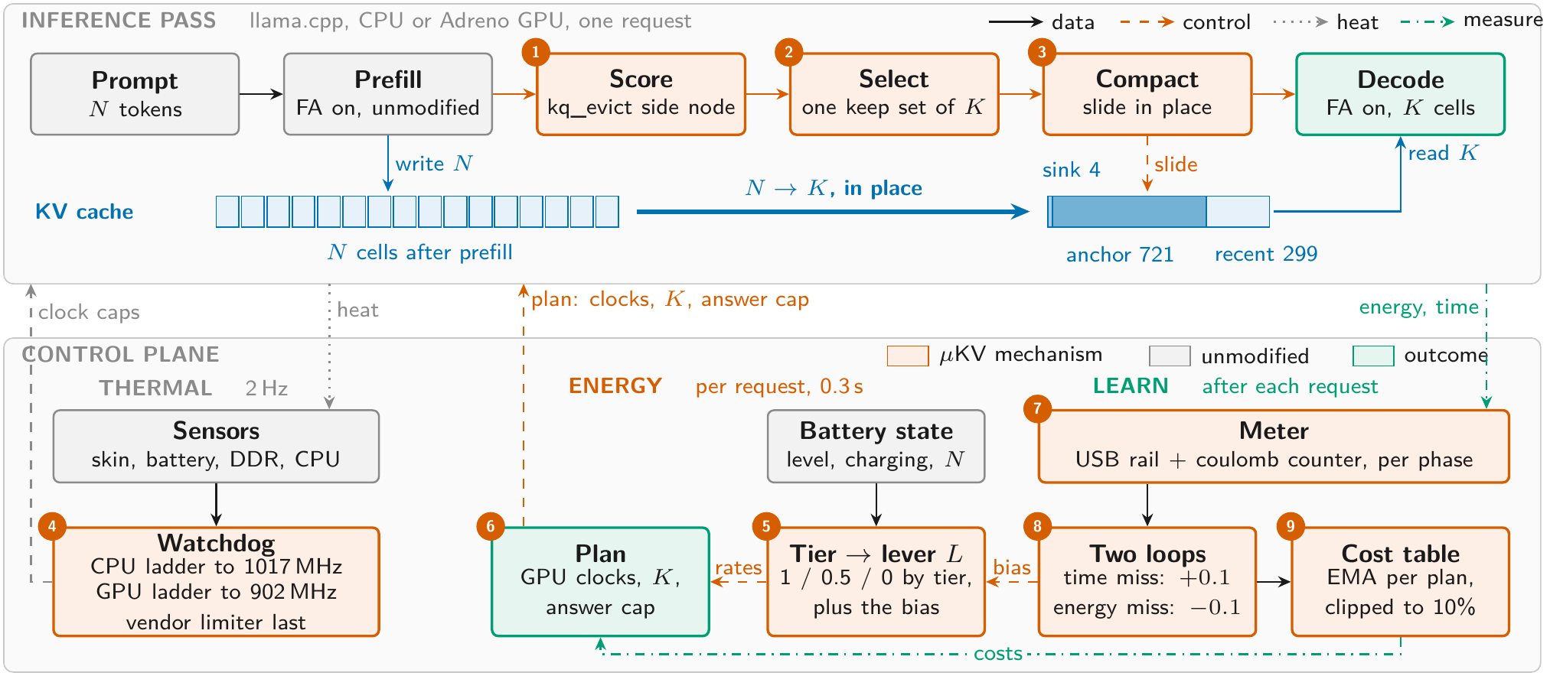
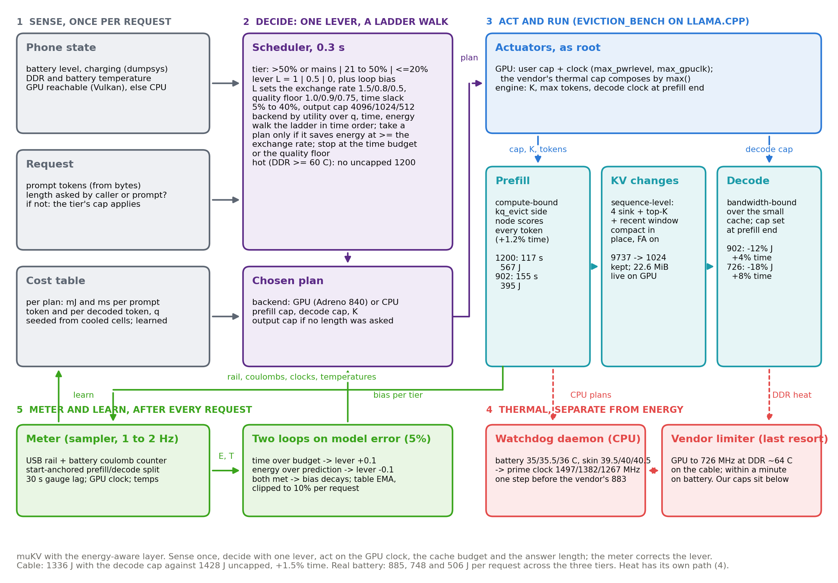
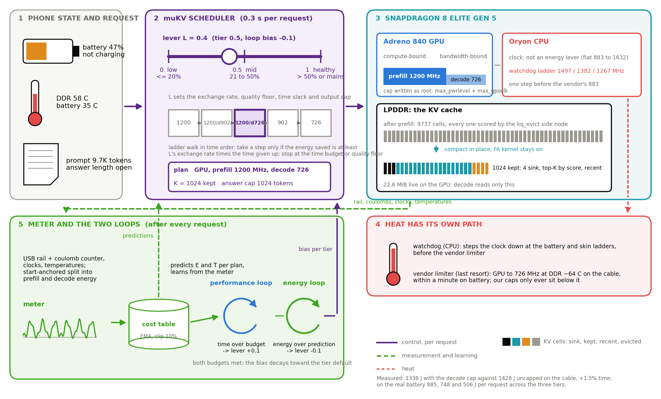
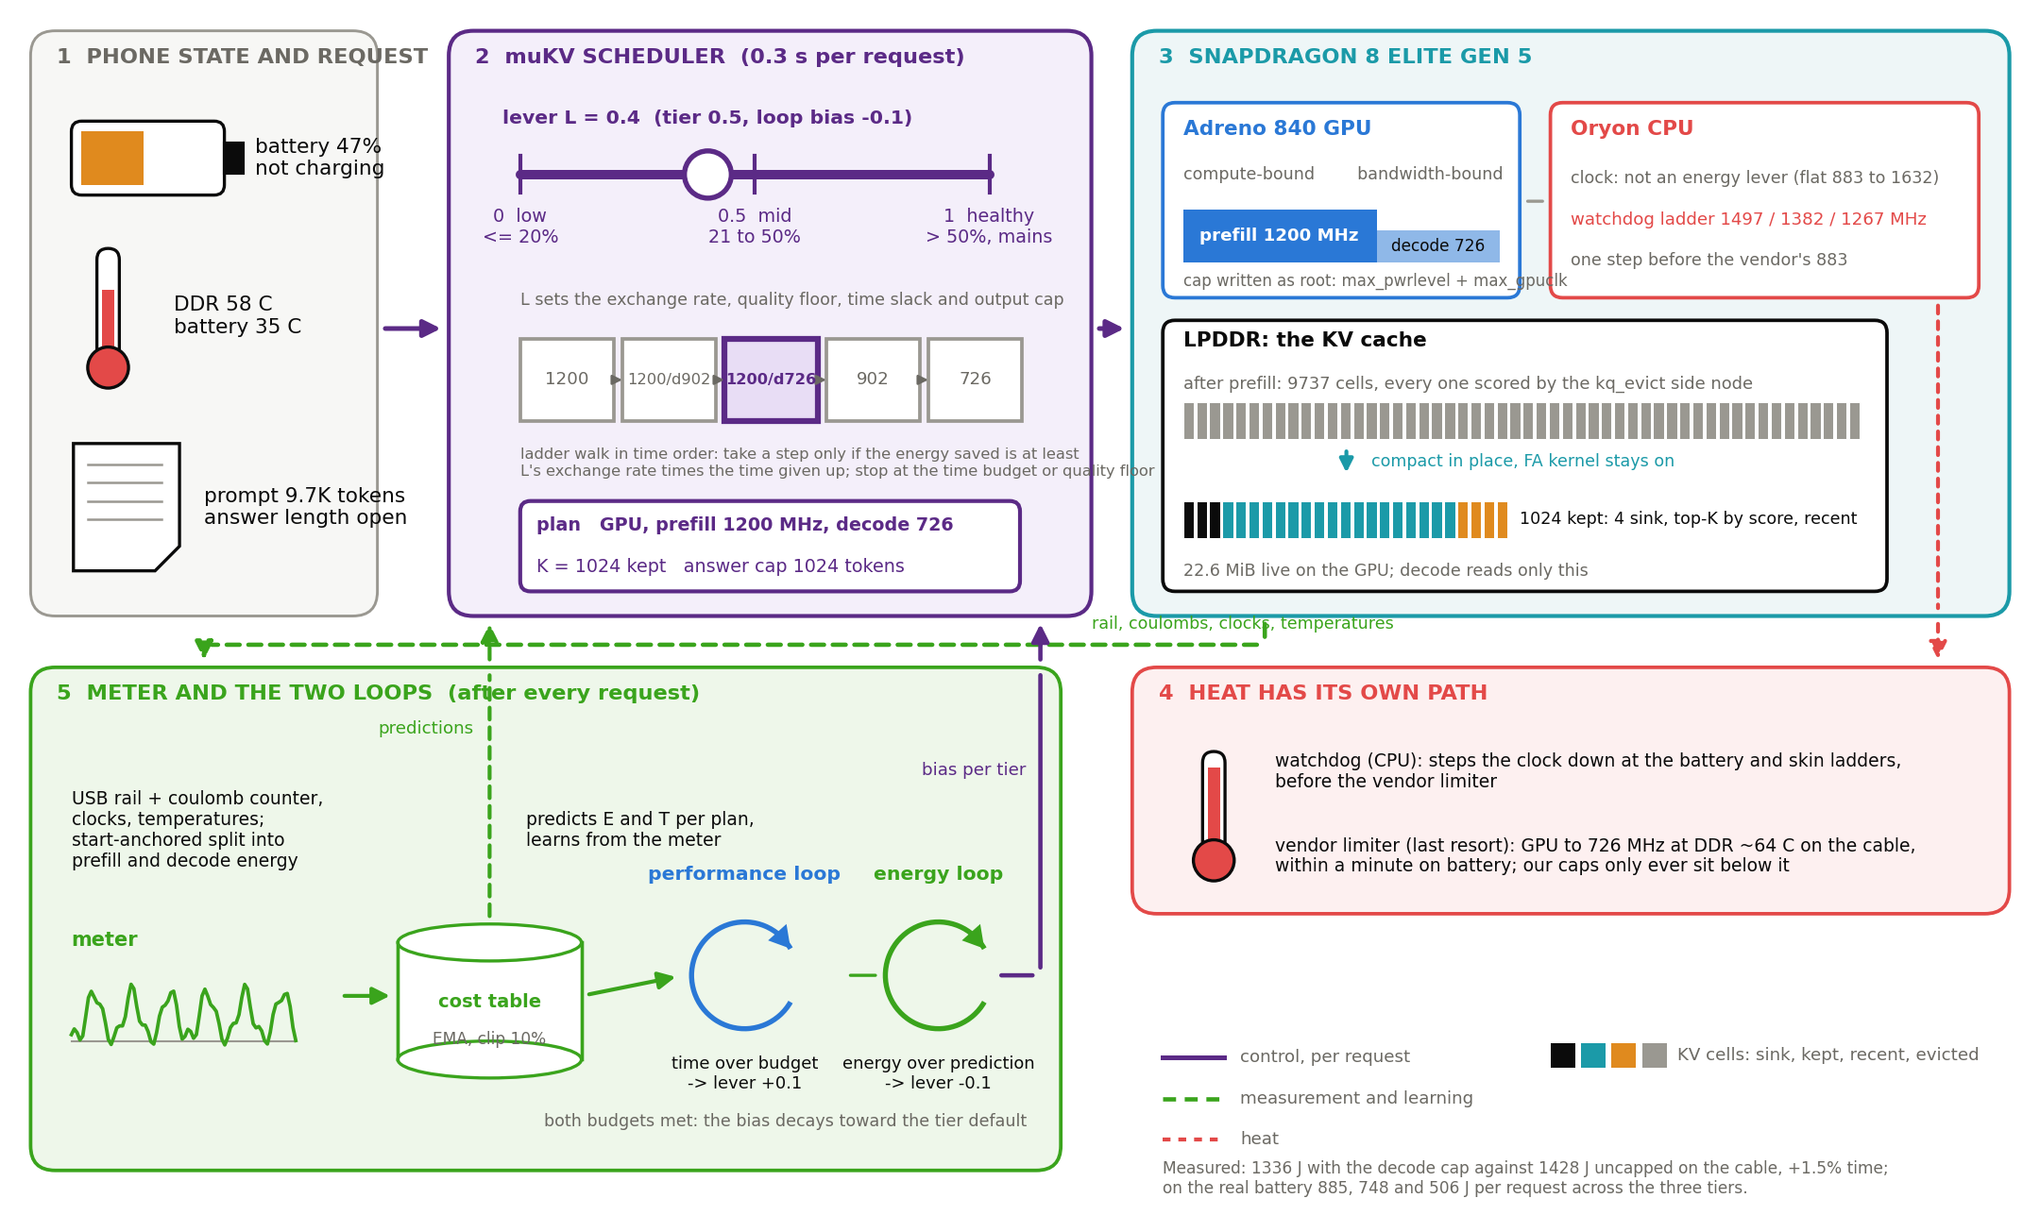
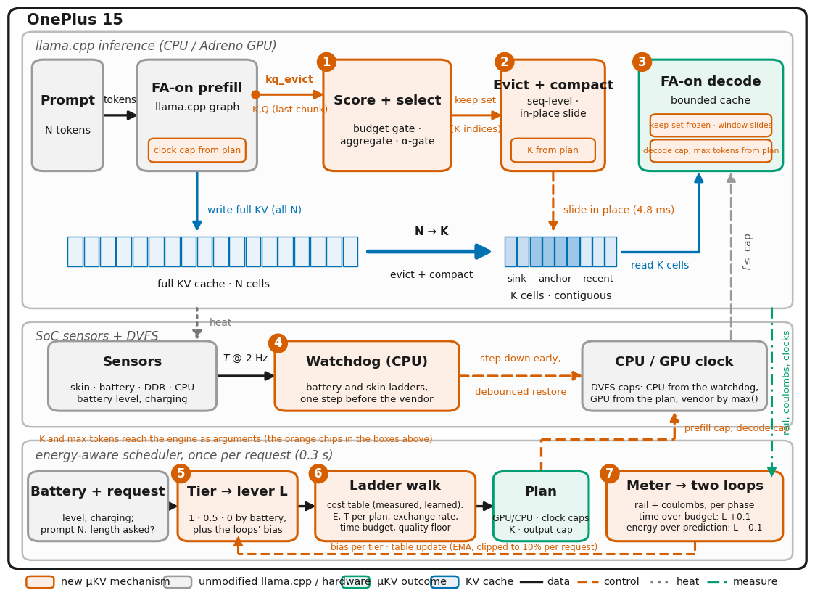
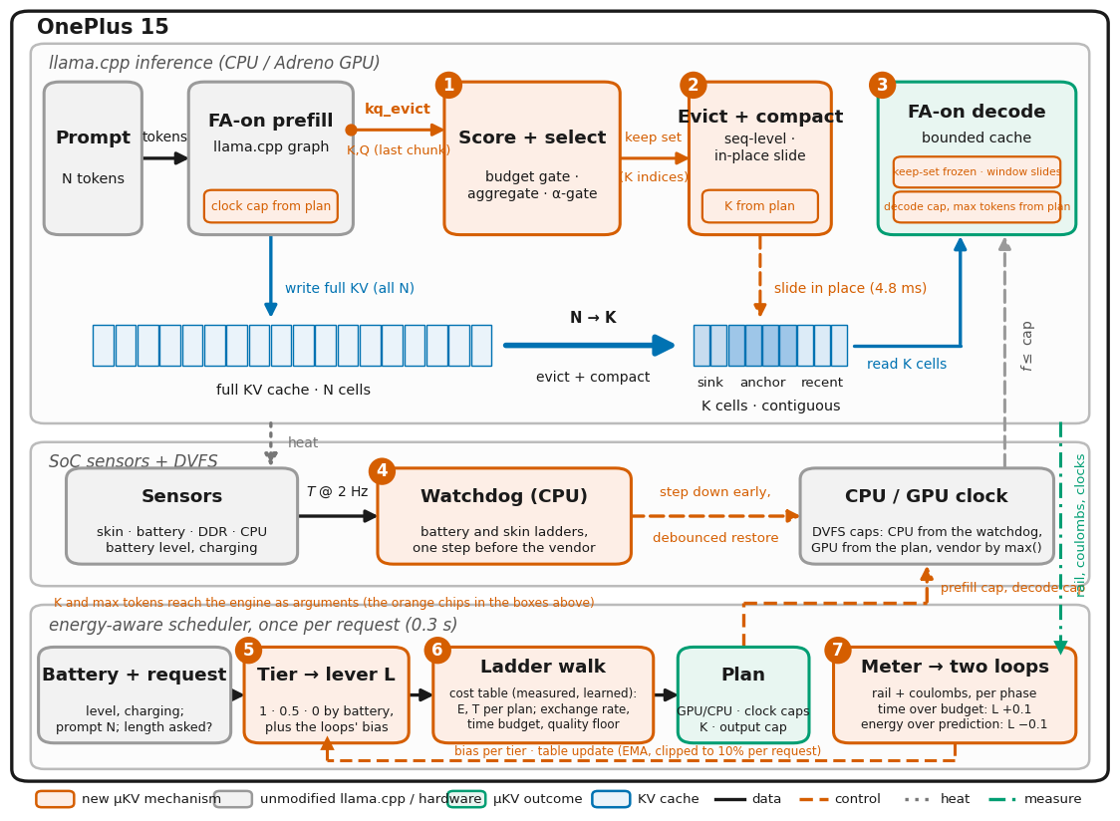
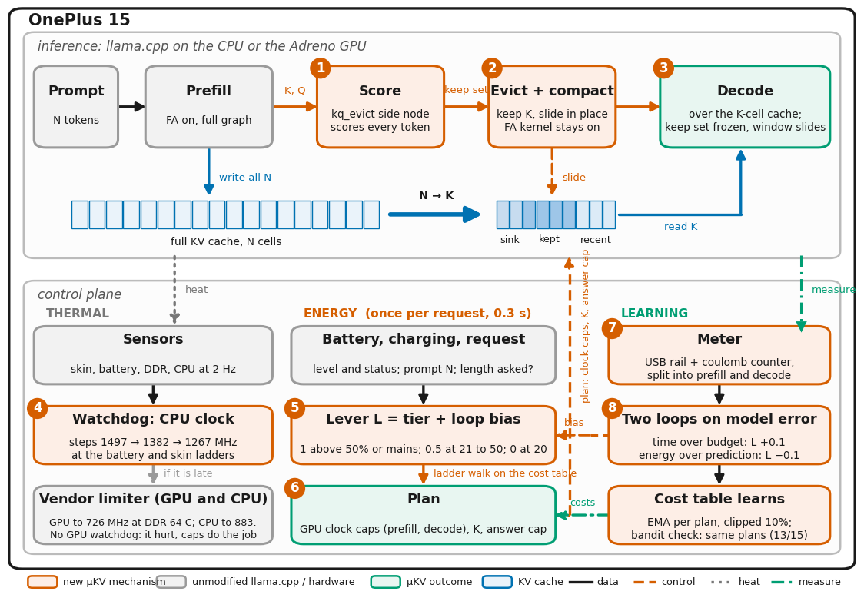

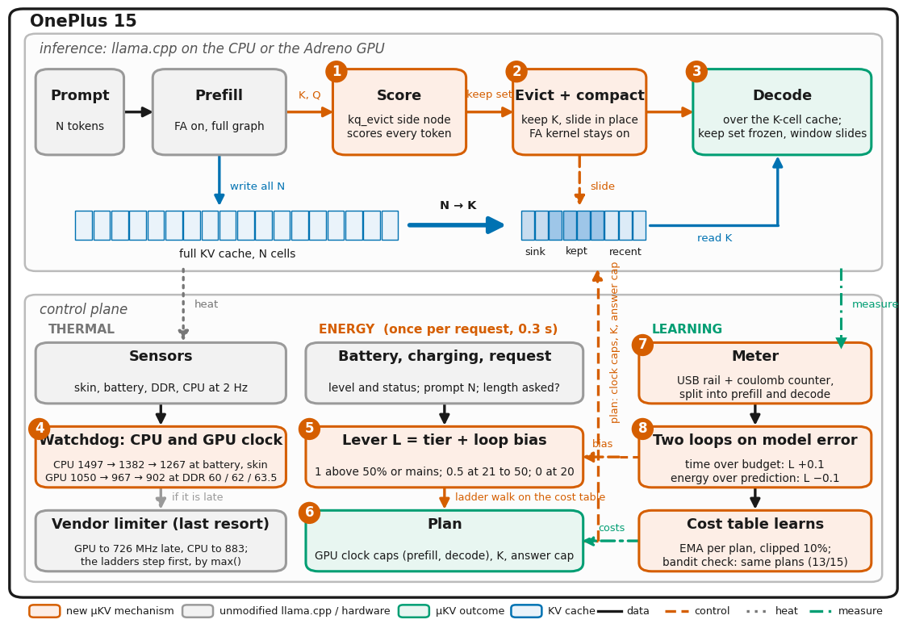
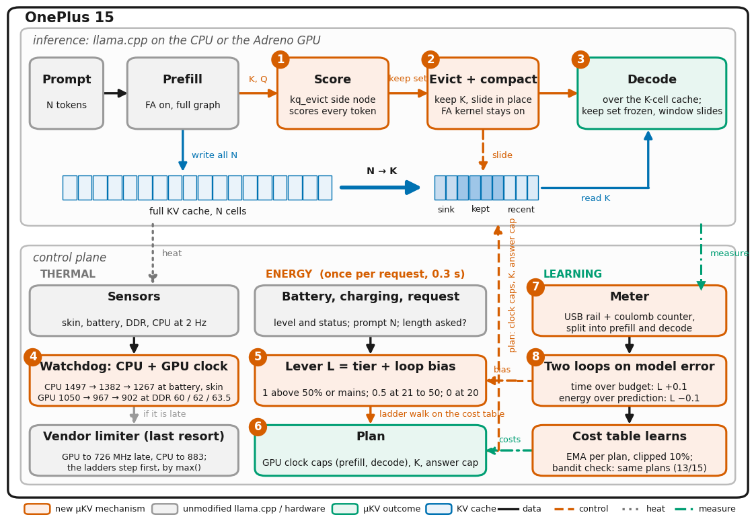
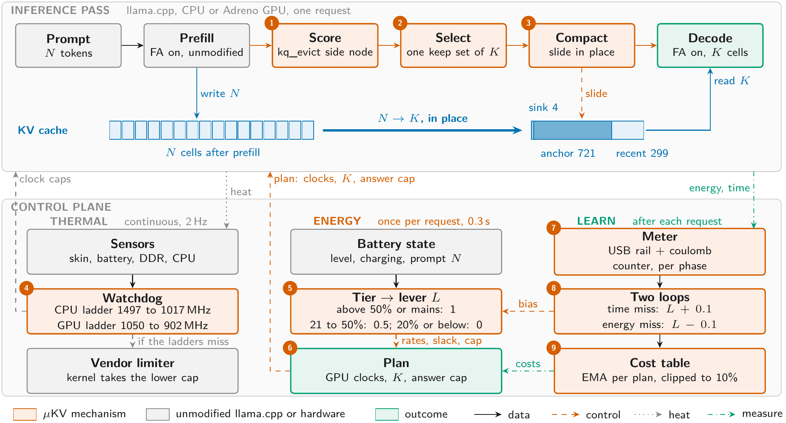
ARCHITECTURE · THE WHOLE MECHANISM WITH THE ENERGY-AWARE LAYER
THE PASS ON TOP, THE CONTROL PLANE BELOW

Slide 11
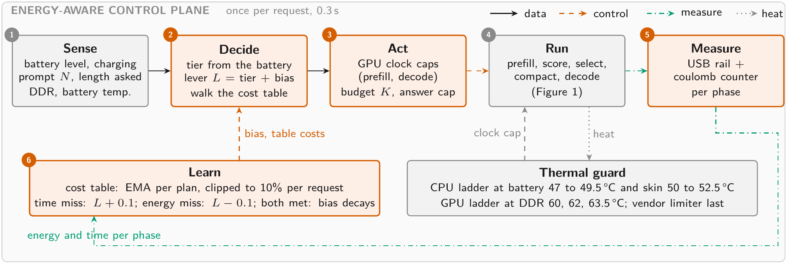
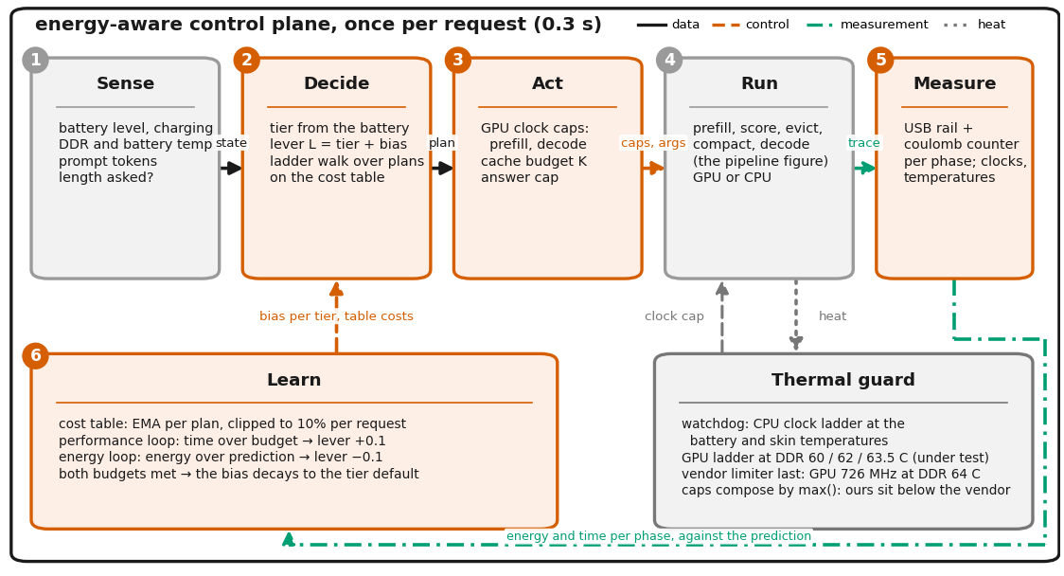
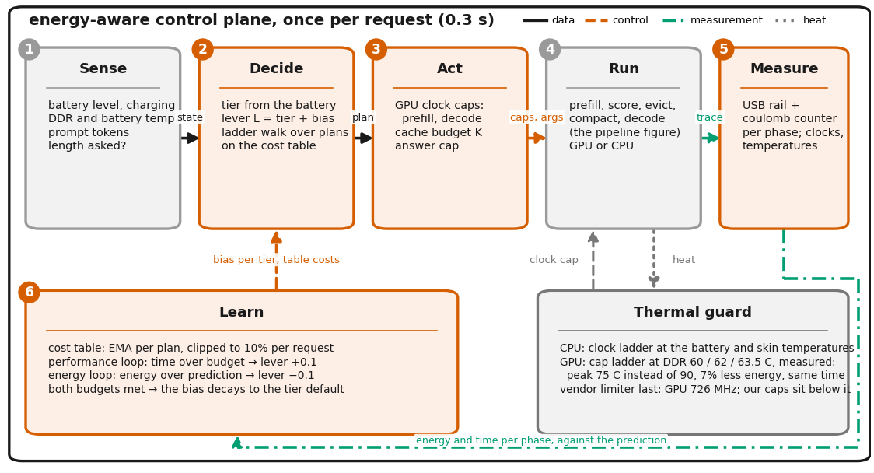
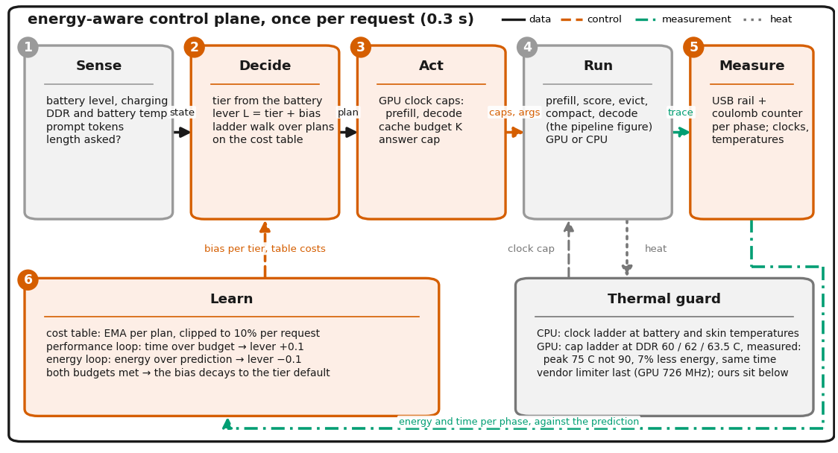
ARCHITECTURE · THE ENERGY-AWARE CONTROL PLANE
SENSE, DECIDE, ACT, RUN, MEASURE, LEARN: ONCE PER REQUEST

Slide 12
RESULT · SUSTAINED DECODE, PHONE CPU
4.80× faster than the full cache, on one twelfth of the cells
Llama-3.2-1B Q4_K_M · phone CPU, 6 threads · 9.7K-token prompt + 4096 decoded tokens
Policy | config | tok/s | ×van | wall (s) | mWh | live cells
μKV | K=1024 | 23.91 ±0.37 | 4.80× | 379 | 595 | 721
KeyDiff | K=2048 | 16.40 ±0.11 | 3.29× | 484 | 700 | 2049
Ada-KV | FA on | 11.52 | 2.29× | 566 | 845 | 3489
StreamingLLM | 4+2000 | 10.25 ±0.06 | 2.06× | 580 | 781 | 2001
SnapKV | FA off | 6.83 | 1.36× | 849 | 1180 | 5931
H2O | FA off | 6.45 | 1.29× | 856 | 1262 | 9151
SnapKV | FA on | 5.38 | 1.07× | 953 | 1346 | 8893
vanilla | full cache | 4.99 ±0.01 | 1.00× | 1004 | 1431 | 9741
How to read this: the last column is what the engine still holds. The policies at the bottom are slow BECAUSE they never freed anything.
4.80×
−58%
12.3×
23.91 vs 4.99 tok/s, three runs each, rotated order
energy for the same 4096 tokens, 595 vs 1431 mWh
fewer live cells than SnapKV FA-on, 721 vs 8893
RESULTS · CPU
10

Slide 13
A CLAIM WE HAD TO GET RIGHT
Compaction does not shrink the allocation. It shrinks what is read.
Llama-3.2-1B · phone GPU (Adreno 840) · 9737-token prompt
Measured | vanilla | μKV | change
Peak cache ALLOCATED | 432 MB | 392 MB | −9%
Cache READ per token | 304 MB | 23 MB | −93%
AND IT IS SAFE
23 of 25
WHAT COMPACTION IS
generations byte-for-byte identical to the same run without compaction, across Llama-1B, Phi-3 and Bonsai-8B, with the keep-set held identical so compaction is the only variable.
Selection marks which cells to keep. Compaction slides those survivors into one contiguous block at the front of the cache, inside tensors the engine already holds.
The engine reserves the whole context up front, so peak memory barely moves. What changes is how much of it the device touches on every decoded token, and that is where the speed and the energy come from. New since: because compaction leaves the dead cells contiguous, madvise hands 485.8 MiB back to the OS, ending the run 444 MiB below vanilla with byte-identical output.
The two exceptions differ by a trailing full stop and by text after the answer. Sliding survivors keeps their positions, so the maths is unchanged.
WHY COMPACTION IS STILL NECESSARY
If the survivors stay scattered, the engine still walks the whole array every token. Packing them into one contiguous block is what turns 'dropped' into 'never read again'.
WHAT COMPACTION ACTUALLY BUYS
11

Slide 14
RESULT · QUALITY AND RETRIEVAL
Always read the score next to how much cache was kept
Finding a fact hidden in a long document
Question answering (LongBench hotpotqa)
Llama-3.2-1B · phone GPU · 14 stimuli x 7 depths
Llama-3.2-1B · phone CPU · 15 questions
Policy | budget | found | kept
μKV | 1024 | 14/14 | 13.0%
vanilla | full | 14/14 | 100%
SnapKV | 1024 | 12/14 | 98.2%
StreamingLLM | 2004 | 7/14 | 32.9%
Policy | F1 | kept
SnapKV | 40.00 | 89.1%
vanilla | 36.00 | 100%
μKV | 29.79 | 13.7%
StreamingLLM | 23.57 | 19.5%
μKV finds every needle while keeping one eighth of the cache. StreamingLLM keeps 2.5× more and still loses half of them, because it keeps by position, not by evidence.
Compared only against policies that actually evict, μKV is ahead: +6.2 F1 over StreamingLLM on less cache. The ones above it kept 6× more.
BUT BE HONEST ABOUT THIS TABLE
With only 15 questions, one question changes the score by 6.7 points. μKV and vanilla answer 13 of 15 identically. The F1 ranking here is not a real difference; the retention column is.
RESULTS · QUALITY
12

Slide 15
RESULT · THERMAL
The watchdog gives back whatever the workload is short of
Llama-3.2-1B · phone CPU · six back-to-back 16K generations
Run | trigger | 1st gen | later | at floor | peak DDR
vanilla | off | 4.97 | 4.99 | 3.3% | 68.3
vanilla | 47 °C | 5.01 | 4.98 | 3.6% | 67.2
μKV | off | 23.32 | 23.14 | 8.2% | 65.6
μKV | 47 °C | 26.95 | 22.97 | 6.4% | 66.0
μKV | 35 °C | 18.00 | 15.95 | 2.4% | 58.7
+15.5%
μKV, first generation. It is compute-bound, so it can use the clock it is handed.
+0.9%
The watchdog steps the clock down early, before the vendor's own thermal limiter slams it to 883 MHz. At its first step it also lifts a cap the vendor had already applied, which is why the first generation gets faster rather than slower.
vanilla, identical watchdog. It is bandwidth-bound, so the same clock buys nothing and the gain shows up as −2.4 °C instead.
+10.8%
the early trigger on the GPU, where it helps. On the CPU the same early trigger costs 37% more time. The sign flips with the processor.
RESULTS · THERMAL
13

Slide 16
RESULT · ENERGY-AWARE CONTROL
Same command line; only the battery state changes the plan
GPU · clock caps by prefill / decode phase · K held at 1024 · 4096 output tokens
lever picks at | prefill / decode MHz | prefill mJ/tok | prefill s | decode mJ/tok | decode tok/s | total J | total s
full perf. (n=3) | 1200 / 1200 | 58 | 117 | 210 | 40.0 | 1428 | 221
healthy, mains (n=3) | 1200 / decode 902 | 59 | 117 | 186 | 38.7 | 1336 | 224
mid (n=3) | 1200 / decode 726 | 61 | 117 | 179 | 37.0 | 1328 | 229
low (n=3) | 902 / 902 | 40 | 154 | 187 | 38.3 | 1154 | 263
never (n=3) | 726 / 726 | 40 | 191 | 175 | 36.8 | 1105 | 303
-6% energy
GPU, decode capped at 902 MHz, prefill untouched: +1.4% total time, energy x time -5%. The lever's choice at full charge.
-19% energy
CPU · the tier sets the cache budget K · clock untouched · 1024 output tokens
GPU, 902 MHz on both phases: +19% total time, energy x time -4%. The lever's choice at low charge; 726 is never taken.
lever picks at | cache budget | prefill mJ/tok | prefill s | decode mJ/tok | decode tok/s | total J | total s
every tier (n=3) | K 1024 (chosen) | 60 | 258 | 209 | 22.1 | 802 | 305
never (n=3) | K 512 | 61 | 257 | 195 | 24.0 | 789 | 300
never (n=3) | K 256 | 61 | 256 | 187 | 24.8 | 783 | 298
-2% energy
A cap on decode alone is nearly free: 6% less energy for 1.5% more time and a DDR peak 19 C lower, the best energy x time of all plans. Capping prefill too saves 19% for 19% more time; below 902 the wait grows faster than the saving.
On the CPU three quarters of a request is prefill, which the cache cannot touch: the tiers land within 3%, so 1024 is the CPU balance point. The cache is the CPU lever against the full cache (62% less energy), not between tiers.
CPU, K 512 instead of 1024: 37% of qasper F1 for 2% of the request. The lever holds K=1024; the cache pays against the full cache, not between tiers.
RESULTS · ENERGY-AWARE · LLAMA-3.2-1B · ONEPLUS 15 · 9737-TOKEN PROMPT · N=1 UNLESS STATED
14

Slide 17
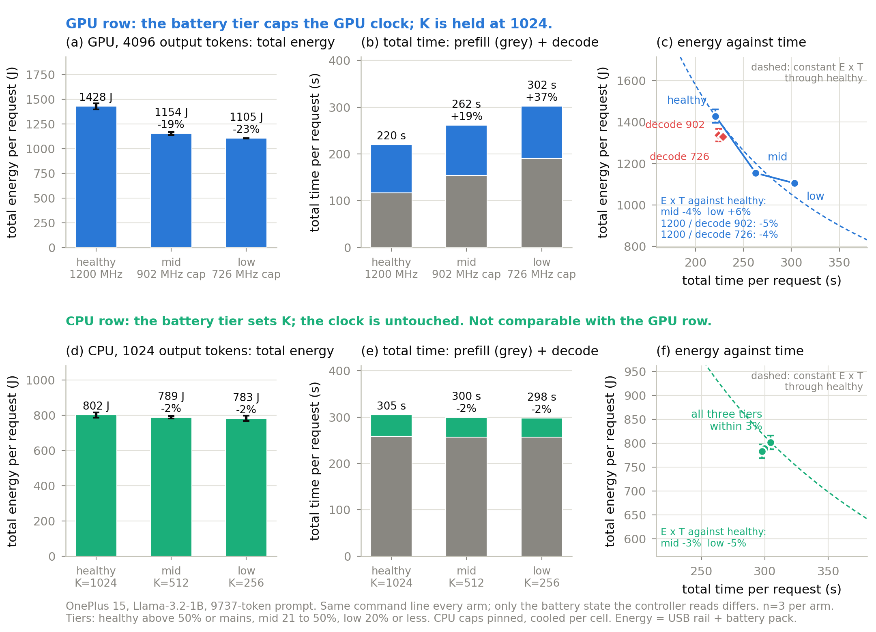
RESULT · ENERGY-AWARE CONTROL, THE PICTURE
Energy falls with the tier; the price is time, not decode speed
Same command line every arm, n=3. GPU row: the tier caps the clock. CPU row: the tier sets K. Rows differ in output length.
RESULTS · ENERGY-AWARE · LLAMA-3.2-1B · ONEPLUS 15 · 9737-TOKEN PROMPT
15

Slide 18
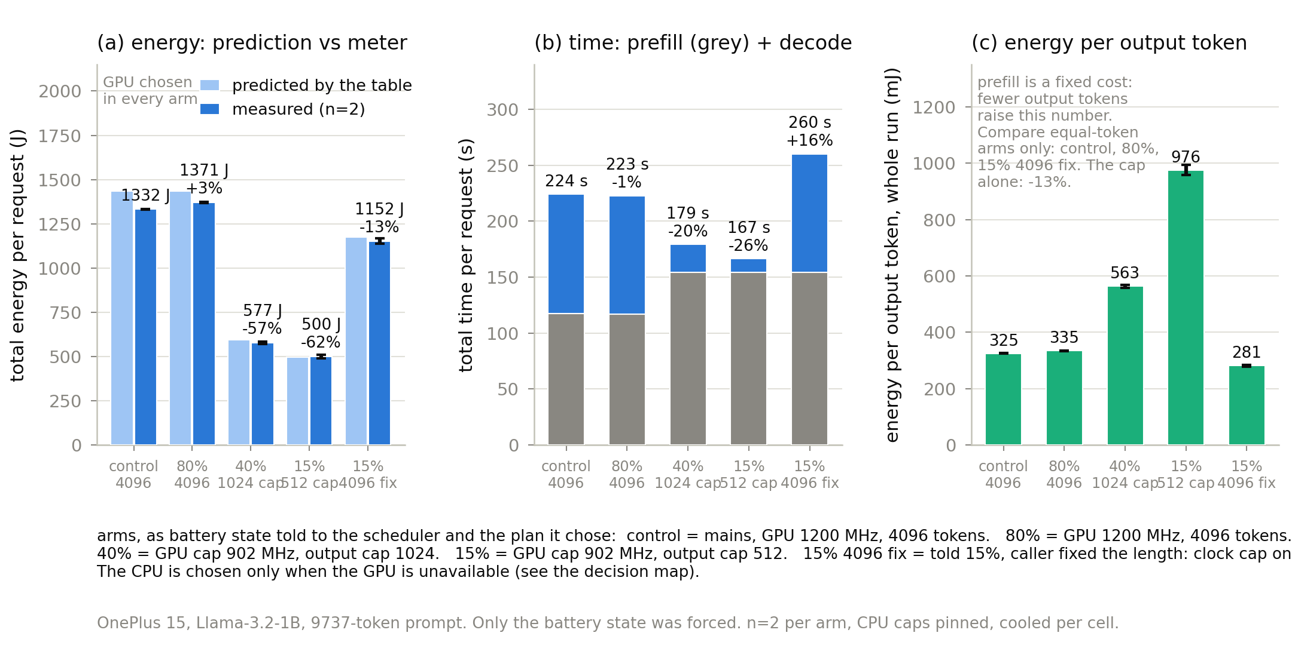
RESULT · THE SCHEDULER, MEASURED
The scheduler chose every plan; the phone measured what it cost
Same prompt through ukv_sched.sh under forced battery states; control = told mains. Predictions from its table land within 1 to 7% of the meter.
At 40% and 15% the request costs 57% and 62% less than the control, mostly through the output cap; with the output fixed by the caller (15%, 4096 fix) the clock cap alone saves 13% at equal tokens. At 80% and on mains the scheduler runs the full-performance plan.
RESULTS · ENERGY-AWARE · SCHEDULER PROOF · N=2 PER ARM
16

Slide 19
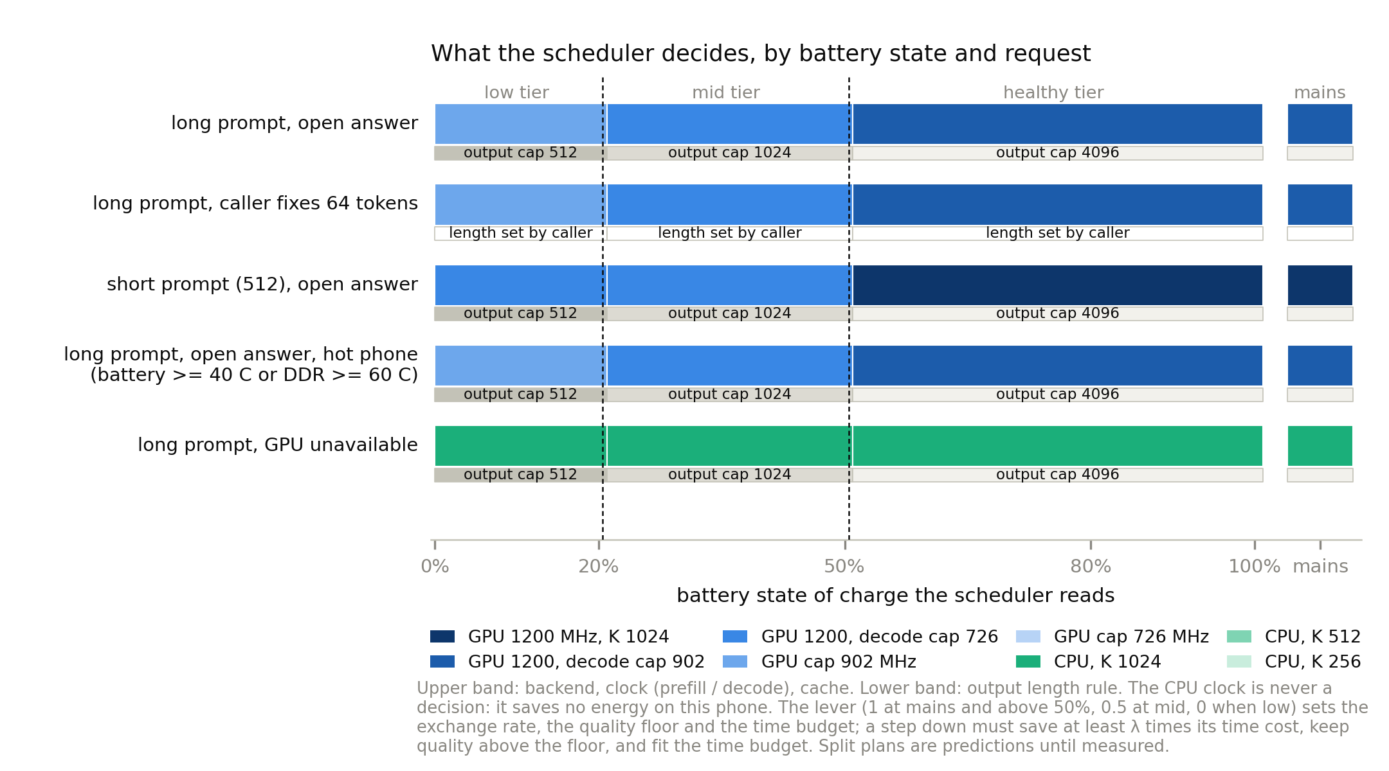
RESULT · WHAT IT DECIDES, BY BATTERY STATE
When the GPU clock, when the cache, when the output cap
The policy at every state of charge, five request situations. CPU only when the GPU is unavailable; the CPU clock is never a decision.
RESULTS · ENERGY-AWARE · DECISION MAP
17

Slide 20
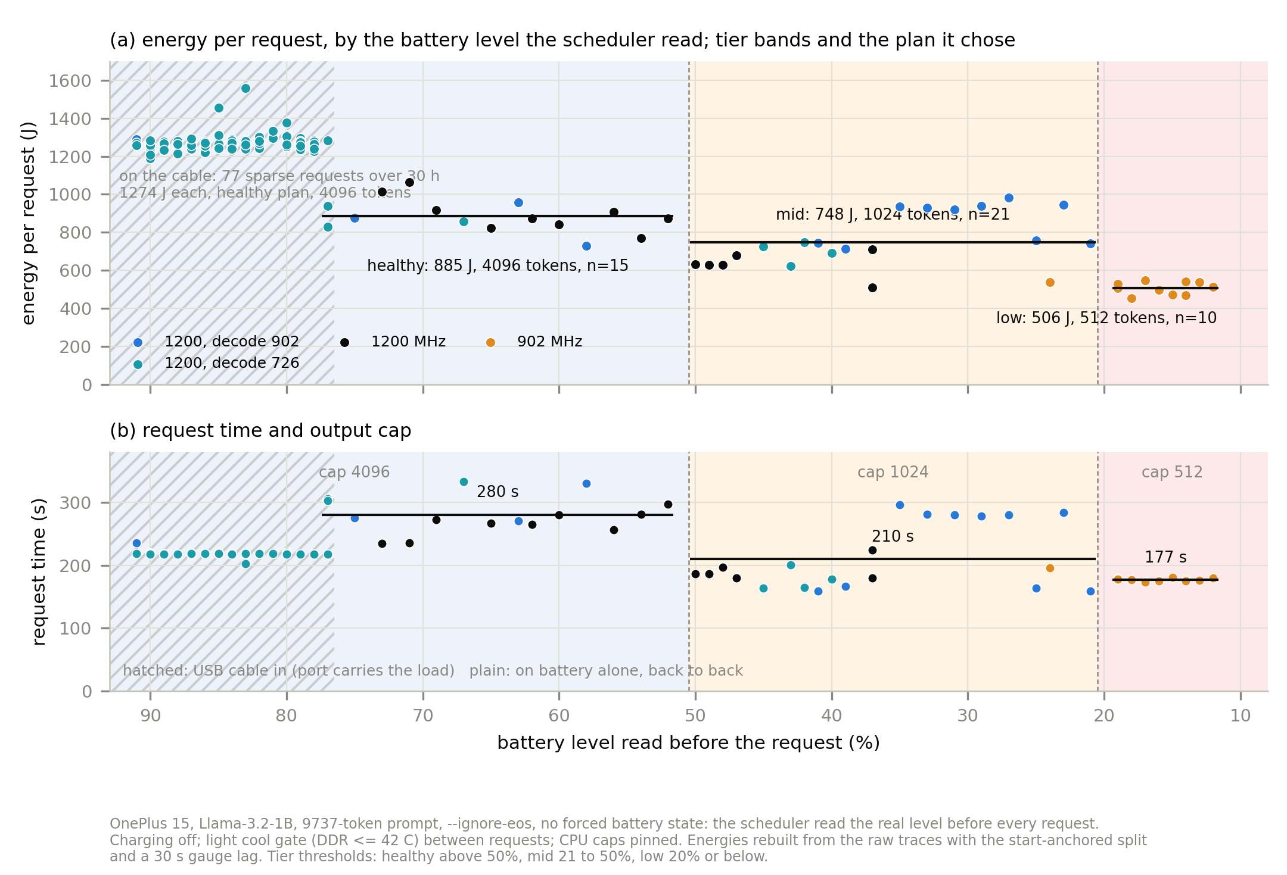
RESULTS · ENERGY-AWARE · THE REAL DISCHARGE · 123 REQUESTS, 91% TO 11%
RESULT · IT SWITCHES ON THE REAL BATTERY, AND SAVES
No forced state: the scheduler read the real level
before every request. Charging off, cable out
for the last 46 requests.
Healthy, above 50%: 4096 tokens, 885 J, 280 s
Mid, 50 to 21%: cap 1024, 748 J, 210 s (−15%)
Low, 20% and below: 902 MHz, cap 512, 506 J,
177 s (−43%)
Switches on the first request past 50 and 20.
On battery the OEM already runs the GPU cooler
and caps prefill at 726 MHz within a minute, so
the answer cap and the prefill cap carry the
saving; the decode-clock lever (6% on the cable)
is pre-empted by the vendor.
Table re-learned the battery regime in 3 requests.

Slide 21
WHAT WE CLAIM, AND WHAT BACKS IT
Four contributions, each with the evidence beside it
1
First end-to-end measurement of published eviction on a phone
Tables 1 and 2, every row re-derived from raw logs
Nine policies, each at its own published setting, on four models and two processors, measured on speed, energy, temperature and cells actually freed.
2
Three failure modes that belong to the device, not to any policy
Three-way control; CPU vs GPU control
Budgets that do not materialize, a scoring route that corrupts on Adreno, and a hardware ceiling. Each is shown on published baselines, not only on ours: a problem hurting only our design would be our bug, not a finding.
3
μKV: sequence-level, in-graph, with a characterised thermal dial
n=3 rotated; compaction 23/25 identical
Score in-graph, one keep-set, compact in place, freeze during decode, plus a watchdog that steps the clock before the vendor cliff. 4.80x on CPU on 7.4% of the cache, at 58% less energy.
4
The measurement traps that make phone numbers wrong
Quantified so others can avoid them
A baseline at the wrong budget reads 5.75 instead of 29.07 tok/s. An unpinned scheduler spreads identical runs by 39%, so any GPU ratio under 1.39x is noise.
Every table in the paper was re-derived from the raw campaign data during preparation: Tables 1, 2 and 4 exact on all rows, Table 3 exact on 12/12 retention and 14/14 F1.
CONTRIBUTIONS
18

Slide 22
NOVELTY, CHECKED AGAINST THE CLOSEST PRIOR WORK
What is ours, and what we explicitly do not claim
The claim | Closest prior work | Our position
Evicting while FlashAttention stays on | KeyDiff does this too | No priority claimed. Our difference is per-token cost: 2,510 decode evictions vs 59,238, a 24x gap
Per-head budgets do not materialize | KV-Compress notes it qualitatively, for server tensor layouts | We quantify it on-device and show it scales with head count: 8 heads spread 36 to 91%, 32 heads collapse to 85 to 100%
Eviction measured on a phone | KeyDiff reports scoring-kernel latency only | First end-to-end account: speed, energy, temperature, and cells actually freed
Energy and thermals on mobile | Characterization studies measure them but never vary the eviction policy | We vary the policy and measure both, and add a governor characterised as a measured dial
KV systems that ship on phones | KVSwap, DynaKV, MobiLoRA move bytes to disk or across adapters | None of them evicts, and none reads the battery
WHERE THE NOVELTY ACTUALLY SITS
Not in the eviction rule. It sits in the measurement, in naming three failures that belong to the device rather than to any policy, and in composing eviction with a thermal governor, which no KV paper does.
NOVELTY
19

Slide 23
WHAT DID NOT WORK
Reported rather than quietly fixed
Cache moves heat only where it moves traffic
Peak memory does not fall
Two of four models cannot run this on the GPU
Halving the cache at a held GPU clock raises peak DDR 5.8 °C (mean 2.3), because the freed bandwidth becomes work. But on the CPU, where both arms settle at the same clock (1374 vs 1378 MHz), μKV is 2.4 °C COOLER on DDR at 4.6x the throughput. The sign is set by the backend, not by the cache.
The engine reserves the full context up front and we select only at the end of prefill, so peak allocation drops 9% while bytes read per token drop 93%. The win is bandwidth, not footprint.
Bonsai-8B and gemma-2 crash the Adreno driver at 16K with ErrorDeviceLost, vanilla included. Bonsai is also killed for memory. This is a device limit, not a μKV limit.
And the one a reviewer will find: our quality table cannot pick a winner
On 15 questions, μKV and the full cache answer 13 identically, with one win and one loss each way. A sign test gives p = 1.00, meaning no difference at all was demonstrated. The uncertainty on every score is larger than every gap in the table. Retention separates these policies. F1 at this sample size does not, and we say so rather than letting the ranking imply otherwise.
NEGATIVES
20

Slide 24
THE ONE-SENTENCE VERSION
The hardware sets the ceiling on what eviction can pay. The policy decides how much of that ceiling you capture, or whether you go backwards.
On one processor the policy spans 4.5x (1.07 to 4.80), so the policy matters. For one policy on one model, changing only the processor moves KeyDiff from 3.29x to about 0.06x, so the device matters just as much. A speedup quoted without naming both is not describing a phone.
4.80×
7.4%
+0.7%
phone CPU, sustained decode, three runs each
of the cache still live, and genuinely freed
prefill vs no eviction at a fixed clock
μKV is what the device's constraints leave you with: score inside the FlashAttention graph, select one keep-set at sequence level, pack the survivors in place, and keep the thermal loop away from the cache entirely.
CLOSE
21

