Slide 1
HOTMOBILE 2027
μKV: Energy- and Thermal-Aware
KV-Cache Eviction for LLM Inference on a Phone
The KV cache, not compute, is the wall. The policies that bound it were built for server GPUs,
and three properties of a real on-device engine break them.
Md Romyull Islam · Kennesaw State University
OnePlus 15, Snapdragon 8 Elite Gen 5, Adreno 840 · every number measured on the device

Slide 2
THE PROBLEM
The phone is bound by the cache, not the matrix multiply
Cache size
Phi-3 at 2K holds 1.2 GiB of f16 KV
DRAM traffic
every step reads the whole cache, about 750 MB per attention pass
Heat
the vendor cuts the prime cores to 883 MHz when the battery reaches 50 °C
Energy
a 4096-token request costs 1.4 kJ on the GPU at full clock
The four are one chain. Cache size sets traffic, traffic sets power, power sets temperature, temperature sets the throttle, and the throttle sets throughput.
Across 372 on-device cells, live cache correlates with DDR temperature at r = 0.80 and with throughput at r = − 0.77.
So a mobile cache policy has to be judged on quality, throughput, heat and energy at once, on real hardware.
2

Slide 3
WHAT BREAKS
Nine policies, and three engine properties that break them
1 Budgets do not materialize
one cell array serves every head and layer, so a cell is freed only when all of them drop it
2 Scores cost the fast path
reading post-softmax attention forces the FlashAttention-off path
3 Compaction doubles memory
the state API restores survivors into a second full context
None of the three is visible on a server with per-head paged storage.
All three decide what a policy can actually do on a phone, and each is measured on the next three slides.
3

Slide 4
BREAK 1
A nominal budget is not a freed cell
at a matched budget of 1024 | live cells | share of the prompt
vanilla, Llama-3.2-1B CPU | 9737 | 100%
μKV | 721 | 7.4%
SnapKV | 5929 | 61%
H2O | 6110 | 63%
TOVA | 4091 | 42%
Ada-KV | 3484 | 36%
• A cell survives if any head or any layer keeps it, so the per-head unions cover most of the prompt.
• At their own published budgets the gap widens: on 110 LongBench prompts SnapKV at 2048 per head keeps 94% of the cache and H2O at 20% of the prompt keeps 92%.
• SnapKV reports an 8.2 times smaller cache, H2O 5 to 10 times. On Llama-3.2-1B they deliver 1.6 to 2.8, and on Bonsai-8B 1.0 to 1.6.
• μKV picks one keep set for every head and layer, which is what lets the cache compact.
Live cells measured with the engine's own state size call, which serializes live cells only.
4

Slide 5
BREAK 2
Reading attention scores costs more than eviction saves
Llama-3.2-1B, Adreno 840 | tok/s | vs full cache
vanilla (full cache) | 24.18 | 1.00
μKV | 29.77 | 1.23
SnapKV | 4.76 | 0.20
TOVA | 4.34 | 0.18
H2O | 3.58 | 0.15
Ada-KV | 2.86 | 0.12
• FlashAttention never writes the attention tensor, so a policy that reads scores cannot use it.
• On Llama-3.2-1B every score-reading evictor decodes slower than not evicting at all, 0.12 to 0.20 times the full cache.
• Retention does not predict speed. StreamingLLM keeps 777 cells, fewer than μKV's 723, and still runs at 0.23 because it stays on the slow path in this engine.
• μKV scores inside the FlashAttention graph, so it keeps the signal and the fast path.
12K-token prompt plus 4096 generated tokens, f16 KV for every policy, cold start.
5

Slide 6
BREAK 3
The state API needs a second full context
Phi-3-mini at 16K
two 6.4 GB caches plus 2.4 GB of weights
Android kills the process
reproduced twice, with six co-resident apps killed alongside
and on a 24 GB desktop GPU
so it is the mechanism, not phone memory
μKV slides survivors into a dense prefix inside the tensors prefill already allocated
peak memory does not rise, and the same configuration runs; the two modes produce identical keep sets, with perplexity agreeing to 0.15%
Measured: in-place compaction runs Phi-3 at 16K and reaches 2.64 times the full cache. The round trip runs only at ctx 8192.
6

Slide 7
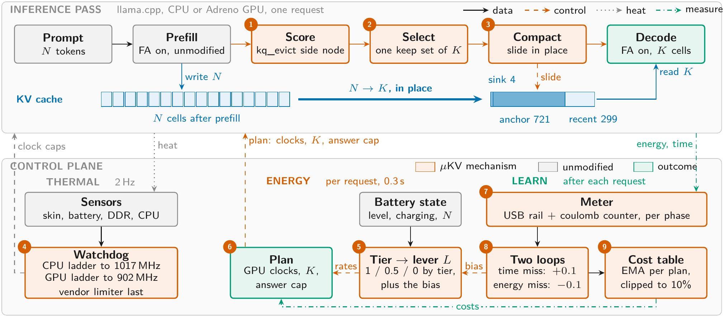
μKV
The pass on top, the control plane below
Steps 1 to 3 are the only changes to the inference pass. Steps 4 to 9 are the thermal, energy and learning columns.
Figure 1 of the paper.
7

Slide 8
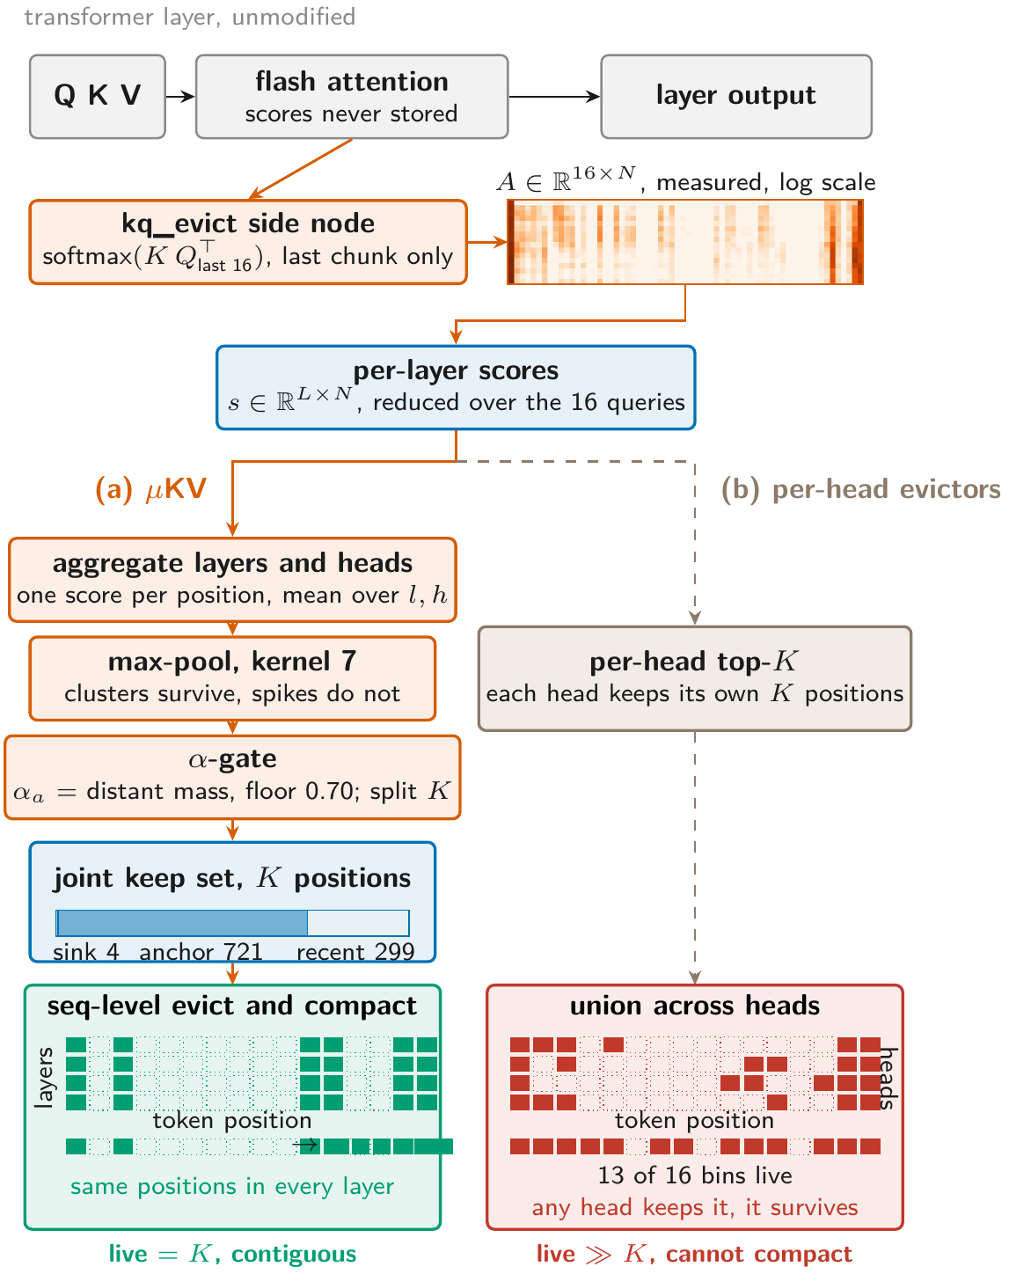
SELECTION
One keep set for every head and layer
• The side node computes the real softmax scores for the last 16 queries of the last prefill chunk.
• One score per position: the mean over layers and heads, max-pooled over 7 positions.
• The split α is the share of attention mass outside the recent window, floored at 0.70.
• K = 1024 becomes 4 sinks, 721 anchors, 299 recent.
• Per-head keep sets are a union, so 13 of 16 position bins stay live and nothing compacts.
• Heatmap and grids are measured, not drawn: Llama-3.2-1B, layer 8.
Figure 2 of the paper.
8

Slide 9
RESULT · SUSTAINED DECODE ON THE CPU
9737-token prompt, 4096 generated, cold start, charging off
Llama-3.2-1B, K = 1024 | tok/s | wall (s) | live cells | DDR °C | mWh
vanilla (full cache) | 5.0 | 1055 | 9737 | 59.8 | 1033
μKV | 24.2 | 406 | 721 | 54.4 | 391
SnapKV | 6.8 | 902 | 5929 | 56.3 | 818
Ada-KV | 6.7 | 875 | 3484 | 57.1 | 1002
StreamingLLM | 6.6 | 877 | 777 | 56.7 | 1052
H2O | 5.8 | 1006 | 6110 | 54.8 | 1094
TOVA | 6.0 | 947 | 4091 | 54.4 | 1069
4.8×
the full cache's throughput
−62%
energy for the same work
7.4%
of the cells kept
Both policies run the same vendor-clamped 1.6 GHz, so the heat comes from memory traffic, not the clock.
Only μKV both compacts and keeps decode on the fused kernel.
−5 °C
peak DDR, joint coolest with TOVA
Table 1 of the paper. Three more models are in the paper: Bonsai-8B 4.5x, Phi-3-mini 4.5x, gemma-2-2b 2.4x, all against their own full cache.
9

Slide 10
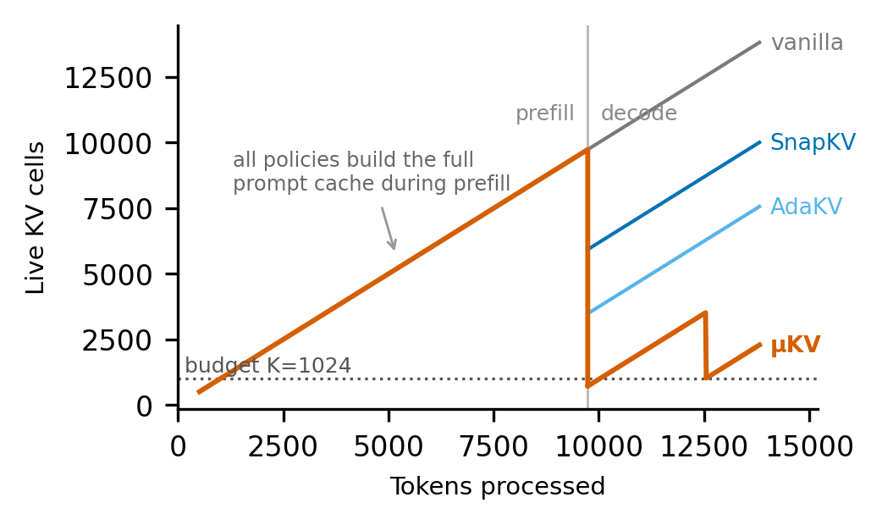
WHY
Every policy builds the full prompt cache. Only μKV gives it back
• At the end of prefill μKV compacts to 721 cells and stays bounded near 2K through decode.
• SnapKV can only drop to 5.9K, because a cell needs every head to release it.
• Vanilla grows without bound.
• This one picture is the paper's argument: the budget a policy asks for is not the cache it frees.
Figure 4 of the paper, Llama-3.2-1B on the phone CPU.
10

Slide 11
RESULT · MOBILE GPU
The same workload on the Adreno 840
Llama-3.2-1B | tok/s | dec × | cells
vanilla | 24.18 | 1.00 | 9741
μKV | 29.77 | 1.23 | 723
μKV, no compaction | 25.61 | 1.06 | 723
best baseline (StreamingLLM) | 5.55 | 0.23 | 777
Phi-3-mini | tok/s | dec × | cells
vanilla | 5.05 | 1.00 | 11157
μKV, in place | 13.36 | 2.64 | 878
StreamingLLM, own budget | 10.60 | 2.10 | 2000
SnapKV, gate promoted | 5.80 | 1.15 | 10862
• In-place compaction runs Phi-3 at 16K, where the state-API round trip is killed. That is the configuration the paper's third break describes.
• Phi-3 needs a driver gate: the FlashAttention-off capture is numerically broken at head dimension 96, and uncorrected runs decode at full speed while emitting 18 to 44% corrupted tokens. The gate promotes SnapKV and Ada-KV to the in-graph side node and refuses H2O and TOVA.
11

Slide 12
RESULT · QUALITY, BOTH ON THE PHONE
Retrieval and long-context, at each policy's own budget
Policy | needle hits, Phi-3 / Llama / Gemma / Bonsai | cells attended | LongBench F1 | cache held
vanilla (full cache) | 14 / 13 / 11 / 14 | 4858 | 36.9 | 100%
μKV | 14 / 13 / 11 / 14 | 774 | 37.0 | 14%
SnapKV | 14 / 12 / 11 / 14 | 4237 | 38.0 | 94%
Ada-KV | 14 / 12 / 11 / 14 | 3361 | 37.8 | 71%
TOVA | 14 / 12 / 11 / 14 | 3670 | 37.4 | 77%
H2O | 14 / 8 / 10 / 13 | 4212 | 36.2 | 92%
StreamingLLM | 3 / 3 / 2 / 3 | 890 | 35.0 | 33%
μKV matches the full cache on both benchmarks while holding a seventh of the cache. The others buy about a point of F1 by holding 71 to 94% of it.
StreamingLLM fails retrieval everywhere: its window evicts exactly the middle of the context, which is where a buried fact lives.
392 needle cells and 103 LongBench prompts, all on the phone. A four-model desktop sweep gives the same ordering.
12

Slide 13
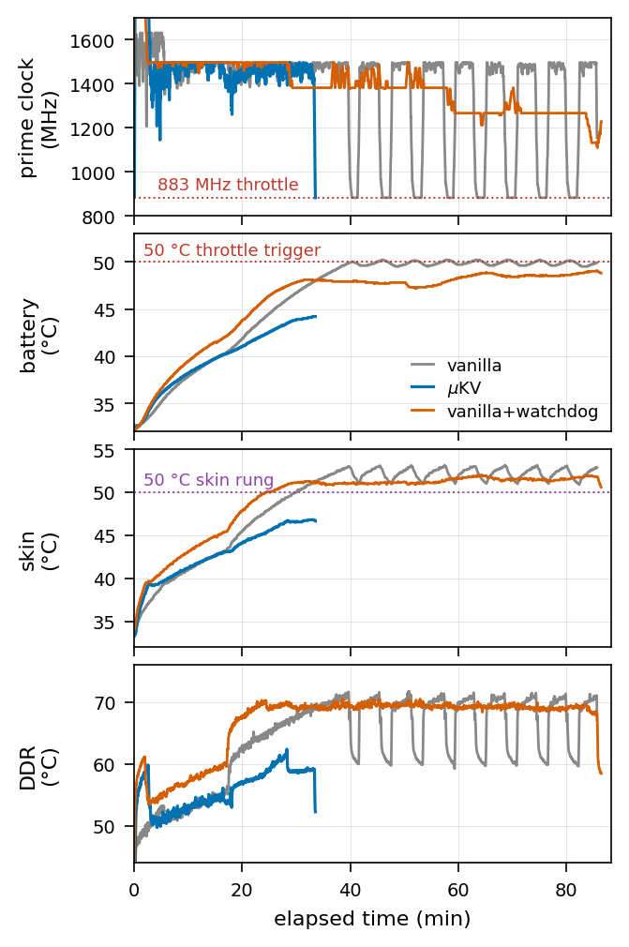
RESULT · SUSTAINED HEAT
Two levers against the vendor's cliff
• The full cache on Bonsai-8B runs 85.6 minutes and drives the battery to 50.2 °C. At 50 °C the vendor deep-throttles both clusters: 17 dips, 923 s at 883 MHz.
• μKV finishes in 33.5 minutes at a 44.2 °C peak, before the trigger. That is the cache lever.
• Given the watchdog as an ablation, the full cache's battery rise flattens from 0.48 to 0.05 °C per minute and settles at 49.1 °C. The prime cores never reach 883 MHz. That is the clock lever.
• The watchdog belongs to μKV and is never given to a baseline.
• On the GPU the ladder gives 1289 against 1390 J and a DDR peak of 75 against 90 °C, for 1% more time.
• Negative result: a cache budget tied to temperature does not cap peak heat. Cache controls throughput and energy; the clock caps heat.
13

Slide 14
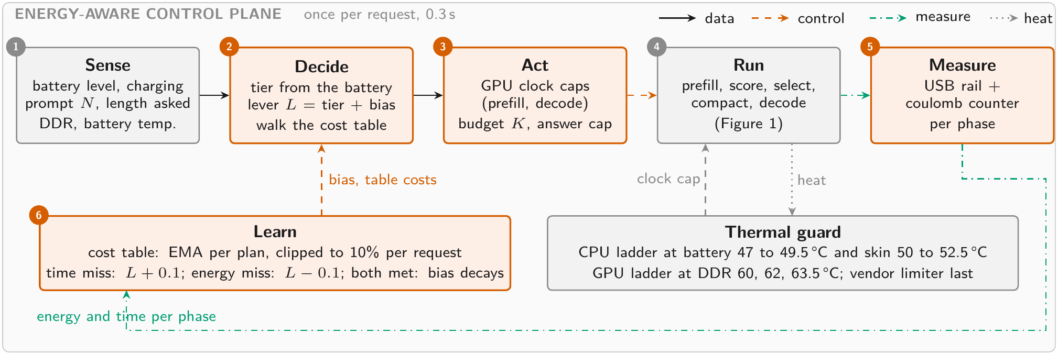
RESULT · ENERGY-AWARE CONTROL
One lever from the battery, two loops on model error
tier | J | s | vs healthy
healthy, cap 4096 | 885 | 280 | —
mid, cap 1024 | 748 | 210 | −15%
low, cap 512 | 506 | 177 | −43%
• 123 requests, 91% to 11%, charging off, nothing forced.
• It switched on the first request past each threshold, 50% and 19%.
• A table seeded on the cable over-predicted by 36%; the clipped learning fixed it in three requests.
Figure 3 and Table 6 of the paper. A decision costs 0.3 s on the phone.
14

Slide 15
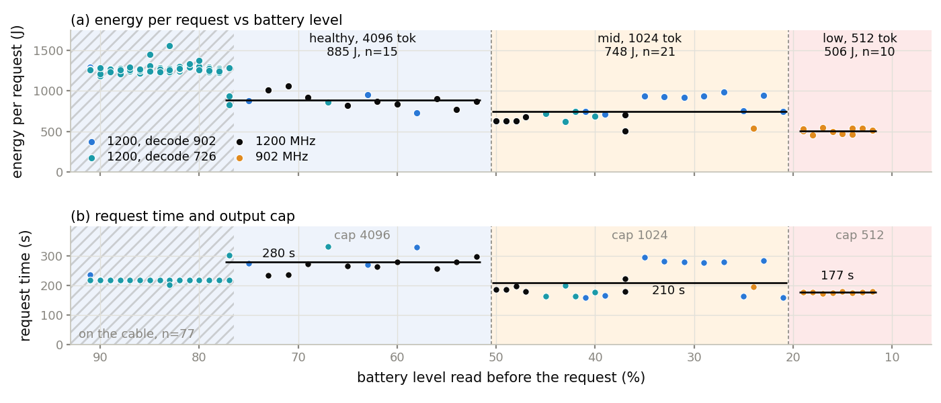
RESULT · THE REAL DISCHARGE
It switches on the real battery, and it saves
• On the battery the phone is a different machine. The same healthy request costs 885 J instead of 1274 on the cable.
• The OEM caps prefill at 726 MHz within a minute of every request, so the answer cap and the prefill cap carry the saving.
• Mean prediction error over the run: 8.9% on the battery, 3.7% on the cable.
15

Slide 16
THE RL QUESTION
Would a learned policy beat the rule? Three experiments said no
1 Simulator
bandit over 72 values and a Q-learner over 576, 60 episodes and 6 seeds
2 Real cells, offline
a bandit fitted on logged requests, bootstrap for the best arm
3 On the phone
24 real requests, ε-greedy over three GPU clocks
13 / 15
15.7 kJ
149 min
free pulls chose the rule's arm
spent to learn it
of phone time
Energy and time per plan do not depend on the state of charge; only the weighting does, and that is a design choice. So the table learns and the rule decides.
16

Slide 17
REPORTED, NOT HIDDEN
The negative results are load-bearing
• Cache size is not a temperature actuator. Halving K under co-load left peak DDR unchanged, and on a cool phone a smaller cache runs hotter at peak.
• The per-head budget gate we built is idle. Its candidate pool holds 96.5 to 99.8% of the prompt, and bypassing it leaves the keep set identical, so it is removed.
• A learned policy does not beat the rule, and we report what learning cost.
• Eviction still costs verbatim recall of the spans it drops, even though prediction and retrieval are preserved.
• The 1-bit kernels return non-finite logits on this GPU, so Bonsai's phone numbers are CPU numbers, and every backend now needs an output-validity check.
17

Slide 18
SUMMARY
μKV in four lines
• Three engine properties break server eviction policies on a phone: shared cells, the fast path, and the second context.
• μKV answers all three: scores from inside the FlashAttention graph, one keep set for every head and layer, compaction in place.
• 4.8 times the full cache's decode throughput on the CPU, at 7% of the cells and 62% less energy, and 1.23 times on the GPU, with full-cache retrieval and LongBench.
• Around it, a clock watchdog holds the CPU below the vendor's throttle and a per-request scheduler spends the battery by its level: 15% and 43% less per request at the lower tiers.
18

