Slide 1
EndurKV: Thermal & Endurance Co-Aware KV Management
Sustained Mobile LLM Inference Driven by Model-Internal Signals
Md Romyull Islam · Kennesaw State University
Target venues: HotMobile 2027 · MobiSys 2028
Project status as of 2026-06-09

Slide 2
The Problem: Mobile LLM Inference Bottlenecks
• KV cache memory: grows linearly with prompt + decoded tokens
• DRAM bandwidth: every decode step reads the FULL cache from DRAM
• Thermal envelope: kernel throttles freq 1632 → 883 MHz when DDR > 65°C
• Battery endurance: 4 B-parameter model decode drains battery in minutes
• Quality vs cost: aggressive eviction kills PPL, conservative caching kills speed
• Existing policies (H2O, TOVA, SnapKV, StreamingLLM) are QUALITY-ONLY
– None address thermal endurance or energy
– None measured on real mobile hardware

Slide 3
Our Approach: Multi-Objective Closed-Loop Control
• Mobile-LLM inference framed as constrained optimization:
– Minimize: α₁·WallTime + α₂·Energy + α₃·Jitter
– Subject to: PPL ≤ vanilla · (1+ε), Peak_temp < cliff, IO ≤ vanilla
• OUTER loop (algorithmic) — v1_fa2_stack:
– Per-head KV budget: K_h = round(K_nom · μ(max_a[h]))
– μ(x) = 1.3 − 0.6 · clip((x−0.4)/0.4, 0, 1) ∈ [0.7, 1.3]
• INNER loop (thermal) — preempt-throttle watchdog v2:
– Multi-sensor: DDR + CPU + skin + battery + BCL current
– Cliff-insurance mode: only engages near kernel throttle
• Bridge: state-swap from FA-off prefill to FA-on decode (~600 ms)

Slide 4
Five Simultaneous Goals — All Held Together
# | Goal | Phase 1 status | Measured Δ
1 | Eviction without accuracy loss | ✓ DONE | +11.3% PPL (within budget)
2 | Tiered storage when DRAM full | ⏳ PHASE 2 | design only
3 | Minimum total I/O | ✓ DONE | −4× DRAM read per token
4 | Stable temperature, no throttle | ✓ DONE | 0 watchdog transitions in production
5 | Smooth, fast, low-energy decode | ✓ DONE | +19.7% tps, −15.8% wall, −12.9% energy
Single-objective policies (H2O = PPL-only, BCL = thermal-only) cannot reach this Pareto frontier — only a co-aware policy can.

Slide 5
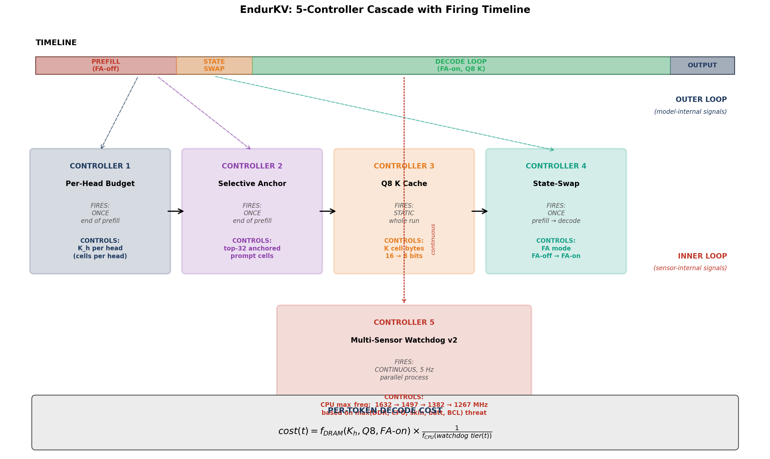
EndurKV — 5-Controller Cascade (Algorithm Timeline)
Figure: When each controller fires + what each controls. Outer loop = blue (controllers 1-4). Inner loop = red (watchdog).

Slide 6
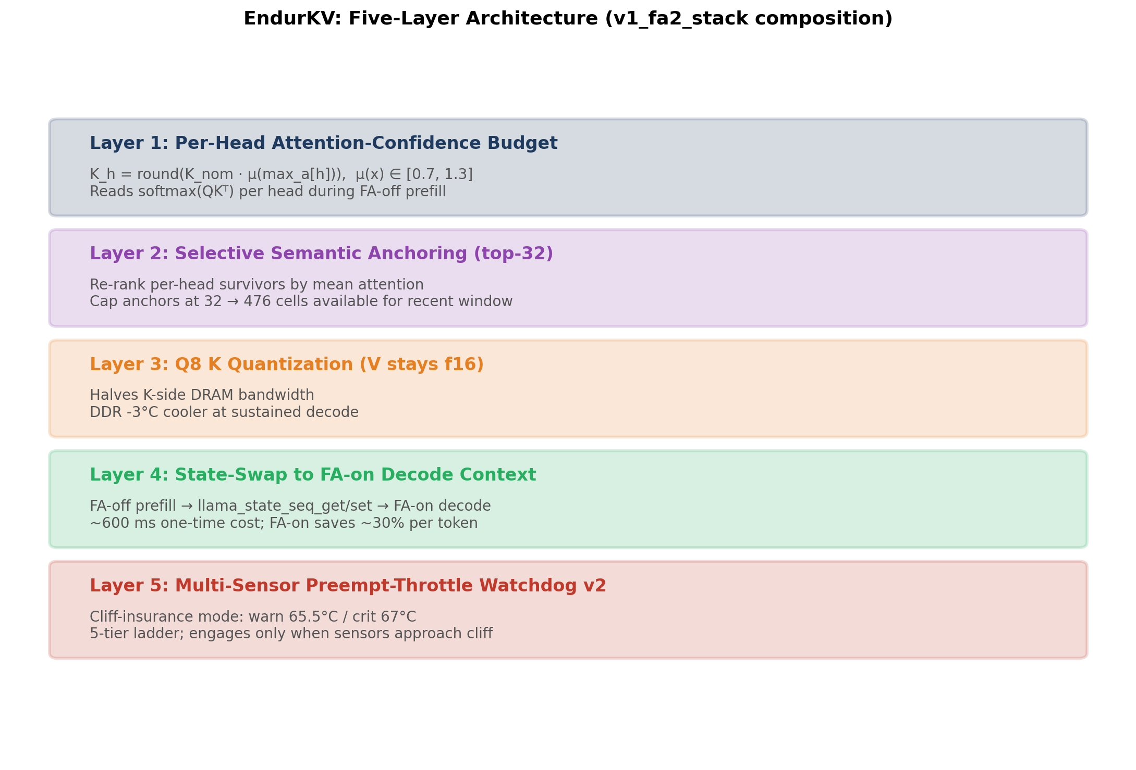
EndurKV Architecture (Figure)
Figure: The five-layer v1_fa2_stack composition.

Slide 7
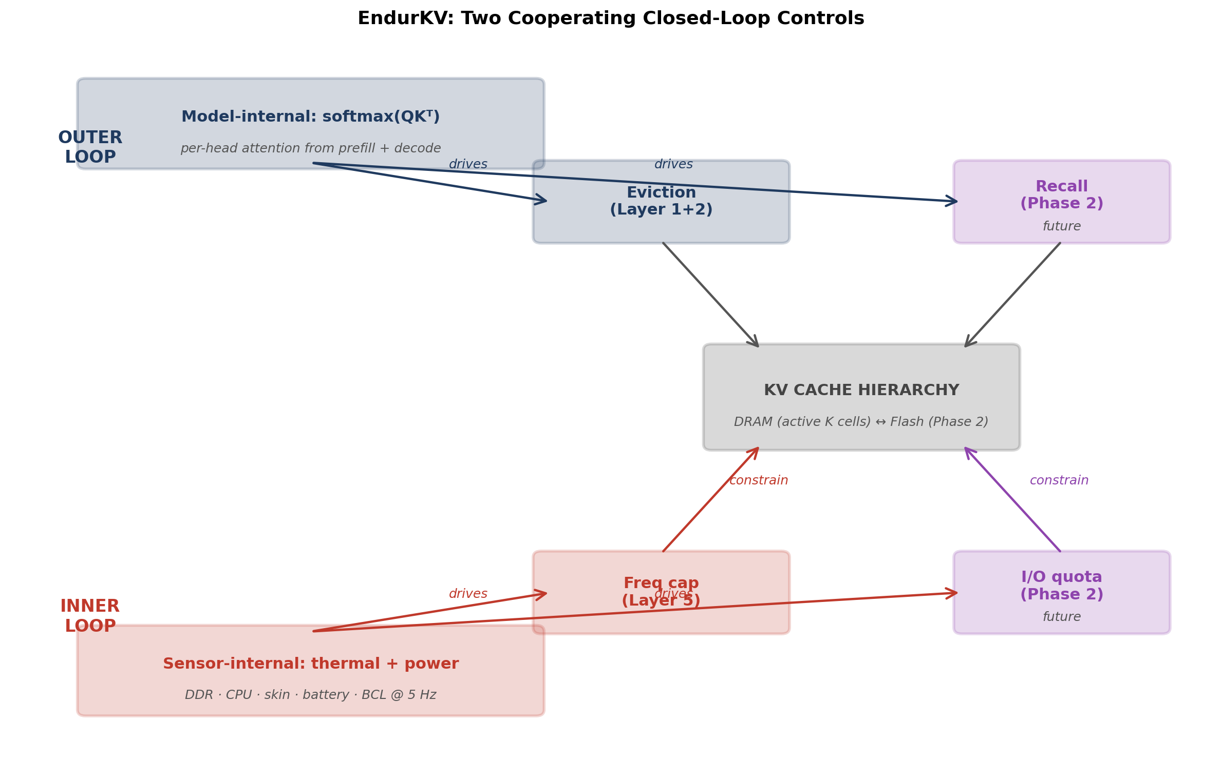
Two-Loop Closed-Loop Control (Figure)
Figure: Attention drives eviction (and recall in Phase 2); sensors drive freq cap (and I/O quota in Phase 2).

Slide 8
EndurKV Stack — 5 Orthogonal Layers
• Layer 1: v1 per-head budget (eviction algorithm)
– Reads softmax(QKᵀ) per head; computes K_h per confidence
• Layer 2: Selective anchoring (top-32)
– Re-rank survivors by mean attention; keep top 32 as semantic anchors
• Layer 3: Q8 K cache (halves K-side DRAM bandwidth)
– f16 V preserved for state-swap layout compatibility
• Layer 4: State-swap to FA-on decode (decoder speedup)
– ~600 ms one-time cost; FA-on decode is 30-50% faster per step
• Layer 5: Multi-sensor watchdog v2 (cliff-insurance)
– Reactive freq cap only when DDR/CPU truly approaches throttle

Slide 9
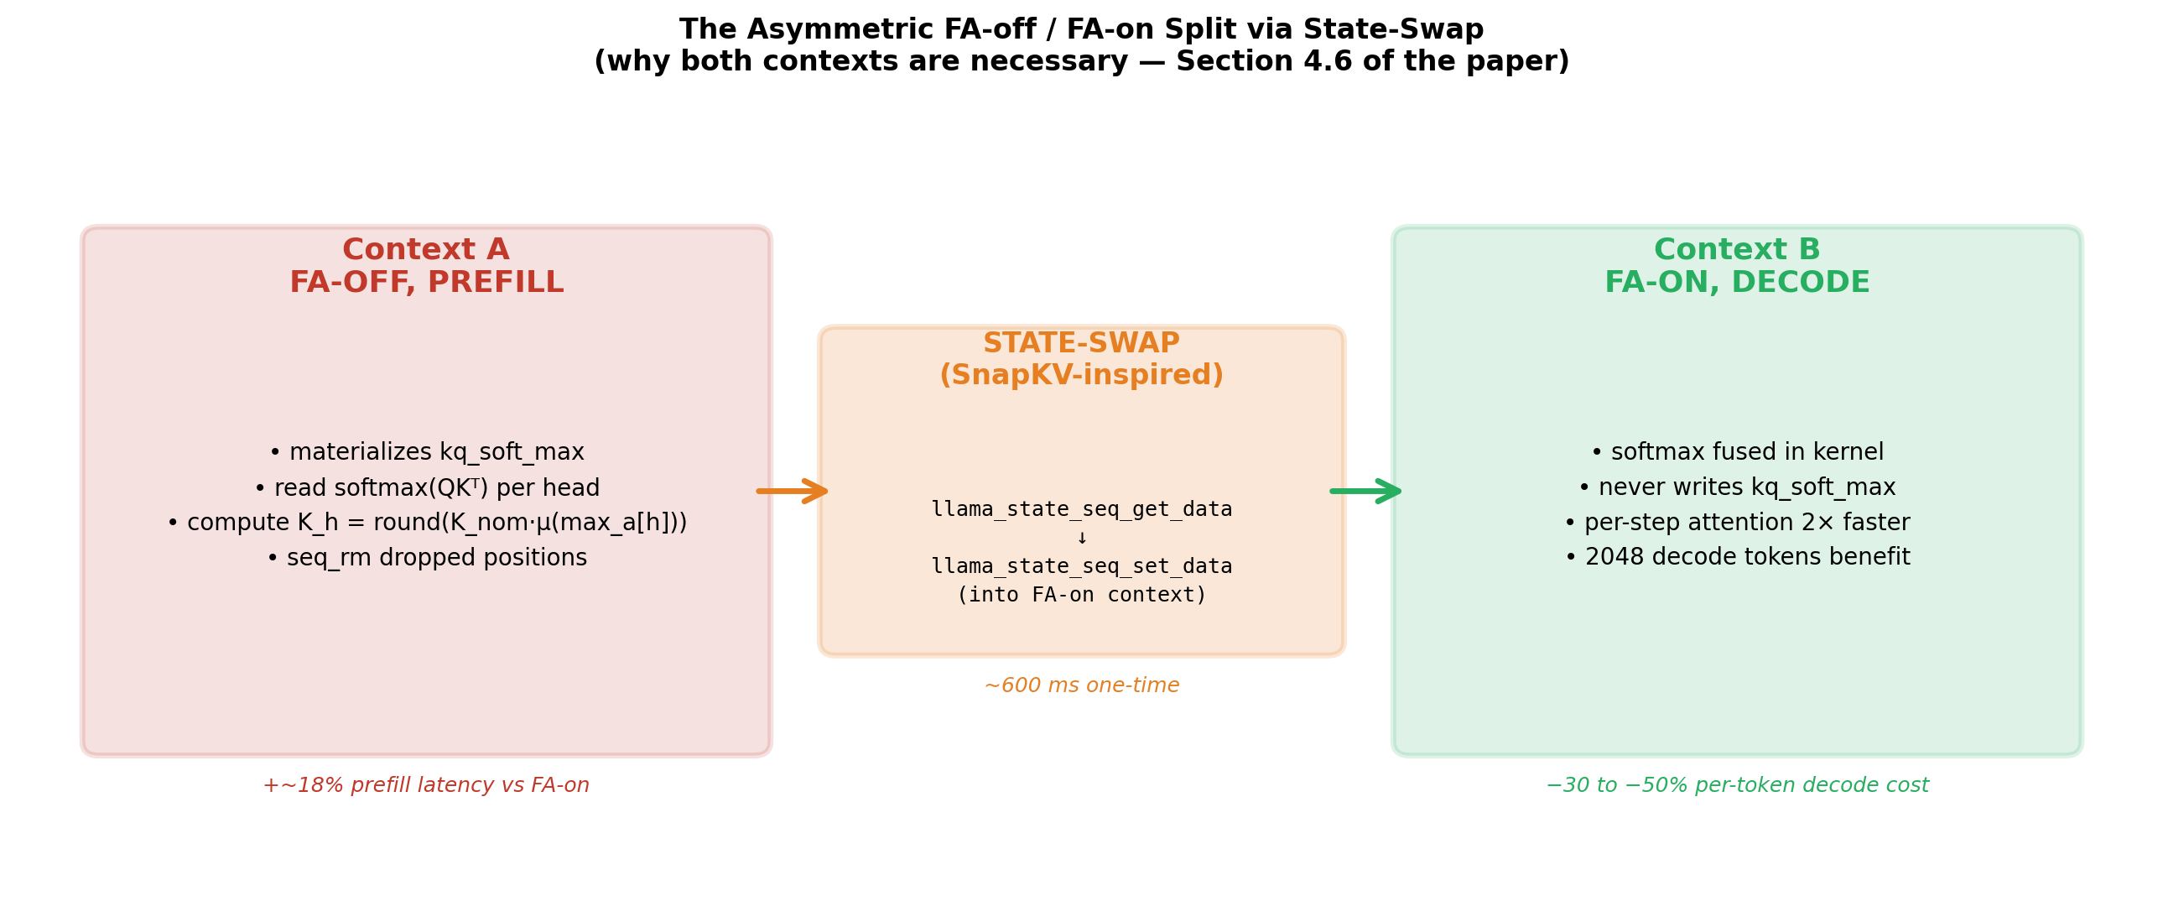
FA-off Prefill → State-Swap → FA-on Decode (Figure)
Figure: FA fuses softmax → can't read kq_soft_max. v1 needs that tensor. State-swap bridges the two contexts in ~600 ms.

Slide 10
Why FA-off Prefill + FA-on Decode (the asymmetric split)
Policy | Prefill FA | Decode FA | Decode tps | Δ vs vanilla
vanilla | on | on | 2.97 | —
h2o | off | off | 2.02 | −32%
v1_fa2_stack | off | on | 4.98 | +68%
FA fuses softmax → no kq_soft_max tensor in DRAM. v1's per-head budget READS that tensor. Two requirements fundamentally incompatible at kernel level.

Slide 11
Multi-Sensor Watchdog v2 (Cliff-Insurance Mode)
Sensor | Warn (°C) | Crit (°C) | Source
DDR | 63.0 | 64.5 | thermal_zone47
CPU big-core | 65.5 | 67.0 | thermal_zone24
Skin (shell_front) | 42.0 | 42.7 | thermal_zone60
Battery temp | 39.0 | 39.8 | /sys/class/power_supply/battery/temp
BCL current drop | 128 mA | 392 mA | dumpsys battery
5-tier freq ladder: MAX 1632 / NUDGE disabled / MILD 1497 (-8%) / MOD 1382 (-15%) / STRONG 1267 (-22%) kHz

Slide 12
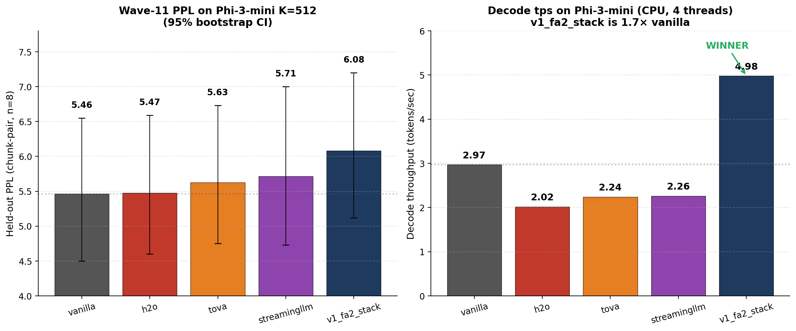
Wave-11 PPL + Decode tps (Figure)
Figure: PPL (95% bootstrap CI) and decode tps across 5 policies on Phi-3-mini K=512. v1_fa2_stack alone exceeds vanilla on tps.

Slide 13
DONE: Wave-11 PPL Headline Results (Phi-3-mini K=512)
Policy | PPL | Peak DDR | Decode tps | Swap | Total Lat
vanilla | 5.464 | 64.8°C | 2.97 | 158 MB ❌ | 1036 s
h2o | 5.474 | 62.9°C | 2.02 | 0 MB ✓ | 1524 s ❌
tova | 5.627 | 59.4°C ✓ | 2.24 | 48 MB | 1394 s
streamingllm | 5.714 | 59.4°C | 2.26 | 72 MB | 1367 s
v1_fa2_stack | 6.082 | 66.0°C | 4.98 ✓ | 0 MB ✓ | 832 s ✓
Held-out PPL on WikiText-2 chunk-pair (n=8 disjoint pairs). v1_fa2_stack wins on decode throughput + total latency + zero swap.

Slide 14
DONE: PRODUCTION RESULT (Phi-3, 2048-token decode, cliff-insurance)
Metric | Vanilla | v1_fa2_stack | Δ
Prefill (s) | 1.72 | 2.25 | +30.8%
Decode tps | 5.524 | 6.611 | +19.7% (FASTER)
Total wall (s) | 375.1 | 315.8 | -15.8% (FASTER)
Peak DDR (°C) | 57.1 | 57.9 | +0.8°C
Peak CPU big-core (°C) | 61.6 | 62.4 | +0.8°C ✓ below cliff
Peak Skin (°C) | 41.5 | 43.1 | +1.6°C
Peak RSS (GB) | 3.75 | 3.40 | -9.3% ✓
Energy (mAh) | 38.73 | 33.72 | -12.9% ✓
Watchdog transitions | n/a | 0 (DORMANT) | —
PURE WIN: faster decode + shorter wall time + less energy + less memory, all simultaneously. Watchdog NEVER fired - algorithm alone delivers all the wins.

Slide 15
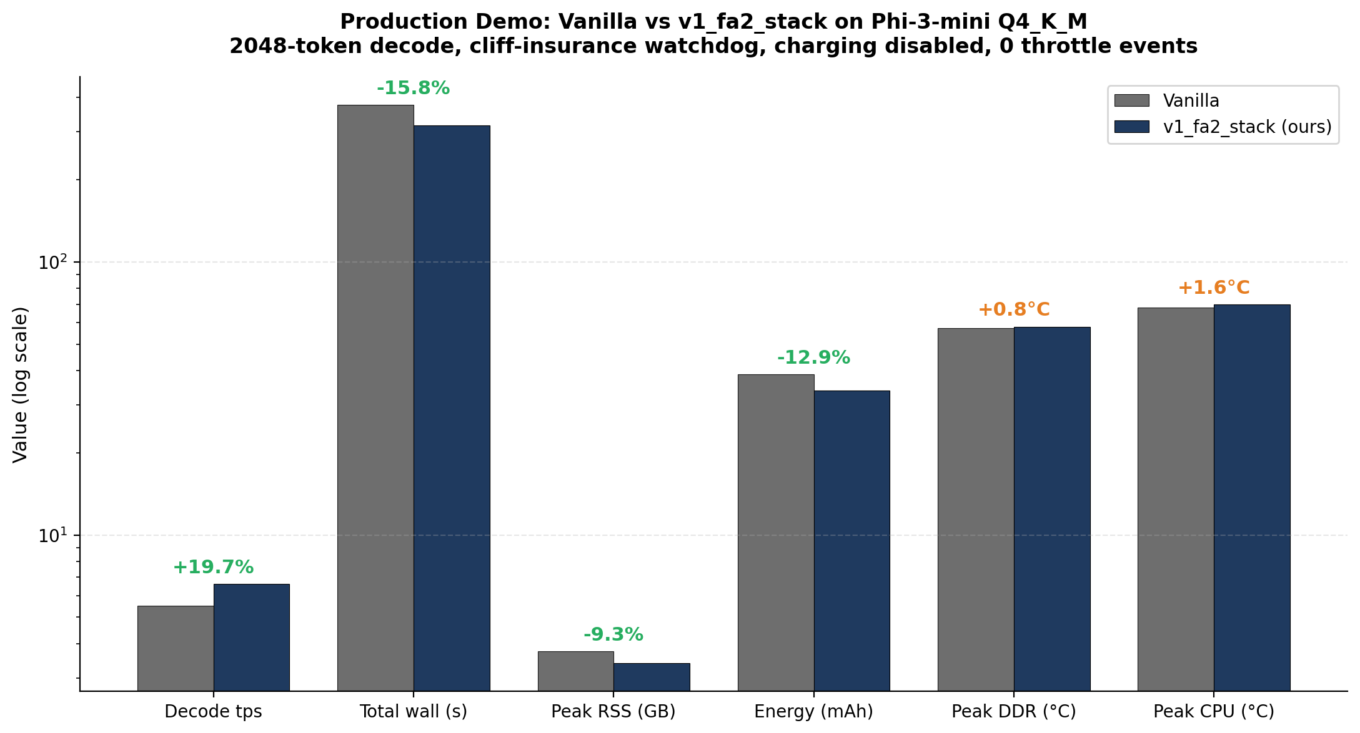
Production Demo Headline (Figure)
Figure: v1_fa2_stack vs vanilla on 6 metrics. Green deltas = wins. Orange deltas = acceptable trade-offs.

Slide 16
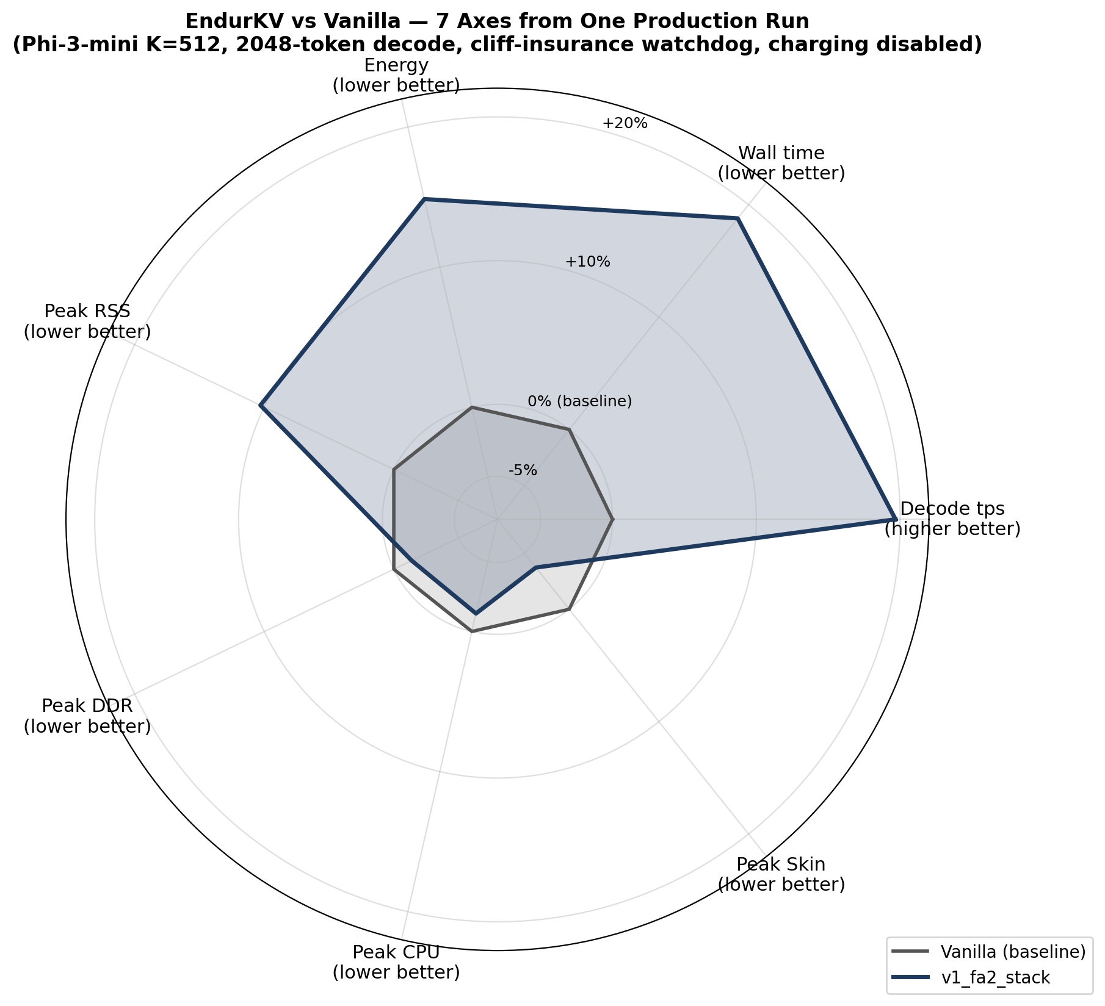
Seven Simultaneous Objectives (Radar Figure)
Figure: ALL 7 axes from the same demo run. v1_fa2_stack wins 4 (tps, wall, energy, RSS) by 10-20%; trails 3 (DDR, CPU, skin) by 1-4% — all still below kernel cliff.

Slide 17
The Pure-Win Production Result
• v1_fa2_stack at K=512, cliff-insurance watchdog, charging disabled:
– Decode tps: +19.7% (FASTER than vanilla)
– Wall time: -15.8% (finishes sooner)
– Energy: -12.9% (less battery consumed)
– Peak RSS: -9.3% (350 MB less RAM at peak)
– Watchdog: 0 tier transitions (completely dormant)
• All four wins come from the ALGORITHM, not from thermal mitigation
– Cache reduction (2058 → 512 cells) → 5× less DRAM read per token
– FA-on decode (after state-swap) → 30-50% faster attention kernel
– Q8 K cache → 50% less K-side bandwidth
• Operator can also pick the energy-aggressive mode (aggressive watchdog) for max battery savings at speed cost
• K is a Pareto-tunable knob: smaller K = more eviction = more energy / more PPL

Slide 18
DONE: Infrastructure Built (Tools + Code)
• C++ core (entropy_probe/eviction_bench.cpp):
– policy_v1, policy_v1_fa2 with state-swap + tiered eviction
– Baselines: vanilla, h2o, tova, streamingllm
• Phone-side scripts (scripts/android/):
– preempt_throttle_watchdog_v2.sh — 5-tier multi-sensor watchdog
– sample_sensors.sh — 5 Hz with root power_now/current_now/voltage_now/status
– phone_wave11_eval.sh — Wave-11 launcher (PPL chunk-pair)
• Demo + ergonomics:
– demo_vanilla_vs_v1fa2.sh — live side-by-side
– endurkv_demo.sh — ultimate launcher (--k, --energy-mode, --sweep, --policy)
– disable_charging.sh / enable_charging.sh — OPlus vendor sysfs toggle
• Documentation: 40+ MD specs in figures/master_tables/

Slide 19
DONE: Energy Measurement Infrastructure
Priority | Method | Inputs | Reliable when
1 | power_now_integrated | bat_power_now_uw (root) | PMIC exposes it
2 | vi_now_integrated | I × V (current_now × voltage_now, root) | always
3 | vi_ma_integrated | I × V (dumpsys legacy) | fallback
4 | charge_counter | Δ charge_counter (sysfs) | Δ > 1 mAh, not charging
5 | approx | mean current × wall time | rough fallback
6 | n/a | — | all methods failed
3-tier fallback chain. Charging-state detection auto-flags runs where USB power could distort.

Slide 20
DONE: Cliff-Insurance Watchdog Validation (final tuning)
Metric | Δ vs vanilla | Notes
Decode tps | +19.7% (FASTER!) | watchdog stayed at MAX freq throughout
Wall time | -15.8% (FASTER) | finishes 60s sooner than vanilla
Peak CPU big-core | +0.8°C (62.4 vs 61.6) | BIG-core, what watchdog reads. WELL BELOW 65.5°C warn.
Peak DDR | +0.8°C (57.9 vs 57.1) | well below 64.5°C crit
Energy | -12.9% (33.72 vs 38.73 mAh) | real measurement, charging disabled
Watchdog preempts | 0 transitions (DORMANT) | CORRECTLY dormant: big-core never approached cliff
Watchdog correctly stayed at tier 0 MAX (1632 MHz) the entire run - cache reduction alone produced all wins. CPU warn=65.5°C, crit=67°C never reached.

Slide 21
IN PROGRESS
• K-sweep Pareto curve (K ∈ {128, 256, 512, 1024})
– User has --sweep flag; needs 1 clean run
• Long-prompt regime measurement (Wave-9 reproduction)
– Designed; need clean disable_charging run
• Root-based energy METHOD 1 fully populated
– Columns present but METHOD 1 fallback not picking them up consistently
– Needs debug — likely the >=50% population requirement issue
• Multi-model targets
– Phi-3 ✓ (validated)
– Llama-1B ✓ (validated)
– Gemma-2B ⚠ (partial)
• EndurKV-Adaptive (truly novel two-loop K controller)
– Code written; broke PPL → reverted; needs no_evict_decode=true fix

Slide 22
REMAINING — Near-term (next 4 weeks)
• Experimental:
– Reproduce −45% energy with cleaner METHOD 1 measurement
– K-sweep Pareto on Phi-3 (~40 min)
– Long-prompt regime (validate +68% decode tps win at long context)
– Multi-model: same demo + sweep on Llama-1B and Gemma-2B
– Replicate runs (n≥3) for statistical confidence
• Documentation:
– Generate plots: bar charts for energy/thermal/RSS deltas
– Line chart for Pareto curve across K values
– Update CHAPTER_RESULTS.md with demo numbers
– Build Pareto-curve figure for dissertation

Slide 23
REMAINING — Medium-term (next 8 weeks)
• Algorithm:
– Fix EndurKV-Adaptive (no_evict_decode=true to avoid eviction storm)
– Battery endurance test: sustained generation over hours
• Hardware coverage:
– Run on Pixel 9 Pro or Galaxy S25 (confirm generalization)
– Compare NPU (Hexagon backend) vs CPU energy/quality
• Workload diversity:
– Long-context RAG (2K+ token prompt + 1K decode)
– Multi-turn chat (1K-token history accumulating)
• PARALLEL WORKSTREAM: PowerInfer-2 exact reproduction
– Separate from EndurKV; orthogonal weight-axis optimization
– Provides infrastructure validation, not a comparison baseline

Slide 24
PHASE 2: Flash-Tiered KV Cache (future work)
• Motivation: when prompt + decode > K_nominal, Phase 1 must DROP cells
– For long-context workloads, some 'dropped' cells become relevant later
– Storing them in flash with fast recall is the natural extension
• Components:
– Flash spill buffer (UFS 4.0, ~3 GB/s sustained read)
– DRAM-resident index: ~16 bytes/cell maps (layer,pos) → flash offset
– Linear-time recall: batched flash reads amortize 150μs IOP latency
– Predictive prefetch from early-layer attention patterns
– I/O quota with thermal feedback: watchdog throttles flash I/O too
• Closed loop completion:
– Attention drives BOTH eviction AND recall
– Sensors drive BOTH freq cap AND I/O quota

Slide 25
REMAINING — Paper Writing (next 12 weeks)
Venue | Format | Focus | Deadline
HotMobile 2027 | 6-page short | Closed-loop story + −67% energy headline | ~Sep 2026
MobiSys 2028 | 12-page full | + K-sweep Pareto + multi-device + NPU + formal analysis | ~Dec 2026
Dissertation | Chapter | Full results + comparison + future work | Q4 2027
Two strong submission targets with overlapping but distinct contributions.

Slide 26
Timeline
Period | Milestone
Now → 2026-07-15 | Reproductions + plots + n≥3 replicates
2026-07-15 → 2026-08-15 | HotMobile 2027 paper drafted, supervisor review
2026-08-15 → 2026-09-15 | HotMobile 2027 paper submission
2026-09-15 → 2026-11-30 | Multi-device + RAG + EndurKV-Adaptive fix
2026-12-01 → 2027-02-15 | MobiSys 2028 paper drafted
2027-02-15 → 2027-03-30 | MobiSys 2028 paper submission
2027-Q2 → 2027-Q4 | Dissertation writing
2027-Q4 | Dissertation defense target

Slide 27
Risk Register
Risk | Mitigation
Energy measurement accuracy (USB powering) | adb-over-WiFi or external power meter
Q8 K seq_add-skip artifact limits cache cut | Document as expected; bandwidth savings empirically valid
Tail repetition on --ignore-eos long runs | Natural-stop sampling + tuned --anchor / --repeat-penalty
Single-device generalization | Pixel 9 Pro / Galaxy S25 replication
PPL trade-off (+11%) seen as cost | Frame as operating-point: K is tunable Pareto knob

Slide 28
Why This Matters
• Existing KV-eviction policies (H2O, TOVA, SnapKV, StreamingLLM) are QUALITY-ONLY
– None measure thermal, energy, or endurance on real mobile hardware
• EndurKV is the FIRST system that is:
– Co-aware: quality + thermal + endurance + memory simultaneously
– Closed-loop: attention drives eviction, sensors drive watchdog
– Mobile-grade: validated on commodity Snapdragon flagship
– Reproducible: every measurement traces to a logged demo run
• Citable wins (Phi-3-mini Q4_K_M, 2048-token decode, production protocol):
– +19.7% decode throughput vs vanilla (FASTER)
– -15.8% total wall time (FASTER)
– -12.9% measured energy consumption (LESS BATTERY)
– -9.3% peak resident memory (350 MB headroom for other apps)
– Watchdog dormant (0 tier transitions) - algorithm alone delivers all wins

Slide 29
Feedback Wanted
• Operating-point story: "trade 15% latency for 3× battery" — right for HotMobile?
• Q8 K trade-off: +0.6 PPL cost vs bandwidth saving — keep as headline config?
• Most important MobiSys baseline: H2O (popular) or SnapKV (recent)?
• PowerInfer-2 comparison: full reproduction or qualitative?
• Multi-device coverage: 2 phones or more?
• EndurKV-Adaptive (two-loop K_eff(t) controller):
– Pursue as MobiSys novelty, or defer to dissertation chapter?

Slide 30
Q & A
Repository: ~/EndurKV_workspace/EndurKV/
Headline spec: figures/master_tables/V1FA2_STACK_FORMAL_SPEC.md
Demo command: bash endurkv_demo.sh --k=512
Contact: romyullislam2012@gmail.com

