Slide 1


TWITTER SENTIMENT ANALYSIS – Ukraine Russia War
Presented by :
Aishwarya Ghaytadak
Ronak Patil
Nikita Gaurihar
Anshuman Karan

Slide 2
BACKGROUND
The Russo-Ukrainian War is an ongoing war between Russia (together with pro-Russian separatist forces) and Ukraine. It began in February 2014 following the Ukrainian Revolution of Dignity, and initially focused on the status of Crimea and the Donbas, internationally recognized as part of Ukraine.
The first eight years of the conflict included the Russian annexation of Crimea (2014) and the war in Donbas (2014–present) between Ukraine and Russian-backed separatists, as well as naval incidents, cyberwarfare, and political tensions.
Following a Russian military build-up on the Russia–Ukraine border from late 2021, the conflict expanded significantly when Russia launched a full-scale invasion of Ukraine on 24 February 2022.

Slide 3
Sentiment Analysis on Twitter Data using NLP
Analyze the tweets posted by the people and build an algorithm to find their corresponding emotions
User Fined-Grained Sentiment Analysis and predicted polarity of tweets in 5 different sentiment classifications

Slide 4
Data Scraping from Twitter
Scrape tweets using “snscrape” from Twitter platform
We have scrapped around 164279 tweets with 7 different hashtag attributes
The list of attributes in our tweet extraction is mentioned below –
1. Datetime
2. Tweet Id
3. Text
4. Username
5. Like Count
6. Display Name
7. Language

Slide 5
Data Concatenation:
We then collated data from 6 different extraction files in one data frame using the python’s ‘concat’ function.
Performed Exploratory data analysis and data preprocessing using the Python’s Natural Language Tool kit – ‘nltk’

Slide 6
Data pre-processing steps
Text Clear – Removed URL from data using Regex.
Text Lower – Converted our text data in lower case
Text punctuation – Removed all the symbols and punctuation marks
Text Stop – Removed stop words using ‘English’ library and customized the stop words list which was prevalent to our text data.
Text Tokenized – Split the sentences in list of comma-separated words
Text Lemmatised – Converted the words in its true form.

Slide 7
Predicting Polarity of Tweets:
Determined the polarity of tweets using the ‘Vader Sentiments’ python package.
Using the “SentimentIntensityAnalyser”, we segregated tweets with 5 polarities.

Slide 8
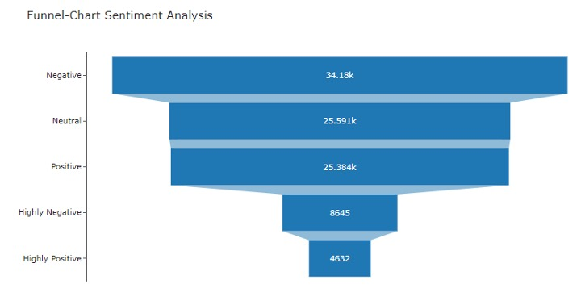
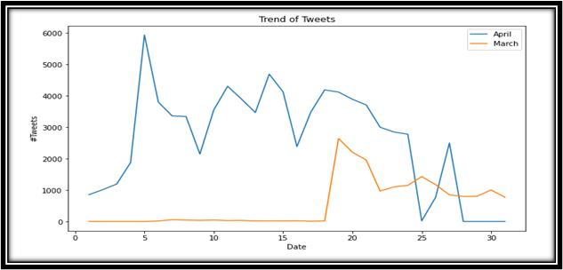
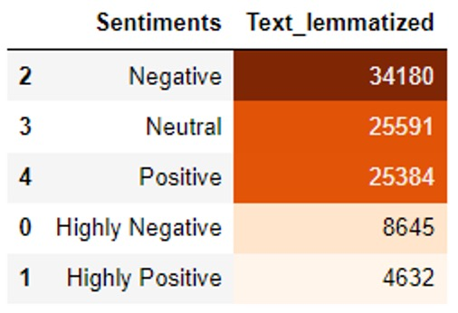
Data Visualization

Slide 9
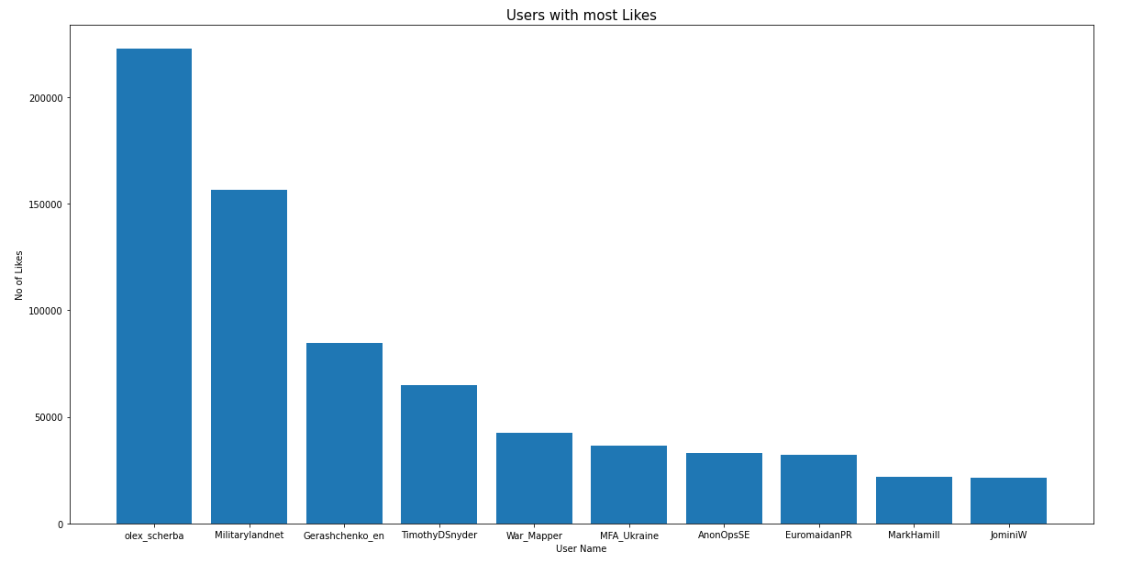
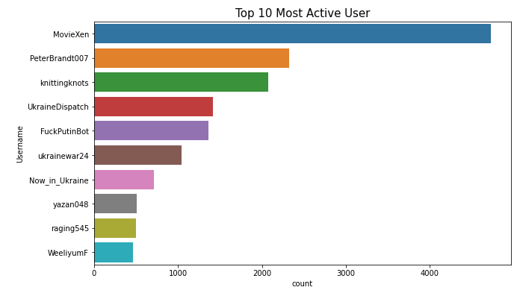
Data Visualization

Slide 10
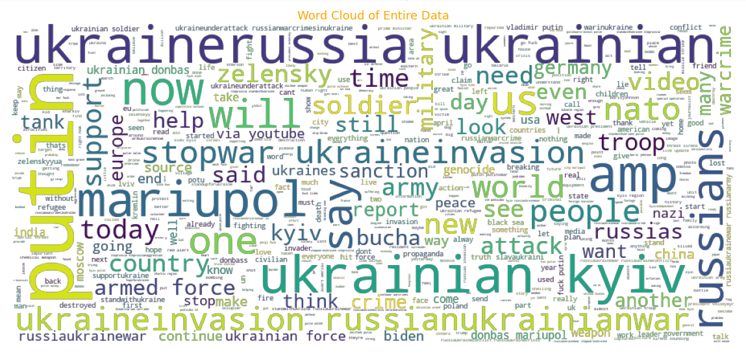
Data Visualization

Slide 11
Vectorization:
Vectorization is a process used to convert the input data from its raw format in numeric form to support the ML Models.
There are various vectorization techniques –
Bag of Words
Tf-Idf
Word2Vec
We have used TF-IDF method

Slide 12
Prediction through Data Modeling
Further, we split the data in train and test set with split ratio as 80:20.
Performed 3 classification models namely – Logistic Regression, Decision Tree Classifier and Random Forest Classifier.
Performed hyperparameter tuning to find the best parameter that gives better model accuracy.

Slide 13
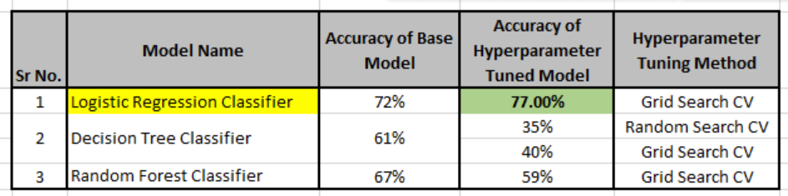
Data Modeling Results

Slide 14
Conclusion
We have implemented 3 models such as Decision Tree Classifier, Random Forest Classifier and Logistic Regression Classifier and performed hyperparameter tuning to get best parameters
Logistic Regression Classifier is the best model with 72% and accuracy of Grid Search CV model with 77%

Slide 15
References
https://www.commsights.com/benefits-of-sentiment-analysis-for-businesses/
https://www.analyticsvidhya.com/blog/2017/01/ultimate-guide-to-understand-implement-natural-language-processing-codes-in-python/
https://machinelearningmastery.com/hyperparameter-optimization-with-random-search-and-grid-search/
https://github.com/rashidesai24/Analyzing-Twitter-Trends-On-COVID-19-Vaccinations

