Slide 1
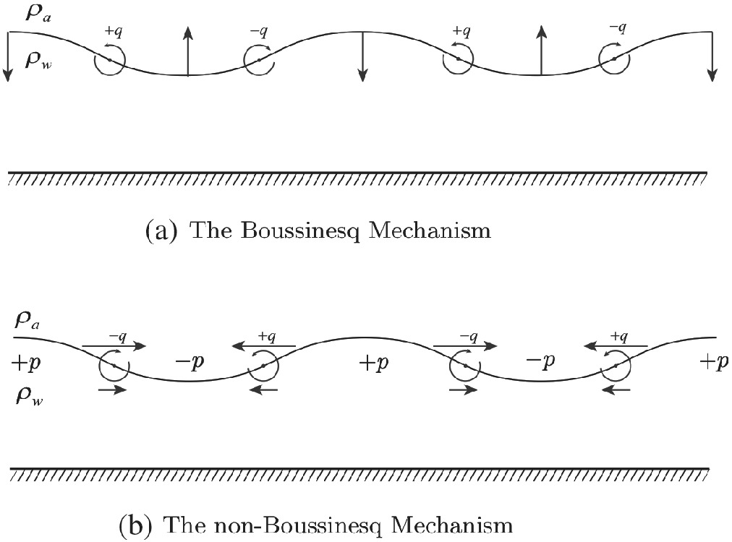
On the opposing roles of the Boussinesq and non‐Boussinesq baroclinic torques in surface gravity wave propagation
Quart J Royal Meteoro Soc, Volume: 146, Issue: 727, Pages: 1056-1064, First published: 04 December 2019, DOI: (10.1002/qj.3719)
Notes:
Schematic illustration of the air–water interface (wavy line); density of air and water are respectively and . (a) The vertical arrows denote vertical velocity generated by the Boussinesq term (), contributing to the in vorticity . (b) The non‐Boussinesq term () is a scaled horizontal perturbation pressure gradient force generating vertical shear of the horizontal velocity, , and thus contributes to the generation of . In both (a) and (b), the generated is shown by circular arrows
IF THIS IMAGE HAS BEEN PROVIDED BY OR IS OWNED BY A THIRD PARTY, AS INDICATED IN THE CAPTION LINE, THEN FURTHER PERMISSION MAY BE NEEDED BEFORE ANY FURTHER USE. PLEASE CONTACT WILEY'S PERMISSIONS DEPARTMENT ON PERMISSIONS@WILEY.COM OR USE THE RIGHTSLINK SERVICE BY CLICKING ON THE 'REQUEST PERMISSIONS' LINK ACCOMPANYING THIS ARTICLE. WILEY OR AUTHOR OWNED IMAGES MAY BE USED FOR NON-COMMERCIAL PURPOSES, SUBJECT TO PROPER CITATION OF THE ARTICLE, AUTHOR, AND PUBLISHER.

