Slide 1
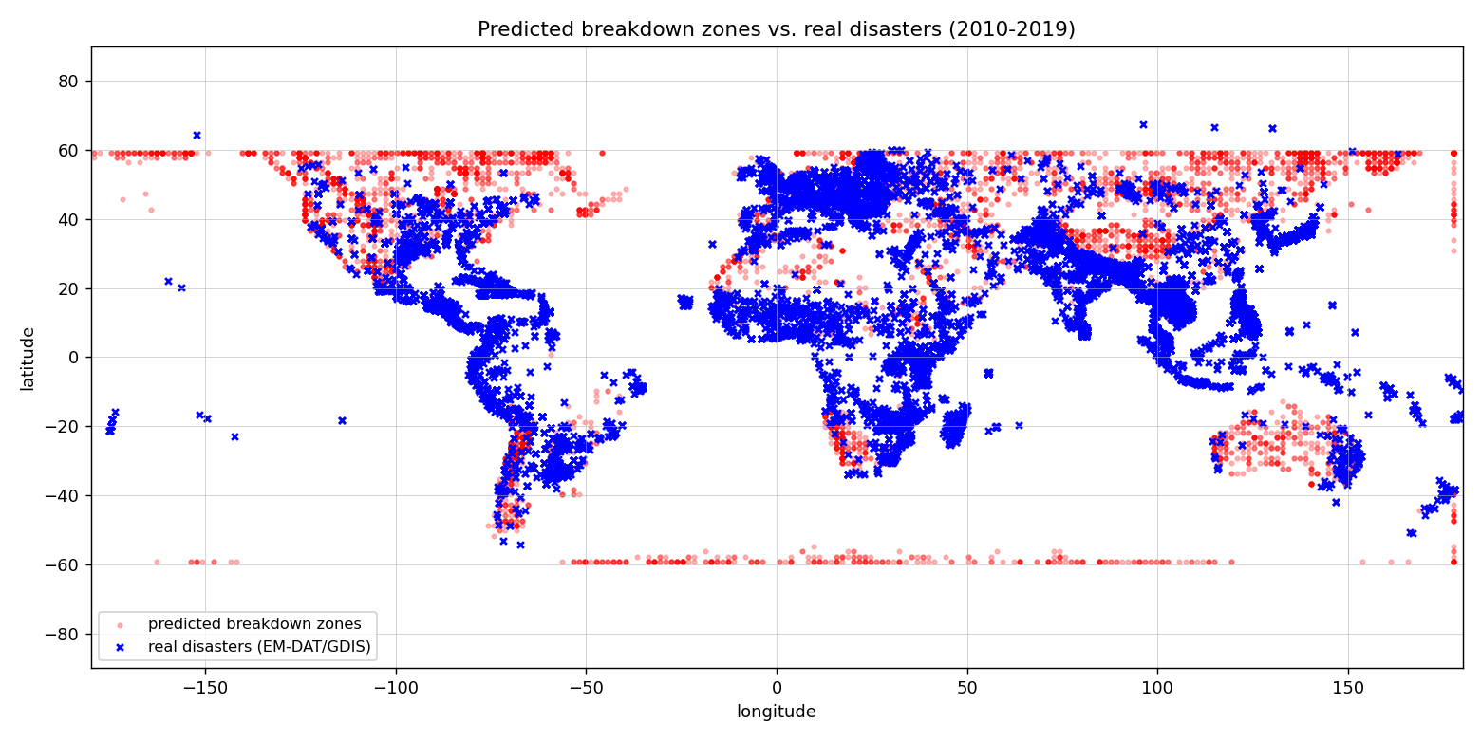
THE CLIMATE CAPACITOR
+
Can extreme-weather disasters be predicted as “electrical breakdowns” of accumulated heat?
−
Project 26-1-R-14 · Ron Salama & Lior Dagash · Supervisor: Dr. Zakharia Frenkel
1 · BACKGROUND & THE CAPACITOR ANALOGY
Extreme weather — floods, storms, heatwaves — strikes where energy builds up and suddenly releases. Conventional forecasting simulates atmospheric fluid dynamics; this project tests a different, structural idea: the Climate Capacitor analogy, which treats Earth’s surface as one giant capacitor.
● Thermal charge — temperature anomalies (hotter/colder than normal) accumulate in each grid cell.
● Dielectric (terrain) — mountains and valleys resist the release of energy (permittivity ε).
● Breakdown — a disaster is the “discharge” where the gradient between adjacent hot and cold regions grows too steep for the terrain to contain.
Core question: does this electrostatic lens reveal where and when disasters actually strike?
2 · HOW IT WORKS
breakdown field E = ‖∇Q‖ / ε
Temperature
anomaly
Accumulate
charge Q
Terrain
permittivity ε
Breakdown
field E
Cluster into
events
Validate vs
disasters
Charge is accumulated over a sliding 30-day window; the breakdown field is its spatial gradient divided by terrain permittivity. High-stress cells are clustered into events and matched against real disasters.
3 · SYSTEM REQUIREMENTS
4 · TOOLS & TECHNOLOGIES
Functional
● Ingest 10 yrs of global ERA5 temperature + terrain
● Compute anomalies vs a day-of-year climatology
● Accumulate thermal charge; map terrain → ε
● Build the breakdown field; flag & cluster zones
● Cross-reference zones with a disaster database
● Generate global risk / validation maps
Non-functional
● Scale to global 10-yr data with no memory overflow
● A full run completes in minutes on normal hardware
● Modular & config-driven — any formula is swappable
● Auditable — trace any breakdown back to raw data
● Language: Python
● Data engine: xarray + dask
● Climate + terrain: ERA5 via WeatherBench2 — public cloud, streamed ● Disasters: EM-DAT (dates) + GDIS (precise coordinates)
● Analysis: SciPy, scikit-learn / ndimage (clustering), NumPy
● Stats & viz: pandas, Matplotlib
Six-stage pipeline, one config file
data → anomaly → charge → permittivity → breakdown → events → validation. Every knob (terrain weighting, timescale, thresholds) lives in one config, enabling systematic experiments.
5 · RESULTS & METRICS
Recall = share of real disasters we caught. Precision = share of our alarms that were correct.
~1–3%
< 2%
Recall
(target > 30%)
Precision
(target > 10%)
Statistically “significant” but practically negligible — huge p-values are a sample-size effect, not real skill. The analogy did not meet any success target.
Terrain (the “dielectric”) added almost nothing; and finer resolution, precise GDIS coordinates, and precursor-timing did not help either. The high-stress zones and real disasters occupy different places.
Daily statistic tested — recall @ 500 km:
Predicted breakdown zones (red) vs. real disasters (blue): they mostly occupy different places — the core of the negative result.
mean
3.5%
max (best)
4.8%
min
3.0%
6 · CHALLENGES & CONSTRAINTS
● Data volume (terabytes) — streamed coarse, daily, single-variable from the cloud (~1 GB); no local hoarding.
● Runtime — parallel cloud fetch + connected-component clustering → minutes, not hours.
● Disaster geolocation gap — EM-DAT coords were mostly missing; joined GDIS coordinates to EM-DAT dates.
● Memory — float32 + local caching; the fine 0.7° grid needs ≥ 32 GB RAM (it blue-screened a 16 GB laptop).
● Method artifacts — km-based gradient + polar masking; the strict 100 km metric is near-impossible below grid scale.
CONCLUSION
The Climate Capacitor analogy does not usefully predict real disasters — its high-stress zones and actual events largely diverge, and the terrain component adds little. This is a clear, valuable negative result: it maps the limits of applying electrostatic physics to climate, showing that heat-accumulation gradients alone do not determine where catastrophes strike.

