Slide 1


Climate Modeling Research Project
26-1-R-14: Capacitor Physics as an Analogy for Thermal Energy Dynamics
Team Members: Ron Salama & Lior Dagash
Supervisor: Dr. Zakharia Frenkel
1
Notes:
Good morning everyone. My name is Lior, and this is my partner Ron. We are here to present our Capstone Project: 'Climate Modeling Research Project.' We worked on this under the supervision of Dr. Zakharia Frenkel.
Our goal in this project was very simple. We wanted to find a new way to predict natural disasters. We took the chaotic world of weather and tried to apply the strict rules of engineering to it. Let me show you why.

Slide 2

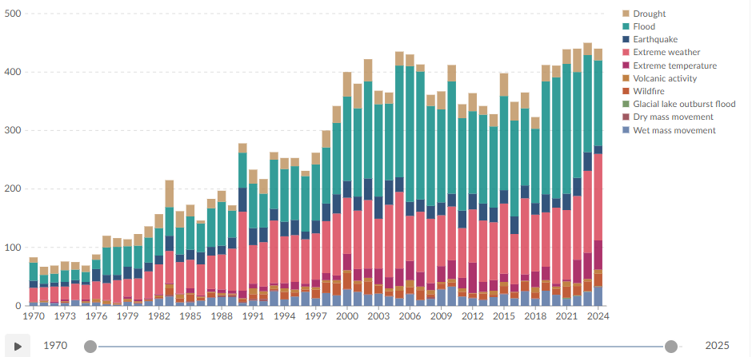
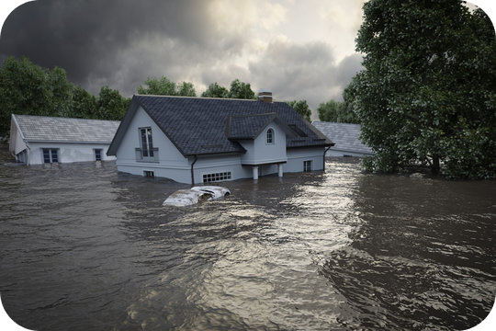
The Problem: Uncertainty in Chaos
Challenge: Predicting WHERE and WHEN
2
Notes:
First, let's look at the problem. If you look at this graph, you can see the number of extreme weather events—like floods and storms—in the last 50 years. You can see clearly: the line is going up. Disasters are happening three times more often than in 1980.
But for us as engineers, the problem is not just that the number is rising. The real problem is Uncertainty. We don't know where and when they will happen.
We know the world is getting hotter. But why does that heat turn into a flood in one place, but a drought in another place? Right now, science treats these events like random accidents. But we believe they are not random. We believe they are Critical Overloads. Think of a bridge. Before a bridge collapses, stress builds up in the metal. We believe the Earth works the same way. The energy builds up, and then—snap—it breaks. We just need to find the right way to measure that stress.

Slide 3
Gap in Current Solutions
NWP Models
AI/ML Models
Our Solution
NWP models solve complex physics equations on supercomputers. They provide accurate short-term forecasts but are computationally too heavy to track long-term energy accumulation.
AI models scan history to find statistical patterns instantly. While fast, they act as "black boxes" that predict disasters without explaining the physical causes.
We treat Earth as a capacitor, where heat is charge and terrain is resistance. This offers an interpretable model that explains the physical "why" behind disasters.
3
Notes:
So, how do we predict these events today? We looked at the two main methods people use, and we found a big gap.
On one side, we have the Physics Models (NWP). These are the supercomputers. They calculate every single wind movement. They are very accurate for tomorrow's weather. But the problem is: They are too heavy. They are too slow. They cannot calculate 10 years of data to see the long-term trends.
On the other side, we have AI (Artificial Intelligence). This is the new popular method. It is very fast. But the problem is: It is a 'Black Box.' The AI gives you an answer, but it cannot explain why. As engineers, we cannot trust a system if we don't understand the logic behind it.
Our Solution is in the middle. We wanted a model that is fast—like AI—but also logical—like Physics. We realized we needed a new way to look at the Earth. We needed a new Analogy.

Slide 4

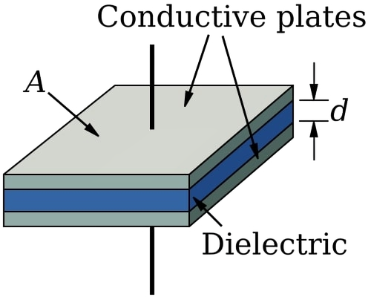
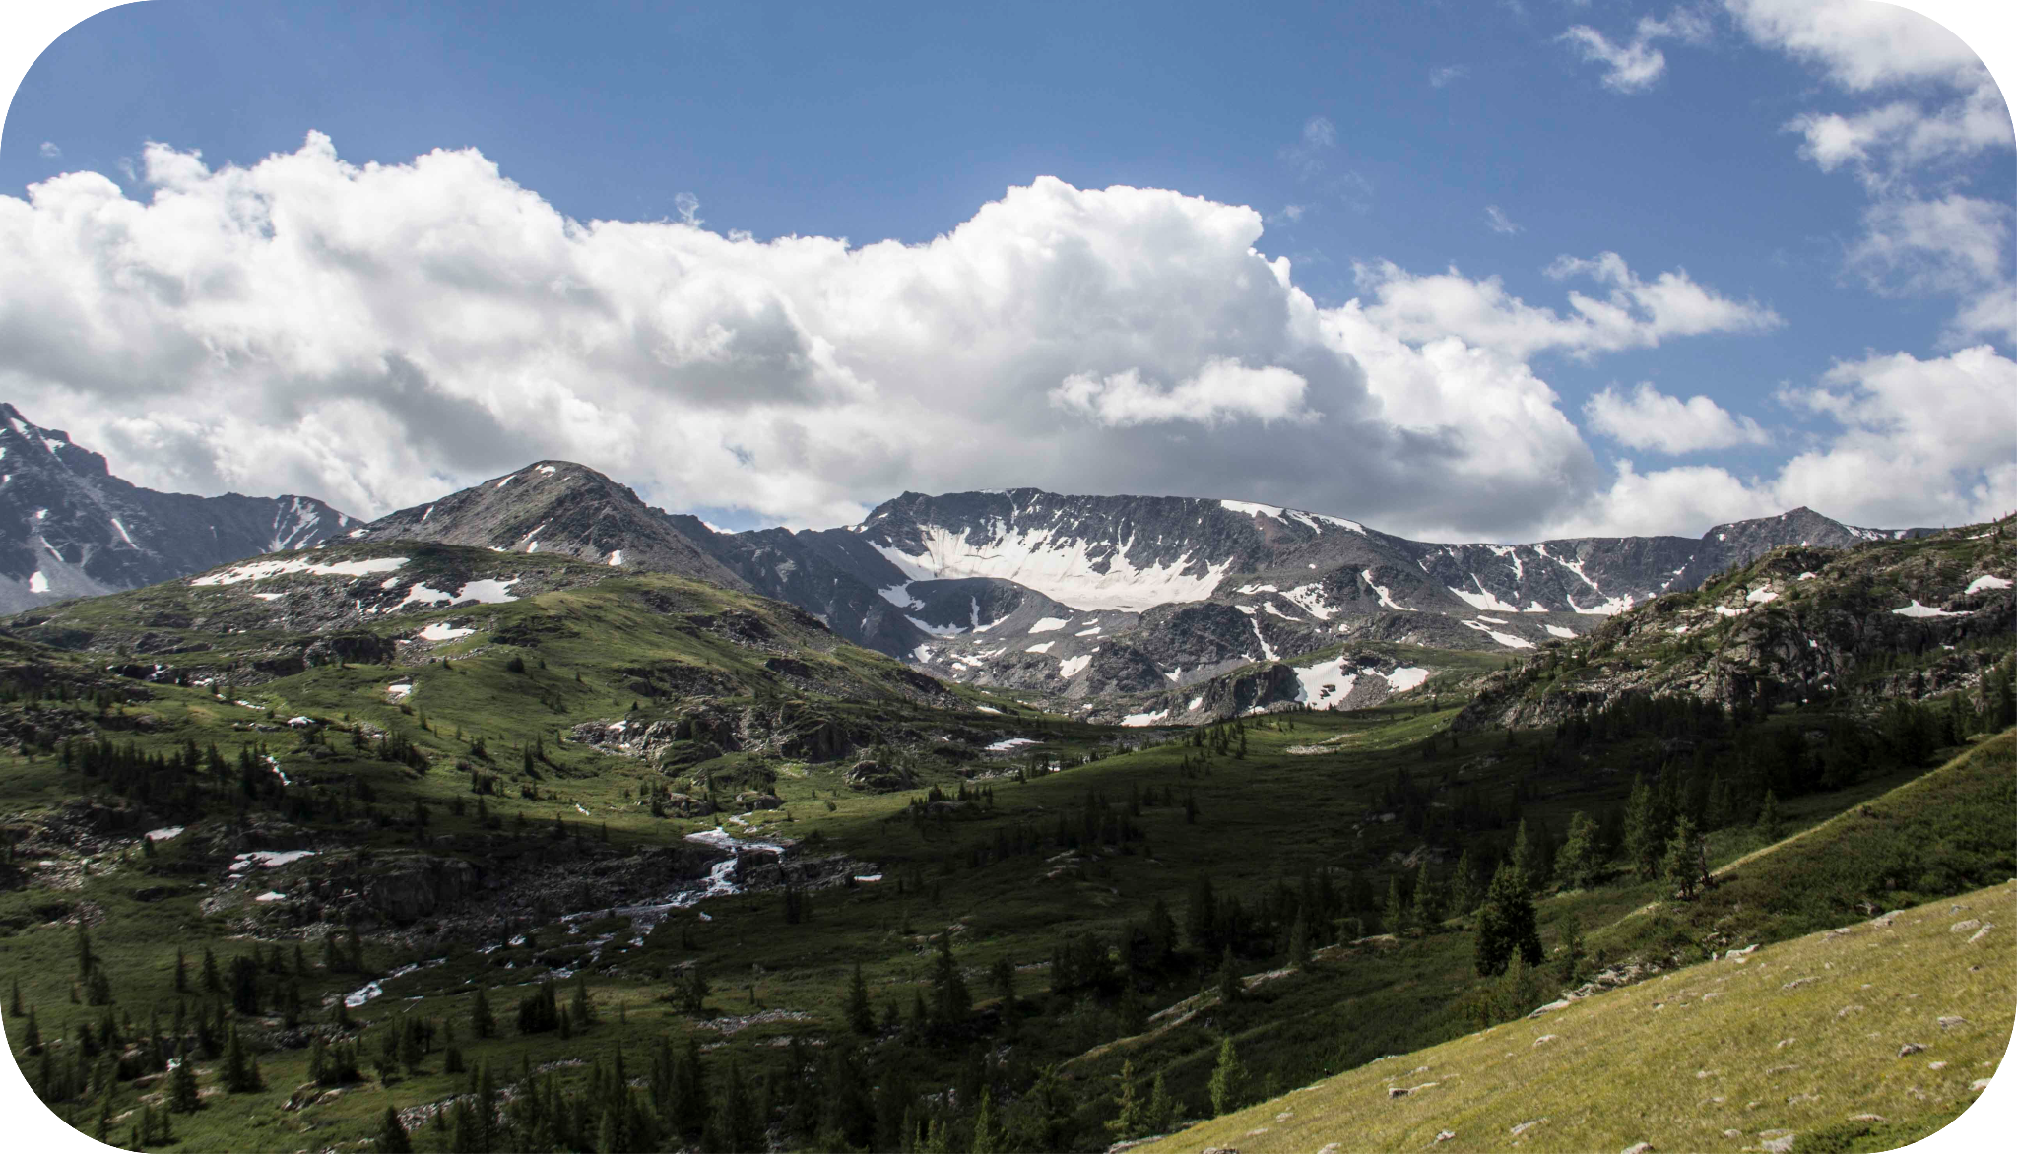
The Core Innovation (The Capacitor)
Charge (Q) = Heat
Dielectric (ε) = Topography
Q
E =
ε
Or Stress = Heat / Terrain Resistance
4
Notes:
This is the core idea of our project: The Earth acts like a Capacitor.
For those who don't know, a capacitor is a simple electrical component. It stores energy between two plates until it gets too full, and then it releases a spark.
We believe the atmosphere does exactly the same thing.
We matched the climate to the circuit like this:
1. First, The Charge (Q):
In our model, Heat is Charge.
When a place gets hotter than its historical average, we say it is 'charging up.' It is storing potential energy in the air.
2. Second, The Dielectric (epsilon):
This is the most critical part. We look at the Topography—the mountains and the valleys.
Think of Epsilon as the 'Capacity' to handle energy.
Imagine a flat ocean. The wind moves easily. The energy flows away. This has High Capacity. It is safe.
Now imagine a complex mountain range. It acts like a wall. It blocks the wind. It traps the heat in small pockets. This has Low Capacity. It cannot handle the energy.
3. Third, The Breakdown (E):
We use the formula you see on the screen: E = Q / epsilon.
This calculates the Atmospheric Stress.
The logic is simple:
You have high Heat (Q)... trying to fit into a Mountain range with Low Capacity (epsilon).
Because the terrain cannot handle that much energy, the Stress (E) skyrockets.
And when that Stress breaks the limit... we get a Disaster.

Slide 5



Research Objectives
Map Global Anomalies
Breakdown Fields
Statistical Validation
To construct a global map that identifies where thermal energy has historically accumulated over time.
To detect high-risk zones where this accumulated energy exceeds the terrain's capacity to contain it.
To scientifically prove the link between these theoretical 'breakdown zones' and actual historical disasters.
5
Notes:
So, this is a nice theory. But we have to prove it works. We set three clear goals for this project:
Goal 1: Quantification First, we needed to quantify the 'Hidden Energy.' Our goal was to build a global map that shows exactly where energy has been accumulating over the last decade.
Goal 2: Identification Second, we needed to find the 'Breaking Points.' Our goal was to identify the specific zones where that energy is structurally trapped by the terrain—creating what we call 'High Stress' areas.
Goal 3: Validation And finally, the proof. Our last goal was to statistically validate these 'High Stress' zones against real history. We need to prove that our theoretical map actually matches the real-world disasters that occurred.
Now, to explain the technical implementation and the data sources we used to build this system, I will pass it over to Ron.

Slide 6
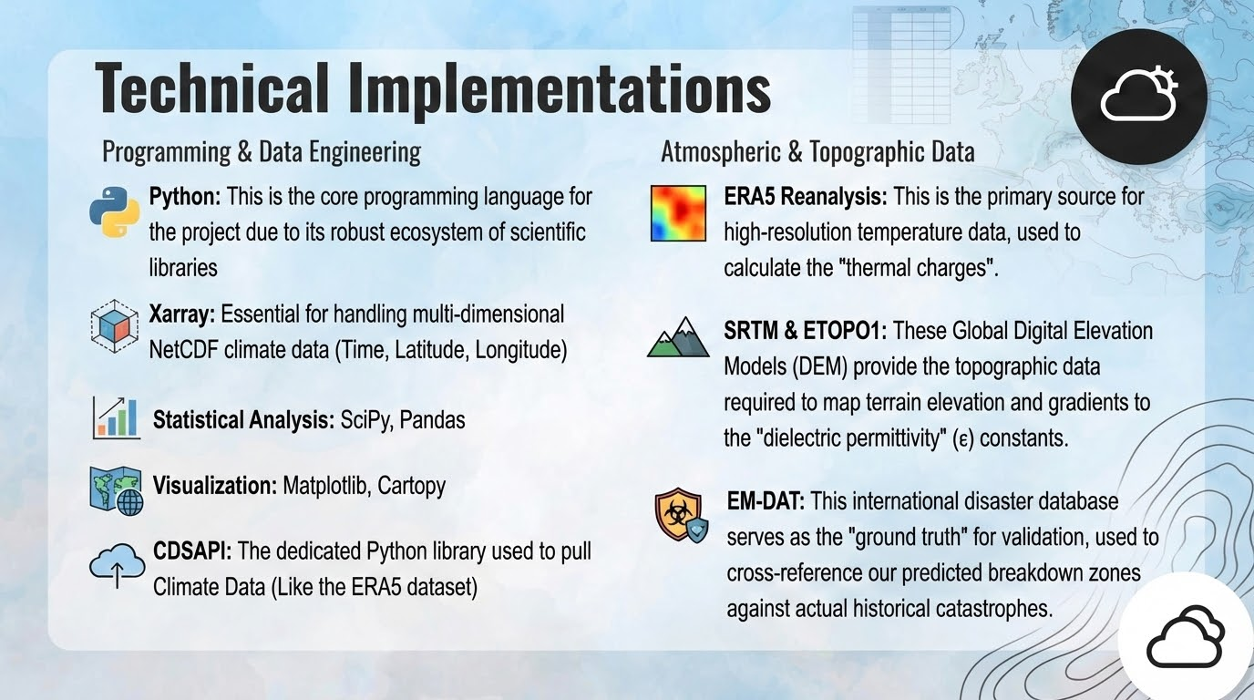
6

Slide 7
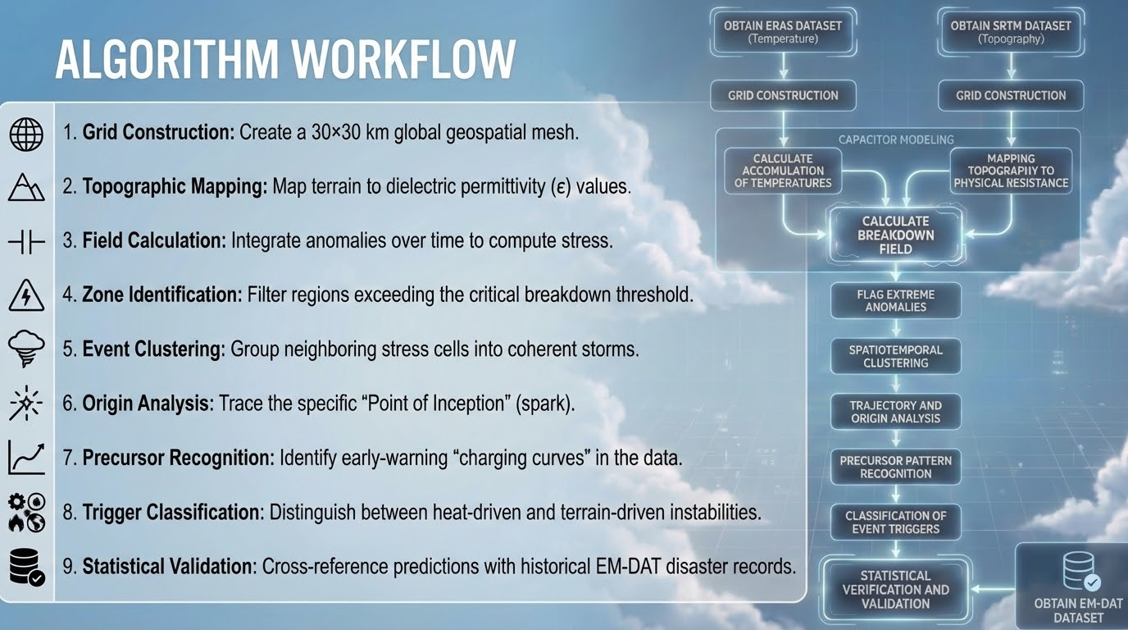
7

Slide 8
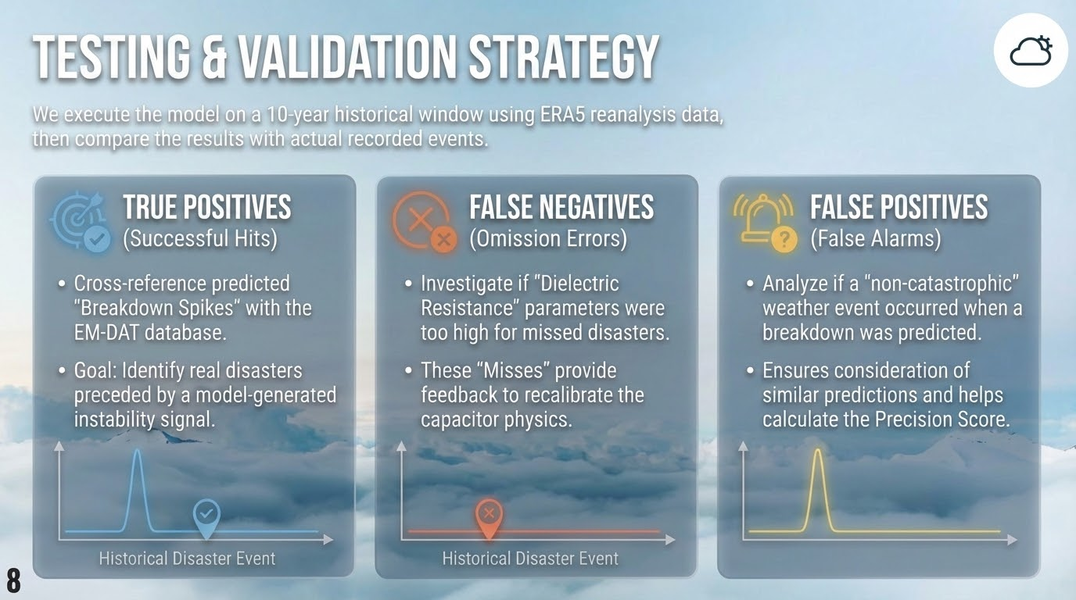

Slide 9
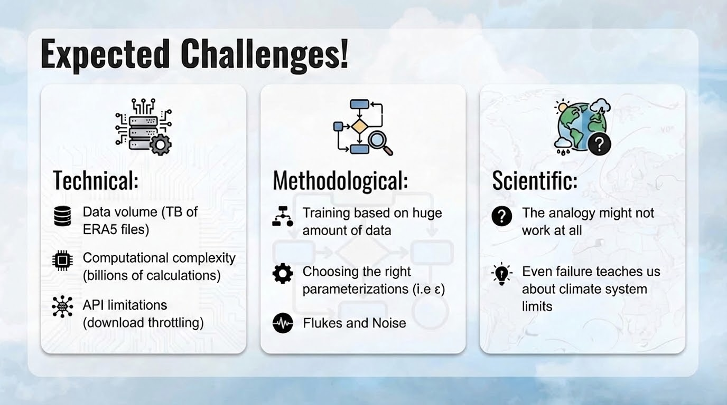
9

Slide 10
Thank You!
Special Thanks to our Supervisor
Dr. Zakharia Frenkel
Presented by Ron Salama & Lior Dagash
10

