Slide 1
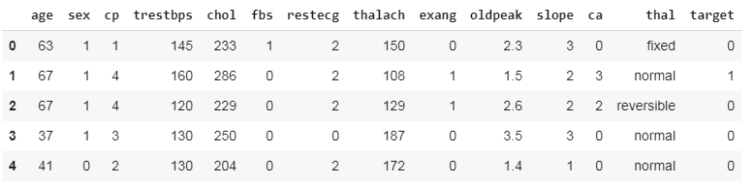
import numpy as np
import pandas as pd
import tensorflow as tf
from tensorflow import feature_column
from tensorflow.keras import layers
from sklearn.model_selection import train_test_split
URL = 'https://storage.googleapis.com/applied-dl/heart.csv'
dataframe = pd.read_csv(URL)
dataframe.head()

Slide 2

train, test = train_test_split(dataframe, test_size=0.2)
train, val = train_test_split(train, test_size=0.2)
print(len(train), 'train examples')
print(len(val), 'validation examples')
print(len(test), 'test examples')

Slide 3
def df_to_dataset(dataframe, shuffle=True, batch_size=32):
dataframe = dataframe.copy()
labels = dataframe.pop('target')
ds = tf.data.Dataset.from_tensor_slices((dict(dataframe), labels))
if shuffle:
ds = ds.shuffle(buffer_size=len(dataframe))
ds = ds.batch(batch_size)
return ds
batch_size = 5
train_ds = df_to_dataset(train, batch_size=batch_size)
val_ds = df_to_dataset(val, shuffle=False, batch_size=batch_size)
test_ds = df_to_dataset(test, shuffle=False, batch_size=batch_size)
for feature_batch, label_batch in train_ds.take(1):
print('Every feature:', list(feature_batch.keys()))
print('A batch of ages:', feature_batch['age'])
print('A batch of targets:', label_batch )

Slide 4
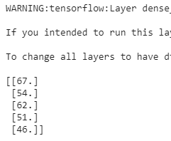
example_batch = next(iter(train_ds))[0]
def demo(feature_column):
feature_layer = layers.DenseFeatures(feature_column)
print(feature_layer(example_batch).numpy())
age = feature_column.numeric_column("age")
demo(age)

Slide 5
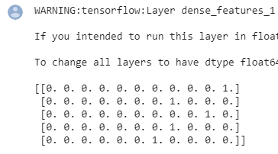
age_buckets = feature_column.bucketized_column(
age, boundaries=[18, 25, 30, 35, 40, 45, 50, 55, 60, 65])
demo(age_buckets)

Slide 6
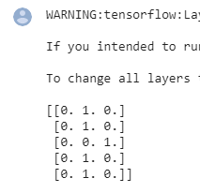
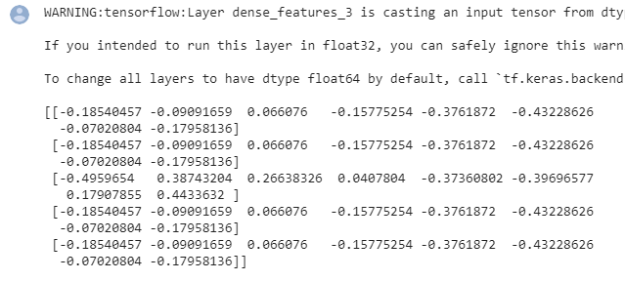
thal = feature_column.categorical_column_with_vocabulary_list(
'thal', ['fixed', 'normal', 'reversible'])
thal_one_hot = feature_column.indicator_column(thal)
demo(thal_one_hot)
thal_embedding = feature_column.embedding_column(thal, dimension=8)
demo(thal_embedding)

Slide 7
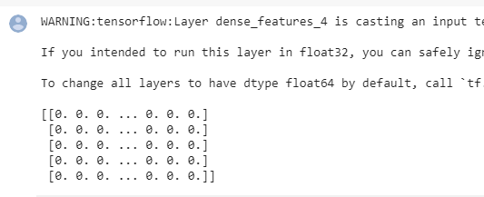
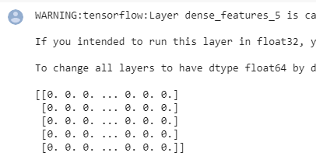
thal_hashed = feature_column.categorical_column_with_hash_bucket(
'thal', hash_bucket_size=1000)
demo(feature_column.indicator_column(thal_hashed))
crossed_feature = feature_column.crossed_column(
[age_buckets, thal], hash_bucket_size=1000)
demo(feature_column.indicator_column(crossed_feature))

Slide 8
feature_columns = []
for header in ['age', 'trestbps', 'chol', 'thalach', 'oldpeak', 'slope', 'ca']:
feature_columns.append(feature_column.numeric_column(header))
age_buckets = feature_column.bucketized_column(
age, boundaries=[18, 25, 30, 35, 40, 45, 50, 55, 60, 65])
feature_columns.append(age_buckets)
thal = feature_column.categorical_column_with_vocabulary_list(
'thal', ['fixed', 'normal', 'reversible'])
thal_one_hot = feature_column.indicator_column(thal)
feature_columns.append(thal_one_hot)
thal_embedding = feature_column.embedding_column(thal, dimension=8)
feature_columns.append(thal_embedding)
crossed_feature = feature_column.crossed_column([age_buckets, thal], hash_bucket_size=1000)
crossed_feature = feature_column.indicator_column(crossed_feature)
feature_columns.append(crossed_feature)

Slide 9
feature_layer = tf.keras.layers.DenseFeatures(feature_columns)
batch_size = 32
train_ds = df_to_dataset(train, batch_size=batch_size)
val_ds = df_to_dataset(val, shuffle=False, batch_size=batch_size)
test_ds = df_to_dataset(test, shuffle=False, batch_size=batch_size)

Slide 10
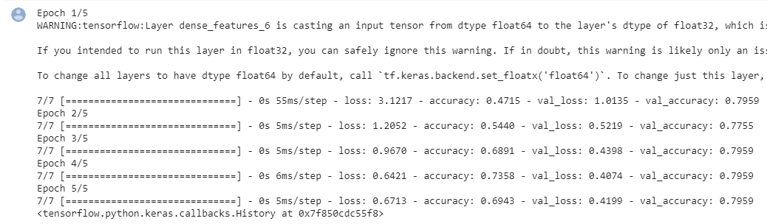
model = tf.keras.Sequential([
feature_layer,
layers.Dense(128, activation='relu'),
layers.Dense(128, activation='relu'),
layers.Dense(1)
])
model.compile(optimizer='adam',
loss=tf.keras.losses.BinaryCrossentropy(from_logits=True),
metrics=['accuracy'])
model.fit(train_ds,
validation_data=val_ds,
epochs=5)

Slide 11
loss, accuracy = model.evaluate(test_ds)
print("Accuracy", accuracy)

Slide 12
import tensorflow as tf
from tensorflow import keras
import os
import tempfile
import matplotlib as mpl
import matplotlib.pyplot as plt
import numpy as np
import pandas as pd
import seaborn as sns
import sklearn
from sklearn.metrics import confusion_matrix
from sklearn.model_selection import train_test_split
from sklearn.preprocessing import StandardScaler
mpl.rcParams['figure.figsize'] = (12, 10)
colors = plt.rcParams['axes.prop_cycle'].by_key()['color']

Slide 13
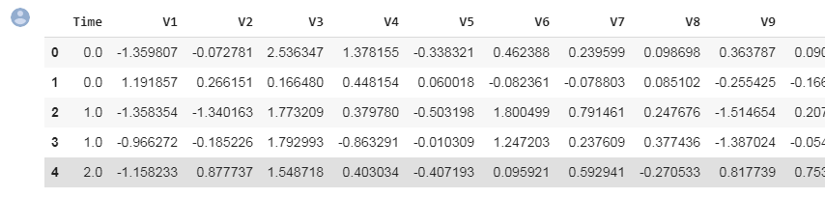
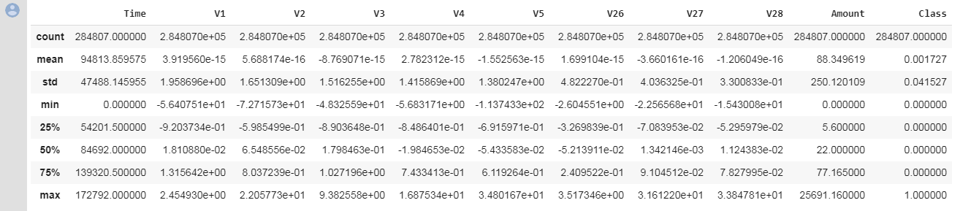
file = tf.keras.utils
raw_df = pd.read_csv('https://storage.googleapis.com/download.tensorflow.org/data/creditcard.csv')
raw_df.head()
raw_df[['Time', 'V1', 'V2', 'V3', 'V4', 'V5', 'V26', 'V27', 'V28', 'Amount', 'Class']].describe()

Slide 14

neg, pos = np.bincount(raw_df['Class'])
total = neg + pos
print('Examples:\n Total: {}\n Positive: {} ({:.2f}% of total)\n'.format(
total, pos, 100 * pos / total))
cleaned_df = raw_df.copy()
cleaned_df.pop('Time')
eps=0.001 # 0 => 0.1¢
cleaned_df['Log Ammount'] = np.log(cleaned_df.pop('Amount')+eps)

Slide 15
# Use a utility from sklearn to split and shuffle our dataset.
train_df, test_df = train_test_split(cleaned_df, test_size=0.2)
train_df, val_df = train_test_split(train_df, test_size=0.2)
# Form np arrays of labels and features.
train_labels = np.array(train_df.pop('Class'))
bool_train_labels = train_labels != 0
val_labels = np.array(val_df.pop('Class'))
test_labels = np.array(test_df.pop('Class'))
train_features = np.array(train_df)
val_features = np.array(val_df)
test_features = np.array(test_df)

Slide 16
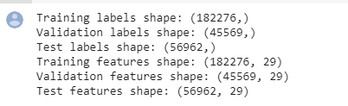
scaler = StandardScaler()
train_features = scaler.fit_transform(train_features)
val_features = scaler.transform(val_features)
test_features = scaler.transform(test_features)
train_features = np.clip(train_features, -5, 5)
val_features = np.clip(val_features, -5, 5)
test_features = np.clip(test_features, -5, 5)
print('Training labels shape:', train_labels.shape)
print('Validation labels shape:', val_labels.shape)
print('Test labels shape:', test_labels.shape)
print('Training features shape:', train_features.shape)
print('Validation features shape:', val_features.shape)
print('Test features shape:', test_features.shape)

Slide 17
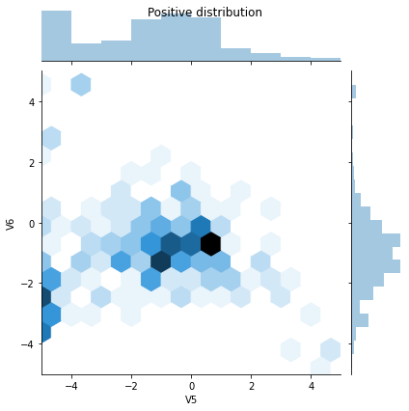
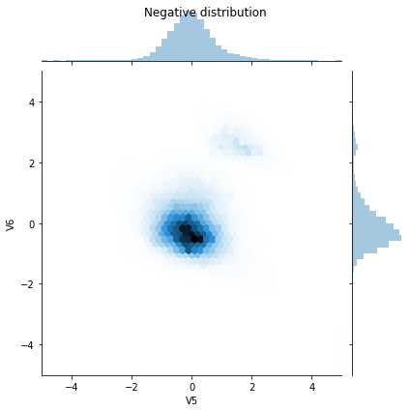
pos_df = pd.DataFrame(train_features[ bool_train_labels], columns = train_df.columns)
neg_df = pd.DataFrame(train_features[~bool_train_labels], columns = train_df.columns)
sns.jointplot(pos_df['V5'], pos_df['V6'],
kind='hex', xlim = (-5,5), ylim = (-5,5))
plt.suptitle("Positive distribution")
sns.jointplot(neg_df['V5'], neg_df['V6'],
kind='hex', xlim = (-5,5), ylim = (-5,5))
_ = plt.suptitle("Negative distribution")

Slide 18
METRICS = [
keras.metrics.TruePositives(name='tp'),
keras.metrics.FalsePositives(name='fp'),
keras.metrics.TrueNegatives(name='tn'),
keras.metrics.FalseNegatives(name='fn'),
keras.metrics.BinaryAccuracy(name='accuracy'),
keras.metrics.Precision(name='precision'),
keras.metrics.Recall(name='recall'),
keras.metrics.AUC(name='auc'),
]
def make_model(metrics = METRICS, output_bias=None):
if output_bias is not None:
output_bias = tf.keras.initializers.Constant(output_bias)
model = keras.Sequential([
keras.layers.Dense(
16, activation='relu',
input_shape=(train_features.shape[-1],)),
keras.layers.Dropout(0.5),
keras.layers.Dense(1, activation='sigmoid',
bias_initializer=output_bias),
])
model.compile(
optimizer=keras.optimizers.Adam(lr=1e-3),
loss=keras.losses.BinaryCrossentropy(),
metrics=metrics)
return model

Slide 19
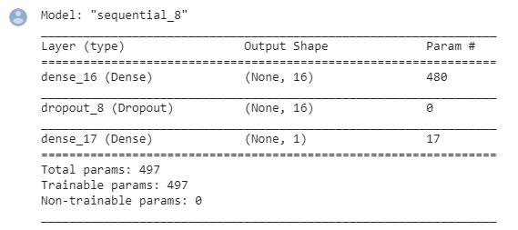
EPOCHS = 100
BATCH_SIZE = 2048
early_stopping = tf.keras.callbacks.EarlyStopping(
monitor='val_auc',
verbose=1,
patience=10,
mode='max',
restore_best_weights=True)
model = make_model()
model.summary()

Slide 20
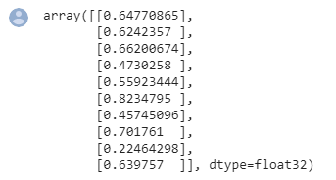


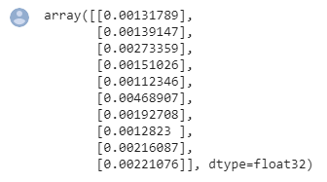
model.predict(train_features[:10])
results = model.evaluate(train_features, train_labels, batch_size=BATCH_SIZE, verbose=0)
print("Loss: {:0.4f}".format(results[0]))
initial_bias = np.log([pos/neg])
initial_bias
model = make_model(output_bias = initial_bias)
model.predict(train_features[:10])

Slide 21

results = model.evaluate(train_features, train_labels, batch_size=BATCH_SIZE, verbose=0)
print("Loss: {:0.4f}".format(results[0]))
initial_weights = os.path.join(tempfile.mkdtemp(),'initial_weights')
model.save_weights(initial_weights)
model = make_model()
model.load_weights(initial_weights)
model.layers[-1].bias.assign([0.0])
zero_bias_history = model.fit(
train_features,
train_labels,
batch_size=BATCH_SIZE,
epochs=20,
validation_data=(val_features, val_labels),
verbose=0)

Slide 22
model = make_model()
model.load_weights(initial_weights)
careful_bias_history = model.fit(
train_features,
train_labels,
batch_size=BATCH_SIZE,
epochs=20,
validation_data=(val_features, val_labels),
verbose=0)
def plot_loss(history, label, n):
# Use a log scale to show the wide range of values.
plt.semilogy(history.epoch, history.history['loss'],
color=colors[n], label='Train '+label)
plt.semilogy(history.epoch, history.history['val_loss'],
color=colors[n], label='Val '+label,
linestyle="--")
plt.xlabel('Epoch')
plt.ylabel('Loss')
plt.legend()

Slide 23
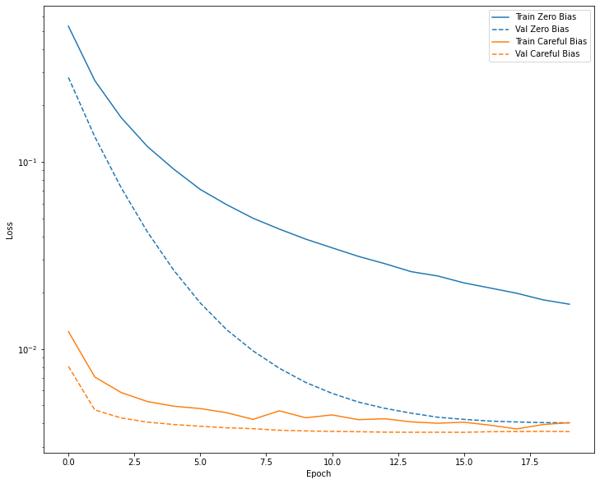
plot_loss(zero_bias_history, "Zero Bias", 0)
plot_loss(careful_bias_history, "Careful Bias", 1)

Slide 24
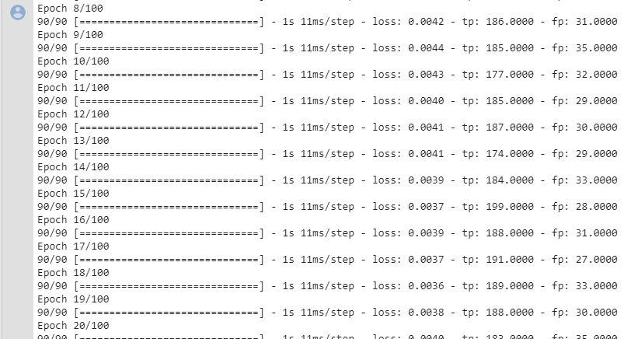
model = make_model()
model.load_weights(initial_weights)
baseline_history = model.fit(
train_features,
train_labels,
batch_size=BATCH_SIZE,
epochs=EPOCHS,
callbacks = [early_stopping],
validation_data=(val_features, val_labels))

Slide 25
def plot_metrics(history):
metrics = ['loss', 'auc', 'precision', 'recall']
for n, metric in enumerate(metrics):
name = metric.replace("_"," ").capitalize()
plt.subplot(2,2,n+1)
plt.plot(history.epoch, history.history[metric], color=colors[0], label='Train')
plt.plot(history.epoch, history.history['val_'+metric],
color=colors[0], linestyle="--", label='Val')
plt.xlabel('Epoch')
plt.ylabel(name)
if metric == 'loss':
plt.ylim([0, plt.ylim()[1]])
elif metric == 'auc':
plt.ylim([0.8,1])
else:
plt.ylim([0,1])
plt.legend()

Slide 26
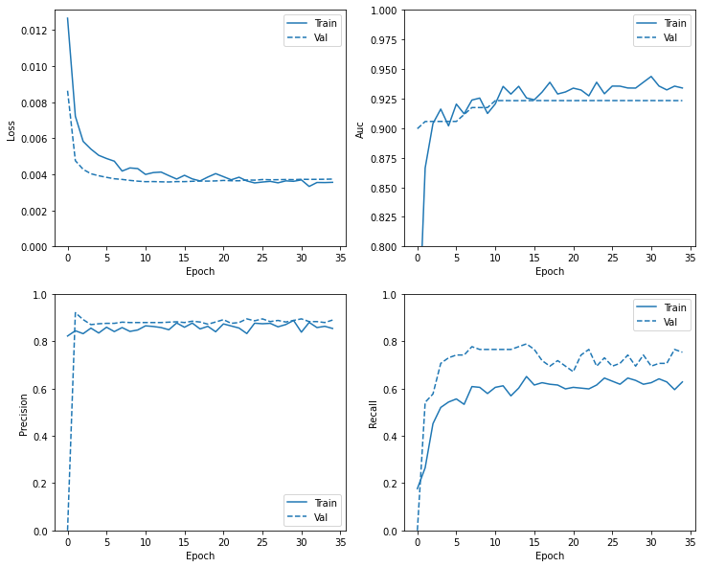
plot_metrics(baseline_history)

Slide 27
train_predictions_baseline = model.predict(train_features, batch_size=BATCH_SIZE)
test_predictions_baseline = model.predict(test_features, batch_size=BATCH_SIZE)
def plot_cm(labels, predictions, p=0.5):
cm = confusion_matrix(labels, predictions > p)
plt.figure(figsize=(5,5))
sns.heatmap(cm, annot=True, fmt="d")
plt.title('Confusion matrix @{:.2f}'.format(p))
plt.ylabel('Actual label')
plt.xlabel('Predicted label')
print('Legitimate Transactions Detected (True Negatives): ', cm[0][0])
print('Legitimate Transactions Incorrectly Detected (False Positives): ', cm[0][1])
print('Fraudulent Transactions Missed (False Negatives): ', cm[1][0])
print('Fraudulent Transactions Detected (True Positives): ', cm[1][1])
print('Total Fraudulent Transactions: ', np.sum(cm[1]))

Slide 28
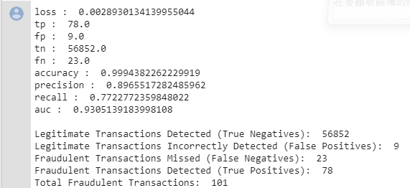
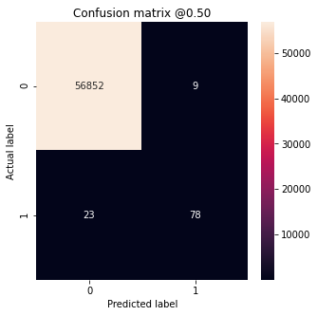
baseline_results = model.evaluate(test_features, test_labels,
batch_size=BATCH_SIZE, verbose=0)
for name, value in zip(model.metrics_names, baseline_results):
print(name, ': ', value)
print()
plot_cm(test_labels, test_predictions_baseline)

Slide 29
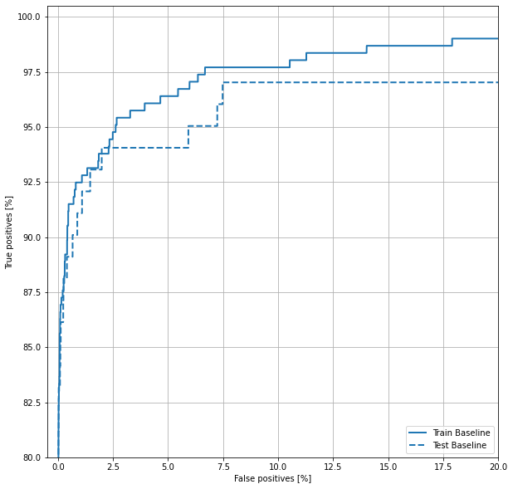
def plot_roc(name, labels, predictions, **kwargs):
fp, tp, _ = sklearn.metrics.roc_curve(labels, predictions)
plt.plot(100*fp, 100*tp, label=name, linewidth=2, **kwargs)
plt.xlabel('False positives [%]')
plt.ylabel('True positives [%]')
plt.xlim([-0.5,20])
plt.ylim([80,100.5])
plt.grid(True)
ax = plt.gca()
ax.set_aspect('equal')
plot_roc("Train Baseline",
train_labels,
train_predictions_baseline,
color=colors[0])
plot_roc("Test Baseline",
test_labels,
test_predictions_baseline,
color=colors[0], linestyle='--')
plt.legend(loc='lower right')

Slide 30

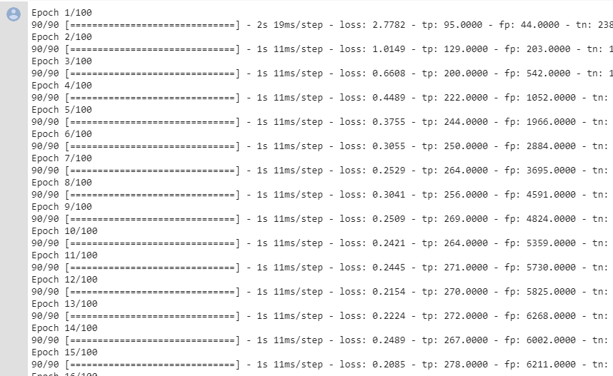
weight_for_0 = (1 / neg)*(total)/2.0
weight_for_1 = (1 / pos)*(total)/2.0
class_weight = {0: weight_for_0, 1: weight_for_1}
print('Weight for class 0: {:.2f}'.format(weight_for_0))
print('Weight for class 1: {:.2f}'.format(weight_for_1))
weighted_model = make_model()
weighted_model.load_weights(initial_weights)
weighted_history = weighted_model.fit(
train_features,
train_labels,
batch_size=BATCH_SIZE,
epochs=EPOCHS,
callbacks = [early_stopping],
validation_data=(val_features, val_labels),
# The class weights go here
class_weight=class_weight)

Slide 31
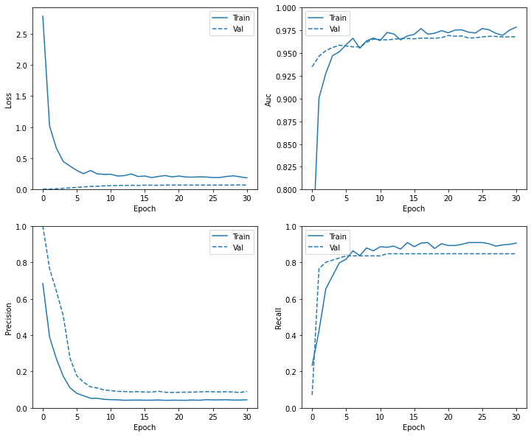
plot_metrics(weighted_history)

Slide 32
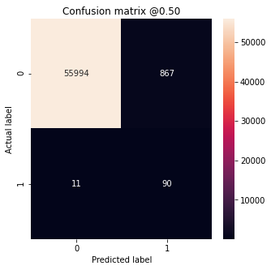
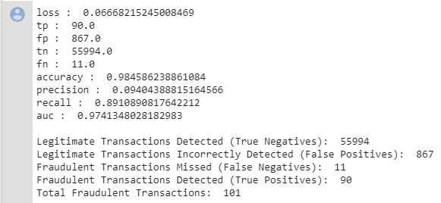
train_predictions_weighted = weighted_model.predict(train_features, batch_size=BATCH_SIZE)
test_predictions_weighted = weighted_model.predict(test_features, batch_size=BATCH_SIZE)
weighted_results = weighted_model.evaluate(test_features, test_labels,
batch_size=BATCH_SIZE, verbose=0)
for name, value in zip(weighted_model.metrics_names, weighted_results):
print(name, ': ', value)
print()
plot_cm(test_labels, test_predictions_weighted)

Slide 33
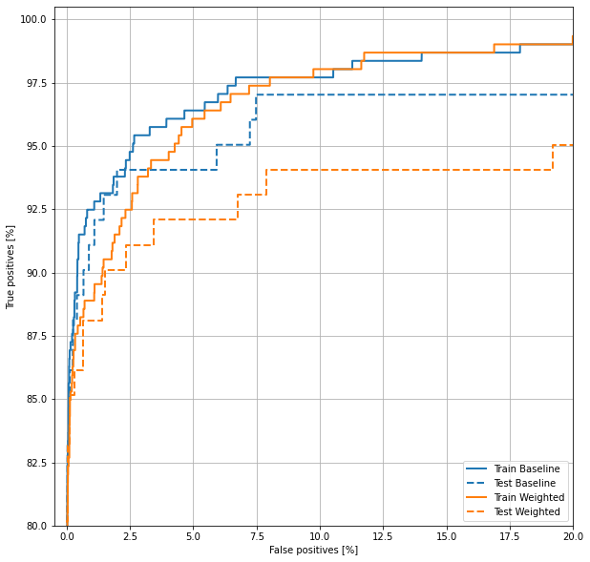
plot_roc("Train Baseline", train_labels, train_predictions_baseline, color=colors[0])
plot_roc("Test Baseline", test_labels, test_predictions_baseline, color=colors[0], linestyle='--')
plot_roc("Train Weighted", train_labels, train_predictions_weighted, color=colors[1])
plot_roc("Test Weighted", test_labels, test_predictions_weighted, color=colors[1], linestyle='--')
plt.legend(loc='lower right')

Slide 34

pos_features = train_features[bool_train_labels]
neg_features = train_features[~bool_train_labels]
pos_labels = train_labels[bool_train_labels]
neg_labels = train_labels[~bool_train_labels]
ids = np.arange(len(pos_features))
choices = np.random.choice(ids, len(neg_features))
res_pos_features = pos_features[choices]
res_pos_labels = pos_labels[choices]
res_pos_features.shape

Slide 35

resampled_features = np.concatenate([res_pos_features, neg_features], axis=0)
resampled_labels = np.concatenate([res_pos_labels, neg_labels], axis=0)
order = np.arange(len(resampled_labels))
np.random.shuffle(order)
resampled_features = resampled_features[order]
resampled_labels = resampled_labels[order]
resampled_features.shape
BUFFER_SIZE = 100000
def make_ds(features, labels):
ds = tf.data.Dataset.from_tensor_slices((features, labels))#.cache()
ds = ds.shuffle(BUFFER_SIZE).repeat()
return ds
pos_ds = make_ds(pos_features, pos_labels)
neg_ds = make_ds(neg_features, neg_labels)

Slide 36
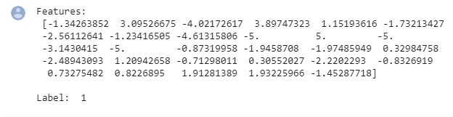


for features, label in pos_ds.take(1):
print("Features:\n", features.numpy())
print()
print("Label: ", label.numpy())
resampled_ds = tf.data.experimental.sample_from_datasets(
[pos_ds, neg_ds], weights=[0.5, 0.5])
resampled_ds = resampled_ds.batch(BATCH_SIZE).prefetch(2)
for features, label in resampled_ds.take(1):
print(label.numpy().mean())
resampled_steps_per_epoch = np.ceil(2.0*neg/BATCH_SIZE)
resampled_steps_per_epoch

Slide 37
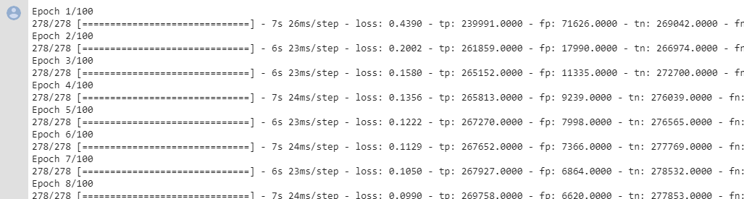
resampled_model = make_model()
resampled_model.load_weights(initial_weights)
# Reset the bias to zero, since this dataset is balanced.
output_layer = resampled_model.layers[-1]
output_layer.bias.assign([0])
val_ds = tf.data.Dataset.from_tensor_slices((val_features, val_labels)).cache()
val_ds = val_ds.batch(BATCH_SIZE).prefetch(2)
resampled_history = resampled_model.fit(
resampled_ds,
epochs=EPOCHS,
steps_per_epoch=resampled_steps_per_epoch,
callbacks = [early_stopping],
validation_data=val_ds)

Slide 38
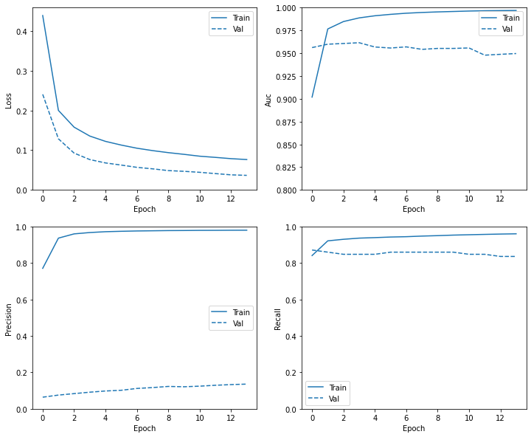
plot_metrics(resampled_history )

Slide 39
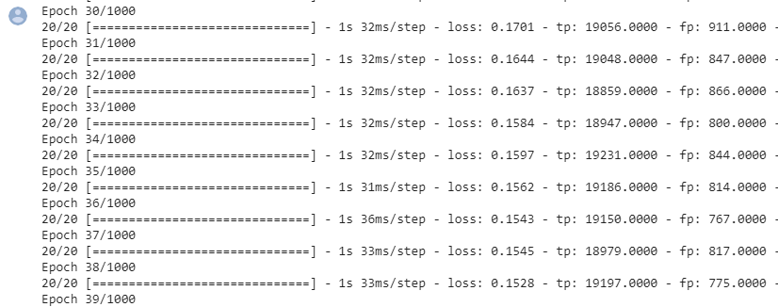
resampled_model = make_model()
resampled_model.load_weights(initial_weights)
# Reset the bias to zero, since this dataset is balanced.
output_layer = resampled_model.layers[-1]
output_layer.bias.assign([0])
resampled_history = resampled_model.fit(
resampled_ds,
# These are not real epochs
steps_per_epoch = 20,
epochs=10*EPOCHS,
callbacks = [early_stopping],
validation_data=(val_ds))

Slide 40
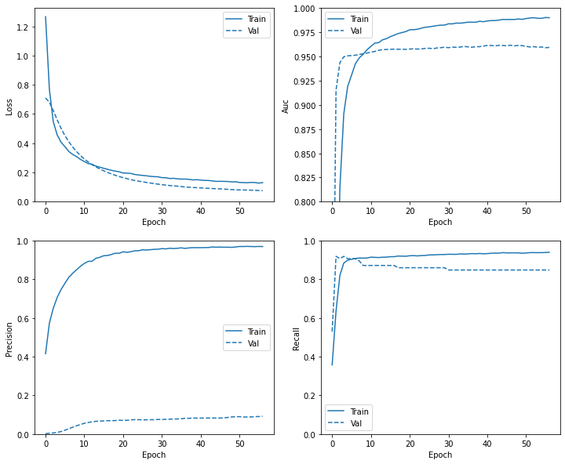
plot_metrics(resampled_history)

Slide 41

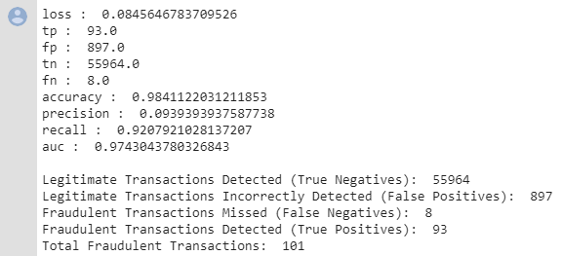
train_predictions_resampled = resampled_model.predict(train_features, batch_size=BATCH_SIZE)
test_predictions_resampled = resampled_model.predict(test_features, batch_size=BATCH_SIZE)
resampled_results = resampled_model.evaluate(test_features, test_labels,
batch_size=BATCH_SIZE, verbose=0)
for name, value in zip(resampled_model.metrics_names, resampled_results):
print(name, ': ', value)
print()
plot_cm(test_labels, test_predictions_resampled)

Slide 42
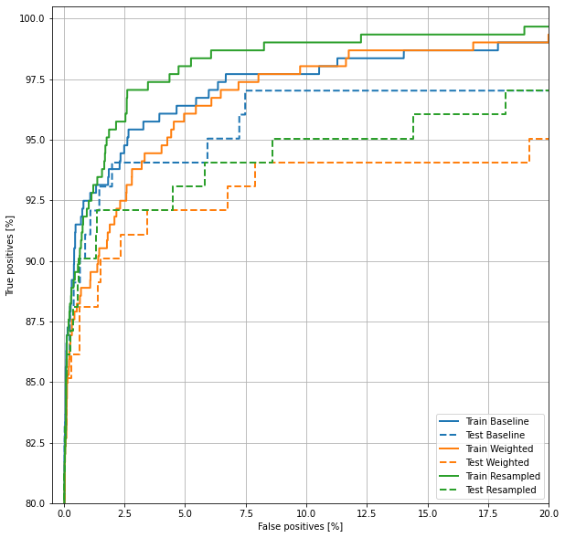
plot_roc("Train Baseline", train_labels, train_predictions_baseline, color=colors[0])
plot_roc("Test Baseline", test_labels, test_predictions_baseline, color=colors[0], linestyle='--')
plot_roc("Train Weighted", train_labels, train_predictions_weighted, color=colors[1])
plot_roc("Test Weighted", test_labels, test_predictions_weighted, color=colors[1], linestyle='--')
plot_roc("Train Resampled", train_labels, train_predictions_resampled, color=colors[2])
plot_roc("Test Resampled", test_labels, test_predictions_resampled, color=colors[2], linestyle='--')
plt.legend(loc='lower right')

Slide 43
import tensorflow as tf
import matplotlib as mpl
import matplotlib.pyplot as plt
import numpy as np
import os
import pandas as pd
mpl.rcParams['figure.figsize'] = (8, 6)
mpl.rcParams['axes.grid'] = False
zip_path = tf.keras.utils.get_file(
origin='https://storage.googleapis.com/tensorflow/tf-keras-datasets/jena_climate_2009_2016.csv.zip',
fname='jena_climate_2009_2016.csv.zip',
extract=True)
csv_path, _ = os.path.splitext(zip_path)
df = pd.read_csv(csv_path)

Slide 44
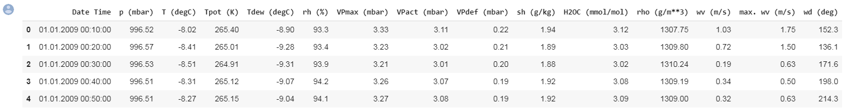
df.head()
def univariate_data(dataset, start_index, end_index, history_size, target_size):
data = []
labels = []
start_index = start_index + history_size
if end_index is None:
end_index = len(dataset) - target_size
for i in range(start_index, end_index):
indices = range(i-history_size, i)
# Reshape data from (history_size,) to (history_size, 1)
data.append(np.reshape(dataset[indices], (history_size, 1)))
labels.append(dataset[i+target_size])
return np.array(data), np.array(labels)

Slide 45
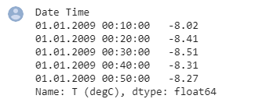
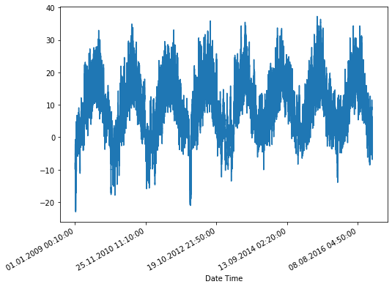
TRAIN_SPLIT = 300000
tf.random.set_seed(13)
uni_data = df['T (degC)']
uni_data.index = df['Date Time']
uni_data.head()
uni_data.plot(subplots=True)

Slide 46
uni_data = uni_data.values
uni_train_mean = uni_data[:TRAIN_SPLIT].mean()
uni_train_std = uni_data[:TRAIN_SPLIT].std()
uni_data = (uni_data-uni_train_mean)/uni_train_std
univariate_past_history = 20
univariate_future_target = 0
x_train_uni, y_train_uni = univariate_data(uni_data, 0, TRAIN_SPLIT,
univariate_past_history,
univariate_future_target)
x_val_uni, y_val_uni = univariate_data(uni_data, TRAIN_SPLIT, None,
univariate_past_history,
univariate_future_target)

Slide 47
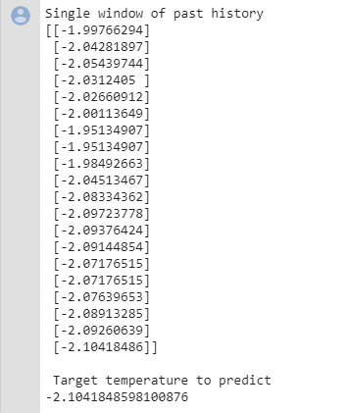
print ('Single window of past history')
print (x_train_uni[0])
print ('\n Target temperature to predict')
print (y_train_uni[0])

Slide 48
def show_plot(plot_data, delta, title):
labels = ['History', 'True Future', 'Model Prediction']
marker = ['.-', 'rx', 'go']
time_steps = create_time_steps(plot_data[0].shape[0])
if delta:
future = delta
else:
future = 0
plt.title(title)
for i, x in enumerate(plot_data):
if i:
plt.plot(future, plot_data[i], marker[i], markersize=10,
label=labels[i])
else:
plt.plot(time_steps, plot_data[i].flatten(), marker[i], label=labels[i])
plt.legend()
plt.xlim([time_steps[0], (future+5)*2])
plt.xlabel('Time-Step')
return plt

Slide 49
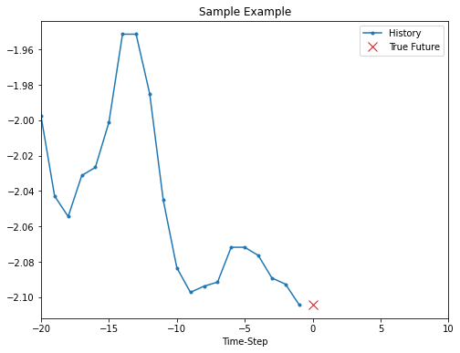
show_plot([x_train_uni[0], y_train_uni[0]], 0, 'Sample Example')

Slide 50
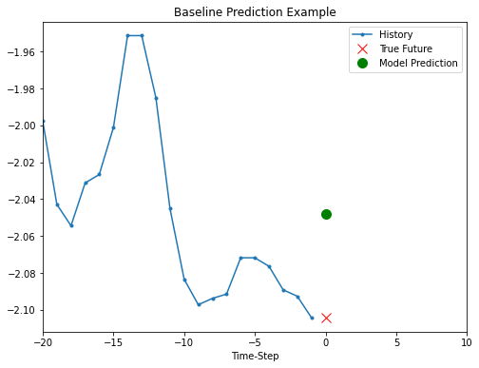
def baseline(history):
return np.mean(history)
show_plot([x_train_uni[0], y_train_uni[0], baseline(x_train_uni[0])], 0,
'Baseline Prediction Example')

Slide 51
BATCH_SIZE = 256
BUFFER_SIZE = 10000
train_univariate = tf.data.Dataset.from_tensor_slices((x_train_uni, y_train_uni))
train_univariate = train_univariate.cache().shuffle(BUFFER_SIZE).batch(BATCH_SIZE).repeat()
val_univariate = tf.data.Dataset.from_tensor_slices((x_val_uni, y_val_uni))
val_univariate = val_univariate.batch(BATCH_SIZE).repeat()
simple_lstm_model = tf.keras.models.Sequential([
tf.keras.layers.LSTM(8, input_shape=x_train_uni.shape[-2:]),
tf.keras.layers.Dense(1)
])
simple_lstm_model.compile(optimizer='adam', loss='mae')
for x, y in val_univariate.take(1):
print(simple_lstm_model.predict(x).shape)

Slide 52
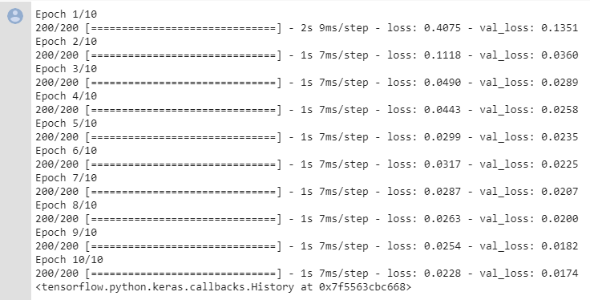
EVALUATION_INTERVAL = 200
EPOCHS = 10
simple_lstm_model.fit(train_univariate, epochs=EPOCHS,
steps_per_epoch=EVALUATION_INTERVAL,
validation_data=val_univariate, validation_steps=50)

Slide 53
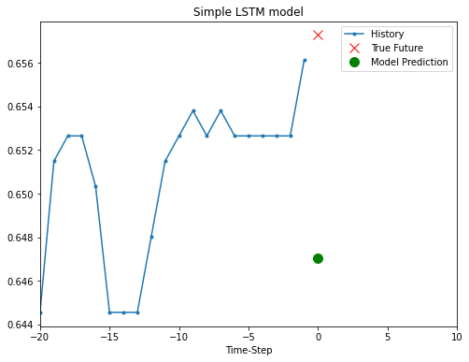
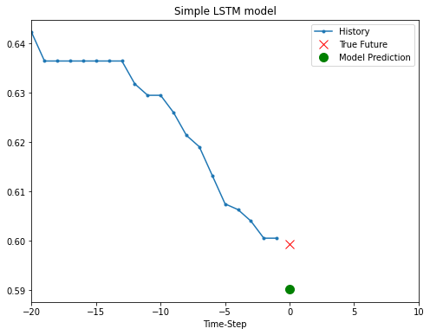
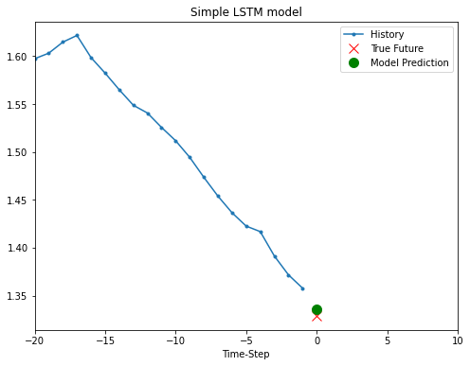
for x, y in val_univariate.take(3):
plot = show_plot([x[0].numpy(), y[0].numpy(),
simple_lstm_model.predict(x)[0]], 0, 'Simple LSTM model')
plot.show()

Slide 54
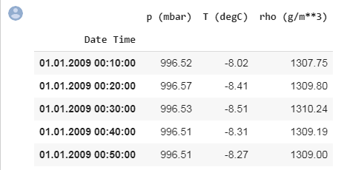
features_considered = ['p (mbar)', 'T (degC)', 'rho (g/m**3)']
features = df[features_considered]
features.index = df['Date Time']
features.head()

Slide 55
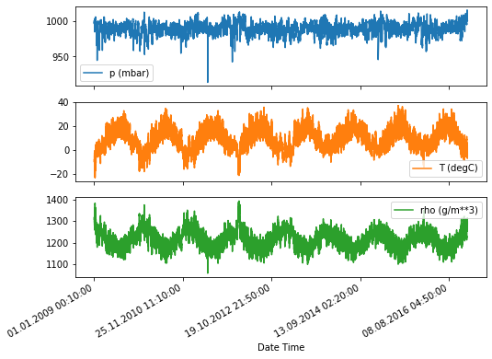
features.plot(subplots=True)

Slide 56
dataset = features.values
data_mean = dataset[:TRAIN_SPLIT].mean(axis=0)
data_std = dataset[:TRAIN_SPLIT].std(axis=0)
dataset = (dataset-data_mean)/data_std
def multivariate_data(dataset, target, start_index, end_index, history_size,
target_size, step, single_step=False):
data = []
labels = []
start_index = start_index + history_size
if end_index is None:
end_index = len(dataset) - target_size
for i in range(start_index, end_index):
indices = range(i-history_size, i, step)
data.append(dataset[indices])
if single_step:
labels.append(target[i+target_size])
else:
labels.append(target[i:i+target_size])
return np.array(data), np.array(labels)

Slide 57
past_history = 720
future_target = 72
STEP = 6
x_train_single, y_train_single = multivariate_data(dataset, dataset[:, 1], 0,
TRAIN_SPLIT, past_history,
future_target, STEP,
single_step=True)
x_val_single, y_val_single = multivariate_data(dataset, dataset[:, 1],
TRAIN_SPLIT, None, past_history,
future_target, STEP,
single_step=True)
print ('Single window of past history : {}'.format(x_train_single[0].shape))

Slide 58

train_data_single = tf.data.Dataset.from_tensor_slices((x_train_single, y_train_single))
train_data_single = train_data_single.cache().shuffle(BUFFER_SIZE).batch(BATCH_SIZE).repeat()
val_data_single = tf.data.Dataset.from_tensor_slices((x_val_single, y_val_single))
val_data_single = val_data_single.batch(BATCH_SIZE).repeat()
single_step_model = tf.keras.models.Sequential()
single_step_model.add(tf.keras.layers.LSTM(32,
input_shape=x_train_single.shape[-2:]))
single_step_model.add(tf.keras.layers.Dense(1))
single_step_model.compile(optimizer=tf.keras.optimizers.RMSprop(), loss='mae')
for x, y in val_data_single.take(1):
print(single_step_model.predict(x).shape)

Slide 59
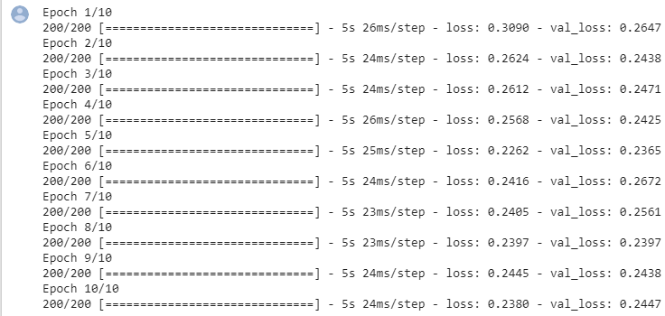
single_step_history = single_step_model.fit(train_data_single, epochs=EPOCHS,
steps_per_epoch=EVALUATION_INTERVAL,
validation_data=val_data_single,
validation_steps=50)

Slide 60
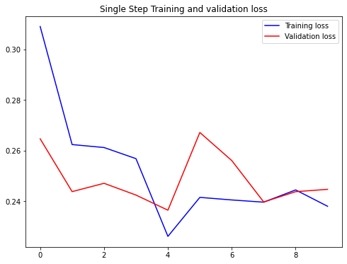
def plot_train_history(history, title):
loss = history.history['loss']
val_loss = history.history['val_loss']
epochs = range(len(loss))
plt.figure()
plt.plot(epochs, loss, 'b', label='Training loss')
plt.plot(epochs, val_loss, 'r', label='Validation loss')
plt.title(title)
plt.legend()
plt.show()
plot_train_history(single_step_history,
'Single Step Training and validation loss')

Slide 61
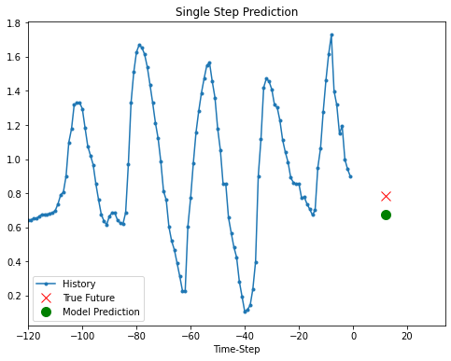
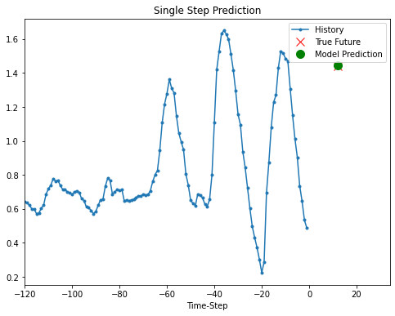

for x, y in val_data_single.take(3):
plot = show_plot([x[0][:, 1].numpy(), y[0].numpy(),
single_step_model.predict(x)[0]], 12,
'Single Step Prediction')
plot.show()

Slide 62

future_target = 72
x_train_multi, y_train_multi = multivariate_data(dataset, dataset[:, 1], 0,
TRAIN_SPLIT, past_history,
future_target, STEP)
x_val_multi, y_val_multi = multivariate_data(dataset, dataset[:, 1],
TRAIN_SPLIT, None, past_history,
future_target, STEP)
print ('Single window of past history : {}'.format(x_train_multi[0].shape))
print ('\n Target temperature to predict : {}'.format(y_train_multi[0].shape))

Slide 63
train_data_multi = tf.data.Dataset.from_tensor_slices((x_train_multi, y_train_multi))
train_data_multi = train_data_multi.cache().shuffle(BUFFER_SIZE).batch(BATCH_SIZE).repeat()
val_data_multi = tf.data.Dataset.from_tensor_slices((x_val_multi, y_val_multi))
val_data_multi = val_data_multi.batch(BATCH_SIZE).repeat()
def multi_step_plot(history, true_future, prediction):
plt.figure(figsize=(12, 6))
num_in = create_time_steps(len(history))
num_out = len(true_future)
plt.plot(num_in, np.array(history[:, 1]), label='History')
plt.plot(np.arange(num_out)/STEP, np.array(true_future), 'bo',
label='True Future')
if prediction.any():
plt.plot(np.arange(num_out)/STEP, np.array(prediction), 'ro',
label='Predicted Future')
plt.legend(loc='upper left')
plt.show()

Slide 64

for x, y in train_data_multi.take(1):
multi_step_plot(x[0], y[0], np.array([0]))

Slide 65

multi_step_model = tf.keras.models.Sequential()
multi_step_model.add(tf.keras.layers.LSTM(32,
return_sequences=True,
input_shape=x_train_multi.shape[-2:]))
multi_step_model.add(tf.keras.layers.LSTM(16, activation='relu'))
multi_step_model.add(tf.keras.layers.Dense(72))
multi_step_model.compile(optimizer=tf.keras.optimizers.RMSprop(clipvalue=1.0), loss='mae')
for x, y in val_data_multi.take(1):
print (multi_step_model.predict(x).shape)
multi_step_history = multi_step_model.fit(train_data_multi, epochs=EPOCHS,
steps_per_epoch=EVALUATION_INTERVAL,
validation_data=val_data_multi,
validation_steps=50)

Slide 66

plot_train_history(multi_step_history, 'Multi-Step Training and validation loss')

Slide 67



for x, y in val_data_multi.take(3):
multi_step_plot(x[0], y[0], multi_step_model.predict(x)[0])

