Slide 1
Providing targeted responsible foreign aid
Group 5: Ron, Kushal, Jimin, Seunggil

Slide 2
Project background(== problem statment)
In 2020, US government spend $51.05 billion US dollars in foreign aid [1]
But, many mixed perspectives about effects of foreign aid exist[2][3]
→Targeted, Responsible foreign aid
Targeted: for which country does it work well?
Responsible: the aid should have actual positive effect
"FA.gov". ForeignAssistance.gov. Archived from the original on 17 December 2021. Retrieved 17 December 2021.
William Easterly (2003). Can Foreign Aid Buy Growth?. Journal of Economic Perspectives—Volume 17, Number 3, 23-48.
Qian, N. (2015). Making progress on foreign aid. Annu. Rev. Econ., 7(1), 277-308.

Slide 3
Datasets
Four features of interest:
U.S Foreign Aid data to be sourced from the World Bank Data bank.
Poverty, unemployment and Inflation Indicators will come from the OECD data sets (This is where we can find the results of foreign aid)
OECD - Organization for Economic Cooperation and Development

Slide 4
project approach / Kushal
Methodology classification, supervised learning / unsupervised learning

Slide 5
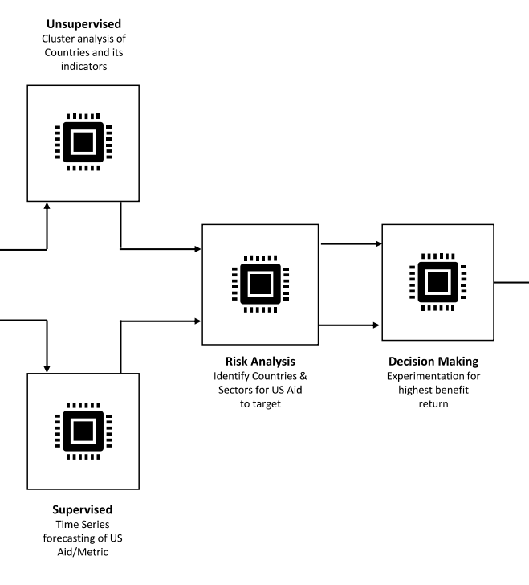
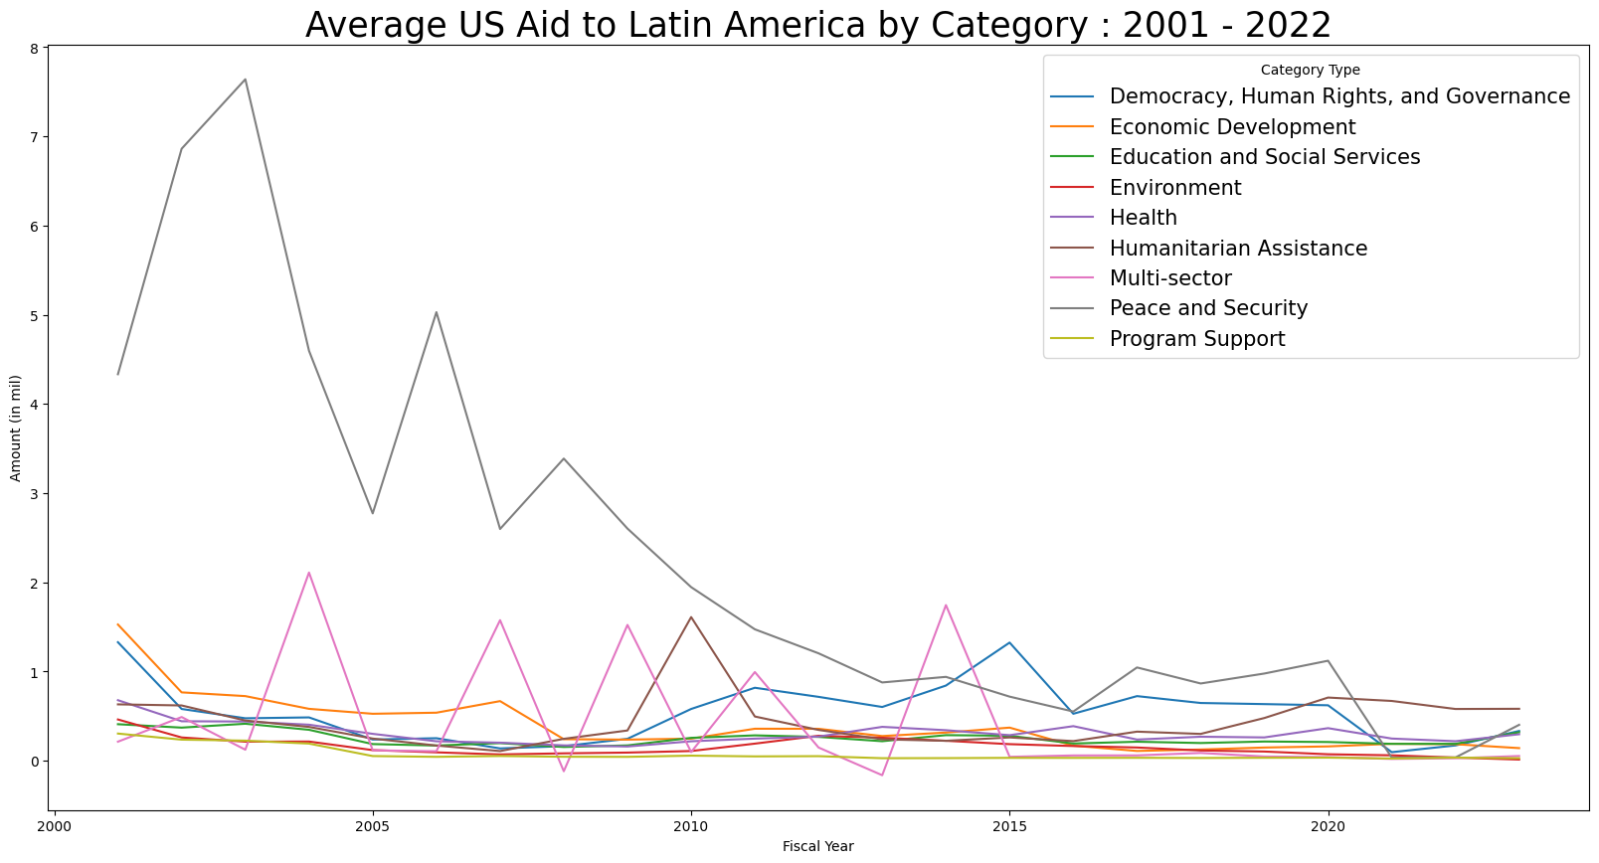
Current / Future (progress) / Seunggil
Current:
We made 4 dataset + did some EDA
Poverty
Foreign aid
Unemployment rate
USAid dataset
Future:
Two approaches In one project pipeline!

Slide 6
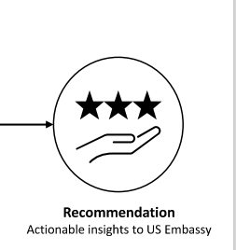
Final Goals / Seungil
1 topic & 2 flows
-> Unsupervised/Supervised
-> Can be actionable insight!

Slide 7
TRASH BIN!
Current:
highlight EDA we did
slightly look about what we have done
you can include design sketch
future work before final presentation:
We need
Goal
Final Output of our project:
should it be the result came out of student’s perspective or government perspective?
our project’s vision
expected result

Slide 8
Project Background (problem statement) /Jimin
introduction
what is the foreign aid?
what is targeted ?
references at least 3~4

