Slide 1
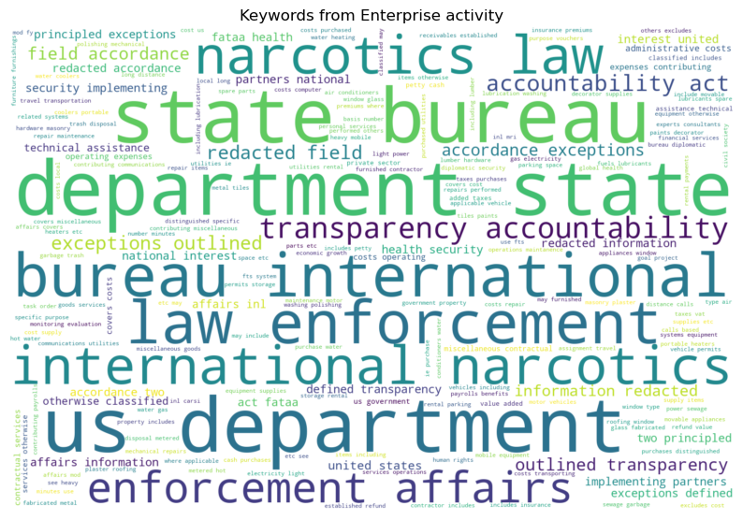
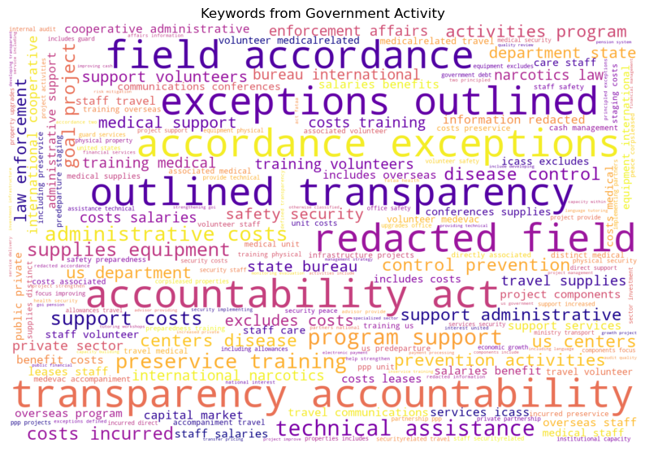
Text analytics – Current Progress
Notes:
Keywords by countries, region, etc.
Why certain countries are not getting accuracy on regression model?
Focus on countries with higher accuracy. – average model performance – top n countries
Think about audience on dashboard
Predicting the missing data

Slide 2
Meeting notes: (05/25/2023)
Modelling
Keywords by countries, region, etc. – Kushal
Data preprocessing - Seunggil, Jimin
Multicollinearity, use PCA,
Changing target value – GDP (Total GDP) [handling the range]
Accuracy by countries
Focus on countries with higher regression results – average model performance – top n countries
Why certain countries are not getting accuracy on regression model?
Reporting
Think about audience while building the dashboard
Report
Describe dataset in brief
Why model is not performing well for certain countries? Mention which countries have low/high performance

Slide 3
Clustering exercise 2
Country | Topic 1 – healthcare | Topic 2 | Topic 3
ABC | 0.5 | 0.2 | 0.3
DEF | 0.4 | 0.4 | 0.2
GHI | 0.33 | 0.33 | 0.33

