Slide 1
Final Project
By: Ronney Aovida
Finding optimal parameters for trimming and masking

Slide 2
Biological background
Gathering taxa- individual identified by taxonomy
Sequence DNA
Merge and assemble
Once the data is acquired on the bioinformatics side, having each individual assembled, then the taxon sets can be put together.
I will be dealing with snakes.
Before trimming, we first find the distances and homologs of the data before then running it through the orthology. This determines different loci associated with genes.
The data is then run through a program for alignment. This is figuring out the most optimal matching of individuals in a taxon set
It is after this that trimming and masking of the data is then done.
Once trimming and masking is completed, trees are then run in order to find the optimal combination of thresholds to produce a phylogeny.
What I am doing…

Slide 3
Methods
How I approached this project:
Step 1: TrimAndMaskRawAlignments3- this program takes in 3 variable thresholds that determine the following
  X= minimum allowable probability of same sites occurring
  Y= minimum amount of good sites (such as GGGG for 4)
  Z= missing allowed, this determines how many sites can be missing at a time
parameters allowed: x=[0,1] y=[0,20] z=[0,96]. I chose my parameters for z in a more focused manner based off of past possible optimal solutions for it
Step 2: PlotAlignmentsSummary2- this is a R script that plots different aspects of the alignments and is typically used to determine the thresholds used in step 1 through visual means
Step 3: SetupRAxML3- this program sets up the files needed to run trees and also provides a file that can be uploaded to geneious to be viewed for further inspection of the alignments. This also helps determine the thresholds.
Step 4: EvalInformativeSitesInPhylipMatrix- this program will provide the results of the trimming and masking with your input thresholds. (number of loci/genes, number of taxa (invidivuals), number of sites, variable sites, informative sites, characters, % of missing characters (N’s and –s only) and % missing characters (all considered).
Note: characters are a single base pair. Variable sites means we don’t know if the site is wrong or biologically different and informative sites are ones we see across all individuals in the taxon set.

Slide 4
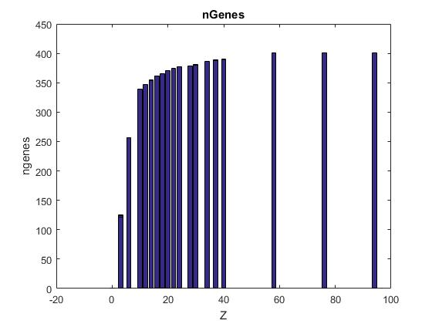
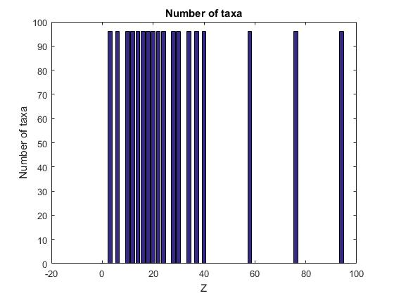
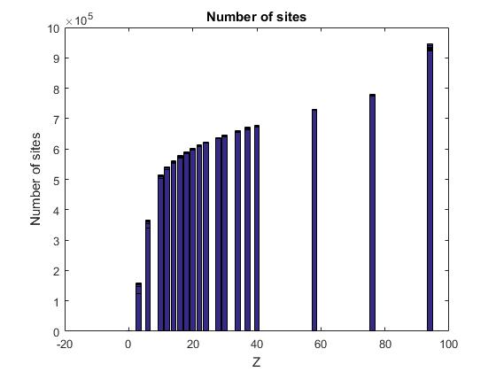
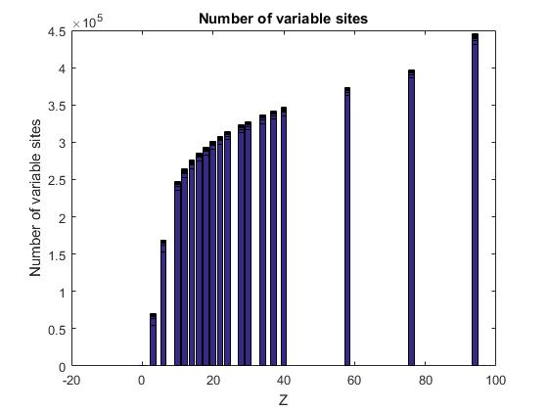
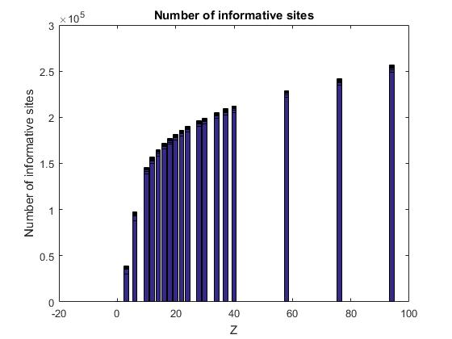
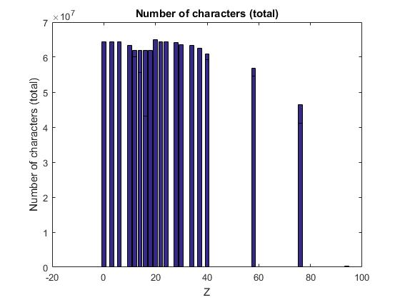
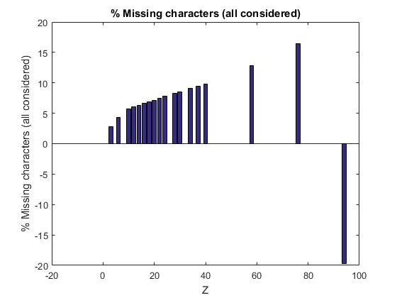
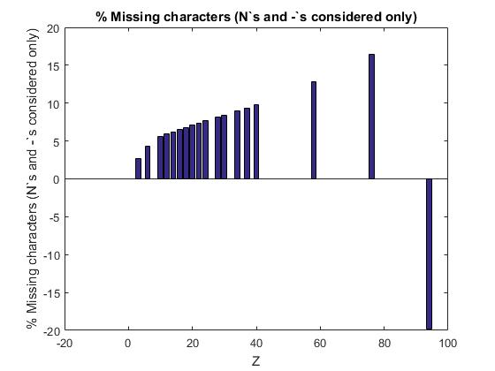
Results
These Graphs depict the results of all X and Y values against the Z threshold for all statistics.

Slide 5
Discussion
Through this research I have come to find the following:
For the first 5 statistics. When Z=0 the program does not run or returns a zero.
In nGenes:
  As Z increased so did the nGenes.
  As X grows larger in value, more Y values become more optimal. However Y=0 seems to be relatively constant independent of the X value.
In Taxa:
  There is no significant change seen here.
Number of sites
  As Z increases so does the number of sites.
  Most optimal values are found at Y=0 no matter the X value.
  As X increases, the most optimal values are found when Y is increased alongside the X value. However, the Y value after the most optimal returns zeros (or does not run)
Number of variable sites
  As Z increases the number of variable sites increases.
  Y=0 is most optimal independent of the X value. And as the X value increases, the Y value that is increamented at the same speed as X seems to carry the most optimal values.
Number of informative sites
  As Z increased so does the info sites.
  Same results as number of variable sites in regard to Y and X relationship.
Number of total characters
  In this case, Values are NOT increasing as Z increases. It is more chaotic.
  The most optimal values tend to be high Y values no matter the X value
% Missing characters (N’s and –’s considered only)
  As Z increases the amount of missing char is highly increased.
  Starting at Y=4, the most optimal values are found as Y increments up with the X value until x=0 or 1, y=2 is then optimal
% Missing characters (all considered)-- This returned relatively the same results as when considering only N’s and –’s.

