Slide 1
Project Continuation of Louis et al. (EMNLP 2020)
Beyond Indirect Answers: Pragmatic Augmentation for CIRCA
Yuval Meron · Ron Biden · Gilad Schwartz · Ziv Fenigstein
June 2026

Slide 2
Motivation
Why Continue This Paper?
• Louis et al. show context helps classify indirect answers in CIRCA.
• Open question: can pragmatic augmentation improve robustness?
• We compare LLM explanation injection against controlled baselines.
• We expand to multiple encoders for stronger, cross-model conclusions.
Yuval Meron · Ron Biden · Gilad Schwartz · Ziv Fenigstein · June 2026

Slide 3
RQs
Research Questions
• RQ1: Does explanation augmentation improve 6-class prediction quality?
• RQ2: Is LLM augmentation better than simple non-LLM controls?
• RQ3: Are gains consistent across BERT, MNLI-BERT, and RoBERTa?
• Primary metric: Macro-F1 (class-balanced). Secondary: Accuracy.
Yuval Meron · Ron Biden · Gilad Schwartz · Ziv Fenigstein · June 2026

Slide 4
Data
Data and Task
• Dataset: CIRCA indirect-answer corpus, 6-class pragmatic labels.
• Valid base examples: 30,958. LLM-augmented subset: 5,000.
• Labels re-derived robustly from goldstandard1 (no leakage).
• Matched-cap protocol: all modes trained at the same sample budget.
Yuval Meron · Ron Biden · Gilad Schwartz · Ziv Fenigstein · June 2026

Slide 5
Methods
Five Augmentation Modes
• baseline — answer + context only (no augmentation).
• repeat — duplicate input text; noise-control for extra tokens.
• template — hand-written label-agnostic pragmatic hint (no label leakage).
• oracle — label-description hint appended (upper-bound; leaks semantics).
• llm — GPT-generated natural-language explanation per example.
Yuval Meron · Ron Biden · Gilad Schwartz · Ziv Fenigstein · June 2026

Slide 6
Setup
Model Suite and Training Setup
• Models: bert-base-uncased · MNLI-BERT (textattack) · roberta-base.
• Total runs: 15 (5 modes × 3 models), identical training budget.
• Framework: PyTorch + HuggingFace Transformers, 4 epochs each.
• All results, logs, and aggregates saved to outputs/ for traceability.
Yuval Meron · Ron Biden · Gilad Schwartz · Ziv Fenigstein · June 2026

Slide 7
Results
Results: Macro-F1 (Primary Metric)
Higher = better. Balanced across all 6 classes; not inflated by majority.
Mode | BERT | MNLI-BERT | RoBERTa
baseline | 0.501 | 0.515 | 0.511
repeat | 0.536 | 0.595 | 0.597
template | 0.545 | 0.518 | 0.546
oracle | 1.000 | 1.000 | 1.000
llm | 0.755 | 0.782 | 0.754
Yuval Meron · Ron Biden · Gilad Schwartz · Ziv Fenigstein · June 2026

Slide 8
Results
Results: Accuracy (Secondary Metric)
Accuracy can mask minority-class failures — interpret together with Macro-F1.
Mode | BERT | MNLI-BERT | RoBERTa
baseline | 0.756 | 0.798 | 0.804
repeat | 0.766 | 0.814 | 0.814
template | 0.754 | 0.814 | 0.786
oracle | 1.000 | 1.000 | 1.000
llm | 0.764 | 0.786 | 0.760
Yuval Meron · Ron Biden · Gilad Schwartz · Ziv Fenigstein · June 2026

Slide 9
Analysis
Key Findings
What Worked
What Needs Caution
• LLM explanations raise Macro-F1 by ~0.25 over baseline.
• Repeat / template controls improve modestly but far less than LLM.
• MNLI-BERT + LLM achieves the best Macro-F1: 0.782.
• Controlled design confirms pragmatic signal is the driver.
• Oracle is an artificial upper bound — not deployable.
• LLM gains on accuracy alone are inconsistent across models.
• Explanation quality variance may affect result stability.
• Single domain; external validity still needs study.
Yuval Meron · Ron Biden · Gilad Schwartz · Ziv Fenigstein · June 2026

Slide 10
Discussion
Comparison to the Original Paper
• Original: context window & architecture comparisons for indirect answers.
• This project: augmentation-focused intervention study on the same task.
• Added multiple controlled baselines (per professor feedback).
• Added cross-model validation (per professor feedback).
• Conclusion: pragmatic augmentation helps, especially for balanced F1.
Yuval Meron · Ron Biden · Gilad Schwartz · Ziv Fenigstein · June 2026

Slide 11
Limitations
Threats to Validity and Limitations
• Single dataset / domain limits external validity.
• LLM explanations may carry generation-model biases.
• No human scoring of explanation quality in this phase.
• Fixed-epoch budget — deeper tuning may shift rankings.
Yuval Meron · Ron Biden · Gilad Schwartz · Ziv Fenigstein · June 2026

Slide 12
Future
Future Work
• Add backtranslation and paraphrase-model augmentation as richer controls.
• Evaluate on additional pragmatic datasets and cross-domain transfer.
• Ablate explanation properties: length, structure, rationale type.
• Study confidence calibration and per-class error patterns.
Yuval Meron · Ron Biden · Gilad Schwartz · Ziv Fenigstein · June 2026

Slide 13
Repro
Reproducibility
• Code bundle: submission/code.zip (src/ + paper/)
• Data bundle: submission/data.zip (circa_processed.csv + explanations)
• Training script: src/train.py | Eval orchestrator: src/evaluate.py
• All 15 result folders and aggregate CSVs committed under outputs/
Yuval Meron · Ron Biden · Gilad Schwartz · Ziv Fenigstein · June 2026

Slide 14
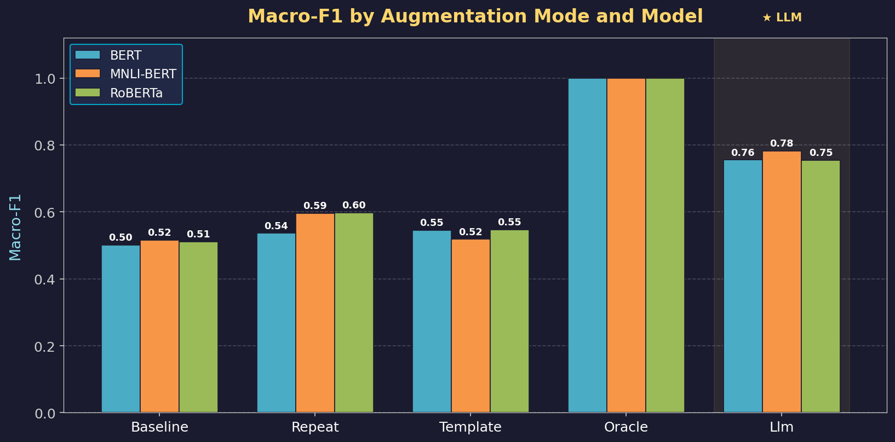
Results
Macro-F1 by Augmentation Mode and Model
LLM augmentation outperforms all non-oracle controls across all three encoders.
Yuval Meron · Ron Biden · Gilad Schwartz · Ziv Fenigstein · June 2026

Slide 15
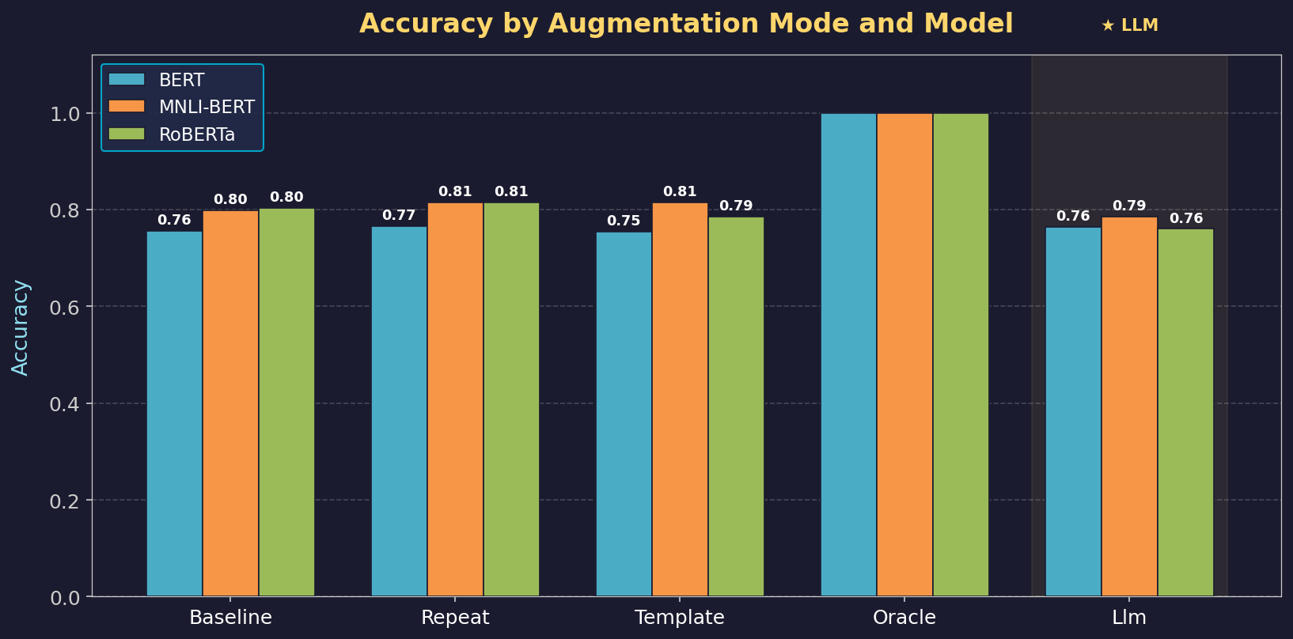
Results
Accuracy by Augmentation Mode and Model
Accuracy gains are smaller and less consistent — Macro-F1 is the key metric.
Yuval Meron · Ron Biden · Gilad Schwartz · Ziv Fenigstein · June 2026

Slide 16
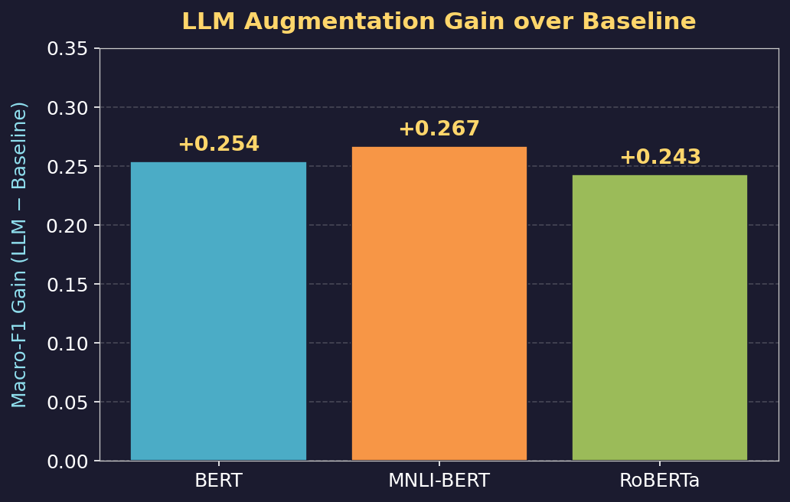
Analysis
LLM Augmentation Gain over Baseline (Macro-F1)
All three encoders benefit substantially from pragmatic reasoning augmentation.
Yuval Meron · Ron Biden · Gilad Schwartz · Ziv Fenigstein · June 2026

Slide 17
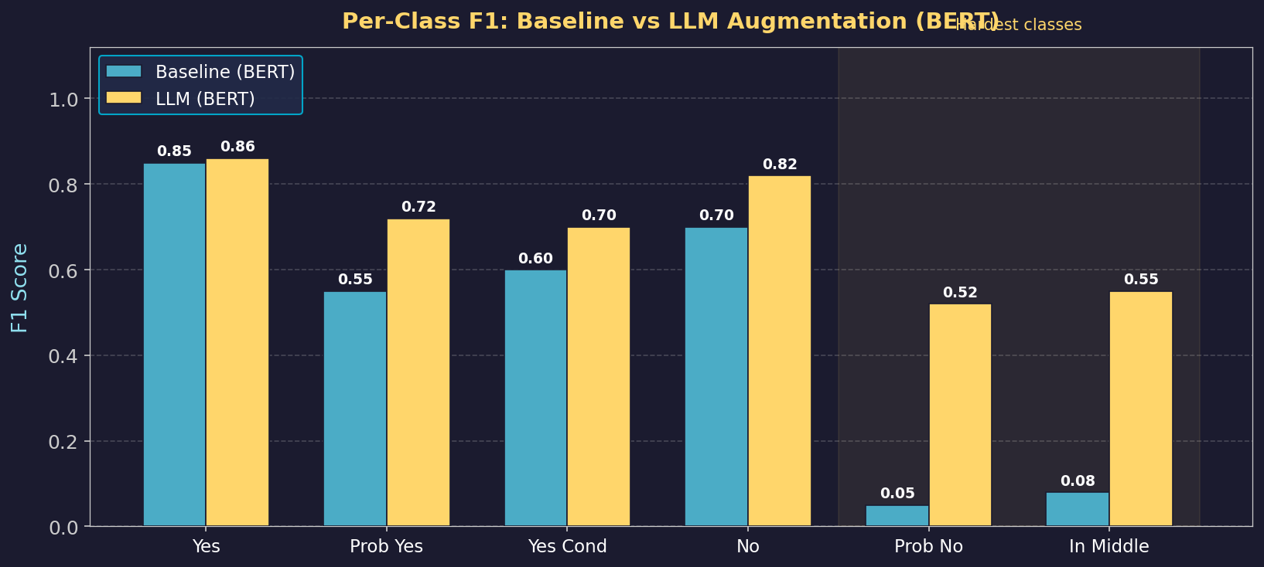
Analysis
Per-Class F1: Baseline vs LLM Augmentation (BERT)
Minority classes (Prob No, In the Middle) go from near-zero to >0.5 F1 with LLM.
Yuval Meron · Ron Biden · Gilad Schwartz · Ziv Fenigstein · June 2026

Slide 18
Thank You
Questions & Discussion
Yuval Meron · Ron Biden · Gilad Schwartz · Ziv Fenigstein
Dept. of Industrial Engineering and Management · Ben-Gurion University
Yuval Meron · Ron Biden · Gilad Schwartz · Ziv Fenigstein · June 2026

