Slide 1
Q3 Project Status Review
Prepared by the Program Office

Slide 2
Key Achievements
Completed preliminary design review ahead of schedule
Requirement ACA-HRS-0190 verified in lab testing
Reduced unit cost by 12% versus the baseline estimate
Delivered the first prototype to the customer
Notes:
Mention that the cost reduction is relative to the FY23 baseline.

Slide 3
Schedule
Milestone | Date | Status
Critical Design Review | 2025-03-14 | Complete
Prototype Delivery | 2025-06-02 | On track
Qualification Testing | 2025-09-15 | At risk

Slide 4
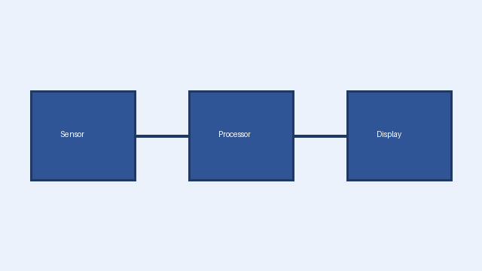
System Architecture

