Slide 1

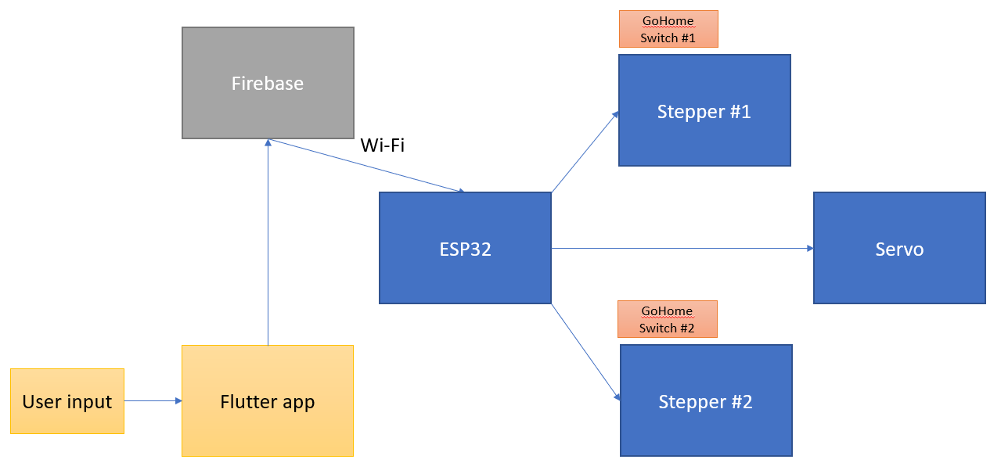
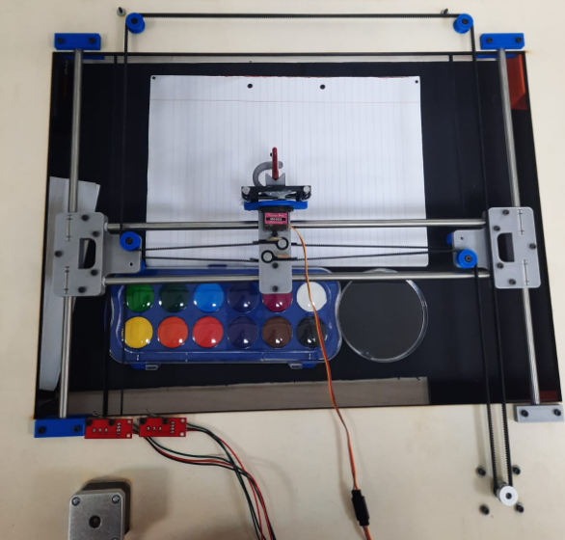
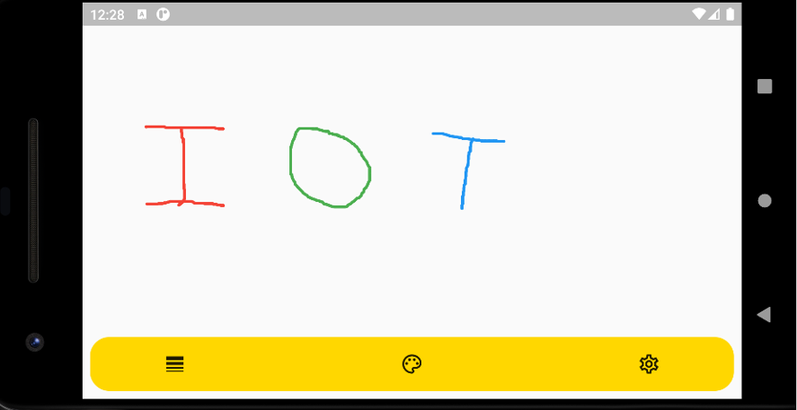
PaintBot
Let the robot paint for you!
Our robot receives a draw from our app and uses water-colors to draw it on paper.
Using Flutter, we built a cross-platform, easy to use app in which the user can select colors and draw a painting.
The painting is sent through the cloud (FireBase) and downloaded by the robot, which moves three motors attached to a brush, strap and metal bars, and paints the user draw.
System Diagram
Robot Prototype
Flutter App
Eyal Attiya, Ron Dahan, Renen Kantor
Instructors - Tom Sofer, Harel Vaknin

