Slide 1
e-Ration
IBM Team 42

Slide 2
Motivation
We know today if we want to change anything regarding our ration card like name correction,adding new member, reduction of members, ownership changing is a hectic task , that we have to fill a lot of details , documents and all, thats why we decided to come up with an idea of a mobile application where we can correct name, add members , delete existing members ,change ownership by simply giving the aadhar number and ration card number.

Slide 3
Assigned Roles
GIRI SANKAR-USE CASE DIAGRAM
HUDA RAHMAN-UI(FRONT END)
JOYAL JOSE-CLASS DIAGRAM
LEO JOY-ACTIVITY DIAGRAM
RON DANIEL-DATABASE SCHEMA

Slide 4
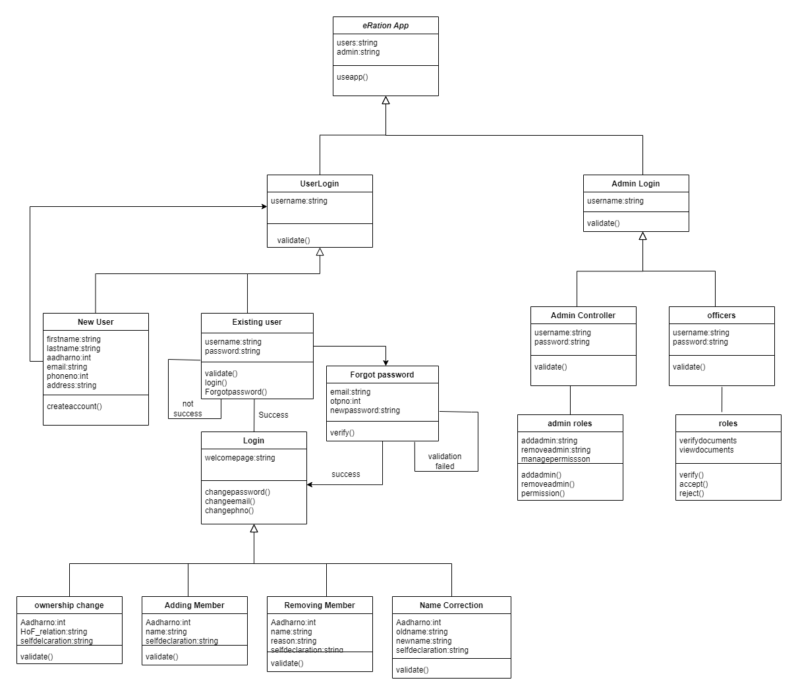
Class Diagram

Slide 5
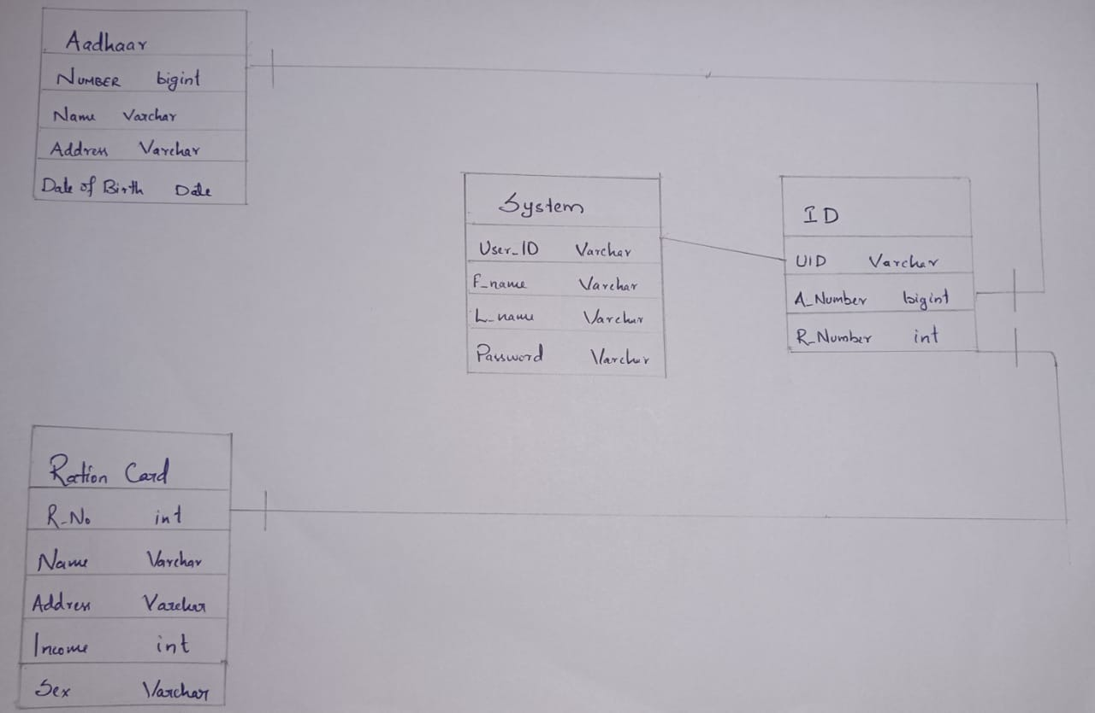
Database Structure

Slide 6
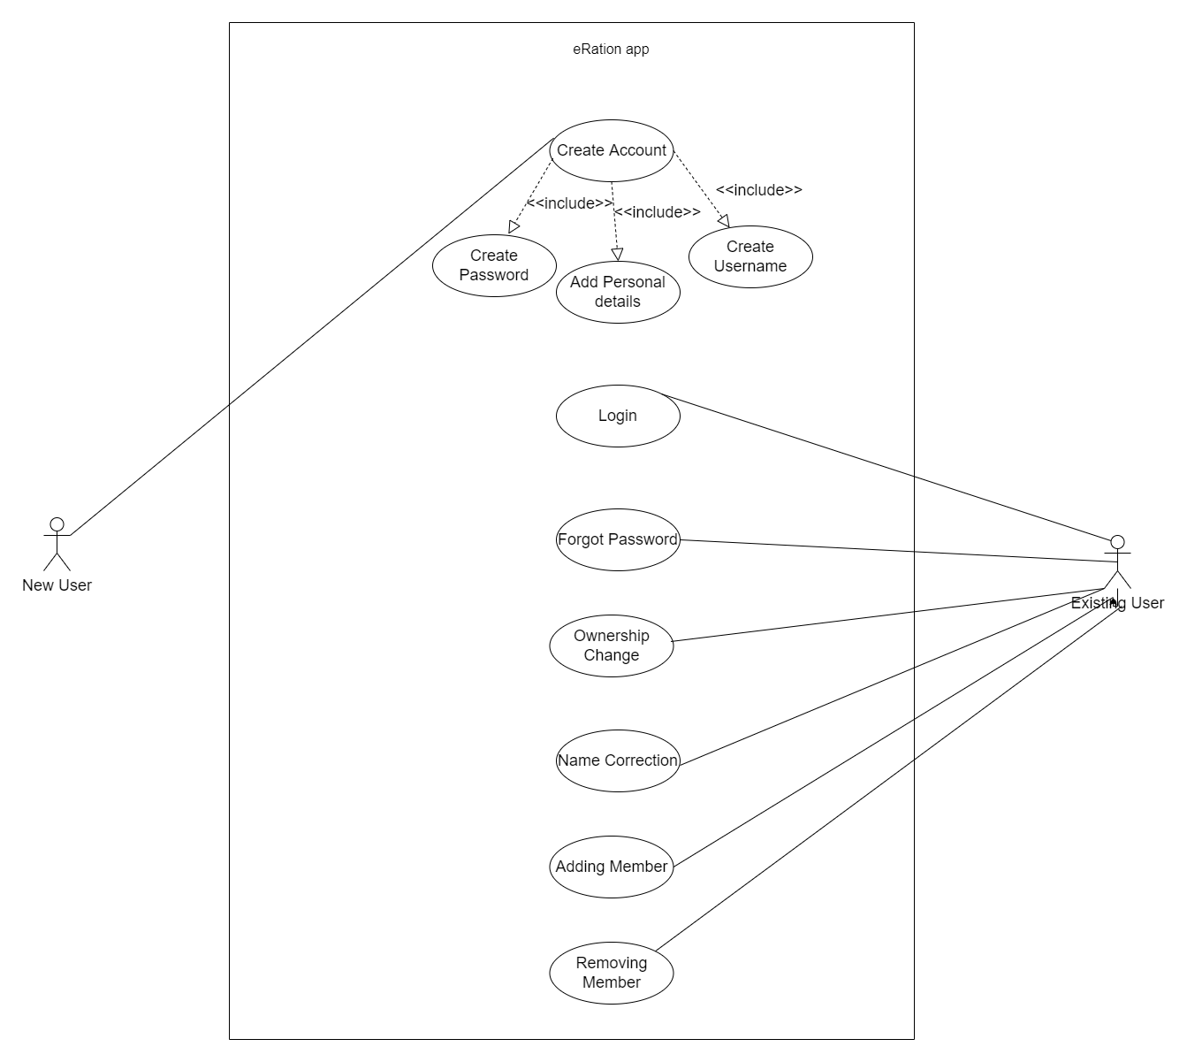
Use case Diagram
-User Side

Slide 7
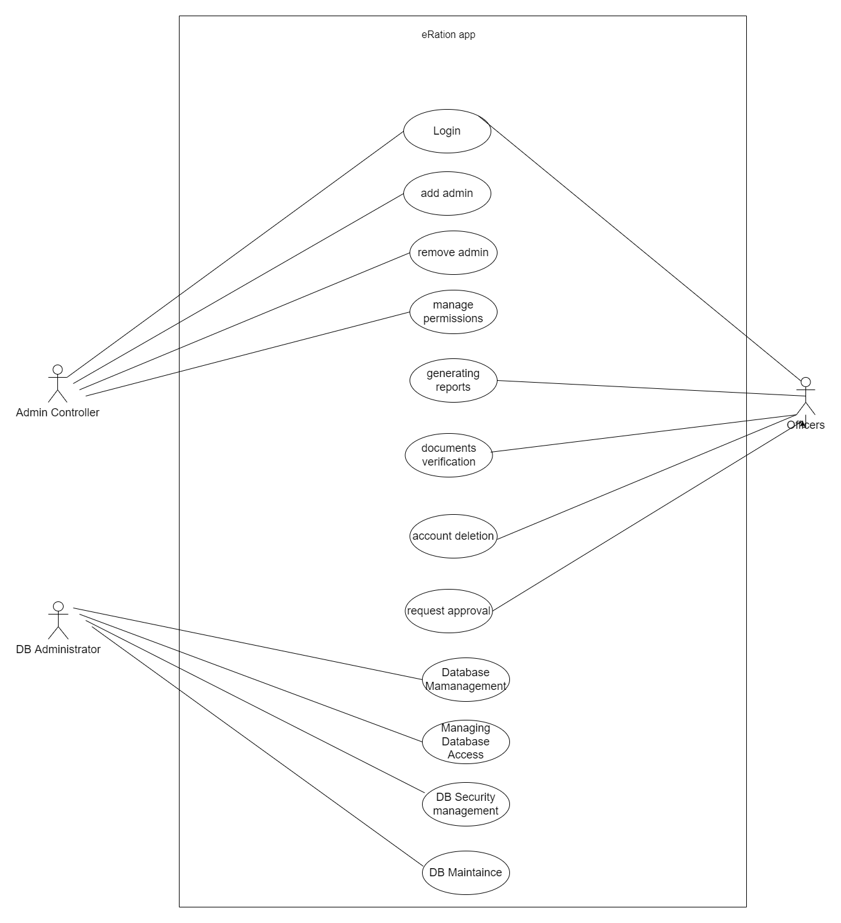
Use case Diagram
-Admin Side

Slide 8
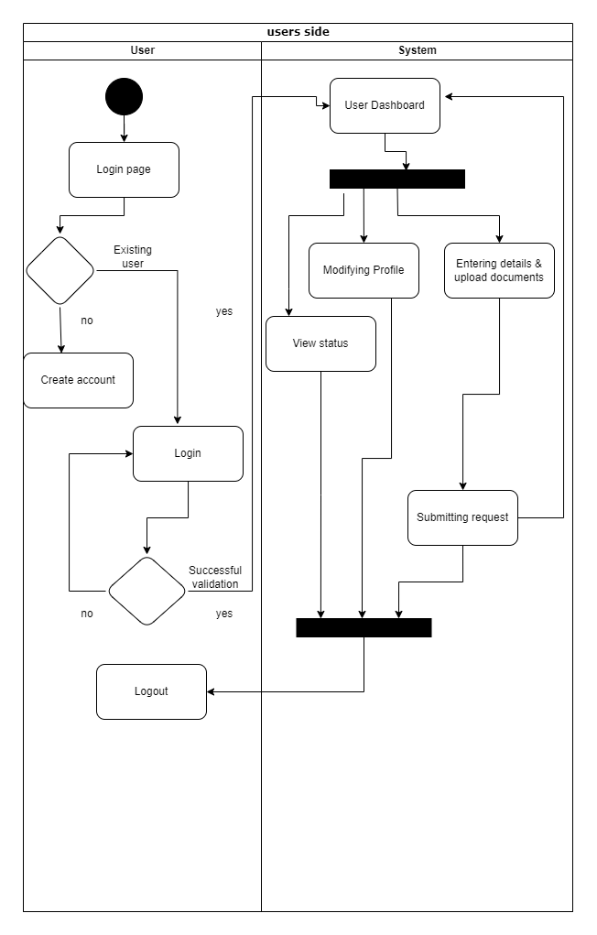
Activity Diagram

Slide 9
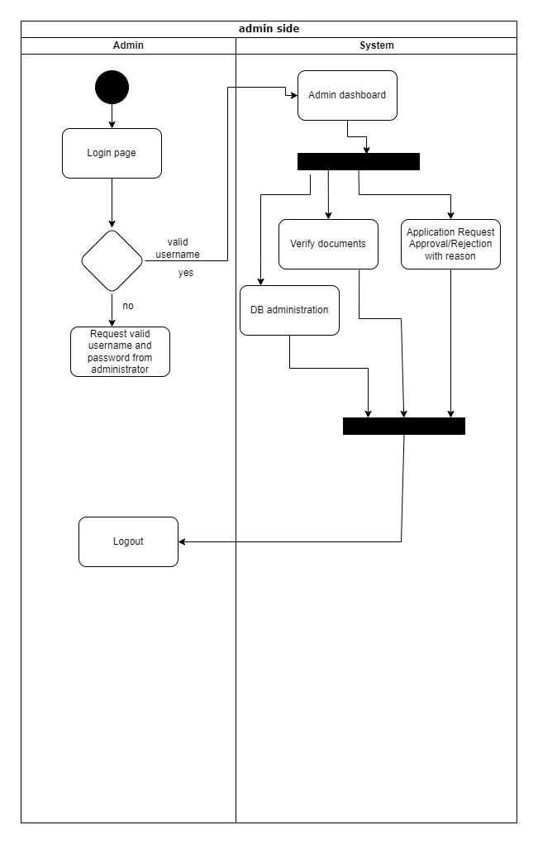
Use case Diagram
-Admin Side

Slide 10
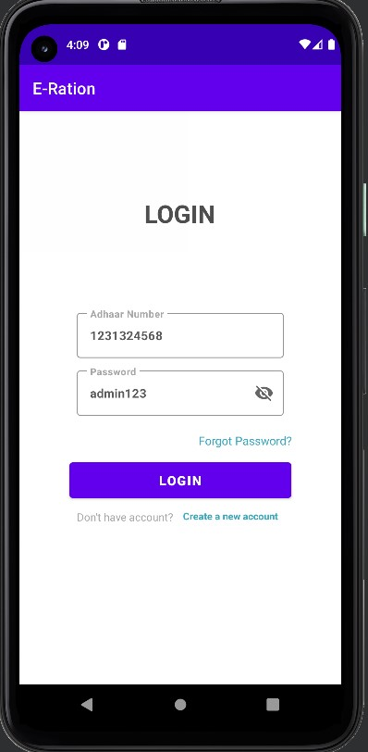
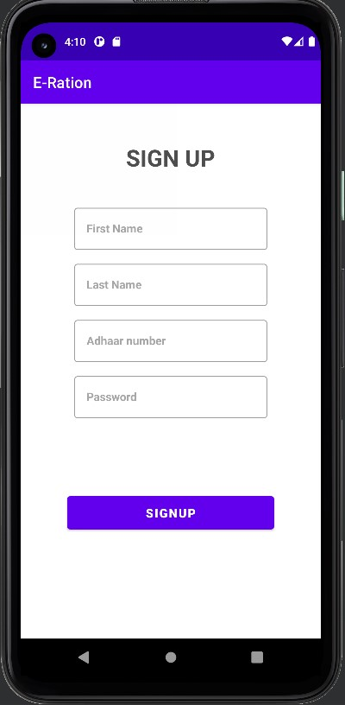
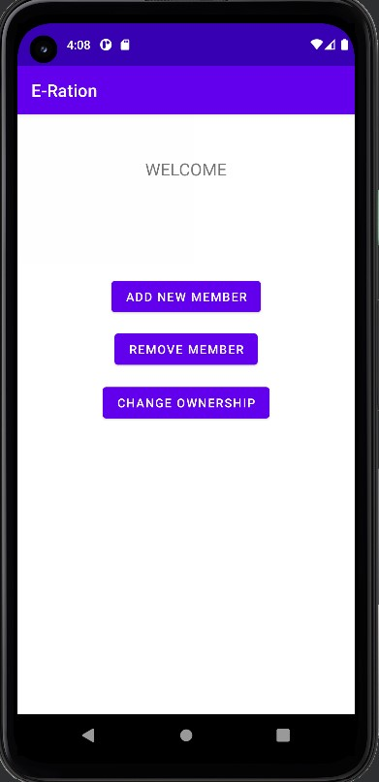
UI
Screenshots

Slide 11
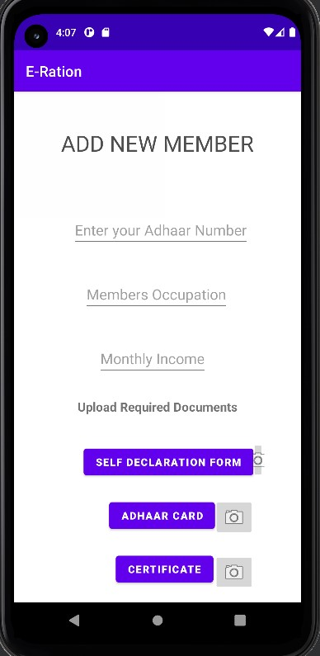
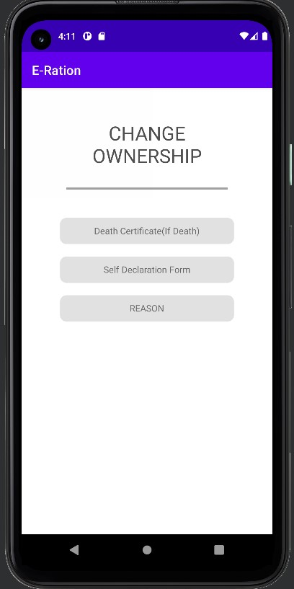
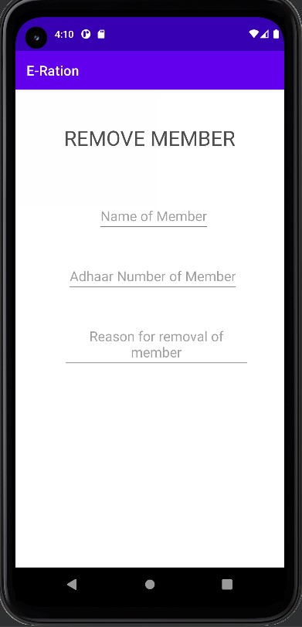
UI
Screenshots

Slide 12
Link for all diagrams
https://drive.google.com/drive/folders/1d3TdP5fGeYZKy4MH5_jhGmJcYwAzvBza?usp=sharing

Slide 13
THANK YOU

