Slide 1
OT to Data Cloud, Alert & Dashboard
26 May 2025
Team 21 – RAL-2025
Ron Inglesby
Alex Martens
Libu Balakrishnan

Slide 2
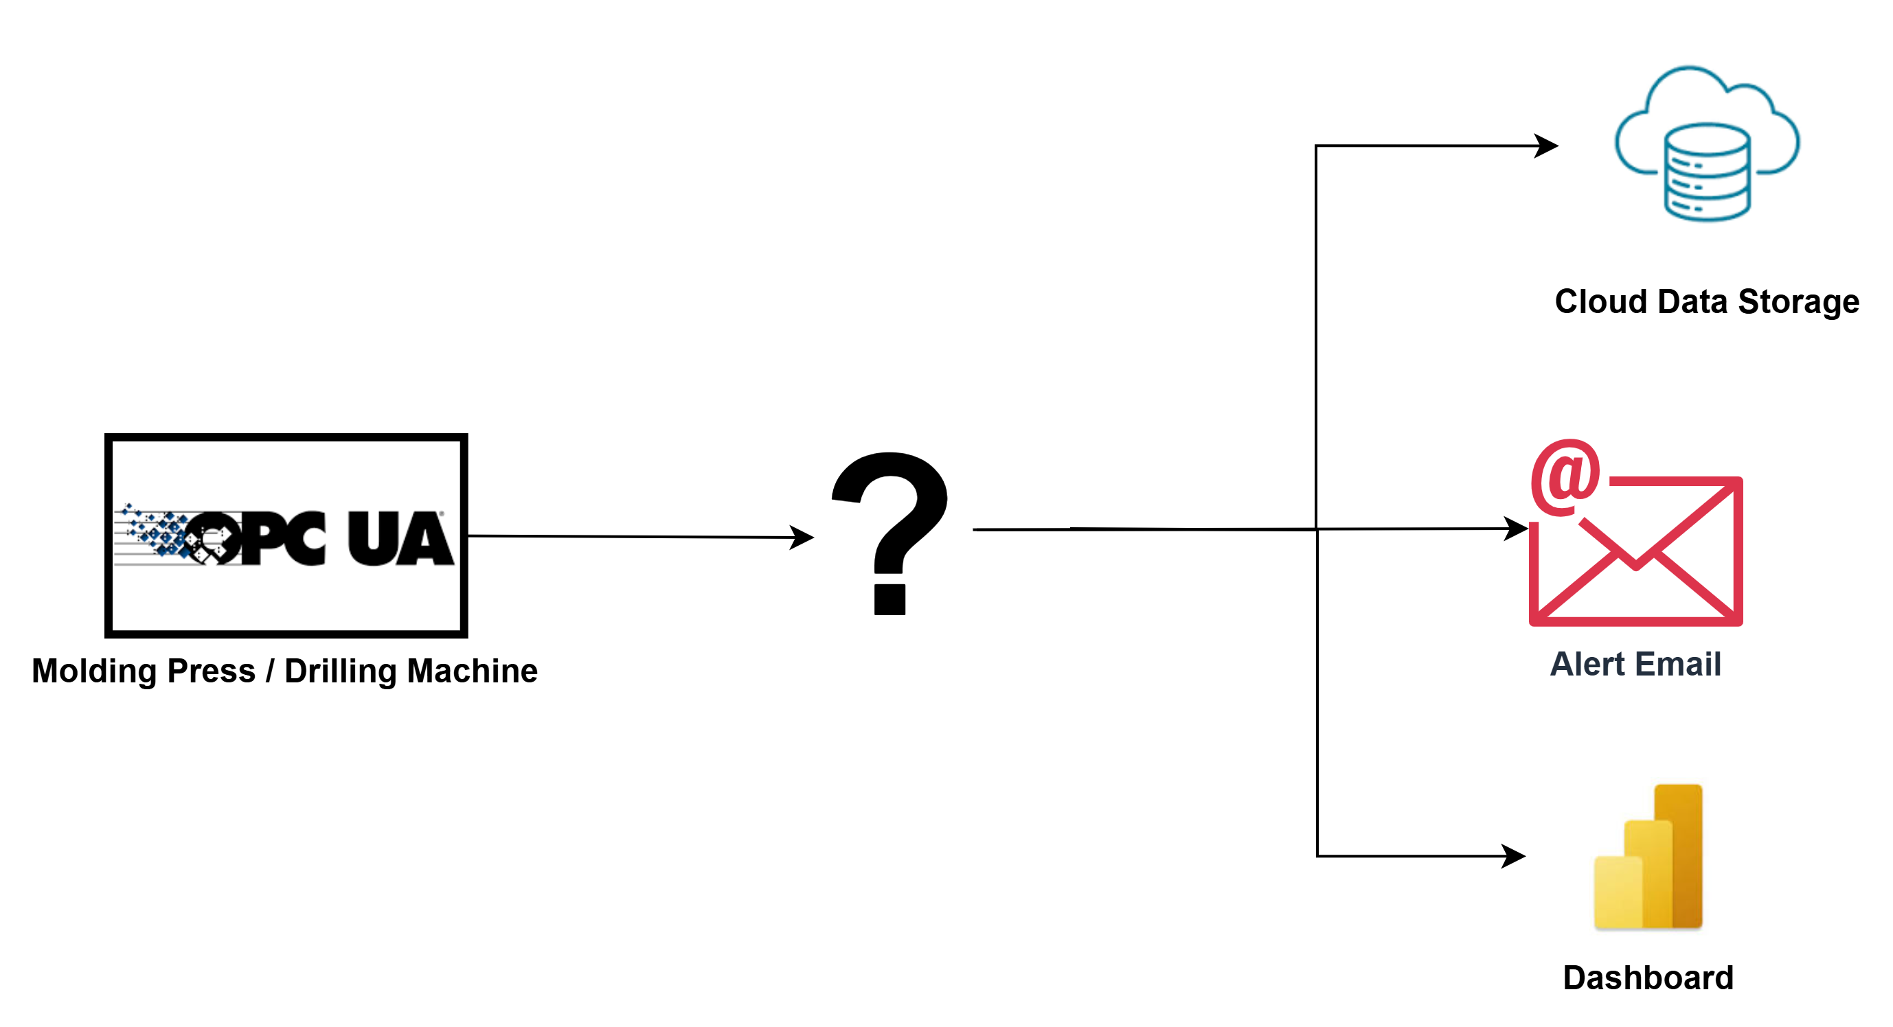

OT to Data Cloud, Alert & Dashboard
© Solace Proprietary & Confidential
Notes:
Key Points
Event Management is built into the Solace Platform
Design to runtime (creates bridges between design and runtime)
Promotion to Production
Talk Track
To provide a little context, the Solace Event Portal sits in the middle of Solace Platform, which combined gives you all the functions you need for a complete event driven integration solution. <click!> Designs from Event Portal flow into the Connection and Integration functions to be implemented. <click!>As the implementation moves across environments, Event Portal precisely configures access to the Event Mesh.

Slide 3
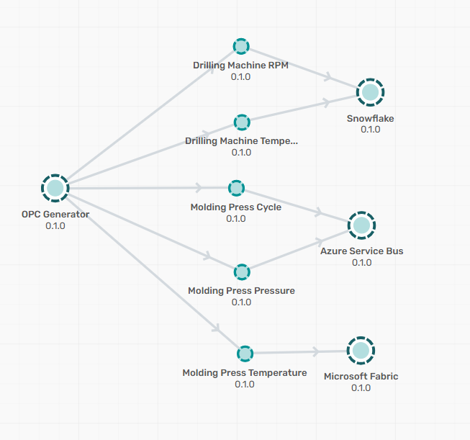
Democratize – Event Portal Model
© Solace Proprietary & Confidential
Notes:
Key Points
Event Management is built into the Solace Platform
Design to runtime (creates bridges between design and runtime)
Promotion to Production
Talk Track
To provide a little context, the Solace Event Portal sits in the middle of Solace Platform, which combined gives you all the functions you need for a complete event driven integration solution. <click!> Designs from Event Portal flow into the Connection and Integration functions to be implemented. <click!>As the implementation moves across environments, Event Portal precisely configures access to the Event Mesh.

Slide 4
Events
$$Ε vent=\left(ηoun\right)+\left(νerb\right)+[ρroperties]$$
Molding Press Events
demothonco/opcua/shopfloor/moldingPress/measured/pressure
demothonco/opcua/shopfloor/moldingPress/measured/temperature
demothonco/opcua/shopfloor/moldingPress/measured/cycle
Drill Machine Events
demothonco/opcua/shopfloor/drillingMachine/measured/rpm
demothonco/opcua/shopfloor/drillingMachine/measured/temperature

Slide 5
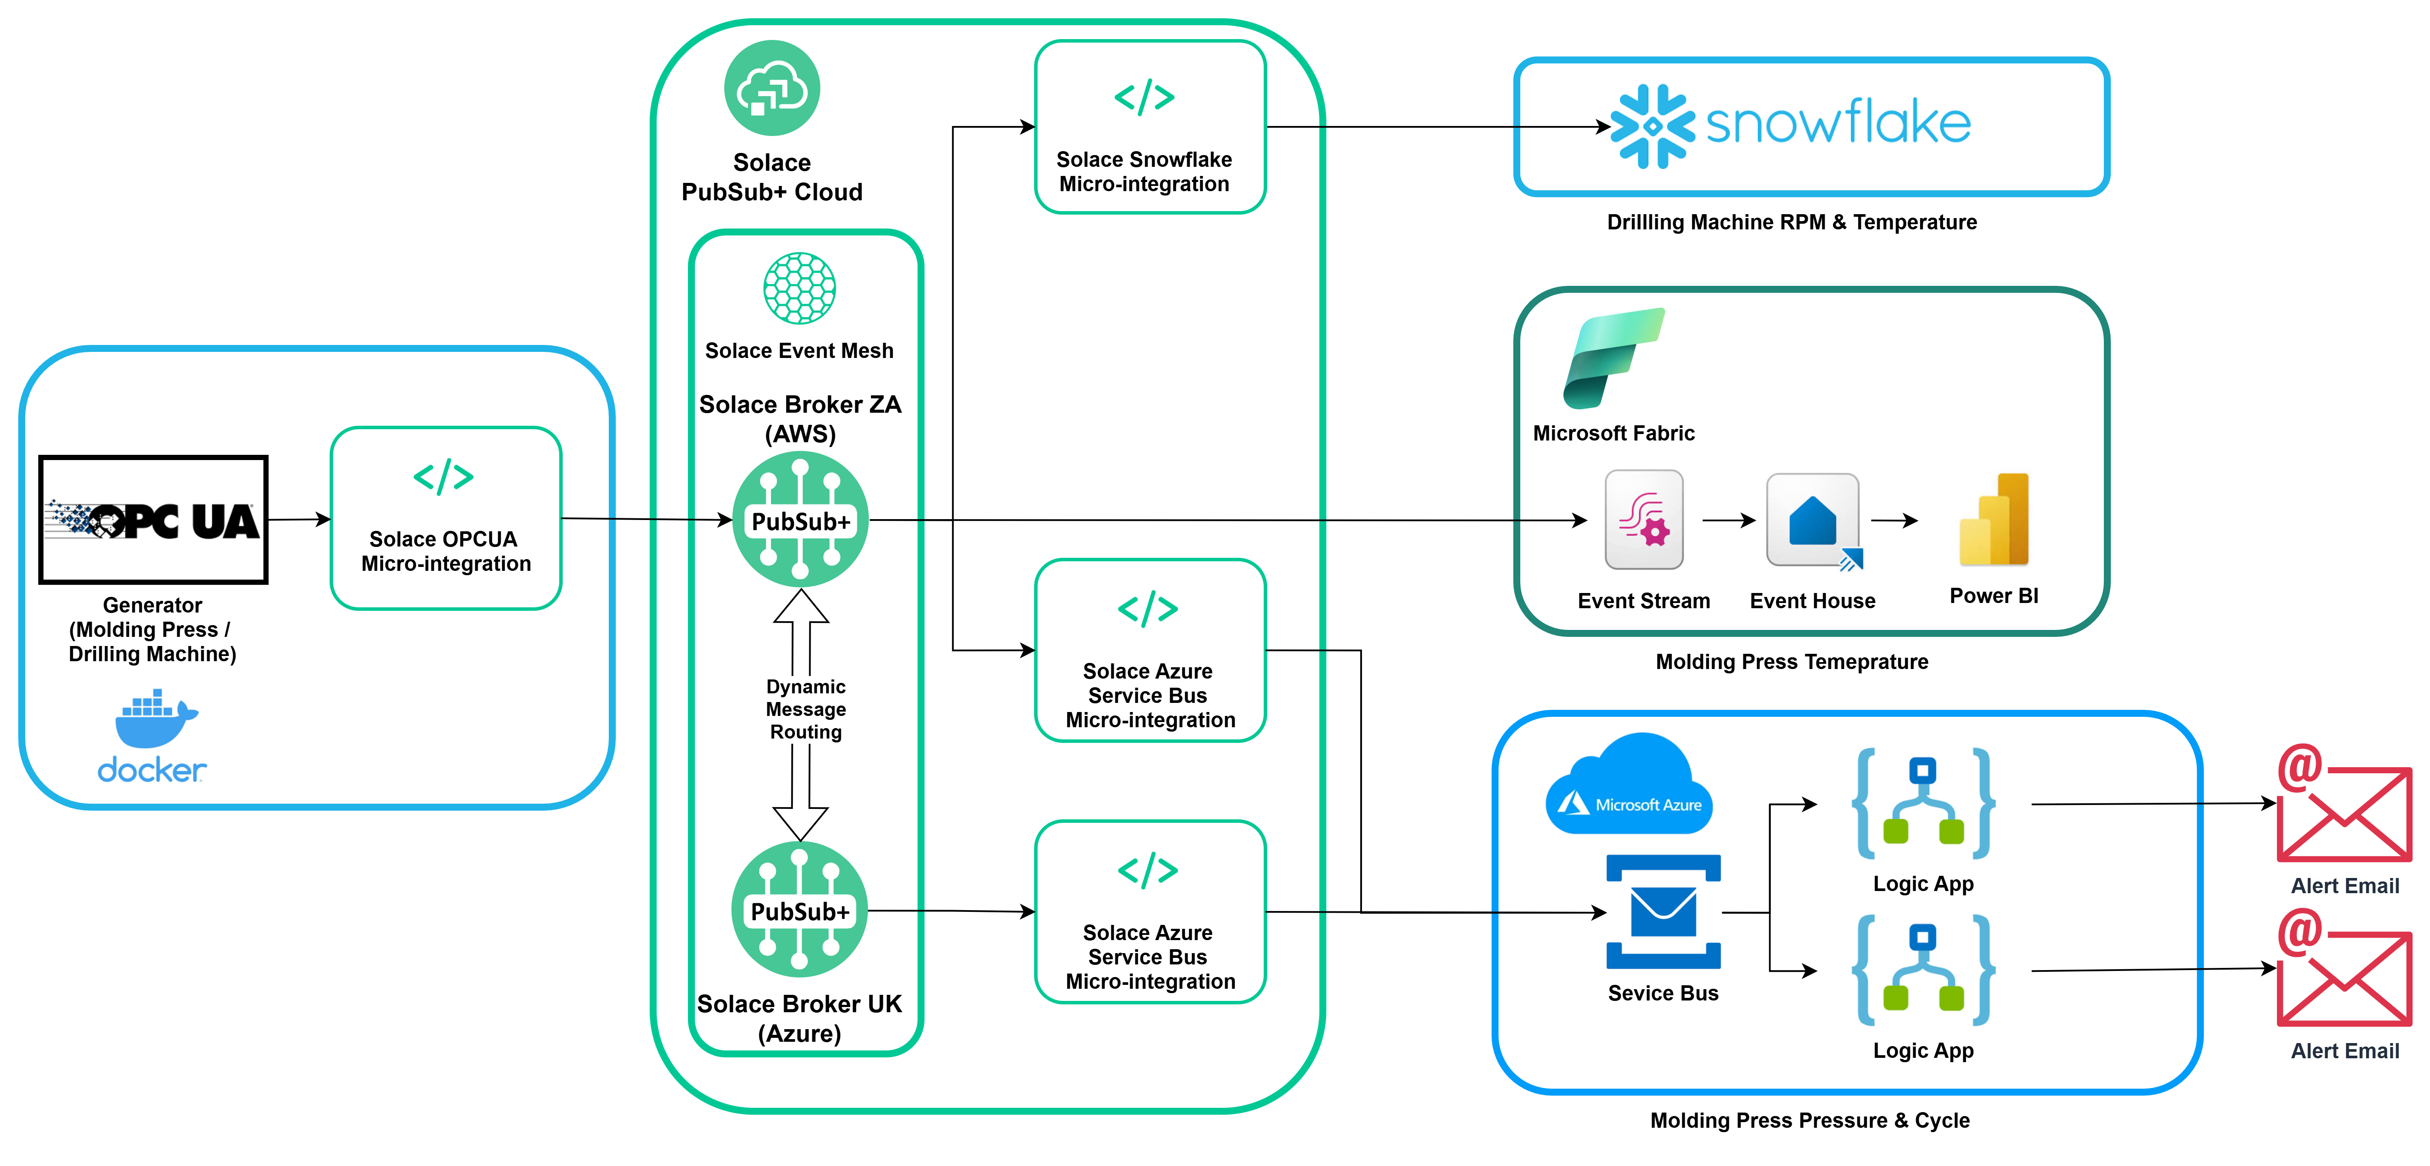
Liberate & Integrate, Stream & Filter
© Solace Proprietary & Confidential
Notes:
Key Points
Event Management is built into the Solace Platform
Design to runtime (creates bridges between design and runtime)
Promotion to Production
Talk Track
To provide a little context, the Solace Event Portal sits in the middle of Solace Platform, which combined gives you all the functions you need for a complete event driven integration solution. <click!> Designs from Event Portal flow into the Connection and Integration functions to be implemented. <click!>As the implementation moves across environments, Event Portal precisely configures access to the Event Mesh.

Slide 6
Questions?

