Slide 1

Task 1
Using terraform, I Defined 2 IAM roles and assigned them the necessary policies.
By creating an AWS account I’ve acquired 2 keys to enable the connection to my own AWS account.
By linking each role’s profile to a different instance and performing terraform actions: “init” and “apply”.
Connection was established with the desired provider – AWS.
Acquiring the Necessary Policies Arn
Ec2 instance 1
Init
IAM Role Definition
Validate
Ec2 instance 2
Apply
Assume Role Policy
Terraform, HCL coding
CSM – intern task

Slide 2
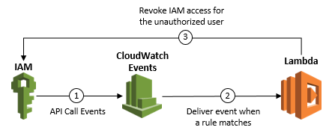
Task 2
The lambda function need to be assigned to a role with the proper permissions. The following access is desired:
1. CloudWatch event access – read access to notice the event as a trigger to run
2. Managing IAM policies.
Writing the function: “SwapPolicy”.
Configure a trigger, CloudWatch Event, that Scheduled every 10 minutes to invoke my lambda function.
Deliver’s an event when my rule was matched invoking my lambda function
My lambda function, “SwapPolicy”, swaps between the role’s policies
CSM – intern task

