Slide 1
Agoda – Home Test
Ron Litman

Slide 2
Problem – Definition
Based on the provided data, map hotels between the 2 provided partners into pairs.
You will be judged on an unseen test set and should reach a minimum of 98% accuracy, and maximize coverage

Slide 3
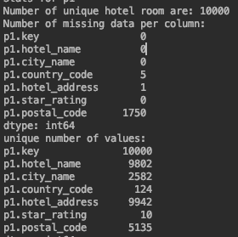
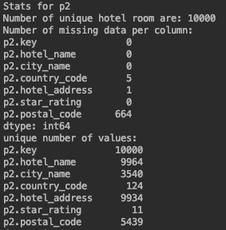
EDA - Stats
P1
P2

Slide 4
Naive model
Method - Using fuzzywuzzy different methods I tried them on the 499 example pairs, when the run time is O(N^2).
Threshold - used a minimum score to predict only pair with a certain amount of confidence, filtered all pairs that are not from the same country
Accuracy – Correct labels / # Predicted labels
Coverage - – Correct labels / # labels
Method | Threshold | Time (Sec) | Accuracy | Coverage
ratio | 70 | 1.19071 | 437/443 (98.645%) | 437/499 (87.575%)
Partial ratio | 75 | 6.39853 | 450/459 (98.039%) | 450/499 (90.18%)
token sort ratio | 70 | 4.23800 | 441/450 (98.0%) | 441/499 (88.37%)
Token set ratio | 80 | 5.7599 | 456/465 (98.06%) | 456/499 (91.38%)

Slide 5
Methods different:
Ratio – Normal Levenshtein distance (edit distance)
Partial ratio – substring Ratio
Token sort ratio - The token sort approach involves tokenizing the string in question, sorting the tokens alphabetically, and then joining them back into a string. We then compare the transformed strings with a simple ratio
Token set ratio – Take the common words, use sort ratio and add the rest of the phrase

Slide 6
TF-IDF with 3-Grams (Cosine similarity)
Get for each 3-gram: IDF(t) = log_e(Total number of documents / Number of documents with term t in it).
Measure the similarity using cosine distance
Method | Threshold | Time (Sec) | Accuracy | Coverage
TF-IDF | 0.0 | 3.06 | 487/498 (97.79%) | 487/499 (97.59%)
TF-IDF (*) | 0.0 | 1.953 | 488/499 (97.79%) | 488/499 (97.79%)
TF-IDF (**) | 0.0 | 2.35 | 496/499 (99.39%) | 496/499 (99.39%)
*Adding the city name to the hotel name
** Adding the city name and the address to the hotel name

Slide 7
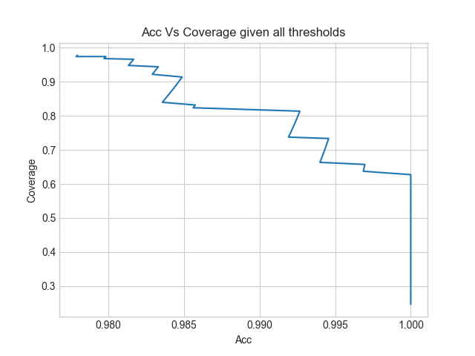
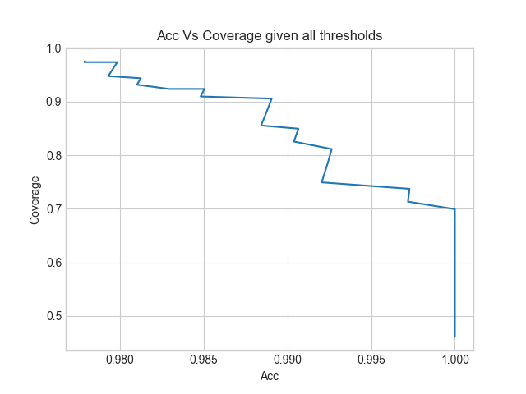
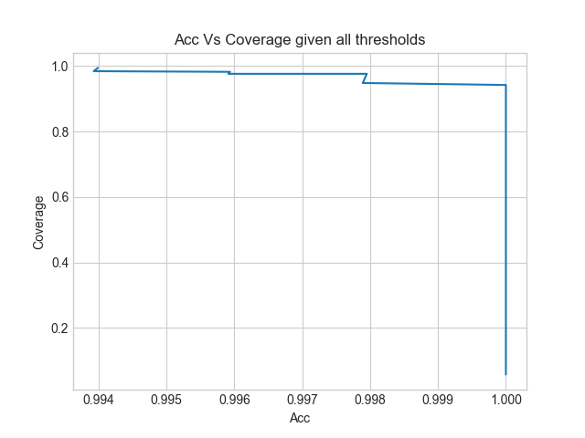
“ROC” Curve
TF-IDF (*)
TF-IDF
TF-IDF (**)

Slide 8
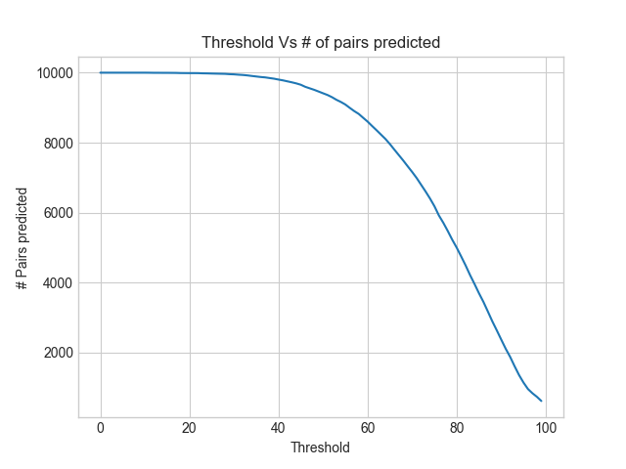
Submission
Using the TF-IDF** (3 Grams with cosine distance)
Dropping results with different county code
Time to run the model – 236.31 sec
Threshold was hard to chose base on 500 examples, so given accuracy is more important I will chose as threshold 50 and get 9412 predicted pairs

Slide 9
Manually Error analysis – using 50 as threshold
P1.hotel name | P1.hotel name | Score | Label
Econo Lodge Syracuse (NY) 3400 Erie Boulevard East | Econo Lodge DeWitt DeWitt 3400 Erie Boulevard East | 48.7 | FN
Hotel Maui Seoul 14 Jongro-66 ga gil, Jongro-gu(201-15 Sungin-dong) | Hotel Maui Dongdaemun Seoul 14, Jong-ro 66ga-gil, Jongno-gu | 48.9 | FN
HOTEL BONFIRE Nagano 4423 Happo Hokujo | Hotel Bonfire Hakuba Hokujo 4423 | 27.8 | FN
Onetangi Beach Apartments Auckland 4-7 Fourth Ave | Onetangi Beach Apartments Onetangi 5-7 Fourth Avenue, Onetangi Beach | 69.5 | FP

Slide 10
Improvement – Given more time
Data cleaning – think of a way to clean name entities (stop word?)
TF-IDF base on a long string with postal code, stars…
A policy for adjusting the the score using weights for the postal code & stars - try and learn the weights
Efficiency
Using word2vec as a model for getting the embeddings
Trying different distance methods –
Word Mover’s Distance (WMD) - The WMD distance measures the dissimilarity between two text documents as the minimum amount of distance that the embedded words of one document need to "travel" to reach the embedded words of another document.
Unsupervised machine translation: A novel approach to provide fast, accurate translations for more languages (here)

