Slide 1
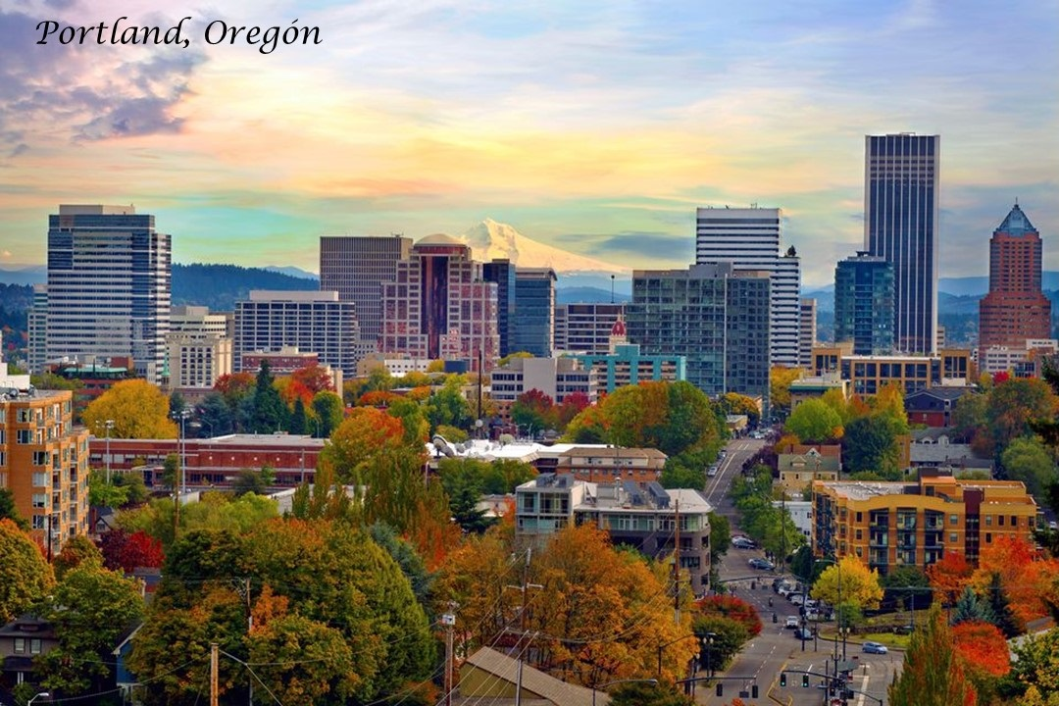

Slide 2
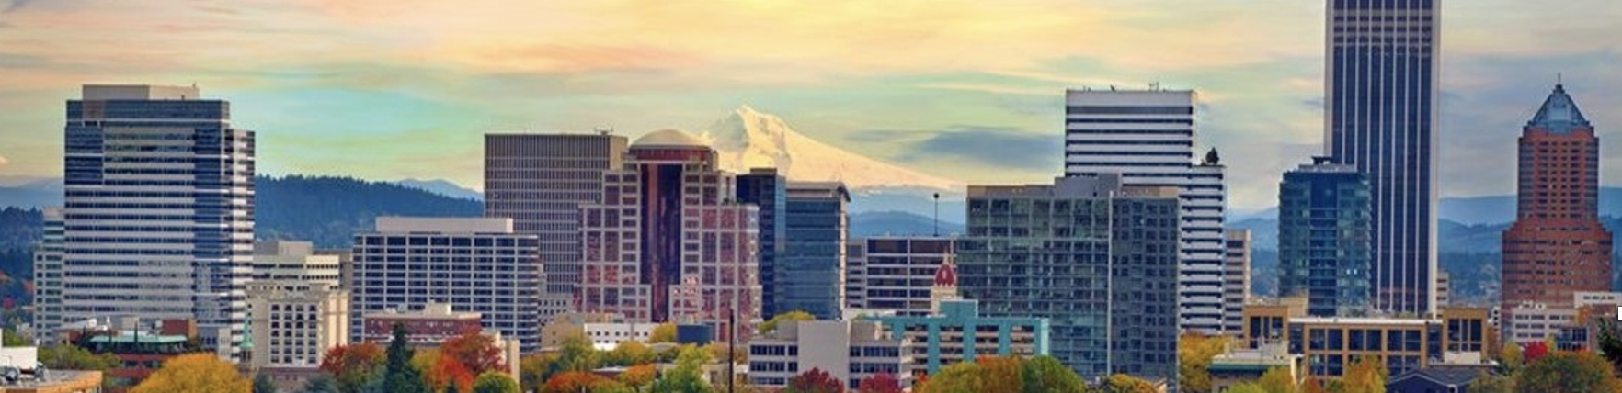
Draft 1
The PASHI Projet
Portland Affordable Safe Housing Initiative

Slide 3
Draft 2
The PASHI Project
Portland Affordable Safe Housing Initiative

